Slide 1
Understanding Family Dynamics

Slide 3
What Influences Family Dynamics?

Slide 4
Influences on Family Dynamics
  Nature of the parents’ relationship
  If parents are lenient or strict
  Number of siblings in the family
  Personalities of the household members
  An absent or single parent
Notes:
Conduct a discussion about how each item listed can influence the dynamics of a family.

Slide 5
Influences on Family Dynamics
  Nature of the household “mix”
  Level and type of influence from extended family or others
  Special needs or chronically sick child and/or adult
  Crisis in the family
  Family values
  Nature of attachments
  Dynamics of previous generations
Notes:
Conduct a discussion about how each item listed can influence the dynamics of a family.
Crisis events which affect family members:
• an affair
• divorce
• trauma
• death
• unemployment
• homelessness
• family violence
• abuse
• alcohol or other drug use
• mental health difficulties
• poverty
How do family values, culture and ethnicity, including beliefs influence the family dynamics?
How does the nature of attachments in a family, such as being secure or insecure, influence the overall family dynamics?
How do the dynamics of previous generations (parents and grandparents families) influence the family dynamics?

Slide 6
Changing Family Dynamics
  Individuals within the family provide the following:
    Basic needs (such as food, clothing, and shelter)
    Economic support
    Education
    Love and affection
Notes:
Changing Family Dynamics
Families take on many forms and shapes, and yet they perform some of the same basic functions from culture to culture. Individuals within the family provide the following:
• Basic needs (such as food, clothing, and shelter)
• Economic support
• Education
• Love and affection

Slide 7
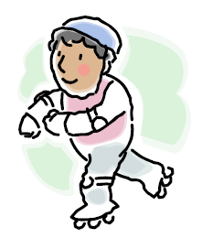
Changing Family Dynamics
  Individuals within the family provide the following:
    Nurturance
    Opportunities to have fun
    Protection
    Religious background
Notes:
Changing Family Dynamics
Families take on many forms and shapes, and yet they perform some of the same basic functions from culture to culture. Individuals within the family provide the following:
• Nurturance
• Opportunities to have fun
• Protection
• Religious background
Each individual in the family has certain roles. Your role as a son, daughter, sister, brother, niece, nephew, aunt, or uncle is a given role that you acquired when you were born into the family. When you marry, you will assume a chosen role as husband or wife. Roles are defined by age and responsibilities. Parents are usually responsible for providing food and shelter. As children get older and enter the workforce, these responsibilities might fall partly on their shoulders. In relationships, it is important to communicate the roles you will be sharing or expected to fulfill to meet the needs of the family.

Slide 8
Roles
  Given Roles
  Acquired Roles
  Character Roles
Notes:
Given Roles: The roles we are given because of a birth in the family such as mother, father, sister, brother, grandparent, aunt, or cousin.
Acquired Roles: The roles you assume because of choice such as husband, wife, co-worker, or vice-president
Character Roles: The roles you demonstrate because you have been labeled as such an athlete, brain, breadwinner, baby, scapegoat, or victim.
Some roles happen by chance (given roles) and others by choice (acquired roles). The roles we choose for ourselves can be changed.
If we are not happy with our acquired roles, we can simply make the change.
Find a new job
Decide to get married or stay single

Slide 9
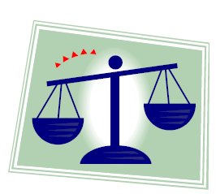
Roles in Life
  Life gives us a lot to balance:
    Family
    Work or school
    Different personalities
    Various roles
Notes:
We have learned that people play many roles in their lives. Some are by choice and some are not.
What are some roles you have as a family member?
What are some roles you have at work or at school?
Do people’s different personalities impact your roles in life? How?

Slide 10
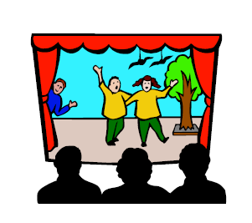
Character Roles
  These are the roles that we are “labeled” because of other’s views of us
Notes:
These are the roles that we are “labeled” because of other’s views of us.
Example: The youngest child of the family is labeled “The Baby”. This child assumes the “baby” role and begins to act this way.
Other family members may feel that this child is spoiled or treated special because they are the baby of the family.

Slide 11
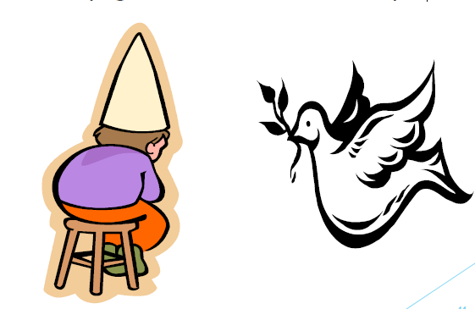
Character Roles
  Scapegoat
  Peace-Keeper
Notes:
Scapegoating - The person who gets blamed for the problem is the scapegoat.
Peace-Keeper - A young person may be inadvertently playing the role of the ‘peace-keeper’, interceding and reducing strain between a disagreeing parent and family member.
How do these two roles influence the family dynamics?

Slide 12
Character Roles
  Can be a true character trait or a myth
  Can be changed, but it takes communication and understanding on all parties.
  Can raise or lower one’s self-esteem
  Can put extra expectation on a person

Slide 13
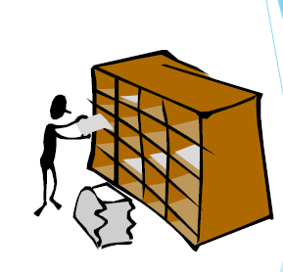
Roles in Life
  Buffering
  Multiplicity
  Roles
  Stereotyping
Notes:
Buffering: Balancing of roles so that the negative aspects of one role can be offset by the positive aspects of another role
Multiplicity: Having several different roles and responsibilities
Roles: The responsibilities we assume and how we portray them individually and in the family
Stereotyping: Categorizing all into one type

Slide 14
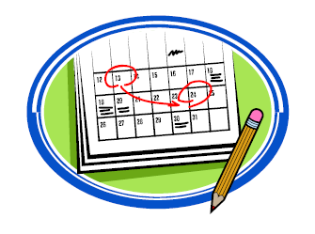
Life Stages
  There are various events or situations in life that can greatly affect us. These are a natural and expected part of each person’s life.
Notes:
Life Stages: A predictable developmental stage in a person’s life. Example: Teen years, 20’s, 30’s, or 40’s.

Slide 15

Life Changes
  Marker Event: A significant event that marks real change in one’s life
Notes:
Marker Event: A significant event that marks real change in one’s life. Example: graduation, marriage, birth of child, or winning the lottery.
Marker events can affect a life positively or negatively. But the one thing about life, is that it is constantly changing.

Slide 16
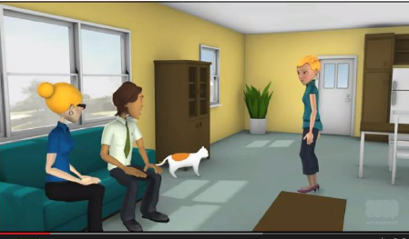
Family Dynamics Scenario
(click on picture)
Notes:
Family Dynamics: Scenario 1
Family Dynamic to illustrate closed, inflexible family boundaries.
http://youtu.be/gddHUVT0NPA
What are the family dynamics in this scenario?

Slide 17
Questions?

Slide 18
References and Resources
  Images:
    Microsoft Clip Art: Used with permission from Microsoft.
  Textbook:
    Strengthening Family and Self, (2004) The Goodheart-Wilcox Company, Inc.
  Websites:
    Family, Career and Community Leaders of America (FCCLA)Website containing curricular ideas and information related to family, career and community. http://www.texasfccla.org
    Public Broadcasting Service (PBS)Website with links to television, articles and information on various curricular subjects of public interest. http://www.pbs.org
    Public Broadcasting Service (PBS)ThisPBSarticle discusses the importance of family meal time and gives tips on how to make it successful. http://www.pbs.org/parents/experts/archive/2012/01/reaping-the-many-benefits-of-f.html
  YouTube:
    Family Dynamics: Scenario 1Family Dynamic to illustrate closed, inflexible family boundaries.http://youtu.be/gddHUVT0NPA

