Slide 1

THE BALANCING ACT
Managing a Career and Family
Hotel Management

Slide 2
Copyright
Copyright © Texas Education Agency, 2014. These Materials are copyrighted © and trademarked ™ as the property of the Texas Education Agency (TEA) and may not be reproduced without the express written permission of TEA, except under the following conditions:
1) Texas public school districts, charter schools, and Education Service Centers may reproduce and use copies of the Materials and Related Materials for the districts’ and schools’ educational use without obtaining permission from TEA.
2) Residents of the state of Texas may reproduce and use copies of the Materials and Related Materials for individual personal use only, without obtaining written permission of TEA.
3) Any portion reproduced must be reproduced in its entirety and remain unedited, unaltered and unchanged in any way.
4) No monetary charge can be made for the reproduced materials or any document containing them; however, a reasonable charge to cover only the cost of reproduction and distribution may be charged.
Private entities or persons located in Texas that are not Texas public school districts, Texas Education Service Centers, or Texas charter schools or any entity, whether public or private, educational or non-educational, located outside the state of Texas MUST obtain written approval from TEA and will be required to enter into a license agreement that may involve the payment of a licensing fee or a royalty.
For information contact: Office of Copyrights, Trademarks, License Agreements, and Royalties, Texas Education Agency, 1701 N. Congress Ave., Austin, TX 78701-1494; phone 512-463-7004; email: copyrights@tea.state.tx.us.
2
Copyright © Texas Education Agency, 2014. All rights reserved.

Slide 3
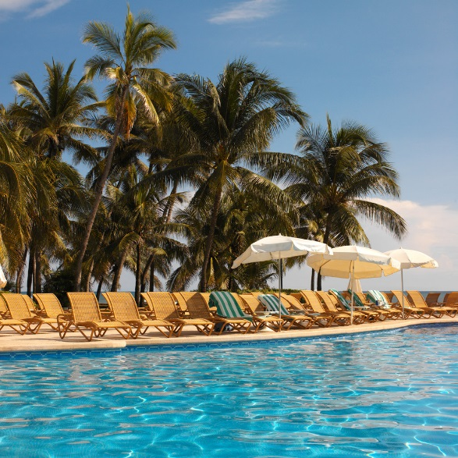
Working in the Hotel Industry
3
Copyright © Texas Education Agency, 2014. All rights reserved.
Notes:
Hotels and Resorts provide amenities, service and accommodations at varying price levels. They can be a fabulous place to work.
But there are advantages and disadvantages to working in the hotel industry.

Slide 4
Advantages
Abundance of jobs
Advancement opportunities
Fast pace and variety
Meeting people
Pleasant workplace
Travel
4
Copyright © Texas Education Agency, 2014. All rights reserved.
Notes:
There are many advantages to working in the hotel industry. Listed above are a few.
Can you think of any others?

Slide 5

Disadvantages
Hours of work
Relocation
Stress
Working conditions
5
Copyright © Texas Education Agency, 2014. All rights reserved.
Notes:
Careers in the hotel industry can be stressful and physically demanding.
The hours are long and may include nights, weekends, and holidays.
Can you name any other disadvantages to a career in the hotel industry?

Slide 6
Multiple Roles
Adult
Employee
Citizen
Spouse
Parent
Community member
Neighbor
Other
6
Copyright © Texas Education Agency, 2014. All rights reserved.
Notes:
Adult – We have to grow up!
Employee – This role will require that you be at work on time and perform your job well
Citizen – This role will require you to be informed about current events and vote
Spouse and parent - These roles add responsibility for relating to and taking care of others
Community member and neighbor – These roles may include responsibilities of organizing and participating in community activities
Other – These roles may include being a member of an athletic club, music group or other special interest groups

Slide 7

Family
May consist of:
  Spouse
  Children
  Grandparents
  Brothers and sisters
  Step-children
  Other relatives
7
Copyright © Texas Education Agency, 2014. All rights reserved.
Notes:
The functions of families are:
meeting the basic needs of family members such as food, shelter, clothing and education
giving emotional support such as helping each other during difficult times
teaching values, such as right from wrong, and what is most important in life
passing on culture and traditions, such as teaching children how to get along with other people, and about their family heritage
What does your family consist of?

Slide 8

Families Struggling for Work-Life Balance
(click on link)
8
Copyright © Texas Education Agency, 2014. All rights reserved.
Notes:
Click on hyperlink to view video:
Families Struggling for Work-Life Balance
A new study released from the Pew Research Center found 37% of mothers say they want to work fulltime, due, in large part, to the recession and financial insecurity.
http://www.nbcnews.com/video/nightly-news/51186744/#51186744

Slide 9
Time and Energy Management
9
Copyright © Texas Education Agency, 2014. All rights reserved.

Slide 10


Time Saving Techniques
Avoid procrastination
Avoid time wasters
Be flexible
Do it right the first time
Make a To Do list
Practice work simplification
Prevent interruptions
Set goals
Stay organized
Take a break
Use small amounts of time
Use a calendar
10
Copyright © Texas Education Agency, 2014. All rights reserved.
Notes:
Take advantage of these tips to make time work for you.

Slide 11

Managing Your Energy
Amount changes daily
Identify your peak period
Levels vary with age
Increase levels by:
  Eating healthy food
  Exercising regularly
  Getting plenty of rest
11
Copyright © Texas Education Agency, 2014. All rights reserved.
Notes:
Understanding when we perform our best and what affects our energy can help us with our work.

Slide 12



Leisure Activities
Community activities
Hobbies
Reflection
Vacations
12
Copyright © Texas Education Agency, 2014. All rights reserved.
Notes:
Leisure time is the time you have free from work and other duties.
This time can include:
Community activities
participating in festivals, concerts or other local activities
Hobbies
building
crafting
drawing
reading
Reflection
taking time for yourself by yourself
Vacations
visiting family in other cities
visiting amusement parks
What is your favorite leisure activity?

Slide 13

Questions?
13
Copyright © Texas Education Agency, 2014. All rights reserved.

Slide 14
References and Resources
Images:
Microsoft Office Clip Art: Used with permission from Microsoft.
Texbooks:
Kelly-Plate, J., & Eubanks, E. (2004). Today’s teen. New York, NY: Glencoe/McGraw-Hill.
Reynalds, J.S. (2010). Hospitality services: Food & lodging. Tinley Park, IL: Goodheart-Willcox Company.
Video(s):
Families Struggling for Work-Life Balance
A new study released from the Pew Research Center found 37% of mothers say they want to work fulltime, due, in large part, to the recession and financial insecurity.
http://www.nbcnews.com/video/nightly-news/51186744/#51186744
14
Copyright © Texas Education Agency, 2014. All rights reserved.

