Slide 1
The Impact Of Technology On The Family Life Cycle

Slide 3
The Family Life Cycle
  Leaving home
  Getting married or committing to a couple relationship
  Parenting the first child
  Adolescent years
  Empty nest years
  Retirement and old age
Notes:
Jean Piaget, Lawrence Kohlberg, and even William Shakespeare have written about the developmental stages individuals pass through as their lives move from birth to death. Jay Haley, in 1973, identified a model of similar stages for families. Each of Haley’s six stages involves different emotional and physical processes.
The stages of the Family Life Cycle can be described as:
•Leaving home
•Getting married or committing to a couple relationship
•Parenting the first child
•Living with an adolescent—adolescent years
•Launching the children—empty nest years
•Retirement and old age
The stages do not occur in exactly the same way in all families. Some families can be in two stages at one time. For example, the same family could be living with an adolescent and launching an older child. Remember, the family life stages are fluid, without rigid boundaries, and that they can encompass the emotional, intellectual, physical, and spiritual aspects of life.
What are the technological considerations related to the family life cycle?
What stage do you think people use the most technology? Why?
Does technology have an impact on the family life cycle?

Slide 4

Family Structures
  Two-parent
  Single parent
  Stepfamily
  Extended kinship
  Foster family
  Adoptive family structures
Notes:
Today, there are many different family structures. There is no one best structure as long as the family members are happy and fulfilled individuals.
The six common structures in society today are the:
•two-parent
•single parent
•stepfamily
•extended kinship
•foster family
•adoptive family structures
The two-parent family is made up of a married couple and their biological children. One or both parents may work outside the home. This is also called a nuclear family. Activities and events center around the family. In 2009, 83 percent of children living in families maintained by two married parents had at least one parent who worked year round, full time. In contrast, 54 percent of children living in families maintained by a single father and 44 percent of children living in families maintained by a single mother had a parent who worked year round, full time.
The single-parent family occurs as the result of divorce, separation, death of a spouse, or having children outside of marriage. In 2010, 66 percent of children ages 0–17 lived with two married parents, down from 77 percent in 1980. In 2010, 23 percent of children lived with only their mother, 3 percent lived with only their father, and 4 percent lived with neither of their parents. Being a single parent, the sole head of the household, can be stressful. Single parents must provide for the same needs and wants as all parents.
The stepfamily occurs when either or both spouses have been married before and have one or more children from the previous marriage. Relationships in stepfamilies can be rewarding and challenging. When families have been combined, it may bring financial tensions to the family. Space, time, and energy resources must be allocated with thought and consideration. Each family has to be dedicated and positive in making the new family system work.
The extended kinship family occurs when several generations of a family live together. It can be a mixture of grandparents, parents, children, aunts, uncles, and cousins in the same household. In many foreign countries, extended kinship families are very common. There are advantages of this type of family, including interaction between family members of all age groups. This can be an opportunity to educate and appreciate each other. Sometimes aging parents are the focus of this type of family. Middle-age has taken on a new image in recent years, partly due to finances. Some sociologists have labeled today’s middle-aged couples as the “sandwich generation.” The couple is often “sandwiched” between caring for their own children and their aging parents.
Foster parents try to make their home loving, caring, and inviting to foster children. They are reimbursed only for the child’s expenses. The challenges lie in the type of child that may be in their homes. Some children are often abused, neglected, angry, frightened, and resentful of their situation. Adjustments must be made for both parties involved.
The adoptive family chooses to adopt and raise a child. The child is legally theirs, and adoption can be just as fulfilling as having a biological child. Most couples prefer to adopt a newborn; however, children of all ages can be adopted.
How would you compare a stepfamily and extended kinship family?
Can you identify the type of family you are currently living in?

Slide 5

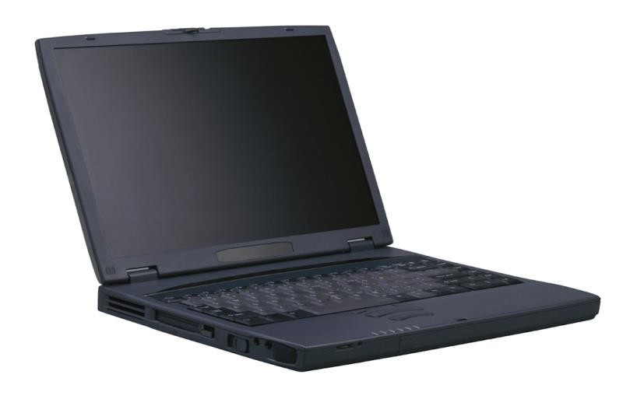
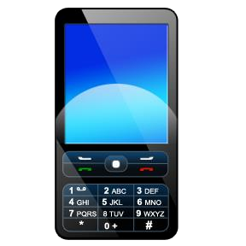
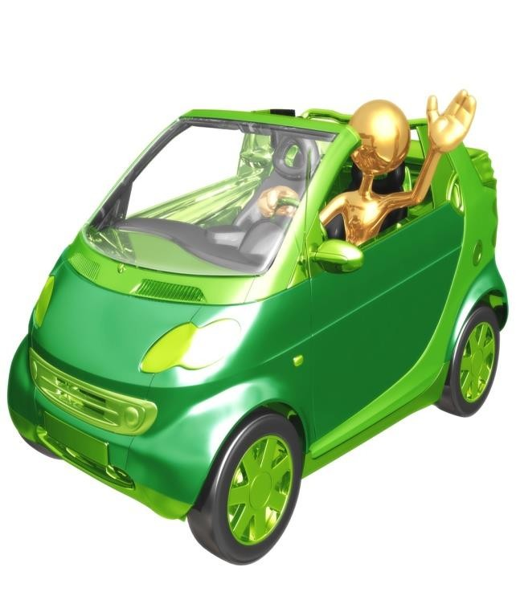
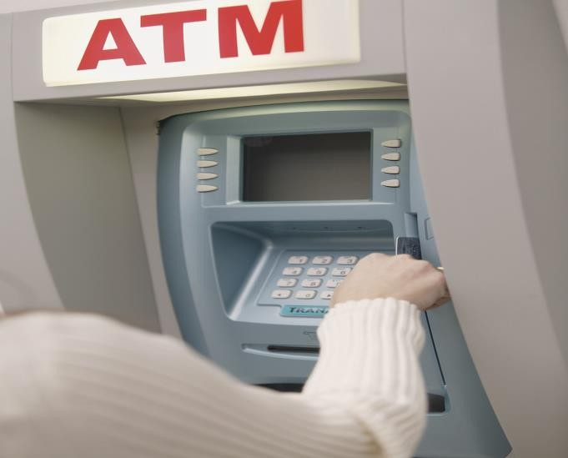
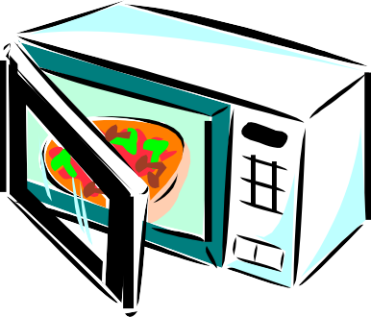
Technology In The Home
Notes:
Have students name each of these technology devices. Ask them how this is a benefit to the family and how it is a drawback. Which is it more? Would you suggest buying it?
Items listed:
Top left to right…cell phone, flat screen T.V., and laptop.
Bottom row: electric smart car, microwave oven, and ATM machine.

Slide 6

Influences And Benefits Of Technology
  With all of technology that has been added to the lives of people, lives should be more carefree, stress free, and we should be healthier
Notes:
How has technology made your life carefree, stress free and healthier? How?

Slide 7

Influences And Benefits Of Technology
  Name five ways families use technology on a daily basis.
Notes:
Name five ways people use technology on a daily basis.

Slide 8

Influences And Benefits Of Technology
  “Computer literate”
  Personal computers
  Telecommute
  Provides recreation
  Educational purposes
Notes:
•People are expected to be “computer literate”.
•Personal computers are in most every home.
•Businesses allow for employees to telecommute.
•Computer games and online chat rooms provide recreation.
•Students use Internet for research and writing papers for school.
Can you elaborate on the reasons why technology is so beneficial to schools and the learning process today?
How is technology related to recreation?
Can you identify ways employers use technology at the workplace?

Slide 9
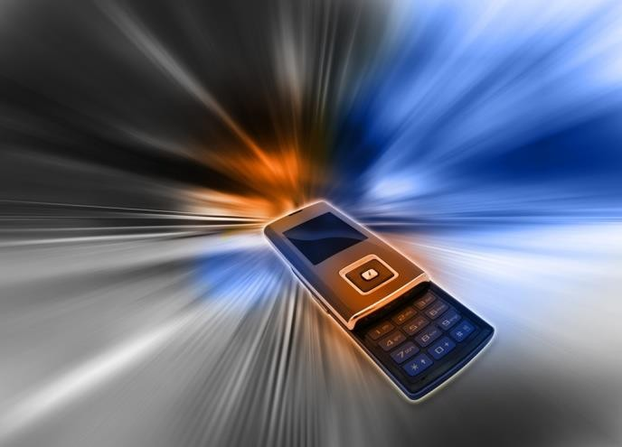
Influences And Benefits Of Technology
  Communicating with others
  Shopping online
  Pay bills online
  24-hour contact with friends and family
  Instant news and updates
Notes:
Computers allow for communicating with others, gathering information, and sharing information with others.
People can go online to pay bills, e-mail others, fax information, and shop online 24/7.
Cell phones allow for 24 hour contact with friends and family.
Technology allows us to know what is going on all over the world at the click of a button.
What makes a “smart phone” so smart?
How would you compare a flip phone to a smart phone?
How many of you have shopped online before? What are the benefits? What are the drawbacks?
Do you or your parents pay bills online? What are the benefits? What are the drawbacks?
What is “Cyber Monday”? What are some incentives offered by merchants to attract people to shop online? Examples: free shipping and handling, coupons, special offers, buy one get one free and shipping directly to the store for customer pick-up.
What percentage of people shop online? According to Commerce Times, 85 percent of net surfers shop online. The reasons are the ability to shop during off-hours, saving time, avoiding trips to the store, being able to buy from non-local merchants, better prices, shopping without salesperson pressure and easier comparison shopping.
Which group in the family life cycle would benefit greatly with this type of technology? Why?

Slide 10

Influences And Benefits Of Technology
  How has technology impacted the entertainment industry, political world, and live news updates and communicating with others?
Notes:
How has technology impacted the entertainment industry, political world, live news updates, and communicating with others?

Slide 11
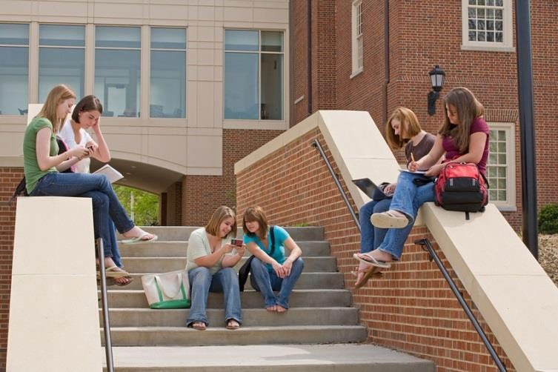
Influences And Benefits Of Technology
  Source of information and entertainment
  News and current updates
  Political analysis
  Allows for telecommuting
  Communication
Notes:
Technology is a great source to obtain information on just about any subject such as animals, politics, and families.
It allows for telecommuting –working from home using computer and Internet
Communication-keep in touch with others at all times via technology
It is also a great tool to provide entertainment. You can watch movies, play games, and listen to music.
Ask students what they have used technology for. Their answers will vary.
How have televisions become “smart”?
What would happen if you could not text for an entire day?
How would you describe a day without the use of technology?
What is a blog? Do you blog?
How has the social media impacted technology?

Slide 12
The Demographics of Social Media Users-2013
  The State of Social Media Users
  (Click on link)
Notes:
According to “The Demographics of Social Media Users”—
What percentage of women ages 18-29, use Facebook? (answer: 67%)
Pinterest is used more often by what age group? (answer: women, under 50, whites with some college education)
What age group has a 13% interest in Instagram? (answer: adults, ages 18-29, African-Americans, Latinos, women and urban residents)
Pew Internet
The State of Social Media Users
http://pewinternet.org/Reports/2013/Social-media-users/The-State-of-Social-Media-Users.aspx

Slide 13
Improved Communication
  Cell phones
  Fax machines
  E-mail
  Internet
  Text messages
  Blogging
  Social networks
  Instant messaging
  Vehicles with Bluetooth
Notes:
How many cell phones do you have in your family?
Do you have a fax machine?
Do you send out e-mails or do you prefer other methods of social networking?
How many text messages do you or does your family send/or receive a day?
How has social networks improved communication between people?
How many of you have a wireless stereo headset? What are the advantages and disadvantages of using this type of device?
Which group in the family life cycle would benefit greatly with this type of technology? Why?

Slide 14
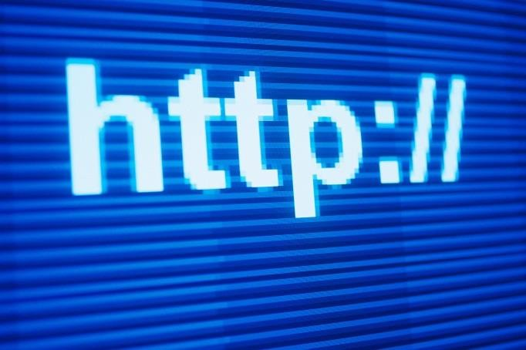
Convenience
  Kitchen appliances
  Convenience food
  Banking Online
  24 hour phone availability
  24 hour Internet availability
  24 hour shopping availability
Notes:
What do you think would happen to you if you could not have any access to technology for a day? How would that impact your life?
What would happen to the family if they did not have access to any technology for a week?
What would happen to businesses if they did not have access to any technology for a week?
How does technology affect the family life cycle and family structures?
Do you bank online?
How often do use an ATM machine?
Do you know how much the bank charges you for making a withdrawal?
What advances are there in the banking industry? (Example: scanning a check to be deposited into your account)
Which group in the family life cycle would benefit greatly with this type of technology? Why?

Slide 15
Health And Medical Advances
  What are the benefits of technology in the medical field?
Notes:
Students will list and discuss the benefits of technology in the medical field.

Slide 16
Health And Medical Advances
  Pacemakers
  Dialysis machines
  Organ transplants
  Laser surgery
  Robotic surgery
  Diabetes
  Heart patients
Notes:
Have students discuss the advances in each area.
Technology in the medical field has allowed the ability for individuals with chronic illness to have productive lives. Not sure? Here are some examples:
• Ability for diabetics to test their blood sugar at home and, more recently, to carry insulin without the need for refrigeration.
• Heart failure patients have the ability to transmit body weight, blood pressure and other important risk factors to a remote physician.
• Radiologist can interpret an x-ray remotely.
• Dialysis patients can perform dialysis at home.
Which group in the family life cycle would benefit greatly with this type of technology? Why?

Slide 17
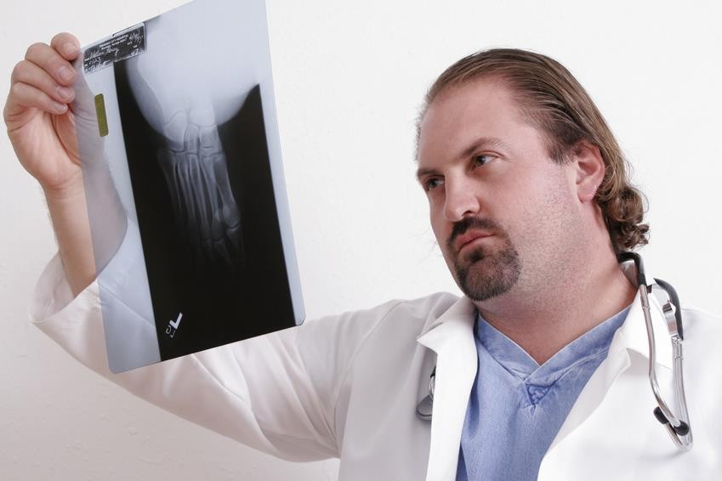
Health And Medical Advances
  Computerized physician order entry
  X-Rays
  Ultrasounds
  Fertility treatments
  Prosthetic technologies
  Blindness
Notes:
Have students discuss the advances in each area.
On a larger scale, hospitals and physician offices can incorporate computerized physician order entry (CPOE) to avoid adverse drug reactions. Individuals can create their own personal electronic health records, or EHR, so that they can carry their medial information from physician to physician.
A new and better bionic hand under development connects directly to the nervous system and could one day return dexterity and sensation to amputees, researchers say.
Tiny, glowing robots could soon be injected into the eye to alert doctors of low oxygen levels that can lead to blindness.
Led by Bradley Nelson, a professor of robotics and intelligent systems at ETH-Zurich, researchers created devices a millimeter in length and one third of a millimeter in width that, once injected, can be steered through the eye’s vitreous fluid via external magnetic fields.
Which group in the family life cycle would benefit greatly with this type of technology? Why?

Slide 18
Heart Technology
  What technological advances have there been in the cardiovascular field?

Slide 19

Heart Technology
  State of the art technology
  Innovative treatment options
  Patient-centered care
  Advanced treatments
  Emergency capabilities
  Heart health screening

Slide 20

Heart Technology
  Healthy Heart 2013: High-tech Advances Help Keep Cardiac Problems Under Control
  (click on link)
Notes:
Discuss medicine, medical devices/surgery, research and basic CPR advances.
Oregon Live
Healthy Heart 2013: High-tech advances help keep cardiac problems under control.
http://www.oregonlive.com/health/index.ssf/2013/02/healthy_heart_2013_high-tech_a.html

Slide 21

People With Special Needs
  What are some technological breakthroughs that empower people with special needs?
Notes:
For people with special needs–hearing impaired, sight, mobility and speech:
• There is equipment such as flashing lights to alert of fire
• Open captions on the television for hearing impaired
• People with limited use of their hands can use a sip and puff keyboard
What are some other technological advances for people with special needs–hearing impaired, sight, mobility and speech?
Which group in the family life cycle would benefit greatly with this type of technology? Why?

Slide 22

People With Special Needs
  Hearing impaired
  Sight
  Mobility
  Speech
Notes:
For people with special needs–hearing impaired, sight, mobility and speech:
• There is equipment such as flashing lights to alert of fire
• Open captions on the television for hearing impaired
• People with limited use of their hands can use a sip and puff keyboard
What are some other technological advances for people with special needs–hearing impaired, sight, mobility and speech?
Which group in the family life cycle would benefit greatly with this type of technology? Why?

Slide 23
Assisted Reproductive Technology
  Information on Fertility
  (click on link)
Notes:
Health Science Channel.com
In this fertility video learn about the advances in assisted reproductive technology that allow many couples to achieve their dream of starting a family.
http://video.answers.com/information-on-fertility-252526783
Which group in the family life cycle would benefit greatly with this type of technology? Why?

Slide 24

Pharmacy Apps
  Free Apps
    Refill reminders
    Refill by scan
    Pill reminder
    Transfer prescriptions
    Text alerts
Notes:
Free Apps are available to:
• Get refill reminders when RX’s are ready.
• Scan your Rx label, choose preferred location, submit and pick up at your local pharmacy.
• Pill reminder can be set up as a helpful reminder to keep you on track.
• Transfer prescriptions--easily transfer your prescriptions to the pharmacy by taking a picture of your Rx label from another pharmacy.
• Text alerts to notify you when your prescription is ready.
Which group in the family life cycle would benefit greatly with this type of technology? Why?

Slide 25
Diagnostics
  Free Apps
    Via your smartphone
    On your computer
    Make appointments
    See, store, and monitor personal information
Notes:
In many states, you can get your test results directly from the lab on your Apple® iPhone, BlackBerry® or Android™ smartphone, by using a mobile app.
If your healthcare provider uses an app friendly system and has agreed to release your results to you, you can access them online. To do so, you’ll need to connect your account with a personal health record program.
You can also schedule your own appointments for lab tests from your computer.
You can share essential health and emergency information with local doctors.
Travel history and vaccination records on hand and up-to-date can also be uploaded and stored.
You can have instant access to allergy information and medical information.
You can also store emergency contacts and information.
Which group in the family life cycle would benefit greatly with this type of technology? Why?

Slide 26
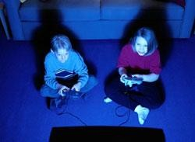
Entertainment
  TV and DVD
  Online movie and programs rental service
  Satellite services
  Computer games
  Amusement parks
Notes:
Have students discuss how technology is used for entertainment.

Slide 27
Safety Factors
  How have technological advances impacted safety factors in the family life cycle?
Notes:
How have these technological advances impacted the family life cycle?

Slide 28
Safety Factors
  Security systems
  Air bags
  Child car seats
  Home security
  Subscription only-vehicle and emergency roadside
  assistance
  Car alarms
  Traffic lights
Notes:
How have these technological advances impacted the family life cycle?

Slide 29

Career Opportunities
  Research career opportunities
  Résumé and portfolio assistance
  Job vacancies
Notes:
Internet can be researched for information on job openings.
Websites provide information, services, or products (résumés and portfolios) for job searching efforts.
You can find job vacancies by accessing websites of companies and applying online.
There are millions of job openings posted on the Internet on a weekly basis. Job applications are easily accessible online.
Have you ever applied for a job online? What are the advantages and disadvantages of applying for a job online?
Have you ever applied for a job at a kiosk at the place of business?
Examples of websites:
Texas Workforce-www.twc.state.tx
Monster.com
Careerbuilder.com

Slide 30
Drawbacks Of Technology
  Devices replace actual human contact
  Time consuming
  Technology changes
  Adapt to new technology
  Stressful
  Social pressures
Notes:
•Devices can take the place of one-to-one contact between people
•Computers take away from active play, social activities, and homework. How many hours have you spent playing videos games and being on your phone?
•Technology changes faster today than ever before
•You have to make decisions about purchasing new technology and have to adapt to new technology changes
•Can be confusing and stressful making choices
•Pressure on families to have what others have

Slide 31

Drawbacks Of Technology
  Parents need to pay attention
  Children should be warned
Notes:
•Parents need to pay attention to what their children are doing with modern technology. They need to put the home computer in a central location in the home where use can be monitored.
•Children should be warned to not give out any personal information online
•Children should be warned about chatting online with strangers
For younger tweens, parental control—including filtering and monitoring tools–can be effective. However, many middle school children have the technical know-how to find a way to get around them. If children aren’t already using the Internet for their homework, this is when they’re likely to start. It’s also when they can discover resources for hobbies and other interests. Many tweens are adept at finding information online. That’s often helpful to the rest of the family, but they still need adult guidance to help them understand which sources are trustworthy.

Slide 32
Online Consequences
  Share with Care
  (click on link)
Notes:
Share with Care What you post online could have an impact on people in the real world. To learn more about how your online actions can have real-world consequences visit: http://youtu.be/m_JB9mA_O3c

Slide 33
Stand Up To Cyberbullying
  Cyberbullying
  (click on link)
Notes:
Stand Up to Cyberbullying You can help stop cyberbullies by standing up for yourself or someone else. To learn more about cyberbullying visit: http://onguardonline.gov/articles/0028-cyberbullying http://youtu.be/lN2fuKPDzHA

Slide 34
Negative Implications of Technology
  Hindrance
  Barrier
  Limited verbal communication
  Less face to face time
  Hardships
  Accidents due to texting
  High cost of car insurance
  Death!
Notes:
We will see that although there are many benefits to the all the technology available to us, it has also caused hindrances and hardships to families.
Although we have many advances in technology to help with everyday life, it has become a barrier between family members and friends. We do not communicate nor spend time with each other as we once did. People do not have to verbally communicate anymore because we have "gadgets" that do it for us. This has had an effect on the way we interact with others and has affected quality time with family and friends.
Family life –togetherness and communication are threatened.
Cars –adults and teens go off in different directions (spend less time together).
We will see that it is important to monitor technological advances in our families and have a plan for effective management of technology.
Do you text and drive? Is this effective management of technology? Have you had an accident due to texting and driving?

Slide 35
Technology Hardship
  Texting and Driving
  (click on link)
Notes:
Texting and Driving Accidents
Consequences of texting and driving. Please don't text and drive!
http://youtu.be/WGg9YOpGuwc

Slide 36
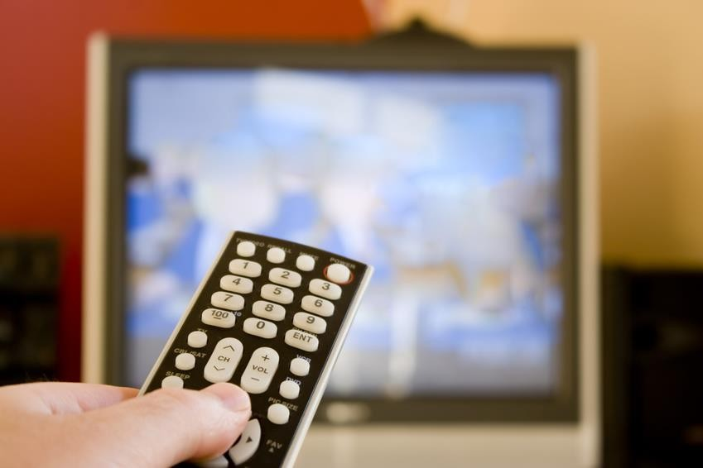
Health Concerns
  Technology can lead to sedentary lifestyles
    Riding lawn mowers
    Television
    Computers
    Cars
    Garage door openers
Notes:
Although technology was meant to help with time management, what people have in effect done to themselves is added more to their schedules and lifestyles. They had the mindset that they were incorporating time saving tools into their daily routine and lives. Instead of taking advantage of the extra time saved by resting and spending family time, more things were squeezed in. This in turn has caused added stress into the lives of people.
We now have to make an effort to add physical activity into our lifestyles.

Slide 37

Health Concerns
  Nutrition: Fast foods – high in calories, fat, and salt
  Food is genetically altered
Notes:
Some of the effects of technological advances on families throughout the family life cycle include potential benefits of genetically engineered food:
•More nutritious food
•Tastier food
•Disease-and drought-resistant plants that require fewer environmental resources (water, fertilizer, etc.)
•Decreased use of pesticides
•Increased supply of food with reduced cost and longer shelf life
•Faster growing plants and animals
•Food with more desirable traits, such as potatoes that absorb less fat when fried
•Medicinal foods that could be used as vaccines or other medications
Potential risks include:
•Modified plants or animals may have genetic changes that are unexpected and harmful.
•Modified organisms may interbreed with natural organisms and out-compete them, leading to extinction of the original organism or to other unpredictable environmental effects.
•Plants may be less resistant to some pests and more susceptible to others
Tomatoes, potatoes, squash, corn, and soybeans have been genetically altered through biotechnology. Many more foods have engineered ingredients and more are being developed. Check with the Food and Drug Administration (FDA) for more information.
Genetically engineered foods are generally regarded as safe. There has been no adequate testing, however, to ensure complete safety. There are no reports of illness or injury due to genetically engineered foods. Each new genetically engineered food will have to be judged individually.

Slide 38
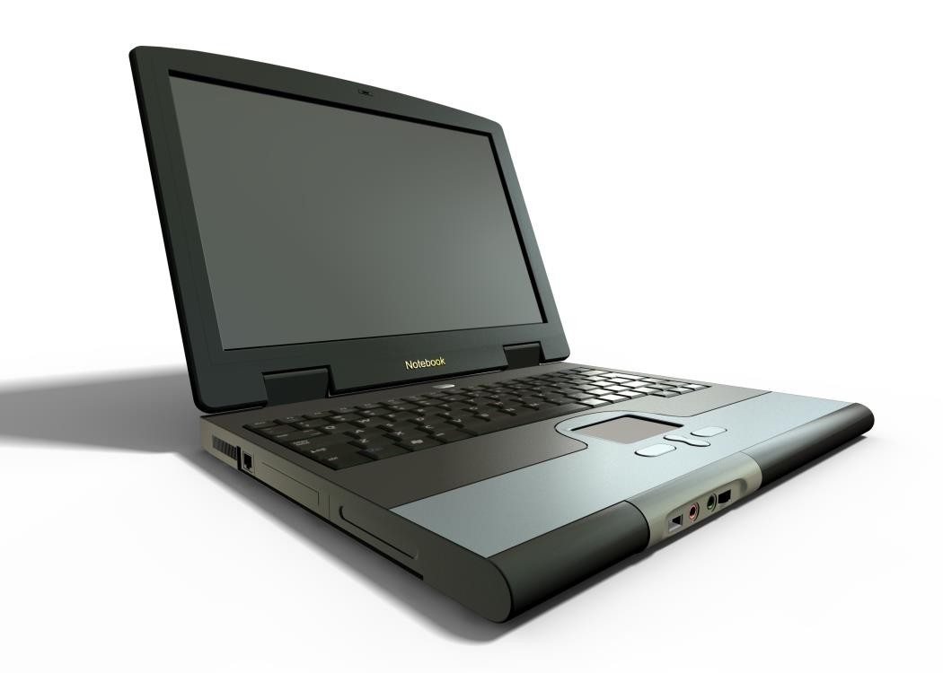
Cost And Value
  Advanced techniques and equipment are expensive
Notes:
Technology is fast paced and expensive. Just as soon as equipment is purchased you will see that a newer, faster, and better system is out. Parents have to tell their children that they can’t purchase every new piece of technology that is available.

Slide 39

Makes Things Too Easy
  Easy access to cash and credit can create problems for some families
  Can cause over spending
Notes:
Everyone still has to manage their financial accounts. Now with the quick and easily accessible ATM’s, credit cards, and credit lines, some people tend to get in trouble with their finances. It’s better to have a budget set and plan for any extra purchases.
What are the advantages and disadvantages of online banking?
Do you bank online?
Do you use your phone to check your balances and expenditures?
Is this a safe way to bank?
Do you scan your checks to deposit them into your checking or savings account?

Slide 40

Environment
  Chemical wastes enter water, earth and the air
  Technology uses up energy and natural resources
Notes:
How has technology helped the environment?
How has technology had a negative impact on the environment?
What impact do these two factors have on the family life cycle?
Why is it important to go paperless with bills and bank statements?

Slide 41
Electronic Waste
  Discard electrical or electronic devices safely
  May involve a risk to the environment
  Electronics Donation and Recycling
  (click on link)
Notes:
The use of electronic products has grown substantially over the past two decades, changing the way and the speed in which we communicate and how we get information and entertainment. According to the Consumer Electronics Association (CEA), Americans now own approximately 24 electronic products per household.
Electronic waste, e-waste, e-scrap, or waste electrical and electronic equipment (WEEE) describes discarded electrical or electronic devices. There is a lack of consensus as to whether the term should apply to resale, reuse, and refurbishing industries, or only to a product that cannot be used for its intended purpose. Informal processing of electronic waste in developing countries may cause serious health and pollution problems, though these countries are also most likely to reuse and repair electronics.
All electronic scrap components, such as CRTs, may contain contaminants such as lead, cadmium, beryllium, or brominated flame retardants. Even in developed countries, recycling and disposal of e-waste may involve significant risk to workers and communities and great care must be taken to avoid unsafe exposure in recycling operations and leaching of material such as heavy metals from landfills and incinerator ashes. Scrap industry and USA EPA officials agree that materials should be managed with caution.
Donating used electronics for reuse extends the lives of valuable products. Recycling electronics prevents valuable materials from going into the waste stream. Consumers now have many options to recycle or donate for reuse their used electronics. Many computer, TV, and cell phone manufacturers, as well as electronics retailers offer some kind of take back program or sponsor recycling events. About half of the states currently have laws on disposal and recycling of electronics and several other states are considering passing similar laws.
Unfortunately not every electronic recycler follows environmentally sound recycling practices; however, responsible electronics recyclers and refurbishers can now become certified by demonstrating to an accredited, independent third party that they meet available standards on responsible recycling practices. EPA encourages all electronics recyclers to become certified and all customers to choose certified recyclers.
How should we dispose phone batteries?
Electronics Donation and Recycling
Electronic products are made from valuable resources and materials, including metals, plastics, and glass; all of which require energy to mine and manufacture.
http://www.epa.gov/wastes/conserve/materials/ecycling/donate.htm

Slide 42

Questions?

Slide 43
References And Resources
  Images:
    Microsoft Clip Art: Used with permission from Microsoft.
  Textbook:
    Decker, C. (2011). Child Development Early Stages Through Age 12. (7th ed., 50-73, 61-63). Tinley Park: Goodheart-Willcox Company, Inc.
  Websites:
    Bureau of Labor Statistics
    What Effects do Macroeconomic Conditions Have on Families’ Time Together? http://www.bls.gov/ore/pdf/ec120030.pdf
    Electronics Donation and Recycling
    Electronic products are made from valuable resources and materials, including metals, plastics, and glass, all of which require energy to mine and manufacture. http://www.epa.gov/wastes/conserve/materials/ecycling/donate.htm

Slide 44
References And Resources
  Websites:
    Forum on Child and Family Statistics
    The Federal Interagency Forum on Child and Family Statistics, or the Forum, is a working group of Federal agencies that collect, analyze, and report data on issues related to children and families. The Forum has partners from 22 Federal agencies as well as partners in private research organizations.
    http://www.childstats.gov/index.asp
    Health Science Channel.com
    In this fertility video learn about the advances in assisted reproductive technology that allow many couples to achieve their dream of starting a family to achieve fertility.
    http://video.answers.com/information-on-fertility-25252678
    Maternal and Child Health
    The Federal Title V Maternal and Child Health program has provided a foundation for ensuring the health of the nation’s mothers, women, children, and youth, including children and youth with special health care needs, and their families.
    http://mchb.hrsa.gov/

Slide 45
References And Resources
  Websites:
    Medline Plus
    Genetically engineered foods have had foreign genes (genes from other plants or animals) inserted into their genetic codes. http://www.nlm.nih.gov/medlineplus/ency/article/002432.htm
    OnGuard Online: Protect Kids Online
    Kids have lots of opportunities for socializing online, but they come with certain risks. Parents can help reduce these risks by talking to kids about making safe, responsible decisions.
    http://www.onguardonline.gov/
    Oregon Live
    Healthy Heart 2013: High-tech advances help keep cardiac problems under control. http://www.oregonlive.com/health/index.ssf/2013/02/healthy_heart_2013_high-tech_a.html
    Pew Internet
    The State of Social Media Users
    http://pewinternet.org/Reports/2013/Social-media-users/The-State-of-Social-Media-Users.aspx

Slide 46
References And Resources
  YouTube:
    Share with Care
    What you post online could have an impact on people in the real world. To learn more about how your online actions can have real-world consequences
    visit http://onguardonline.gov/articles/0033a-share-care http://youtu.be/m_JB9mA_O3c
    Stand Up to Cyberbullying
    You can help stop cyberbullies by standing up for yourself or someone else. To learn more about cyberbullying visit: http://onguardonline.gov/articles/0028-cyberbullying http://youtu.be/lN2fuKPDzHA
    Texting and Driving Accidents
    Consequences of texting and driving. Please don't text and drive! http://youtu.be/WGg9YOpGuwc

