Slide 1
The Balancing Act
Managing a Career and Family
Operations of Restaurants

Slide 3
Working in the Restaurant Industry
Notes:
Everyone enjoys eating out at restaurants and working at a restaurant can be rewarding.
But there are advantages and disadvantages to working in the restaurant industry.

Slide 4

Advantages
  Abundance of jobs
  Advancement opportunities
  Fast pace and variety
  Meeting people
  Pleasant workplace
  Travel
Notes:
There are many advantages to working in the restaurant industry. Listed above are a few.
Can you think of any others?

Slide 5

Disadvantages
  Hours of work
  Relocation
  Stress
  Working conditions
Notes:
Careers in the restaurant industry can be stressful and physically demanding.
The hours are long and may include nights, weekends, and holidays.
Can you name any other disadvantages to a career in the restaurant industry?

Slide 6
Multiple Roles
  Adult
  Employee
  Citizen
  Spouse
  Parent
  Community member
  Neighbor
  Other

Slide 7
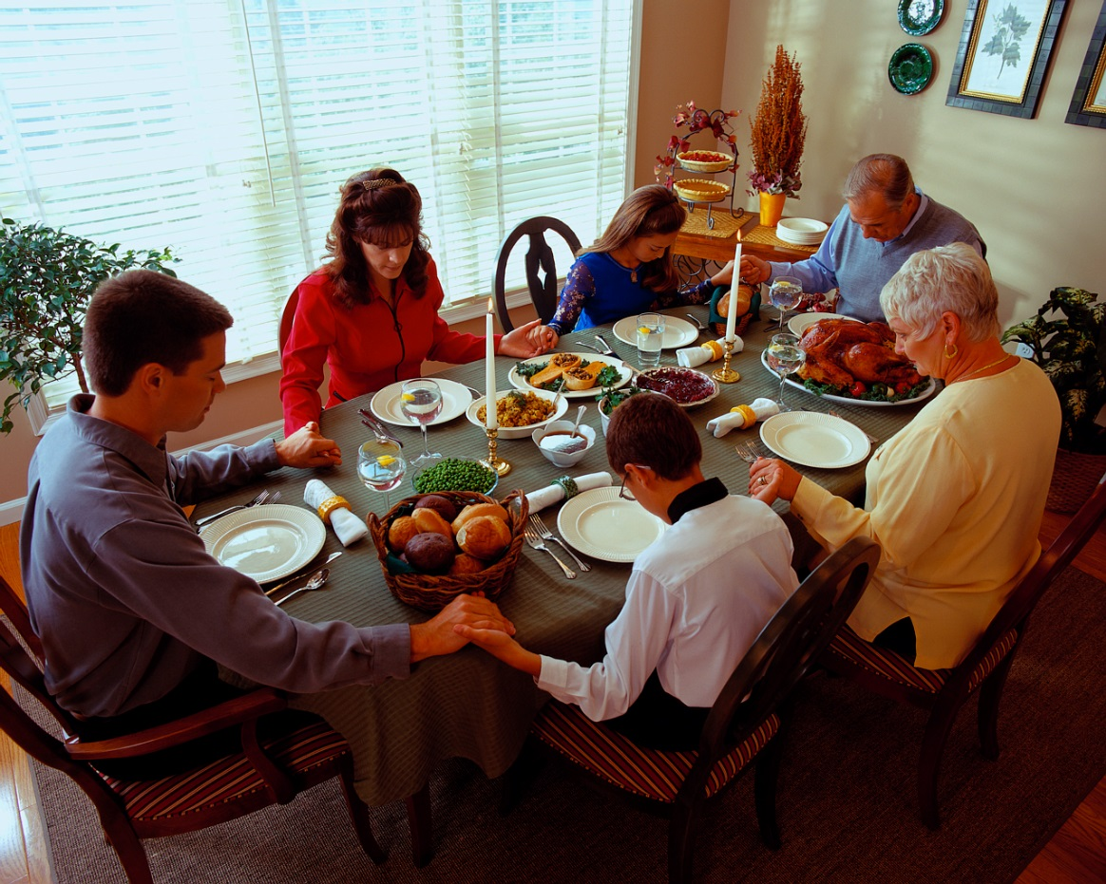
Family
  May consist of:
    Spouse
    Children
    Grandparents
    Brothers and sisters
    Step-children
    Other relatives
Notes:
The functions of families are:
meeting the basic needs of family members such as food, shelter, clothing and education
giving emotional control such as helping each other during difficult times
teaching values such as right from wrong and what is most important in life
passing on culture and traditions such as teaching children how to get along with other people and about their family heritage
What does your family consist of?

Slide 8

Work-Life Balance
  Families Struggling for Work-Life Balance
  (click on link)
Notes:
Click on hyperlink to view video:
Families Struggling for Work-Life Balance
A new study released from the Pew Research Center found 37% of mothers say they want to work fulltime, due, in large part, to the recession and financial insecurity.
http://www.nbcnews.com/video/nightly-news/51186744/#51186744

Slide 9
Time and Energy Management

Slide 10

Time Saving Techniques
  Avoid procrastination
  Avoid time wasters
  Be flexible
  Do it right the first time
  Make a To Do list
  Practice work simplification
  Prevent interruptions
  Set goals
  Stay organized
  Take a break
  Use small amounts of time
  Use a calendar
Notes:
Take advantage of these tips to make time work for you.

Slide 11

Managing Your Energy
  Amount changes daily
  Identify your peak period
  Levels vary with age
  Increase levels by:
    Eating healthy food
    Exercising regularly
    Getting plenty of rest
Notes:
Understanding when we perform our best and what affects our energy can help us with our work.

Slide 12



Leisure Activities
  Community activities
  Hobbies
  Reflection
  Vacations
Notes:
Leisure time is the time you have free from work and other duties.
This time can include:
Community activities
participating in festivals, concerts or other local activities
Hobbies
building
crafting
drawing
reading
Reflection
taking time for yourself by yourself
Vacations
visiting family in other cities
visiting amusement parks
What is your favorite leisure activity?

Slide 13

Questions?

Slide 14
References and Resources
  Images:
    Microsoft Office Clip Art: Used with permission from Microsoft.
  Texbooks:
    Kelly-Plate, J., & Eubanks, E. (2004). Today’s teen. New York, NY: Glencoe/McGraw-Hill.
    Reynalds, J.S. (2010). Hospitality services: Food & lodging. Tinley Park, IL: Goodheart-Willcox Company.
  Video(s):
    Families Struggling for Work-Life Balance
    A new study released from the Pew Research Center found 37% of mothers say they want
    to work fulltime, due, in large part, to the recession and financial insecurity.
    http://www.nbcnews.com/video/nightly-news/51186744/#51186744

