Slide 1
Stories, Stories, and More Stories

Slide 3

“As parents, the most important thing we can do is read to our children early and often. Reading is the path to success in school and life. When children learn to love books, they learn to love learning.”
- Laura Bush
Notes:
Do you agree with this quote? Why or why not?

Slide 4
What influences the development of children?
Notes:
Ask the students for possible answers.

Slide 5

Influences on the Development of Children
Conscience
Culture
Family
Moral development
Playmates
Sex of the child
Social institutions
Notes:
A variety of influences affect how children develop. The family, television, sex of the child, playmates, conscience, moral development, culture and social institutions all affect a child. Such influences are considered important, and a basic knowledge of them helps educators and caregivers improve their understanding of children. All these factors are important, but in this lesson, we are going to focus on cognitive, conscience and moral development.

Slide 6
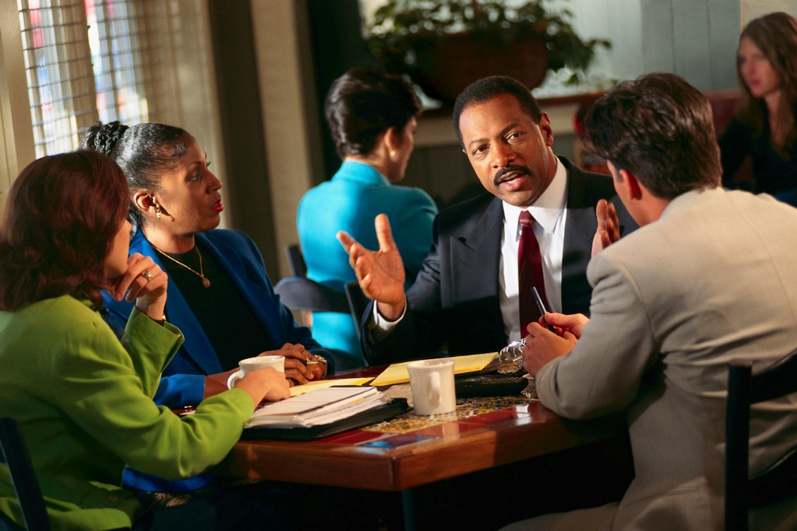
Theories of Moral Development
Kohlberg’s timeline for moral development:
Preconventional
Conventional
Postconventional
Notes:
Lawrence Kohlberg extensively studied the development of moral reasoning in children. Based on his research and Piaget’s cognitive theory, he devised a timetable for such development. Kohlberg proposes that the higher levels of moral reasoning cannot be reached if the person has not reached the higher levels of cognitive development.
The first stage of moral reasoning is the preconventional moral reasoning level. Decisions about moral dilemmas in this stage are motivated by fear of punishment or desire for reward from authority figures, primarily the parents. This type of reasoning is typical of children under eight years old.
The second stage of reasoning, conventional, is characteristic between the ages of eight and thirteen. Groups become the primary source of authority rather than parents. The group of authority may be the family, peers or community. Children adopt the group’s definitions of right and wrong without question. Individuals in the conventional moral reasoning stage want to please other people, uphold the laws of society and act as a “good girl” or “good boy” would.
Most adults make daily decisions using conventional moral reasoning. Many never graduate to stage three. Stage three is termed the postconventional moral reasoning level. In this stage, people make moral decisions based on justice. Individuals at this level challenge and change rules if necessary instead of blindly accepting and following the rules set by others. They are concerned with protecting self-respect by examining different systems of thought and doing what they deeply believe is right.
How does the family influence a child’s moral development?

Slide 7
Theories of Cognitive Development
Piaget’s timeline for cognitive development:
Sensorimotor stage (age 0-2)
Preoperational stage (age 2-6)
Concrete operations stage (age 6-12)
Formal operations stage (age 12+)
Notes:
Cognitive theories emphasize the development of thought over other developmental aspects. Jean Piaget, a Swiss psychologist, realized the similarities in the development of children’s thinking. He noticed that all seem to encounter the same mistakes while exploring their world and seem to come to the same conclusions at the end. He believed children have inborn methods of interacting with their environment. These fundamental plans provide the basis upon which thinking develops.
The four stages of development in Piaget’s cognitive developmental theory include:
Sensorimotor stage (age 0-2): The infant interacts with the world primarily through his senses and the actions he can perform on objects. He does not yet have the capacity to represent objects or people to himself mentally.
Preoperational stage (age 2-6): The child can now represent things to himself internally, but he is still focusing his attention on such external characteristics of objects or people as size, shape, color, and clothing. Still, he uses these features for classifying objects into groups. Language development is enhanced by talking to and being around toddlers. Reading to toddlers and allowing them to read on their own can also develop their language skills.
Concrete operations stage (age 6-12): The child makes a major step forward in the abstractness of thought. He discovers an entire set of basic rules about objects, such as the fact that they can be arrayed in various orders (from small to large or fat to thin, for example) or that aspects of them remain constant even in the face of external change (which Piaget calls conservation). He also develops the ability to use complex mental operations, such as addition, subtraction, or simultaneous classification of one object into two or more categories (a chair is both a piece of furniture and a wooden object, for example).
Formal operations stage (age 12+): As a final step, the teenager becomes able to think still more abstractly, using deductive as well as inductive logic and approaching decisions and problems with a systematic fashion. He can now think about ideas as well as objects and imagine objects or events that he has never actually experienced himself.
How does the family influence a child’s cognitive development?
According to Piaget, how does cognitive development take place?

Slide 8
Cognitive Development
Family members influence how a child’s brain develops through what they teach the child and how they support the child’s development.
Notes:
Children are born with mental ability. Family members influence how a child’s brain develops through what they teach the child and how they support the child’s development. The family environment should provide opportunities for children to exercise thinking skills. A child who uses books and does other learning activities at a young age may find it easy to learn in school.

Slide 9
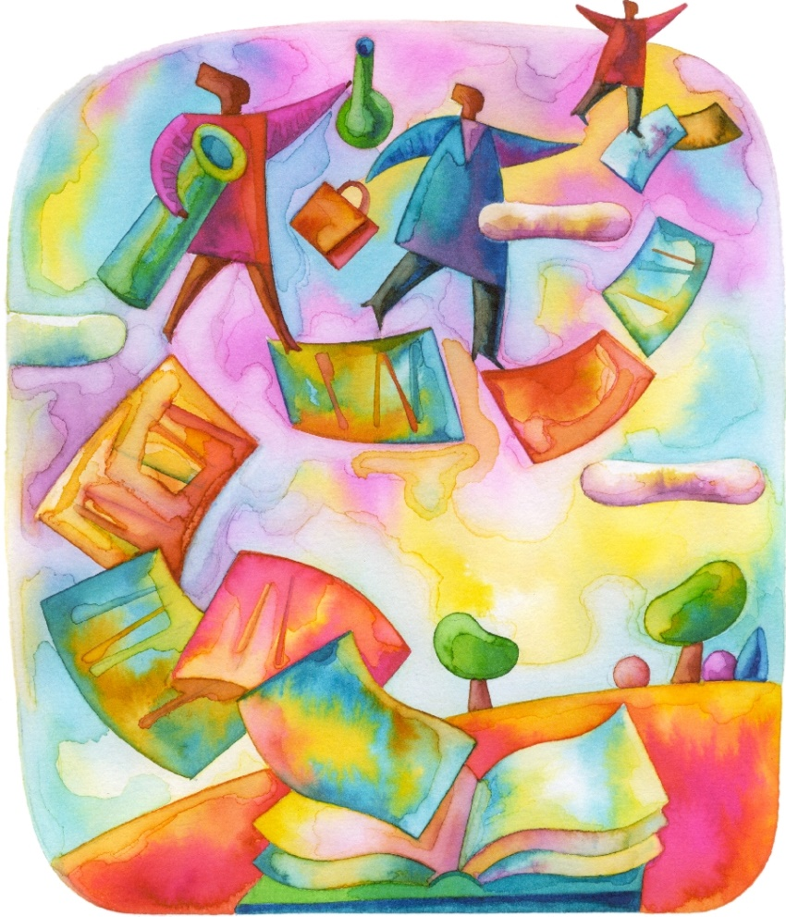
Enhancing Children’s Literacy
Intellectual Benefits of Literacy:
Develops language skills
Identifies letters and promotes writing skills
Identifies picture clues, specific words or phrases
Sparks their imaginations
Teaches them morals
Notes:
Reading and books are a special venue to teach moral development. Moral development is mainly taught through the examples of others as seen in moral based books. As an educator, choose books for children’s relaxation and enjoyment.
What are some examples of moral based books you’ve read?

Slide 10
Best Practices for Encouraging Literacy
Making reading and writing connect to the students’ lives and interests
Encouraging students to interact with each other
Creating student-centered classrooms where students make displays, choose words and create word walls, write and distribute newsletters, develop blogs and online communications
Focusing on vocabulary development and review
Using cooperative and collaborative learning where students must use language to learn
Notes:
Some best practices for encouraging literacy are:
- Making reading and writing connect to the students’ lives and interests.
- Encouraging students to interact with each other.
- Creating student-centered classrooms where students make displays, choose words and create word walls, write and distribute newsletters, develop blogs and online communications.
- Focusing on vocabulary development and review
- Using cooperative and collaborative learning where students must use language to learn.

Slide 11
What are morals? What is conscience?
Notes:
Ask the students for possible answers.

Slide 12

What is a conscience?
Conscience is a feeling for what is right and wrong.
Notes:
As a child becomes cognitively mature, he or she develops a conscience. Conscience is a feeling for what is right and wrong. Why is it important for adults to guide a child’s development of conscience during preschool years?
What happens when adults fail to guide a child’s development of conscience during preschool years?
How is the family affected by this?

Slide 13

Moral Development
Moral development involves learning to follow rules and make good value decisions about what is right and wrong.
Notes:
Moral development involves learning to follow rules and make good value decisions about what is right and wrong. Moral development is controlled mainly by children’s parents. The development of morals and a conscience relates closely to social and emotional development, as well as cognitive development. As a child enters school, it is the job of an educator to further develop and reinforce morals in the classroom.
How do morals relate to social and emotional development?
How do morals relate to cognitive development?
How can educators develop and reinforce morals in the classroom?

Slide 14

Importance of Moral Development
Teach children how their behavior affects other people and why it is important to change inappropriate behavior
Praise children when they show self-control and good judgment
Notes:
To help children develop a conscience and good morals, use discipline methods that are fair, and show children that they are loved. Teach children how their behavior affects other people and why it is important to change inappropriate behavior. Praise children when they show self-control and good judgment. Show them that you recognize their progress. It is most important to set a good example for children by displaying positive character traits. Learn to feel comfortable admitting when you are wrong. This shows children that everyone makes mistakes.
What is a positive character trait?

Slide 15

Good Judgment
A child can develop moral ideas only when he or she is able to think and make judgments
This growth helps children begin to understand the rules of games, as well as the rules of society
Notes:
Good judgment is a social concern. However, a child can develop moral ideas only when he or she is able to think and make judgments. Society expects children in middle childhood to know the difference between right and wrong. By age seven, most children have entered the stage of cognitive development that enables them to think in a logical way and solve problems cognitively. This growth helps children begin to understand the rules of games, as well as the rules of society.
Have you ever made a good judgment in a situation? What were the consequences? What did you learn?
Have you ever made a bad judgment in a situation? What were the consequences? What did you learn?

Slide 16
Guidelines to Help Children Learn
keep children interested and curious
teach children when they are ready to learn
provide surroundings and activities familiar enough for children to feel secure and comfortable
make learning enjoyable and fun
teach children skills they can use in real life
realize that specific needs of individual children affect their ability and motivation to learn
Notes:
Guidelines to follow when helping children learn about their world include the following:
keep children interested and curious
teach children when they are ready to learn
provide surroundings and activities familiar enough for children to feel secure and comfortable
make learning enjoyable and fun
teach children skills they can use in real life
realize that specific needs of individual children affect their ability and motivation to learn
How can books provide an avenue for learning?
How can a book keep a child interested and curious?
How can books make learning enjoyable and fun?
How can books teach children skills they can use in real life?

Slide 17

Focus of the Story
Notes:
Can you remember children’s stories that taught you a life lesson?
What was the focus of the story? Was it moral based?
Why are these types of stories important to read to children?

Slide 18
Aesop’s Fables
"Beware the wolf in sheep's clothing."
(click on picture)
Notes:
Can you remember reading Aesop’s fables?
What is a fable?
What was the focus of the story? Was it moral based?
Why are these types of stories important to read to children?
Teacher note: You may opt to include reading a few of the fables to familiarize the students with moral based stories.
Aesop’s Fables
This famous Book of Fables, which are always referred to as Aesop's Fables, date back to the 5th Century B.C.
http://www.taleswithmorals.com/

Slide 19

How to Develop a Story
Notes:
Do you know how to develop a children’s story? How would you start?

Slide 20

Storyboarding for Writers
Your Book Starts Here - Storyboarding for Writers
(click on link)
Notes:
Teacher note: The video is about 12 minutes long. It will help the students design their story.
Your Book Starts Here - Storyboarding for Writers
How a storyboard designs your book's flow of chapters and ideas
http://youtu.be/pMhLvMJ_r0Y

Slide 21
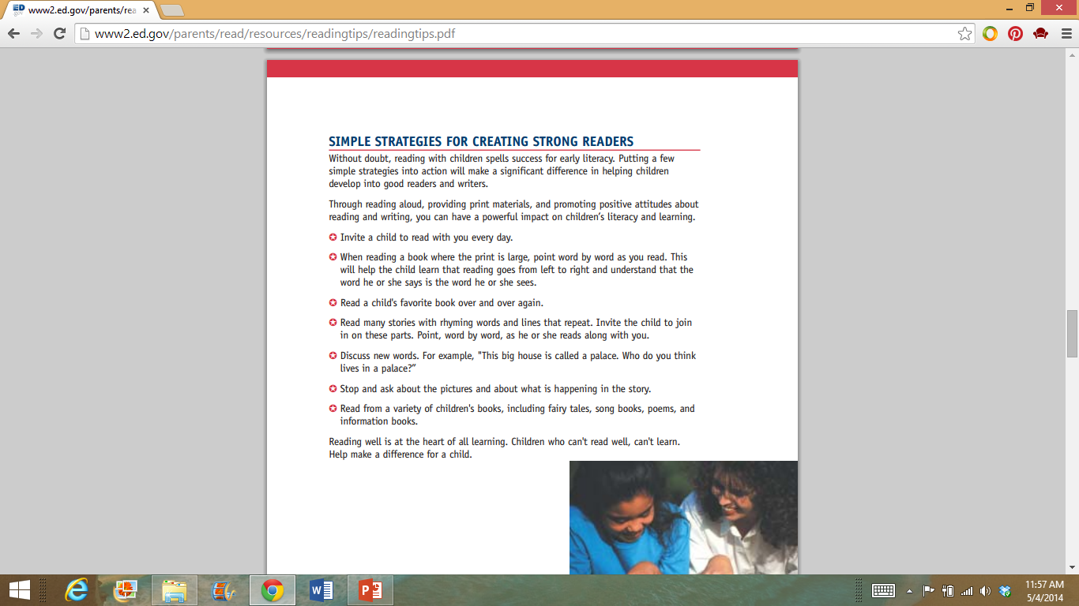
Strategies to Create Readers
Notes:
According to the U.S. Department of Education, parents can promote good reading skills in children by following these strategies.
U.S. Department of Education
Reading Tips for Parents
http://www2.ed.gov/parents/read/resources/readingtips/index.html

Slide 22

Strategies for Reading to Children
Strategies for Reading Aloud to Children
(click on link)
Notes:
Be enthusiastic about reading. Read a story with expression. Make it more interesting by talking as the characters would talk, making sound effects and using facial expressions and gestures.
Teacher note: The video is about 11 minutes long. You may elect to have the students take notes on the different strategies used for reading a book. Discuss their results.
Strategies for Reading Aloud to Children
Join Breeyn Mack for a read-aloud of "Wash and Dry." She uses strategies for helping young children to get the most out of the read-aloud experience such as emphasizing vocabulary, commenting on characters, and asking probing questions
http://youtu.be/tZ2rL0eByfc

Slide 23
In-Class Activity
You will be required to create your own story
Be creative and have fun
You will be evaluated with the Storytelling Rubric
You may work individually or with a partner
Your text and graphics may be either hand or computer generated
Notes:
Write the story in a “book” format
Promote a positive character trait
Create an original story
Written for a specific grade level
Include text and graphics that are either hand or computer generated
Design your book so that it is interesting, colorful and age and grade level appropriate

Slide 24
Presentation
Include at least two distinct characters’ voices
Notes:
Remember to use at least two distinct characters’ voices.
Take the time to practice, practice, practice your presentation.

Slide 25

Get Busy!

Slide 26

Questions?

Slide 27
References and Resources
Images:
Microsoft Clip Art: Used with permission from Microsoft.
Textbooks:
Curriculum Center for FCS. Ready, set, teach! Curriculum Guide. 2003.
Curriculum Center for FCS. Reaching to teach. 2005.
Websites:
Reading is Fundamental
To motivate young children to read by working with them, their parents and community members to make reading a fun and beneficial part of everyday life.
http://www.bookpeopleunite.org/
Texas Association of Future Educators (TAFE)
Advisor Handbook – Competitive Events
http://www.tafeonline.org/?page=CompetitiveEvents
U.S. Department of Education
Reading Tips for Parents
http://www2.ed.gov/parents/read/resources/readingtips/index.html

Slide 28
References and Resources
YouTube™:
Strategies for Reading Aloud to Children
Join Breeyn Mack for a read-aloud of “Wash and Dry.” She uses strategies for helping young children to get the most out of the read-aloud experience such as emphasizing vocabulary, commenting on characters, and asking probing questions
http://youtu.be/tZ2rL0eByfc
Your Book Starts Here – Storyboarding for Writers
How a storyboard designs your book’s flow of chapters and ideas
http://youtu.be/pMhLvMJ_r0Y

