Slide 1
Researching Careers in The Human Services Industry
Practicum in Human Services
Notes:
Careers in human services vary greatly. They include careers in the health care field, retail and consumer services, personal care, government service and many specific areas. Under Human Services in the blue state government pages of your telephone book, you can locate contact information for companies and departments in your community. Many services include special populations, such as aging services, child abuse, mental health, youth corrections, neglect services, crisis centers, service-oriented clubs like the Lions, Rotary and Kiwanis, along with national service organizations such as the Volunteers of America, American Red Cross and many more.
Teacher note: You might want to have this website open on your computer prior to starting the slide presentation. You will be referring to it on slide 8. You will be discussing pages 10 and 11.
AchieveTexas in Action A college and career planning guide. http://www.achievetexas.org/2010%20Guides/71711%20Hum_comp_ np.pdf

Slide 3
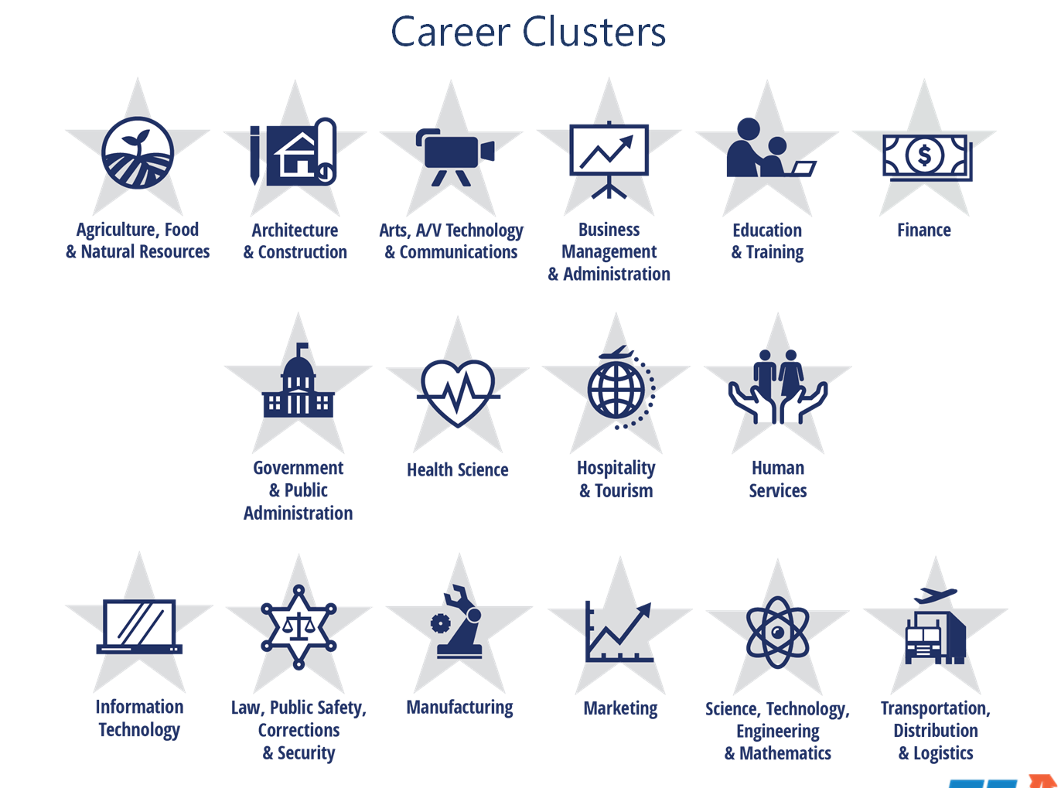
16 Career Clusters™
Notes:
The 16 clusters identified by the U.S. Department of Education classify workforce preparation programs that are obtained through career and technical education.
What cluster do you think Practicum in Human Services falls under? Have students read the descriptors for each cluster.
Practicum in Human Services is in the Human Services cluster.

Slide 4
Human Services
The Cluster icon above is used with permission of the State’s Career Clusters
Initiative, 2007. For more information visit www.careerclusters.org
Notes:
As a student in Practicum of Human Services, do you feel you are providing for families and serving human needs? How? It takes a unique individual to work in Human Services. There are many occupations in the cluster that pay well, but most people don’t do it for the money. They have a deep desire to help other people.

Slide 5
Human Services Programs of Study
  Consumer Services
  Counseling and Mental Health Services
  Early Childhood Development & Services
  Family and Community Services
  Personal Care Services
Notes:
Each cluster has various Programs of Study.
We have already established that Practicum in Human Services is in the Human Services career cluster.
What Program of Study do you think it follows?

Slide 6

Human Services Programs of Study
  Consumer Services
  Counseling and Mental Health Services
  Early Childhood Development & Services
  Family and Community Services
  Personal Care Services

Slide 7
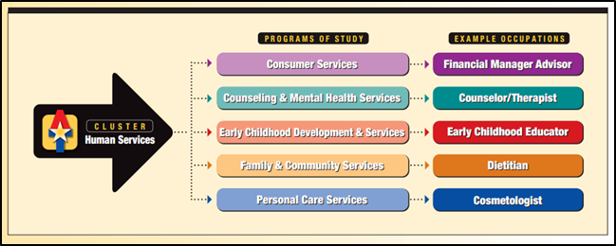
Programs of study
Image: AchieveTexas in Action
Notes:
What are other examples of occupations that would fall under the five programs of study?
Have you ever worked or volunteered at one or more of these programs of study?
AchieveTexas in Action
A college and career planning guide.
http://www.achievetexas.org/2010%20Guides/71711%20Hum_comp_np.pdf

Slide 8

Career Choices
  25 Careers in the Human Services Cluster
  (click on picture)
Notes:
Note to teacher: Click on the guide to the right to view the electronic magazine or download PDF format. Refer to pages 10 and 11 to discuss the 25 careers students might be interested in the Human Services cluster.
Provide explanations for:
Standards for Student Occupational Code (SOC)
Growth
Openings
Wages
Education
Education levels
Job description
These are not all the career options in the career cluster. Can you think of additional careers options in Human Services? Are you interested in pursuing one or more of the 25 careers mentioned?
AchieveTexas in Action
A college and career planning guide.
http://www.achievetexas.org/Human_Services.htm

Slide 9

Consumer Services
  Financial Managers
  Housing Sales Representatives in Housing
  Apparel Sales Managers in Apparel
  Employee Benefits Representatives
  Hospital Patient Accounts Representatives
  Customer Service Representatives
Notes:
Professionals in this area help people with decisions and problems relating to finance, real estate, insurance and consumer goods. Additional occupations could include:
Consumer Research Department Representatives
Consumer Goods or Services Retailing Representatives
Market Researchers
Account Executives
Sales Consultants
Event Specialists

Slide 10
Counseling and Mental Health
  Marriage and Family Therapists
  Career Coaches
  School Counselors/Psychologists
  Substance Abuse and Behavioral Disorder Counselors
  Mental Health Counselors
Notes:
Professionals in these occupations assist people with personal, family, educational, mental health and career decisions and problems. Additional occupations could include:
Vocational Rehabilitation Counselors
Career Counselors
Career Facilitators
Employment Counselors
Residential Advisors
Marriage, Child and Family Counselors

Slide 11

Early Childhood Development and Services
  Directors, Childcare Facilities Directors
  Assistant Directors, Childcare Facilities Assistant Directors
  Elementary School Counselors
  Preschool Teachers
  Educators for Parents
Notes:
Professionals in these careers nurture and teach preschool-age children. Additional occupations could include:
Nannies
Teachers’ Assistants
Childcare Assistants/Workers

Slide 12
Family and Community Services
  Dietitians
  Geriatric Care Managers
  Social and Community Services Managers
  Social Services Workers
  Vocational Rehabilitation Counselors
Notes:
Some professionals in this area help families and individuals meet their nutritional needs. Others help vulnerable populations cope with the problems of daily living, counsel troubled individuals, train or retrain the unemployed, care for the elderly and solicit contributions for various social agencies. Additional occupations could include:
Employment Counselors
Career Counselors
Vocational Rehabilitation Service Workers
Leisure Activities Coordinators
Geriatric Service Workers
Adult Day Care Workers
Residential Advisors
Emergency and Relief Workers

Slide 13
Personal Care services
  Cosmetologists
  Nail Technicians, Manicurists and Pedicurists
  Skin Care Specialists/Estheticians
  Electrolysis Technicians
  Funeral Directors/Morticians
Notes:
Personal care professionals help people with their personal appearance including styling hair, giving manicures, providing facial treatments and giving makeup advice. They also provide health and fitness training. Additional occupations could include:
Embalmers
Funeral Attendants
Personal and Home Care Aides
Companions

Slide 14
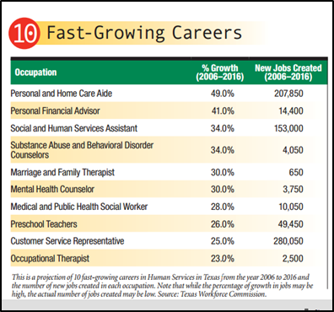
Projection of 10 fast-growing careers in Human Services in Texas
Notes:
This is a projection of 10 fast-growing careers in Human Services in Texas from the year 2006 to 2016 and the number of new jobs created in each occupation. Note that while the percentage of growth in jobs may be high, the actual number of jobs created may be low.
Source: Texas Workforce Commission.
AchieveTexas in Action
A college and career planning guide.
http://www.achievetexas.org/2010%20Guides/71711%20Hum_comp_np.pdf

Slide 15
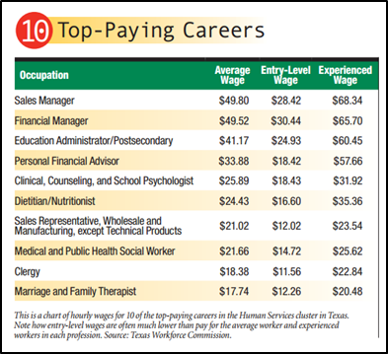
Hourly wages for 10 of the top-paying careers in the Human Services cluster in Texas
Notes:
This is a chart of hourly wages for 10 of the top-paying careers in the Human Services cluster in Texas. Note how entry-level wages are often much lower than pay for the average worker and experienced workers in each profession.
Source: Texas Workforce Commission.
AchieveTexas in Action
A college and career planning guide.
http://www.achievetexas.org/2010%20Guides/71711%20Hum_comp_np.pdf

Slide 16
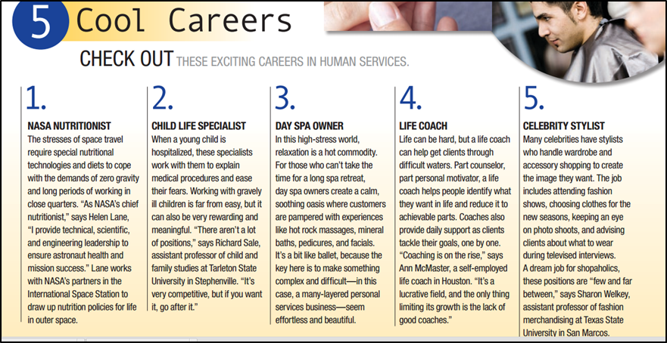
Careers in human services
Notes:
Do these careers sound interesting? For which celebrity would you like to style hair?
AchieveTexas in Action
A college and career planning guide.
http://www.achievetexas.org/2010%20Guides/71711%20Hum_comp_np.pdf

Slide 17

Career Fair Expo
Notes:
As Practicum of Human Services students, you will be practicing communication, critical thinking, problem solving, information technology, leadership and teamwork skills by organizing a career fair expo at school. You will also be responsible for presenting information on one career related to Human Services.
What is a career fair? A career fair is a venue in which students and employers can exchange ideas and information about employment opportunities.
Have you ever been to a career fair?
Were you a participant or presenter?

Slide 18

Why host a career fair at our school?
  Showcase careers in Human Services
  Introduce students to careers related to their coursework
  Provide opportunities to develop skills and network with potential employers
  Bring campus-wide visibility to Family and Consumer Sciences
  Develop a comradery with other groups on campus
Notes:
Why host a career fair at our school?
Showcase careers in Human Services
Introduce students to careers related to their coursework and help them identify the key skills needed in order to become successful professionals
Provide opportunities to develop skills in communication, self‐ presentation and networking, which will prepare students for job interviews and other professional interactions
Develop relationships with area employers, which could lead to student internships, class visits, service‐learning projects and other work-based learning partnerships
Bring campus‐wide visibility to Family and Consumer Sciences and the Human Services cluster
Develop a comradery with other students and groups by enlisting them to assist you with planning and initiating the career fair expo

Slide 19
Tips for a successful career fair
  Identify the goals and objectives of the career fair
  Obtain prior approval from school administrators
  Develop a checklist of jobs and assignments
  A large job fair could run from 9:00 a.m. until 3:00 p.m. or 10:00 a.m. until 2:00 p.m.
  Provide an evaluation form
  Develop a budget for career fair
Notes:
Make a list of companies and agencies that you want to participate in the career fair expo.
You may wish to submit a proposal or agenda of events to the school administrators.
Make a checklist of jobs, and assign those jobs to prospective individuals.
Assign an event coordinator who is responsible for overseeing all the operations of the career fair expo.
Assign an advertising committee to advertise the event.
Assign a communication committee to make phone calls, follow up with confirmation letters and verification phone calls, provide directions to the event and a map of the school and send thank-you notes.
Assign a hospitality committee to prepare and serve food and refreshments.
Meet and greet the company and agency representatives; provide a check-in area.
Assign rooms and schedule a timeline of the event.
Assist with setting up and tearing down the event.
Allow time at the career fair for orientation, closing the event and evaluations. During the last 30 minutes of the career fair, company and agency representatives should be reminded to fill out the career fair evaluation forms and to hand them to the event coordinator.
Obtain financial assistance from various CTSOs if possible. Contact local businesses such as supermarkets and bakeries to donate food and paper goods.

Slide 20
Tips for a successful career fair
  Develop a theme for the event
  Encourage participation from other groups at school such as:
    Culinary Arts
    Art Department
    Science Department
    Math Department
    English Department
    Other Practicum courses
Notes:
Host a contest for developing a theme for the career fair expo. “Exploring Careers for the 21st Century” is a theme example. This sets a positive tone for participants and stimulates creativity in developing flyers and banners to advertise the career fair expo.
Culinary Arts students can provide refreshments (continental breakfast) for the community participants of the career fair expo.
The Art Department can host a contest for designing a logo for the career fair expo. The logo can be used on t-shirts, letterhead, brochures, banners and so forth. They can also provide posters depicting different careers in Human Services.
Science Club students can showcase Human Services careers which are aligned with Science, Technology, Engineering and Math (STEM).
Math students can show salaries earned and projected earnings of careers in Human Services.
If offered at your school, encourage the students enrolled in Practicum in Education and Training, Practicum in Hospitality Services and Practicum in Culinary Arts to participate in the career fair expo. They can highlight careers in their fields of interest.
Have English teachers hold an essay contest called "My Career Path: Mapping My Future." The winning essay can be displayed at the career fair expo.
Do you have any ideas for ways in which we can incorporate more student involvement?

Slide 21
Questions?

Slide 22
References and resources
  Images:
    Microsoft Clip Art: Used with permission from Microsoft.
  Textbooks:
    Kimbrell. , & Vineyard, (2003). Succeeding in the world of work. New York: Glencoe/McGraw-Hill.
    Littrell. (2006). From school to work. (6th ed.). Tinley Park: Goodheart-Willcox Company.
  Websites:
    AchieveTexas in Action
    A college and career planning guide.
    http://www.achievetexas.org/2010%20Guides/71711%20Hum_comp_np.pdf
    AchieveTexas
    College and career initiative providing teacher and student resources for career planning.
    http://www.achievetexas.org

Slide 23
References and resources
  Websites:
    America’s Career Research Network
    America’s Career Resource Network (ACRN) consists of state and federal organizations that provide information, resources, and training on career and education exploration. The network is funded by a grant from the U.S. Department of Education and operates in every state and territory.
    http://www.acrnetwork.org
    Occupational Outlook Handbook
    Teacher’s Guide
    http://www.bls.gov/ooh/About/Teachers-Guide.htm
    Occupational Outlook Handbook
    The nation’s premier source for career information.
    http://www.bls.gov/ooh/home.htm

Slide 24
References and resources
  Websites:
    Mapping Your Future
    Here you can explore careers, prepare for college (help with selecting a school and applying for admission), pay for college (financial aid) and manage your money (student loans and more).
    http://mappingyourfuture.org/
  YouTube™:
    Childhood Interests Can Help You Find the Right Career
    Learn how listening to your inner child can help you find the right career.
    http://youtu.be/6-R0lW_Swio

