Slide 1
Professional and Industrial Organizations in the
Human Services Career Cluster

Slide 3




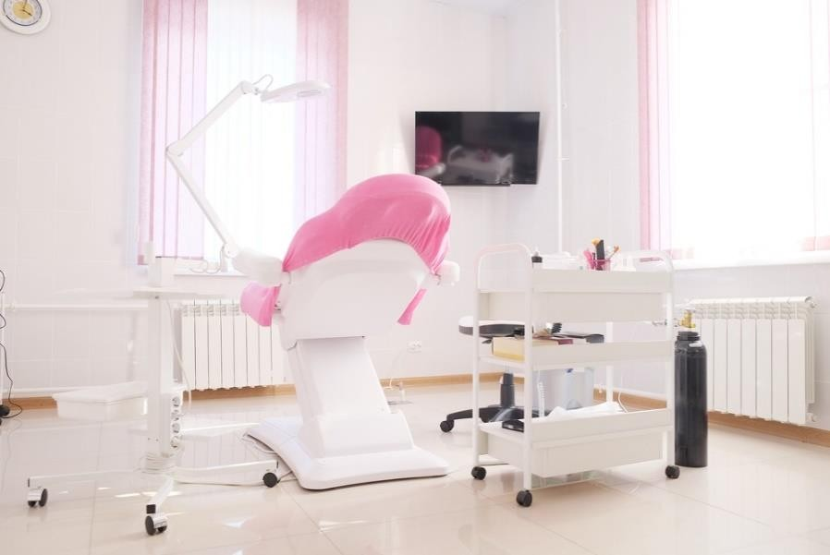
Human Services Career Pathways

Slide 4

The Importance of Joining a Professional or Industrial Organization
If you are interested in furthering your career, joining a professional or industrial organization can benefit you in many ways.

Slide 5
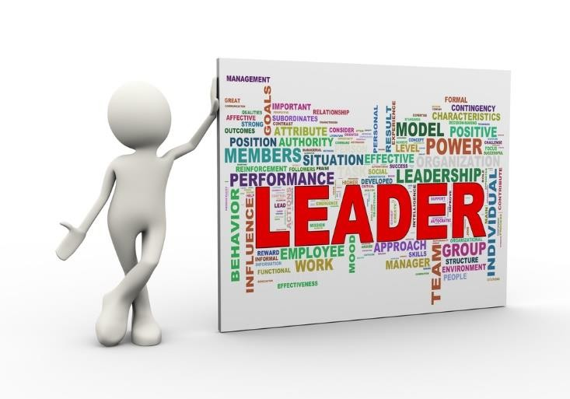
Benefits of Joining a Professional or Industrial Organization
Building a better résumé
Civic leadership
Code of ethics
Conferences and seminars
Education and training
Giving back to the community
Industry standards

Slide 6

Benefits of Joining a Professional or Industrial Organization
Internship and job opportunities
Networking opportunities
Political clout
Publications
Staying motivated and inspired
Support system
Updates on policies

Slide 7

Building a Better Résumé
Many organizations have career resources and workshops available online such as tips on effective résumé or cover letter writing.

Slide 8
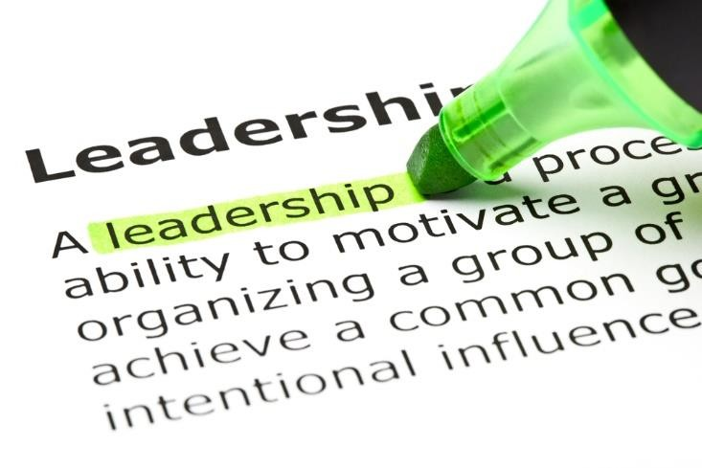
Civic Leadership

Slide 9

Code of Ethics
Ethics are a set of (often unspoken – and generally understood) moral principles relating to a specified group, field or form of conduct.

Slide 10
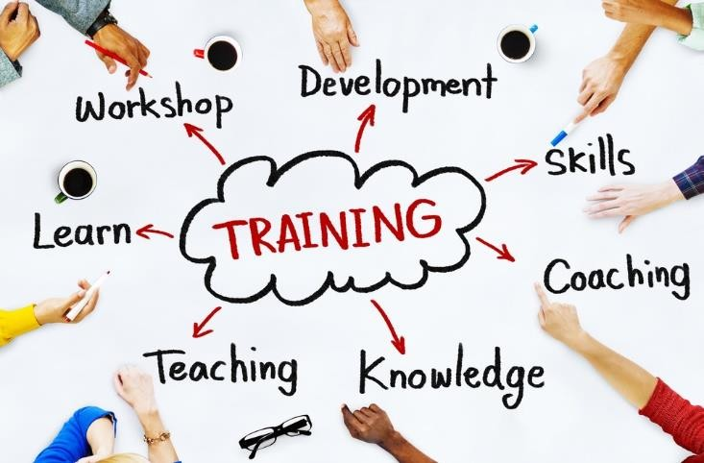
Education and Training
Typical education and training will vary depending on the focus career/occupations of the professional association.

Slide 11

Giving Back to the Community
A professional organization can offer individuals the opportunity to give back to the community.

Slide 12

Industry Standards

Slide 13
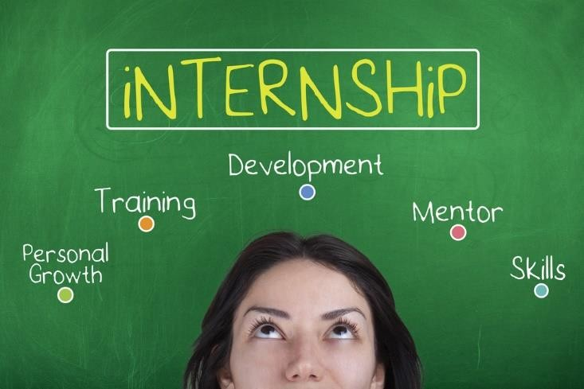
Internship and Job Opportunities

Slide 14
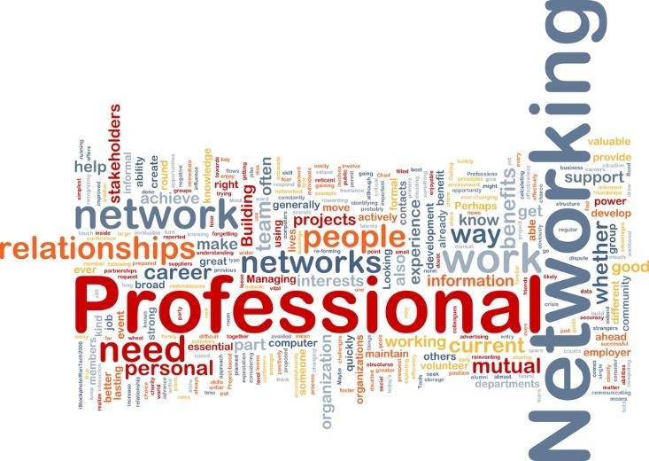
Networking Opportunities
Networking is the exchange of information or services among individuals, groups or institutions.

Slide 15

Publications
Professional organizations often include a monthly publication to members.

Slide 16
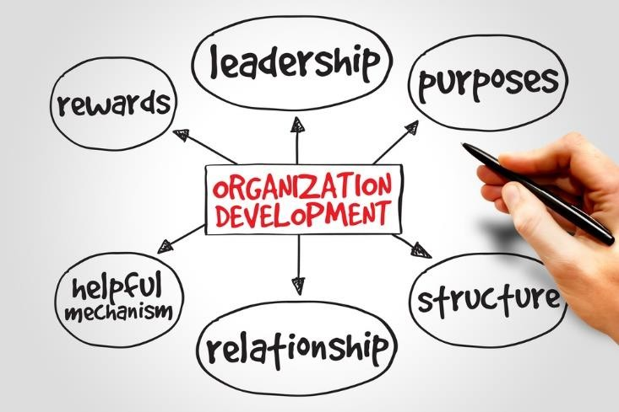
Support System
A support system can provide mentor relationships which provide guidance, answers and resolutions.

Slide 17
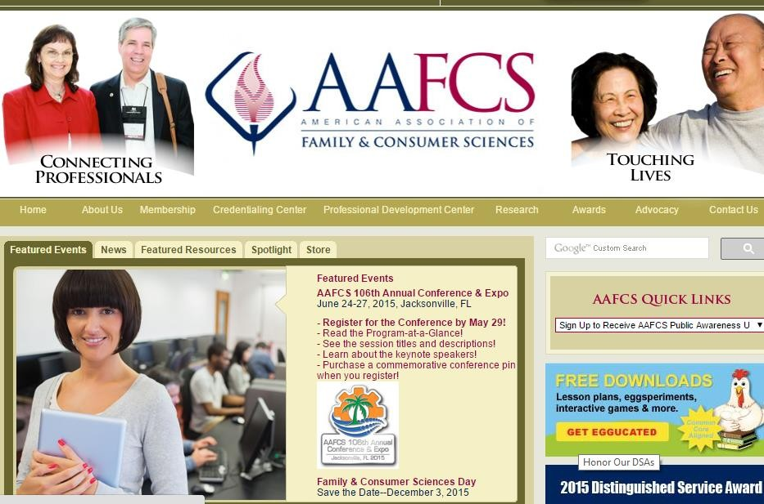
American Association of Family and Consumer Sciences

Slide 18
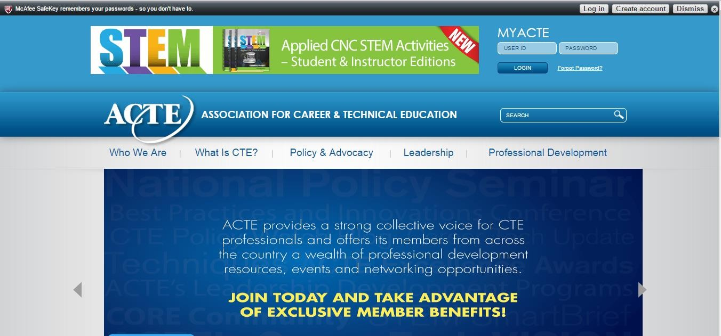
Association for Career and Technical Education (ACTE)

Slide 19
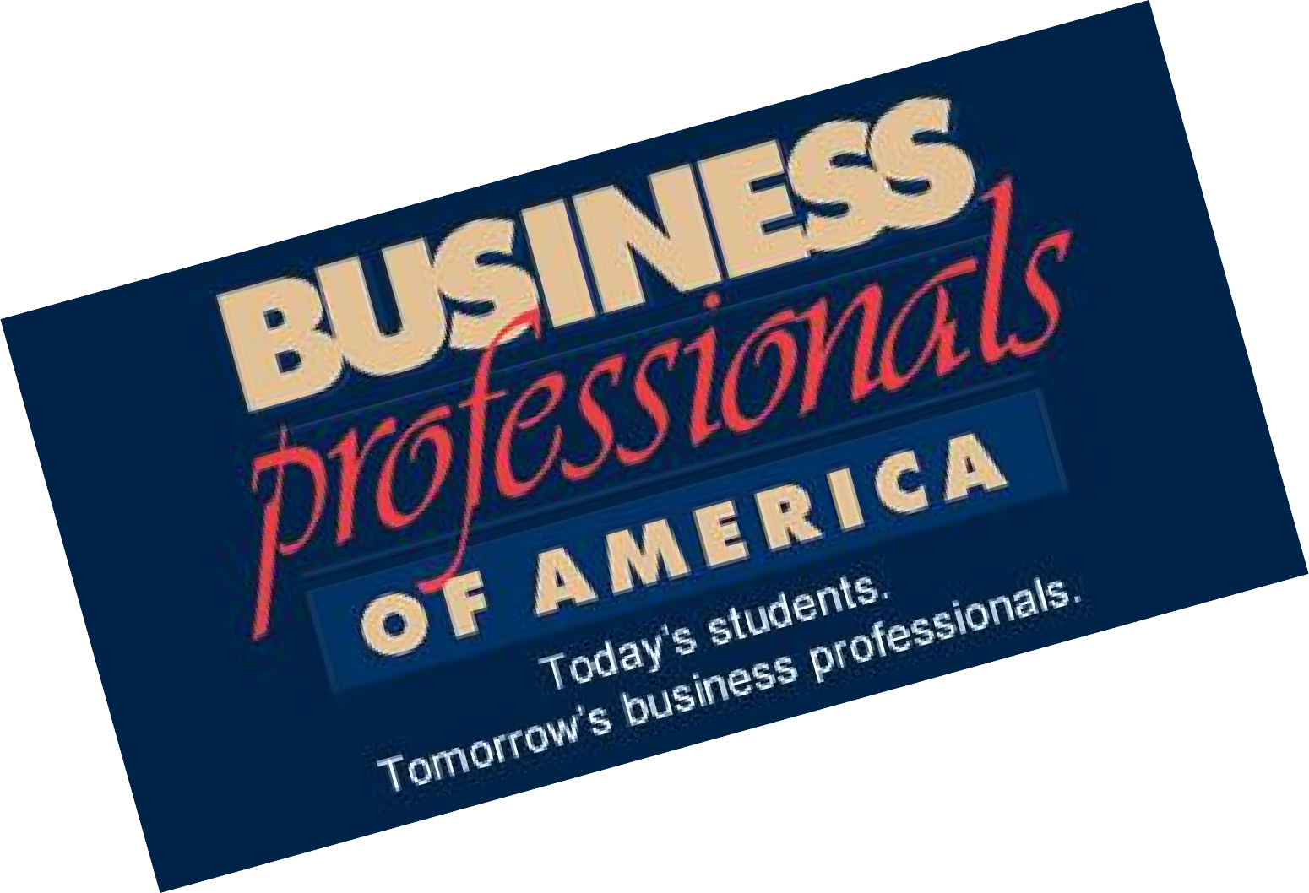

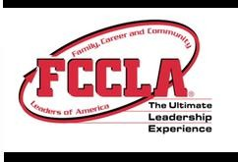



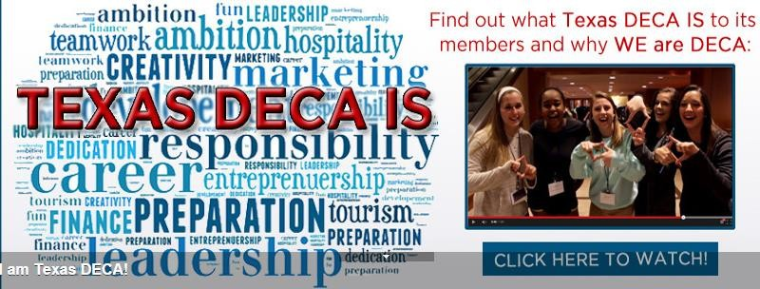

Career and Technical Student Organizations (CTSO)

Slide 20
Questions?

Slide 21
References and Resources
Images:
Career Clusters®: The Career Clusters logo and its extensions are the property of the National Career Technical Education Foundation, as managed by NASDCTEc.
Photos obtained through a license with Shutterstock.com™.
Websites:
American Association of Family and Consumer Sciences (AAFCS) - To provide leadership and support for professionals whose work assists individuals, families, and communities in making informed decisions about their well being, relationships, and resources to achieve optimal quality of life. http://www.aafcs.org
Association for Career and Technical Education (ACTE) - ACTE is the largest national association dedicated to the advancement of education that prepares students for careers. The association promotes career- focused education through publications, teacher resources, professional development activities, and public policy initiatives. http://www.acteonline.org
Domestic Estate Management Association - The benefits of professional association membership. http://www.domesticmanagers.com/the-benefits-of-professional-association-membership
Educating Today - Ten Great Reasons Why You Should Go to a Conference http://www.educatingtoday.com/10-great-reasons-why-you-should-go-to-a-conference
Reference for Business Service Industry - http://www.referenceforbusiness.com/management/Sc-Str/Service-Industry.html
USA Today - Five benefits of joining a professional organization. http://college.usatoday.com/2013/09/19/5-benefits-of-joining-a-professional-association
4C Blog - Top ten reasons to join a professional organization. http://blog.cccctech.com/top-10-reasons-to-join-a-professional-organization

Slide 22
YouTube™:
How to Make a Picture Door Organizer - This organizer is a multi-purpose tool. The students can incorporate information, key terms, sequential events, graphics and concept ideas. It has a hidden element that will make a presentation pop! https://youtu.be/weY4PtrfM3o
Professional Networking: How To Add Value to Your Connections - One-to-one networking only works when both parties benefit. Follow these tips to avoid common networking faux pas and give your contacts something they want from the relationship. https://youtu.be/6M7ahzk0dGU
Without Human Services - The Human Services Council discusses the importance of human services in New York. Edited by Ambre Auzanneau of the Human Services Council. https://youtu.be/qmlWffSoIgg

