Slide 1
Let’s Talk It Over:
Telecommunications
Hotel Management

Slide 3
What is Telecommunication?
Communication
Distance
Technology
Notes:
Telecommunication is communication at a distance by technological means or by using technology.
It is a compound of the Greek prefix tele meaning "distant" and the Latin communicare, meaning "to share".

Slide 4
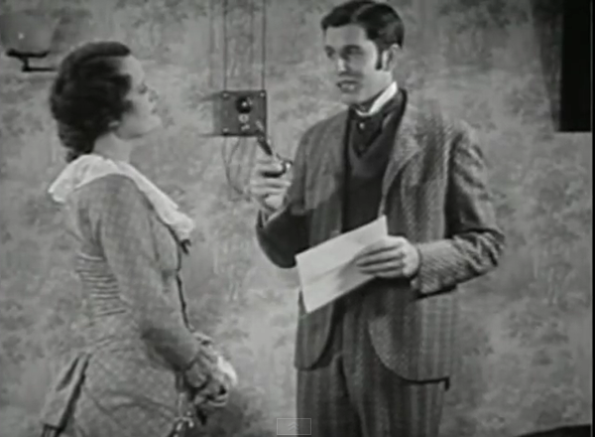
History
  Technology is relevant to the current time period
  Audio signals
  Video signals
  Visual History of Telecommunications
  (click on link)
Notes:
If technology is required, does that mean there was no telecommunications before technology came about?
NO!
Technology is relevant to the current time period. It is whatever technology is available and using it to communicate at a distance.
Early telecommunication technologies included visual signals, for example, smoke signals, signal flags and even visual signals such as those made by flashes of sunlight reflected by a mirror (generally using Morse code).
Other examples of pre-modern telecommunications include drumbeats, horns and loud whistles; usually in a certain sequence to mean different things.
Click on hyperlink to view video:
Visual History of Telecommunications
Video montage prepared to help kick-off Location 2.0 Summit 2009 at CTIA in San Diego
Telecommunications evolution from 1850s thru Oct 8, 2009
http://www.youtube.com/watch?v=aBuAujwygLw&feature=share&list=PLQRaesQXyAr2PoRZq2QQJ9AgjeTWraxAB&index=7

Slide 5
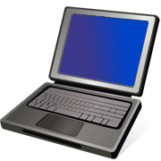
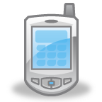
Today
  Computers
  Internet
  Radios
  Satellites
  Telephones
    Landline
    Mobile
  Televisions
Notes:
Again, technology is relevant to the current time period. Now that means today.
Computers, Internet, radios, satellites, and televisions are a few widely used and familiar devices that are used today.
The hotel industry today uses all of these daily.
Can you think of any other means of communication for a hotel?

Slide 6
Equipment Needed
  To Run the Business
    Computers
    Fax machine
    Internet
    Radios
    Telephones
    Television
  As a Service to Guests
    Computers
    Fax machines
    Internet
    Satellites
    Telephones
    Televisions
    Video
Notes:
Today’s telecommunication equipment allows the hotel industry to use these devices in two ways:
To run the hotel efficiently
To offer the devices as a service or convenience to the guests
For business:
Computers - to operate the business such as accounting, reservations
Fax machine – to receive an image of a document made by electronic scanning and transmitted as data by telecommunication links
Internet - to send emails to employees, headquarters, guests and to show website
Radios – to communicate with employees and guests
Telephone - to talk to other employees, departments and guests
Television - to give information to guests
For guests:
Computers – for guest use
Fax machines – for guest use to send and/or receive an image of a document
Internet – Wi-Fi for guests’ connection
Satellites - to offer TV stations to guests
Telephones - in rooms for communication and checkout
Video – for business conferencing

Slide 7

Understanding the Needs
  Key – matching the level of features needed for the hotel and guest to the type of phone
  Advanced features:
    Automated attendant
    Mobile soft phones
    Paging and intercom
    Presence technology
    Unified messaging
    Video conferencing
Notes:
The key to understanding the telephone requirements is to match the level of features needed to the hotel and guest that is serviced.
For example, a full-service hotel might service the business traveler and needs to provide a business center that offers video conferencing features. This type of phone would not be needed in a small town local budget hotel that services budget minded vacationing families.
Some of the more advanced features that today’s telecommunication technology offers are:
Video conferencing
Automated attendant
Mobile soft phones
Paging and intercom
Presence technology
Unified messaging

Slide 8
Computers and Internet
  Combined Technology
    Creating a shift away from traditional communication devices
  Computer
    Productivity tool made of hardware and software
  Internet
    A network of computer networks
  Network
    A series of connected computers worldwide
  World Wide Web
    Interlinked hypertext documents
Notes:
How many of you think the Internet and the World Wide Web are the same thing? Actually they are different.
Much like a computer is hardware and the operating system is the software on the computer to make it operate, in the simplest of terms, you can think of the Internet as the hardware and the web as documents on the Internet.
The Internet is actually a series of connected computer networks that link billions of devices worldwide. These devices include computers, tablets, phones, televisions and more. They are connected using an array of electronic, wireless and optical networking technologies.
The World Wide Web is a system of interlinked hypertext documents accessed through the Internet.
These technologies working together have created an evolution in communication. There has been a dramatic shift away from traditional communications since the 1990’s because of these advancements in the Internet technology and development of new software.
Traditional communication devices are slowly dying out. Now connectivity and communication over the Internet by electronic mail, instant messaging and voice over Internet Protocol (VoIP) telephone, two-way interactive video calls and the World Wide Web with its discussion forums, blogs, social networking and online shopping sites are as easy as turning on the device itself.

Slide 9
Computer Programs
  Email has replaced formal communication
    Remember to remain professional
  Property Management System (PMS)
    used to manage the operation of a hotel
    sends a reservation confirmation by email or text
Notes:
The hotel industry is no different from any other type of business in that they all rely heavily on computers, networks and connectivity to operate business.
Emails have replaced more formal letters and phone calls.
When communication is sent back and forth between hotel and guests regarding questions, complaints, lost property or any other general information, it is usually sent through email rather than letter.
It is essential that hotel employees learn to not only properly operate the equipment or computer and software, it is imperative that they understand the necessity to remain professional. Many people use email as a quick and informal way of communication and can easily forget to remain professional.
Communication through these devices has become second nature. The Property Management System is the software on the computers that is used to manage the operation of a hotel.
When a reservation is made, the front desk agent often asks if the caller (future guest) would like their confirmation sent to their email address or a text message on their smart phone. The Property Management System (PMS) in which the reservation is made can now make that communication for the hotel with a simple click of the mouse when making a reservation.

Slide 10
Radios
  Hotels often use two-way radios to communicate
  Televisions communicate hotel charges
  Used by:
    Front desk agents
    Housekeeping
    Groundskeepers
    Security
Notes:
Hotel staff also use two-way radio to quickly communicate with each other.
Front desk agents, housekeeping, groundskeepers are often walking the property and the use of two-way radio communication is a quick, efficient and very cost effective way of keeping in touch.
Example - the front desk can quickly inform housekeeping that a guest needs more towels.

Slide 11
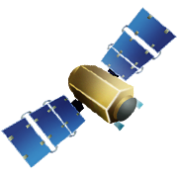

Satellites
  Located in outer space – orbiting earth
  Allow reception and transmission of communication signals
  Common use:
    Telephone
    Television
Notes:
Satellites are not often thought of by most people when they are discussing communication. They are often the backbone of how much of the communication is taking place.
Satellites are launched by companies that allow the transmission of the communication signals between devices.
Some of the most common uses are for telephones and television, both of which are used by businesses such as the hotel industry.

Slide 12
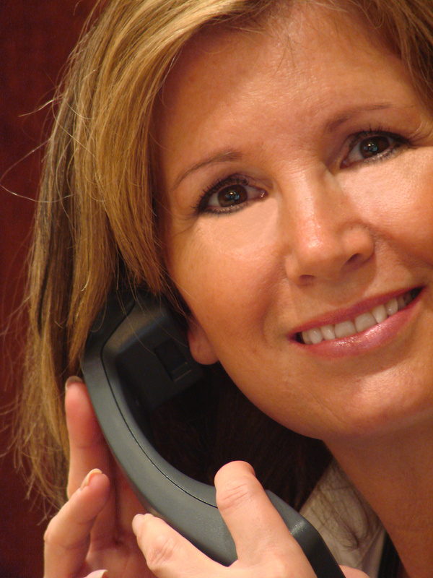

Telephones
  Three things to consider with telephone communications:
    Systems
    Types
    Techniques
Notes:
Three things to consider with telephone communications:
Telephone Systems
Telephone Types
3. Telephone Techniques

Slide 13
Telephone Systems
  Main systems:
    Plain Old Telephone Service (POTS)
    Cellular phones
    Internet Protocol phones (VoIP)
  PBX – Private Business Exchange
    Communication between people inside the business and access to external telephone lines
Notes:
Landline telephone systems are part of the Plain Old Telephone Service (POTS). This is a direct descendant of the system that Alexander Graham Bell invented using copper wiring.
The advantages of this system includes:
standardized equipment
predictable sound quality
no need to share the system’s capacity with others
Because switches are in place, creating a private circuit for each phone call, it is also called the Public Switched Telephone Network (PSTN).
Cellular phones use radio frequencies rather than copper wire.
Internet Protocol (IP), also called Voice over Internet Protocol (VoIP) piggy-backs on existing Internet connections. Almost all VOIP telephone systems offer the same telephone options as those found in traditional phone systems.
PBX or Private Business Exchange – a private telephone switch that is installed in a business location to facilitate communication between people inside the organization while also allowing access to adequate external telephone lines.
Traditional PBX systems are used with POTS, but the same benefits can be achieved by using PBX with a VoIP system (digital) (rather than POTS and analog) without the hardware and software costs associated with traditional PBX systems.
PBX through VoIP systems are basically cheaper and much easier to install. Another advantage of a VoIP PBX is the ability to transmit calls internationally over the Internet, thereby avoiding long-distance charges.
Most of the hotel industry today is using PBX with either POTS or VoIP.

Slide 14
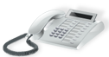
Telephone Types – for Business
  Many types and models
  Each model has different features
  Multiple models used in a hotel
  Basic common features:
    Calls placed on HOLD
    Conference calls
    Display
    Multiple lines
    Transfer calls
Notes:
There are as many telephone types and models as there are companies that make them.
Each telephone model has different features.
Most have basic common features:
Calls – each line can be placed on HOLD
Conference calls – multiple lines/people on same call
Display – shows time, date and caller information
Multiple lines – capable of multiple calls at same time
Transfer calls - capable to exchange calls from room to room, from Front Desk to a room or from outside to inside the hotel
Multiple phone models will be used in a hotel.
For example, each employee or department will have a phone that has the above features and the ability to transfer, conference and put calls on hold but the phones in each room for the guests might be “regular” phones without all of the capabilities and features of those used to run the hotel business.
Other models with a few limited features might be available to guests with upgraded rooms or in the business services lounge.

Slide 15
Telephone Techniques
  What is more important?
    What you say or how you say it?
  More Considerations:
    Background noise
    Non-verbal communication
    Service businesses expect
    Voice levels
Notes:
Now that we have the equipment covered, let’s turn our attention to the proper way to use them.
Let’s get back to the first question and consider.… “Is what you say more or less important than how you say it?”
Many people will argue one over the other, that WHAT you say is more important while others will argue the point that HOW you say something is more important.
Truth – They are BOTH important! When on a telephone, neither party has the opportunity to watch or “read” the other person.
The use of nonverbal communication, such as hand gestures and facial expression, is not an option. So, how you say something is as important as what you say.
Other distractions can also interfere such as background noise, phone line issues, a soft-spoken person versus a voice that carries, and most of all, remembering you are in a service business and your business depends on good service.
Customers expect courtesy and that begins at the front desk and on the phone.

Slide 16
Televisions
  Broadcast information
  Analog and Digital
    Analog
    Digital provides s sharper image and clearer communication
Notes:
Radios and televisions are typically used to broadcast information. The distance can be relatively short, such as a local radio or TV station, or it can be huge such as broadcasting the information by satellite.
There are two types of signals - analog and digital
Analog - of or relating to a device or process in which data is represented by physical quantities that change continuously
Digital signals provide a sharper image and a clearer communication through more efficient lines. Most televisions today receive digital signals.
Televisions are not only used for entertainment. Hotels often tie in a closed circuit station in which to communicate the charges that are connected to a particular room. A hotel guest can tune in to a predefined station and view their bill on the television. This is tied into the hotel’s computer software that tracks those charges.

Slide 17
Other Ways to Communicate
  Fax machine
  Hotel website
    Easy to navigate
    Easy to use
    Contain useful and correct information
    Remain fresh or up-to-date
Notes:
Other ways hotels can communicate with guests:
Fax machine - a short name for facsimile which is a means of sending and receiving printed materials using telephone lines traditionally but is now also utilizing the internet to transmit documents. Fax machines can be standalone machines, tied into a telephone system or even tied into printers.
Hotel website - one of the most used means of communication. The site should be easy to navigate, easy to use (such as making a reservation), contain useful and correct information and be updated to remain “fresh”.

Slide 18
Questions?

Slide 19
References & Resources
  Article:
    Telecommunications in the Hospitality Industry
    A Technology Primer developed by the American Hotel and Lodging Association’s Technology and E-Business Committee
    http://www.ahla.com/uploadedFiles/AHLA/Members_Only/_Common/technology_primers_pdf/88120NEI01ENGE.pdf
  Images:
    Microsoft Office Clip Art: Used with permission from Microsoft.
  Textbooks:
    Reynolds, J. S. and Chase, D. M. (2014) Hospitality Services. Third Edition. Tinley Park, Illinois: The Goodheart-Willcox Company, Inc.
  YouTube™:
    Visual History of Telecommunications
    Video montage prepared to help kick-off Location 2.0 Summit 2009 at CTIA in San Diego
    Telecommunications evolution from 1850s thru Oct 8, 2009
    http://www.youtube.com/watch?v=aBuAujwygLw&feature=share&list=PLQRaesQXyAr2PoRZq2QQJ9AgjeTWraxAB&index=7

