Slide 1
Leadership Today – Making the Right Decisions
Principles of Human Services
Notes:
Possible questions for discussion. You may opt to assign a scribe to write the answers on the board.
What makes a strong leader?
Can you think of anyone who has these leadership qualities? In our school? In our community?
What supporting evidence do you have to back up your opinion?

Slide 3

Making Decisions
Notes:
Think of a decision you made recently. How did you make the decision? Sometimes we make decisions with a conscious thought and sometimes not!
What are some areas in which you must make decisions?
How can even minor decisions have a lasting effect on you?
How can responsible decision-making affect your personal needs, wants, values and priorities?
How can responsible decision-making affect your role as a leader?

Slide 4

How do people make decisions?
  Decision by default
  If it feels g00d
  It’s in the stars
  Least resistance
  On hold
  On impulse
  Overwhelmed
  Planned
Notes:
Decision-making strategies are not necessarily good or bad in themselves. Different strategies are used at various times for unique situations by people. Listed on the slide are various ways in which people sometimes make decisions.
Decision by default – You let someone else decide for you. You only carry out or accept the decision.
If it feels good - You “feel” that one of the options is the best one without studying it. You base your decision on a hunch.
It’s in the stars – You let the environment (external events) decide for you. It’s left up to fate.
Least resistance – You base your choice on the option which produces the least conflict. You take the easy way out.
On hold – You postpone making a decision by refusing to think about it or by not acting. In effect, you make a decision by not deciding.
On impulse – You take the first alternative that comes along, with little thought or examination.
Overwhelmed – You get lost in all the data; you are unable to make an effective decision. You are too confused to make a deliberate decision.
Planned – You use a logical method to make a decision. You collect all of the available information and decide by weighing the facts.

Slide 5
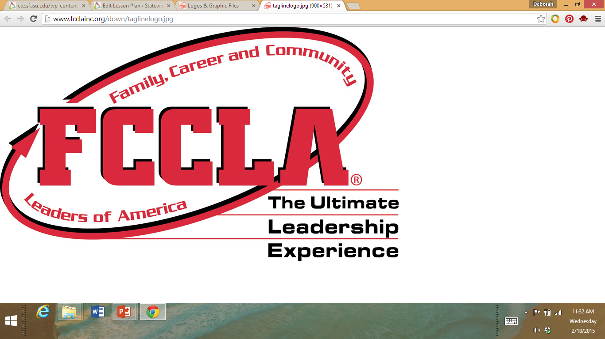
FCCLA Planning Process
  Identify concerns
  Set a goal
  Form a plan
  Act
  Follow-up
Notes:
The Planning Process is a decision-making tool that supports the organization’s overall philosophy about youth-centered leadership and personal growth. It can be used to determine group action in a chapter or class or to plan individual projects.
IDENTIFY CONCERNS
■ Brainstorm to generate ideas, or state the activity or problem you want to address if already determined.
■ Evaluate your list and narrow it down to a workable idea or project that interests and concerns the majority or all of your members.
SET A GOAL
■ Get a clear mental picture of what you want to accomplish, and write your ideas down as your goal.
■ Make sure your goal is one that can be achieved and evaluated.
■ Consider resources available to you.
FORM A PLAN
■ Decide what needs to be done to reach your goal.
■ Figure out the who, what, where, when, and how.
■ List the abilities, skills, and knowledge required on your part.
■ List other available resources, such as people, places, publications and funds.
■ Make a workable timetable to keep track of your progress.
■ List possible barriers you might face, and develop plans if necessary.
■ Decide ways to recognize your accomplishments along the way.
ACT
■ Carry out your group or individual plan.
■ Use family and community members, advisers, committees, task forces and advisory groups when needed.
FOLLOW UP
■ Determine if your goal was met.
■ List ways you would improve your project or plan for future reference.
■ Share and publicize your efforts with others, including the media if appropriate.
■ Recognize members and thank people involved with your project.
Lead a class discussion on decision-making. Point out that the process of careful decision-making is important if individual’s goals are to be reached within available resources. Explain that the decision-making process involves carefully comparing benefits and costs of alternatives before making a decision. Discuss each step and help students understand each step.
When should you implement the decision-making process?
Why are alternatives important in decision-making?
How does evaluating a decision help you make decisions in the future?
How can using the decision-making process make you a better leader?

Slide 6

What is L-E-A-D-E-R-S-H-I-P?
Notes:
As a class, brainstorm positive characteristics of effective leaders with the characteristics starting with the letters L-E-A-D-E-R-S-H-I-P. The students are to share their words with the class. Assign a scribe to write the words on the board from all the groups. Students are to write down all the positive leadership characteristics they personally possess. How can those qualities help you be an effective leader?
Do good leaders practice good decision-making skills? Why is this important?

Slide 7

How can you become a good leader?
Notes:
Why is it important to be a good leader at school? At the workplace? In the community?

Slide 8

Steps to Becoming a Good Leader
  Study the qualities of recognized good leaders
  Study yourself. Determine weak and strong characteristics
  Develop yourself as a good follower. Individuals who cannot obey cannot direct
  Study the organization of various groups
  Follow a definite plan for leadership training and improvement
Notes:
Steps to becoming a good leader include:
Study the qualities of recognized good leaders
Study yourself. Determine weak and strong characteristics
Develop yourself as a good follower. Individuals who cannot obey cannot direct
Study the organization of various groups
Follow a definite plan for leadership training and improvement
Note that the first step is to study the qualities of recognized good leaders. Can you name some leaders at our school? What characteristics make them good leaders?

Slide 9
Your Leadership Characteristics
Strong | Needs Improvement | Leadership Characteristics
 |  | Able to get along with others; I respect individuality.
 |  | Cooperative – I know how to work with others, and I enjoy it.
 |  | Courteous – I use “please” and “thank you” often.
 |  | Hardworking – I do not ask others to do something I am not willing to do.
 |  | Humility – I am confident and realize my own shortcomings.
 |  | Look at facts – I analyze the facts before making decisions.
Notes:
One of the five steps you can take to becoming a good leader is to study yourself. Determine your strong characteristics and those that need improvement can help you develop leadership characteristics.
Teacher note: Distribute the “Your Leadership Characteristics” (see All Lesson Attachments tab) handout. Read the handout along with the students by clarifying each statement. Students will rate themselves on each characteristic by placing a check mark in the appropriate box.

Slide 10
Your Leadership Characteristics
Strong | Needs Improvement | Leadership Characteristics
 |  | Neat – I remain neat in dress and personal appearance.
 |  | Poised – I do not let things irate me.
 |  | Responsible – I keep my word and complete assigned duties.
 |  | Set goals – I set realistic and challenging goals.
 |  | Speaking clearly – I express myself effectively.
Notes:
For the characteristics you feel are strong, write a few sentences stating why you think you are strong in those areas. For the characteristics you feel you need to improve, write a sentence or two explaining ways you think you can improve those areas. By evaluating yourself honestly, you are on your way to becoming a good leader.
Teacher note: Allow the students time to evaluate their leadership characteristics. You may opt to have the students present a “one-minute” speech about their leadership characteristics to the class.

Slide 11

Top Five Characteristics: Leadership
(click on picture)
Notes:
Top Five Characteristics: Leadership
Professor Samuel Bacharach discusses the five leadership traits leaders need to see their agendas through to fruition and make a lasting impact in their organization.
http://youtu.be/EMgElizP_Q0

Slide 12
Leadership Styles
Authoritarian
Democratic
Laissez-faire
Notes:
We will discuss the following leadership styles:
Authoritarian
Democratic
Laissez-faire
Using only the titles, brainstorm to determine what leadership characteristics might be appropriately included in each style.

Slide 13

Authoritarian
  Characteristics:
    Group does not experience feeling of teamwork
    Limits discussion on ideas and new ways of doing things
    Tells others what to do
Notes:
Authoritarian style includes:
Characteristics:
Causes unhappy relationships to develop
Demands group members perform tasks quickly and efficiently
Dictates group activity
Does not accept the ideas of others
Group does not experience feeling of teamwork
Is firm, demanding and direct
Limits discussion on ideas and new ways of doing things
Tells others what to do
Uses power to influence others to carry out ideas
Authoritarian leadership can be effective when:
Group does not know each other
Individuals/group lack skill and knowledge
Time is limited
Authoritarian leadership can be ineffective when:
Developing a strong sense of team is the goal
Group wants an element of spontaneity in their work
Some degree of skill/knowledge is in members

Slide 14

Democratic
  Characteristics:
    Asks before telling
    Involves group members in planning and carrying out activities
    Promotes a sense of teamwork
Notes:
Democratic style includes:
Characteristics:
Allows free flow of ideas
Allows group members to feel they can do tasks their own way
Asks before telling
Involves group members in planning and carrying out activities
Is friendly and sociable
Keeps group focused
Makes decisions and determinations based upon group’s consensus
Motivates group members
Promotes a sense of teamwork
Shapes groups with regard to consensus opinion
Democratic leadership can be effective when:
Group is motivated and/or a sense of team exists
Some degree of skill or knowledge among members of group
Time is available
Democratic leadership can be ineffective when:
Group is unmotivated
High degree of conflict present
No skill/knowledge is in members

Slide 15

Laissez-faire
  Characteristics:
    Individual does not seem to be in charge
    Provides little or no direction to group/individuals
    Opinion is offered only when requested
Notes:
Laissez-faire style includes:
Characteristics:
Allows group members to do whatever they want
A person does not seem in charge
Does not direct group activity
Gives little or no direction to group/individuals
Is less structured than democratic
Opinion is offered only when requested
Produces groups that are not very productive
Stays on the same level as the group
Laissez-faire leadership can be effective when:
High degree of skill and motivation
Routine is familiar to participants
Sense of team exists
Laissez-faire leadership can be ineffective when:
Group expects to be told what to do
Low degree of skill/knowledge is in members
Low sense of team/independence

Slide 16
Leadership Styles
Authoritarian
Democratic
Laissez-faire
Notes:
Lead a discussion with the students to identify and define their own leadership styles. Discuss which styles might be applicable during class group work, class meetings, working on a Career and Technical Student Organization (CTSO) competition and committee meetings (especially when planning special school functions).
Have you ever been part of a team which included an authoritarian leader? Describe your experience.
Have you ever been part of a team which included a democratic leader? Describe your experience.
Have you ever been part of a team which included a Laissez-faire leader? Describe your experience.
Which leadership style might be preferred and why? What type of leader might be preferred at a workplace?

Slide 17
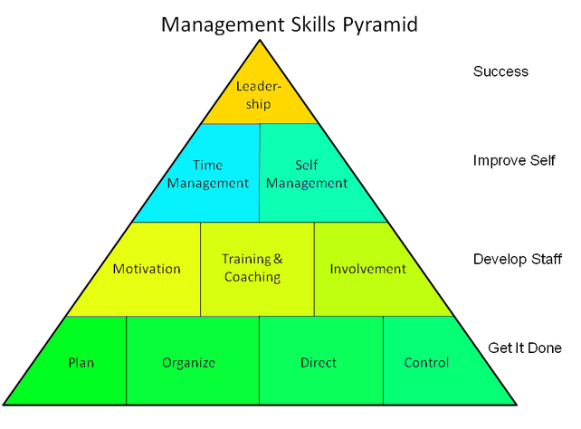
Personal Management Skills
Source: http://samingersoll.com/
Notes:
Individuals should effectively use personal management skills at the workplace such as:
determine the responsibilities of each group member; ask for preferences of the duties keeping in mind age, skills and strength. Some responsibilities can be completed individually or as a team. A rotation system can also be developed.
identify all work to be done and list how often the job needs to be done and the time it will take to complete the task
set a standard of completion
set up a specific schedule and place it on a poster, calendar, chart or notebook within everyone’s view
practice good time management
What skill is at the top of the pyramid? What is the significance of it being there?
Sam Ingersoll
Management Skills
http://samingersoll.com/management-skills/

Slide 18

Leadership (Soft Skills)
(click on picture)
Notes:
Soft Skills-Leadership and Management
It's one thing to know the ins and outs of your industry and profession. But you can't be an effective leader and drive change in your field without soft skills. This episode of ASQ TV describes what soft skills are and how mastering them will help you succeed.
http://youtu.be/qALa8sjvCTc

Slide 19
Review
  List and explain the five steps in the FCCLA Planning Process.
  What are four leadership characteristics?
  How are leadership skills and decision-making skills similar?
  List two characteristics of a democratic leader.
  What are values?

Slide 20

Questions?

Slide 21
References and Resources
  Images:
    Family, Career, Community Leaders of America (FCCLA). (Slide 5)
    Microsoft Clip Art: Used with permission from Microsoft™. (Slide 8)
    Photos obtained through a license with Shutterstock.com™. (Slides 3, 4, 6, 7, 11, 13, 14, 15, 18 and 20)
    Photo obtained from http://samingersoll.com/. (Slide 17)
  Textbook:
    Ryder, Verdene, and Marjorie Harter B. Contemporary living. Tinley Park, IL: Goodheart-Willcox, 2010.
  Websites:
    Leadership Qualities and Why They are Important
    Games and activities to reinforce leadership skills.
    www.learningforlife.org/exploring/resources/99-720/x09.pdf
    Mind Tools
    Leadership Styles – Choosing the Right Approach for the Situation
    http://www.mindtools.com/pages/article/newLDR_84.htm

Slide 22
References and Resources
  Websites:
    Sam Ingersoll
    Management Skills
    http://samingersoll.com/management-skills/
    Schlag's Lagg
    Leadership activities and group games listings.
    http://schlags.com/paul/leadership/listing1zx4ja8ch8.php
  YouTube™:
    Soft Skills-Leadership and Management
    It’s one thing to know the ins and outs of your industry and profession. But you can’t be an effective leader and drive change in your field without soft skills. This episode of ASQ TV describes what soft skills are and how mastering them will help you succeed.
    http://youtu.be/qALa8sjvCTc
    Top Five Characteristics: Leadership
    Professor Samuel Bacharach discusses the five leadership traits leaders need to see their agendas through to fruition and make a lasting impact in their organization. http://youtu.be/EMgElizP_Q0

