Slide 1
Laws, Regulations And Taxes That Impact Consumers
  Dollars and sense

Slide 3
Define laws, regulations and taxes.
Notes:
Define the terms, laws, regulations and taxes as they pertain to government actions. Explain what government entities—federal, state and local—are responsible for enacting these measures. How do these measures affect you as a consumer?

Slide 4

Federal Taxes
  Corporate
  Business Taxes
  Excise Taxes
  Import Taxes
  Medicare
  Personal Income
  Social Security
  Unemployment Insurance
Notes:
What is an excise tax? Excise taxes are taxes paid when purchases are made on a specific good, such as gasoline, tobacco or gambling—rather than general tax bases such as income or consumption. Excise taxes are often included in the final price of products and services and are often hidden to consumers. Overall excise taxes account for less than 10 percent of all federal receipts. All 50 states and many local municipalities levy excise taxes of various kinds. What are some additional excise taxes paid by the consumer? Possible answers can include airline taxes, diesel fuel taxes, customs and duties.
The Federal Insurance Contributions Act (FICA) tax includes two separate taxes. It is also known as Payroll Tax or Self-Employment Tax, depending on your employment status. It is your contribution to Social Security and Medicare as a percentage of your salary. Different rates apply for each of these taxes. The current tax rate for social security is 6.2% for the employer and 6.2% for the employee, or 12.4% total. The current rate for Medicare is 1.45% for the employer and 1.45% for the employee, or 2.9% total. In 2013, people with high salaries began paying an additional Medicare tax of 0.9%. Unlike the rest of Medicare, this tax depends on your filing status. If you are employed, do you know how much you pay to Social Security and Medicare?
Teacher note: You may ask the students how much they earn and help them figure out their payroll tax. Click on the picture and enter their amount or a fictitious amount to determine how much is paid in social security tax and Medicare tax.
The top 20 percent of households pay 94 percent of income taxes. How would you feel if you were in the top 20 percent?
Source: Tax Foundation.org
Social Security and Medicare Contributions
The Federal Insurance Contributions Act (FICA) is your contribution to Social Security and Medicare. It is a percentage of your salary.
http://www.moneychimp.com/features/fica.htm

Slide 5
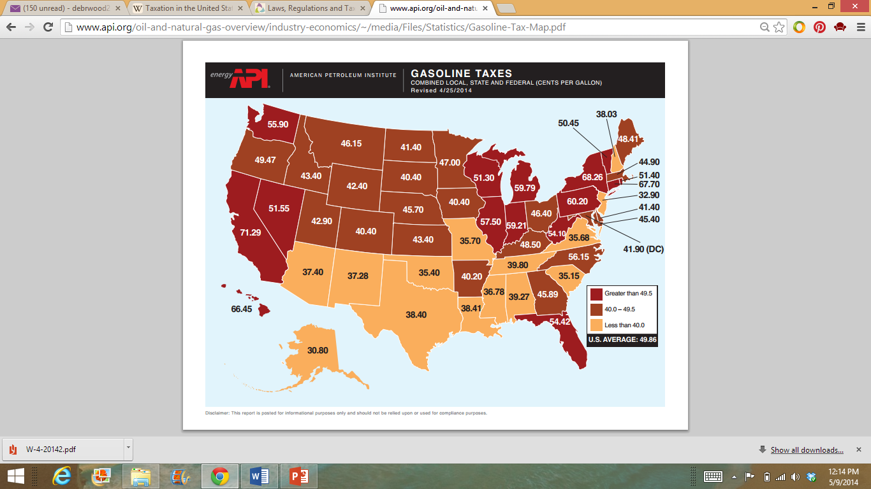
Gasoline Excise Tax
Notes:
Teacher note: Click on the interactive map to share the information with the students.
Did you know that every time you put a gallon of gas in your vehicle, you are automatically paying nearly 18.4 cents of federal excise tax? In Texas, there is an additional 0.20 cents a gallon for gasoline. So for each gallon of gas, you are paying 0.38 cents in taxes alone!
What state has the lowest gasoline excise tax?
What state has the highest gasoline excise tax?
What is the average?
American Petroleum Institute
Gasoline Excise Taxes in the United States.
http://www.api.org/oil-and-natural-gas-overview/industry-economics/fuel-taxes/gasoline-tax

Slide 6



State and Local Taxes
  State taxes include:
    Business licenses and permits
    Corporate
    Estate and gift
    Excise taxes
    Motor vehicle licenses
    Personal income
    Personal property
    Real property
    Sales taxes
    Unemployment insurance
  Local taxes include:
    Business licenses and permits
    Mobile home taxes
    Motor vehicle stickers
    Personal licenses (marriage)
    Personal property
    Real property
    Sales taxes
Notes:
How does revenue from taxes benefit individuals and families?
Could these services be provided without state or local involvement?
What would life be like without each of these services depicted on slides four and six?
What is the sales tax for Texas? Answer: 8.15%

Slide 7
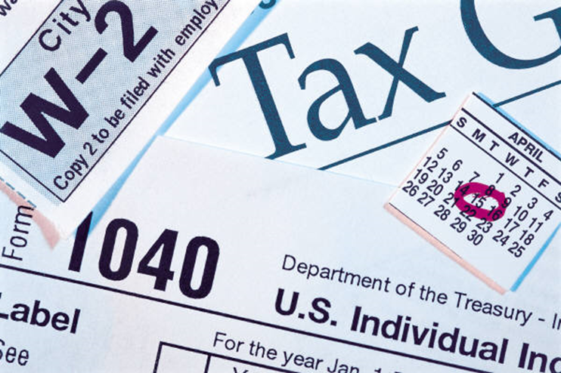
How Are Taxes Spent?

Slide 8

How Taxes Are Spent
  Federal Level
    Agriculture and Medical Research
    Courts
    Educational Services
    Federal Government
    Federal Prisons
    Highways
    National Defense Program
    National Parks
    Public Health and Public Assistance Services
Notes:
What would happen at the federal level if there was not enough revenue to pay for these services?

Slide 9
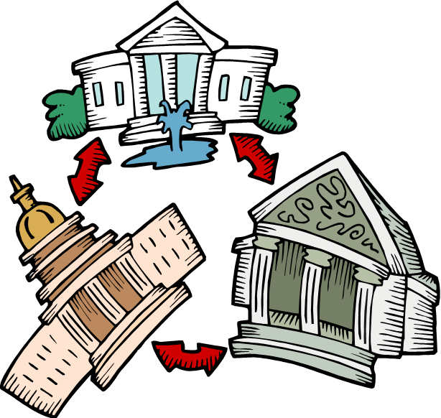
How Taxes Are Spent
Notes:
Teacher note: Enter a few pieces of information, and the Taxpayer Receipt gives you a breakdown of how your tax dollars are spent on priorities like education, veteran’s benefits or health care. Enter $2,880 for Social Security tax, $1,700 for Medicare tax and $8,500 for Income tax and view the results. You may ask the students for additional fictitious amounts and discuss the results.
The White House
Your 2013 Federal Taxpayer Receipt
http://www.whitehouse.gov/2013-taxreceipt

Slide 10

How Taxes Are Spent
  State Level
    Courts
    Education
    Highways
    Hospitals
    Public Assistance
    Recreation and Parks
    Special Schools
    State Government
    State Prisons
    Welfare Service
Notes:
How often do you or your family use these services at the state level?
Why are state colleges less expensive than private colleges?

Slide 11

How Taxes Are Spent
  Local Level
    Courts
    Libraries
    Local Government
    Parks and Swimming Pools
    Prisons
    Police and Fire Protection
    Schools and Community Colleges
    Streets and Sidewalks
    Water and Sewer Systems
Notes:
How often do you or your family use these local services?
How are taxes collected at the local level to pay for these services?

Slide 12

Additional Taxes
  Accounts Receivable
  Building Permits
  Capital Gains
  CDL Licenses
  Dog Licenses
  Fishing Licenses
  Food Licenses
  Marriage Licenses
Notes:
There are currently many federal taxes. Recent health care changes have resulted in over 20 additional federal taxes. There are many types of taxes that take many different forms depending on where you live. There are excise taxes, fees, tariffs, direct taxes, indirect taxes, federal taxes and state taxes. Here is a list of taxes most of us pay for in one way or another. This, however, is not a complete list because, as previously mentioned, it depends on where you live.
How Many Taxes Are There?
A list of taxes most of us pay for in one way or another.
http://www.weatherimagery.com/blog/how-many-taxes-are-there/

Slide 13


Types of Taxes
  Progressive
  Proportional
  Regressive
  Direct
  Indirect
Notes:
Taxes may be classified in two ways – grouped according to tax rate or according to how they are paid. Taxes grouped by tax rate may be proportional, progressive or regressive; payment methods include direct or indirect. Taxes can be distinguished by the effect they have on the distribution of income and wealth. Few true regressive taxes exist today, but taxes such as sales tax (which may also be classified as proportional), are regressive in nature when the impact on total income is considered.
Taxes can be either direct or indirect. A direct tax is one that the taxpayer pays directly to the government. These taxes cannot be shifted to others. A homeowner pays personal property taxes directly to the government. A family pays its own federal income taxes.
An indirect tax can be passed on to another person or group. A business may recover the cost of the taxes it pays by charging higher prices to customers. A tax shift occurs when the business shifts its taxes to others.
Quiz the students on their understanding of a direct and indirect test. Click on the picture. You may opt to cover activities 1-4 along with the assessment.
What is Taxed and Why?
Direct and Indirect Taxes
http://apps.irs.gov/app/understandingTaxes/student/whys_thm04_les04.jsp

Slide 14

What laws and regulations protect you as a consumer?
Notes:
Ask the students and proceed with a discussion.

Slide 15

Governmental Protection For The Consumer
  Consumer Credit Protection Act
  Equal Credit Opportunity Act
  Fair Credit Reporting Act
  Fair Debt Collection Practices Act
  The Truth In Lending Act
Notes:
There are many laws and regulations that protect you as a consumer. We are going to learn about a few right now. You will be researching additional laws and regulations impacting consumers during Independent Practice and presenting the information to the class.
Consumer Credit Protection Act protects employees from discharge by their employers because their wages have been garnished for any one debt and limits the amount of an employee's earnings that may be garnished in any one week.
The Equal Credit Opportunity Act prohibits creditors from discriminating against credit applicants on the basis of race, color, religion, national origin, sex, marital status, age, because an applicant receives income from a public assistance program, or because an applicant has in good faith exercised any right under the Consumer Credit Protection Act.
Fair Credit Reporting Act is a United States federal law that regulates the collection, dissemination and use of consumer information, including consumer credit information.
The Federal Trade Commission (FTC), the nation’s consumer protection agency, enforces the Fair Debt Collection Practices Act (FDCPA), which prohibits debt collectors from using abusive, unfair or deceptive practices to collect from you.
The Truth in Lending Act (TILA) protects you against inaccurate and unfair credit billing and credit card practices. It requires lenders to provide you with loan cost information so that you can comparison shop for certain types of loans. For loans covered under TILA, you have a right of rescission, which allows you three days to reconsider your decision and back out of the loan process without losing any money. This right helps protect you against high-pressure sales tactics used by unscrupulous lenders.
Why are these laws and regulations important to you as a consumer?
Federal Trade Commission
Are you behind on your bills? Have you been receiving calls from a debt collector? A debt collector is someone, other than the creditor, who regularly collects debts owed to someone else.
http://youtu.be/dQzIc56gydM

Slide 16
Federal Agencies Serving Consumers
  Consumer and Governmental Affairs Bureau
  Consumer Financial Protection Bureau
  Consumer Product Safety Commission
  Environmental Protection Agency
  Federal Trade Commission
  Food and Drug Administration
  National Service Center for Environmental Publications
  Office of Consumer Affairs and Dispute Resolution
Notes:
As citizens, we are provided services by local, state and national government agencies. Many federal agencies have enforcement and/or complaint-handling duties for products and services used by the general public. Others act for the benefit of the public but do not resolve individual consumer problems. Agencies also create printed publications and websites that may be helpful when making purchase decisions or dealing with consumer problems. I have listed just a few of the federal agencies serving consumers on this slide.
What are some additional examples of local, state and national government agencies that provide services affecting the consumer?
What types of services are offered by each agency?
How can individuals and families benefit from government services?
What are examples of services that are provided free to the public?
What are examples of services for which consumers must pay?
Which services do you and your family use frequently?

Slide 17


Better Business Bureau (BBB)
  Better Business Bureaus offer a variety of consumer services, including consumer education materials and business reports.
Notes:
Better Business Bureaus (BBBs) are nonprofit organizations that encourage honest advertising and selling practices and are supported primarily by local businesses. They offer a variety of consumer services, including consumer education materials; business reports, particularly unanswered or unsettled complaints or other problems; mediation and arbitration services; and information about charities and other organizations that are seeking public donations. They also provide ratings (A, B, C, D, or F) of local companies to express the BBB's confidence that the company operates in a trustworthy manner and demonstrates a willingness to resolve customer concerns.
What services are provided by the Better Business Bureau (BBB)?
Who supports the Better Business Bureau?
What fraudulent practices can be prevented or remedied by the BBB?
What are some common consumer problems and complaints registered with the BBB?
How do people access information from the BBB?
How do people register a complaint with the BBB?
Have you or someone you know used the services provided by the BBB? If so, what were the results?
Teacher note: Click on the picture to locate the nearest BBB in your community.
Better Business Bureau
Directory of offices in Texas.
http://www.usa.gov/directory/bbb/texas.shtml

Slide 18
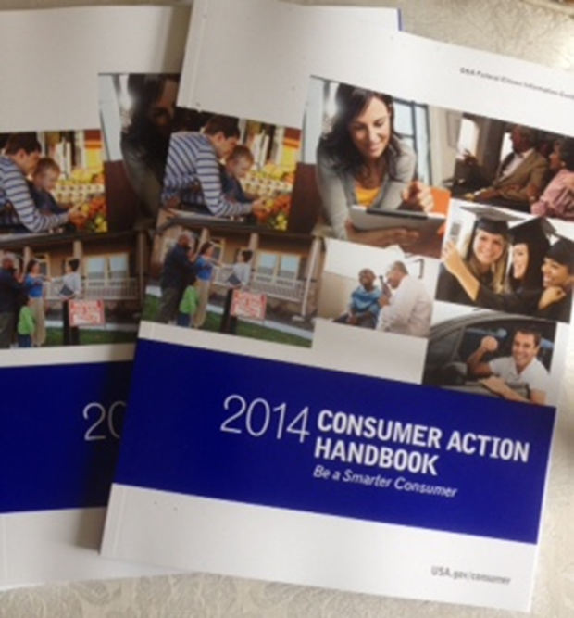
Consumer Action Handbook
Notes:
Use the Consumer Action Handbook (CAH) to get help with consumer purchases, problems and complaints. Find consumer contacts for hundreds of companies and trade associations, local, state and federal government agencies, national consumer organizations and more. You may download a free copy or order a free copy at http://publications.usa.gov/USAPubs.php

Slide 19

Questions?

Slide 20
References And Resources
  Images:
    Microsoft Clip Art: Used with permission from Microsoft.
  Textbook:
    Lowe, Ross. Consumer education and economics. 6th ed. Glencoe/McGraw Hill, 2006. Print.
  Websites:
    American Petroleum Institute
    Gasoline Excise Taxes in the United States.
    http://www.api.org/oil-and-natural-gas-overview/industry-economics/fuel-taxes/gasoline-tax
    Better Business Bureau
    Directory of offices in Texas.
    http://www.usa.gov/directory/bbb/texas.shtm
    Consumer Financial Protection Bureau
    Information, laws and regulations pertaining to mortgages.
    http://www.consumerfinance.gov/

Slide 21
References And Resources
    Federal Reserve Consumer Help
    Have a complaint about your bank?
    http://www.federalreserveconsumerhelp.gov/about/ConsumerHelponline.pdf
    How Many Taxes Are There?
    A list of taxes most of us pay for in one way or another.
    http://www.weatherimagery.com/blog/how-many-taxes-are-there/
    Internal Revenue Service
    Understanding Taxes – Teacher Site
    http://apps.irs.gov/app/understandingTaxes/teacher/index.jsp
    Social Security and Medicare Contributions
    The Federal Insurance Contributions Act (FICA) is your contribution to Social Security and Medicare. It is a percentage of your salary.
    http://www.moneychimp.com/features/fica.htm
    The White House
    Your 2013 Federal Taxpayer Receipt
    http://www.whitehouse.gov/2013-taxreceipt

Slide 22
References And Resources
    What is Taxed and Why?
    Direct and Indirect Taxes
    http://apps.irs.gov/app/understandingTaxes/student/whys_thm04_les04.jsp
    USA.GOV
    Order a FREE copy of the Consumer Action Handbook to get the latest tips on credit, money, filing a complaint, and more!
    http://www.usa.gov/topics/consumer.shtml
  YouTube™:
    Federal Trade Commission
    Are you are behind on your bills? Have you been receiving calls from a debt collector? A debt collector is someone, other than the creditor, who regularly collects debts owed to someone else.
    http://youtu.be/dQzIc56gydM

