Slide 1
Iron Chef Classroom Challenge

Slide 3
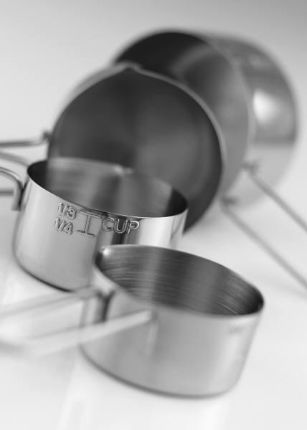
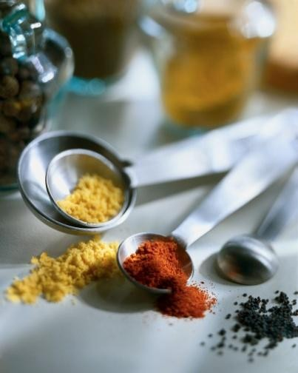
Background
Based upon the Japanese cult sensation, Iron Chef America carries on the legend of Kitchen Stadium and the famed "secret ingredient."
Notes:
Get a sneak peek of the backstage action at the Iron Chef America cook-off.

Slide 4
Rules
Lab groups may choose their own partners
Limited to 4 or 5 team members
Appropriate chef uniform should be worn
Arrive on time to start promptly
All food safety rules must be followed:
    Washing hands, clean counters and equipment, clean apron, hair pulled back, and so forth
    Secret ingredient must be incorporated into the recipe
    Food items entered must be made from scratch and all prep done in the lab
    Food entries must be ready in minutes to allow for judging time
Notes:
Note to Teacher: Decide before class how you will conduct this competition. You may allow your students to make only one item with the secret ingredients such as an appetizer, salad, an entrée, a dessert, or a combination of two, three, or all four. Keep in mind budget and time. For this lab, you may choose your own partners and exhibit teamwork, productive work habits, communication skills, and culinary techniques. Remember to bring your chef uniform and arrive on time to begin work immediately.
Reminder: Since we will be serving food to the judges to taste, all food safety rules must be followed. The secret ingredient must be used in the recipe and all recipes are to be made from scratch with all prep work done in the lab. Food entries should be ready to judge in ____ minutes. (Choose a time that will fit into the class schedule – one recipe that is simple may only take 15 to 20 minutes, while more recipes with more ingredients and steps will take longer.)

Slide 5
Judging
Food entries will be judged on:
    Appearance
    Taste
    Degree of difficulty
    Use of secret ingredient
Judging rulings are final
Winners will be awarded an Iron Chef Classroom Award of Excellence Certificate
Good Luck!
Notes:
Judges will be teachers, staff, administrators, community people, local chefs, and local chef instructors from community colleges, anyone that would like to see the student’s talents in the kitchen. This will also provide good public relations for your courses as they will be able to see the skills students have learned.

Slide 6
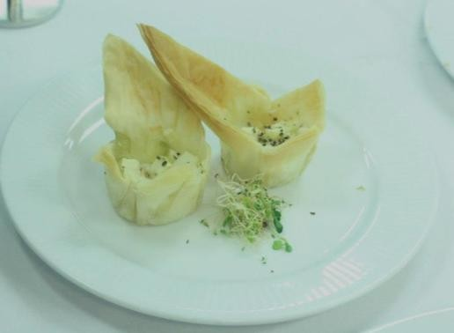
Recipes
All recipes are to be made from scratch
Recipes should be pre-approved from teacher
Secret ingredient should be incorporated
Recipes should yield at least six servings
Plating of food items will also be judged
Notes:
All recipes are to be made from scratch and will be prepared during class following all food safety rules. No prepared mixes. Secret ingredient should be incorporated. Recipes should yield at least six servings. A small portion will be given to the judges to taste and group may also sample the food. (Provide take home boxes for judges to take remaining portion) Ingredients for recipe will only be provided once for the actual competition. Students may choose to practice their recipe at home with their ingredients. Decide on a secret ingredient before class begins. Refer to slide 11 for ideas. Choose an ingredient that is in season as they are more flavorful, abundant, and lower in price or a canned item. All groups in the class should have the same secret ingredient to see who incorporated the item the best. Different classes may have different secret ingredients. For plating, only plates available in lab may be used but students may bring other plating from home if so desired.

Slide 7
Time
One class period to introduce challenge and discussion
Two class periods to choose a team and recipe
One class period to prep ingredients
One class period to prepare recipe(s) and judge
One class period to evaluate and award certificates
Notes:
Depending on your schedule, adjust time as needed.
Remind students of time constraints so that they do not waste class time. Working together as a
team and dividing tasks will assist them in preparing the recipe(s) on time.

Slide 8
Recipe Cost Analysis
Ingredients | Amount needed | Purchase Price and Size | Unit Price
Flour | 2 ½ cups | $2.29/5 lb. | $.57
Sugar | 1 ½ cups | $2.64/4 lbs. | $.50
Eggs | 2 | $1.58/12 | $.26
Notes:
Discuss the importance of the Recipe Cost Analysis and assist the students as they figure the
unit price of the ingredients they used for their recipe. Use copies of receipts from previous
labs so students can analyze their recipe cost. Prices will vary. Students should figure the total
cost to the recipe and the individual serving.

Slide 9
Recipe Nutritional Analysis
Ingredient and Amount Needed | Serving Size | Servings Used in Recipe | Calories | Calories from Fat | TOTAL FAT % DAILY VALUE | SATURATED FAT % DAILY VALUE
Flour 2 ½ cups | ¼ cup | 10 | 100x10 1,000 | 0 | 0% | 0%
Sugar 1 ½ cups | 1 tsp. | 72 | 15x72 1080 | 0 | 0% | 0%
Eggs 2 | 1 | 2 | 70x2 140 | 45x2 90 | 7% | 8%
Notes:
Use the Nutrition Facts from all the ingredients used in your recipe and the measurement
equivalents on the Standards of Measurement handout. Be sure to multiply amounts by the
amount used in the recipe. Depending on brand used, numbers will vary.

Slide 10
Secret Ingredient Ideas
Be creative!
Chocolate
Fruits (apples, bananas, oranges)
Grains (cereal, oatmeal, pasta)
Meats (beef, fish, poultry)
Vegetables (carrots, potatoes, zucchini)
Various nuts (be wary of allergies)
Notes:
Brainstorm with your students about possible ingredients that would be incorporated into the
recipe (keep in mind budget) or make the decision yourself. Give students a small idea, and
they will expand on it.

Slide 11
References/Resources
Images:
Hollenstein Career and Technology Center Eagle Mountain - Saginaw ISD
Fort Worth, TX
Microsoft Office Clip Art: Used with permission from Microsoft.
Textbook:
(2010). Culinary essentials. Woodland Hills, Illinois: Glenco, McGraw-Hill.

