Slide 1
Helping Clients: Treatment Options for Drug Dependency
Counseling and Mental Health

Slide 3

Anyone Can Become Addicted to Drugs
(click on picture)
Notes:
Anyone Can Become Addicted to Drugs
You might think that only some types of people can get addicted to drugs. The truth is, it can happen to anyone, whether you're young or old, rich or poor, male or female. This video from National Institute on Drug Abuse (NIDA) explains addiction in simple terms and offers a hotline to help you or a loved one find treatment.
http://youtu.be/SY2luGTX7Dk

Slide 4
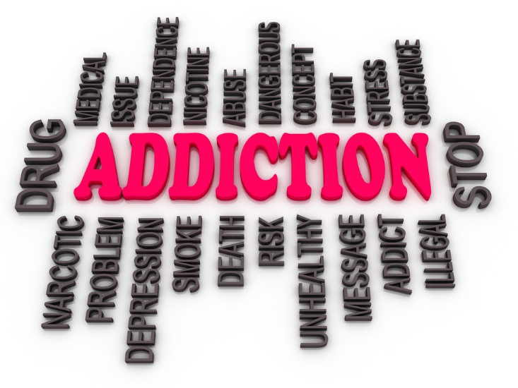
Predisposing Factors for Drug Abuse
  Predisposing factors can include:
    “addictive” personality
    emotional problems
    healthcare workers
    family history of substance abuse
    history of childhood physical or sexual abuse
    ineffective coping mechanisms
Notes:
Predisposing factors can include:
“addictive” personality
emotional problems
healthcare workers (high risk due to availability of drugs)
highest addiction rate—anesthesiologists
family history of substance abuse
history of childhood physical or sexual abuse
ineffective coping mechanisms

Slide 5
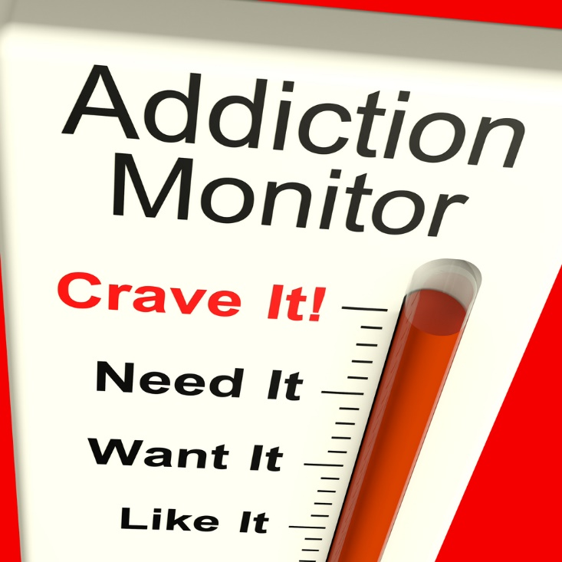
Substance Dependence
  What is dependence?
Notes:
Substance Dependence
Dependence is the state of being addicted to alcohol or a drug.
Dependence can occur if:
individual’s symptoms have persisted for at least one month
individual must manifest three of the following symptoms:
a pattern of persistent desire
great deal of time is spent in activities necessary to obtain the substance, use the substance or recover from its effects
important social, occupational or recreational activities are given up or reduced because of substance use
substance is taken in larger amounts or over a longer period than was intended
substance use is continued despite knowledge that it is a problem
tolerance
need for markedly increased amounts of substance to achieve desired effect
markedly diminished effect with continued use of same amount of substance
withdrawal

Slide 6
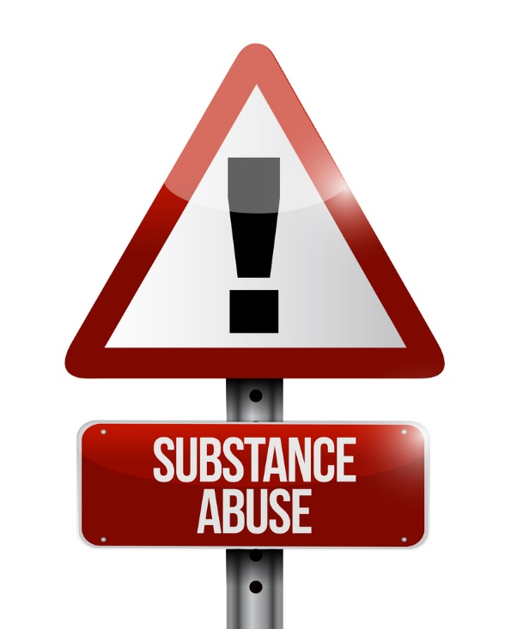
Substance Abuse Categories
  Alcohol
  Cannabis
  Cocaine
  Hallucinogen
  Heroin
  Meth
  Nicotine
  Painkillers
Notes:
What are some facts/information you may already know about drug abuse?

Slide 7

Alcohol Abuse
Notes:
Alcohol abuse
Can lead to the inability to function at work or with friends/family
Person may be unable to cut down or stop drinking
Person may need the use of alcohol to function
What are some symptoms of intoxication?
Treatment for alcoholism can include:
alcoholics anonymous
detoxification
inpatient rehabilitation treatment program
What does detoxification mean? It is a medical treatment of an alcoholic or drug addict involving abstention from drink or drugs until the bloodstream is free of toxins.
What are the dangers of binge drinking?

Slide 8
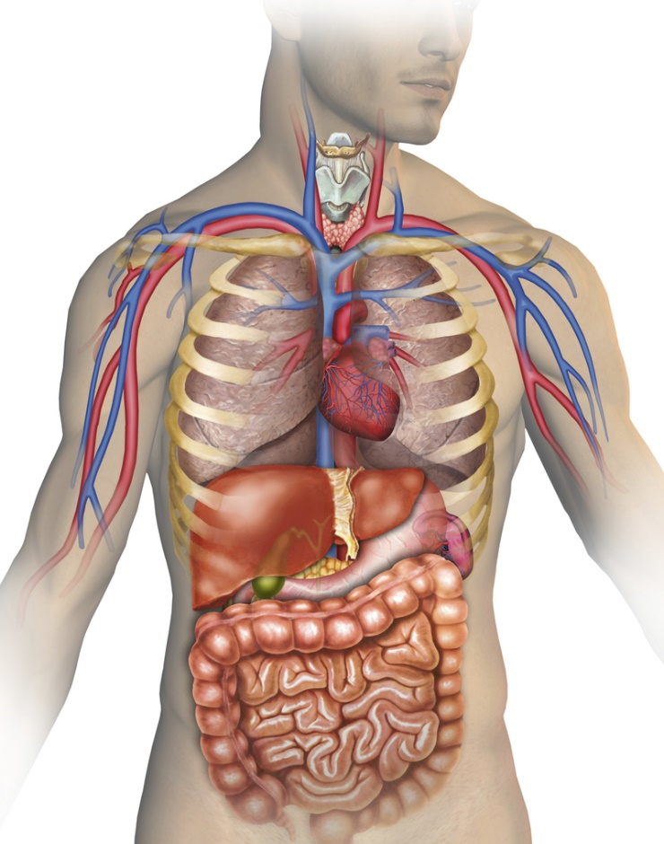
Alcohol Consequences of Drinking
Mouth and throat
Brain
Heart
Liver
Blood vessels
Notes:
Consequences of drinking can include:
Blood vessels - Alcohol causes the capillaries in the skin to enlarge and give off excessive heat. This is a false sense of warmth because the body is actually losing heat and the body temperature is decreasing.
Brain - Alcohol acts as a sedative and depresses nerve activity in the brain. Alcohol can affect a person’s inhibitions, attention, memory, motor actions and emotional behavior.
Heart - Long term drinking can lead to damage of heart muscles.
Liver - The liver has difficulty breaking down fat when alcohol is present in the body. When fat and protein collect in the liver, the liver has a hard time working properly. The cells die and scar tissue grows in the place of the cells. This condition is called cirrhosis of the liver and can eventually lead to liver failure.
Mouth and throat - Drinking a lot can harm the lining of the mouth and throat. This can increase your chances of cancer especially if you also smoke.

Slide 9

Cannabis - Marijuana Abuse
Notes:
Cannabis-marijuana abuse
It causes euphoria
Most commonly used substance
It was prescribed for a variety of ailments during the 19th century
Intoxication symptoms can include:
apathy
dry mouth
increased appetite
red eyes
slowed time
What are some street names for marijuana?

Slide 10
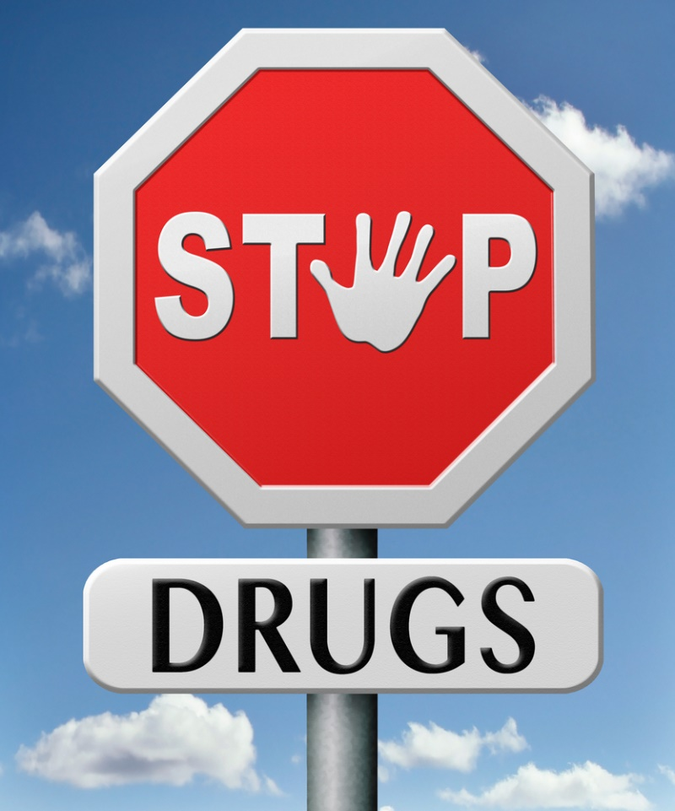
Marijuana Use and Educational Outcomes
Notes:
Review and discuss the contents of the infographic.
Marijuana Use and Educational Outcomes
Students who use marijuana regularly tend to get lower grades and are more likely to drop out of high school than those who don't use. See the latest statistics and effects of marijuana on the teen brain.
http://www.drugabuse.gov/related-topics/trends-statistics/infographics/marijuana-use-educational-outcomes

Slide 11

Cocaine Abuse
Notes:
Cocaine abuse is a problem of almost epidemic proportions in our society today. It is derived from leaves of coca plant which is indigenous to Bolivia and Peru. The most commonly abused form of cocaine is crack.
Intoxication symptoms can include:
excitement
euphoria
grinding or clenching teeth
paranoia
restlessness
toxic psychosis with visual, auditory and tactile hallucinations

Slide 12

Hallucinogen Abuse
Notes:
Hallucinogen abuse is not categorized by intoxication or withdrawal but instead by their ability to alter mental status.
Can include:
LSD (d-lysergic acid diethylamide) is one of the most potent mood-changing chemicals.
Peyote is a small, spineless cactus in which the principal active ingredient is mescaline. (Teacher note: It is pictured on the slide)
PCP (phencyclidine) was developed in the 1950s as an intravenous anesthetic.
Psilocybin (4-phosphoryloxy-N,N-dimethyltryptamine) is obtained from certain types of mushrooms that are indigenous to tropical and subtropical regions of South America, Mexico and the United States.
Episodes of hallucinogenic flashbacks can occur at unpredictable times for years following termination of the drug. According to the National Institute on Drug Abuse, the effects of hallucinogens are highly variable and unreliable, producing different effects in different people at different times. This is mainly due to the significant variations in amount and composition of active compounds, particularly in the hallucinogens derived from plants and mushrooms. Because of their unpredictable nature, the use of hallucinogens can be particularly dangerous.

Slide 13

Heroin Abuse
Notes:
According to the National Institute on Drug Abuse, heroin is a white or brown powder or a black, sticky goo.
Heroin causes a rush of good feelings just after it's taken. But some people vomit or itch after taking it. For the next several hours you want to sleep, and your heart rate and breathing slow down. Then the drug wears off and you may feel a strong urge to take more.

Slide 14
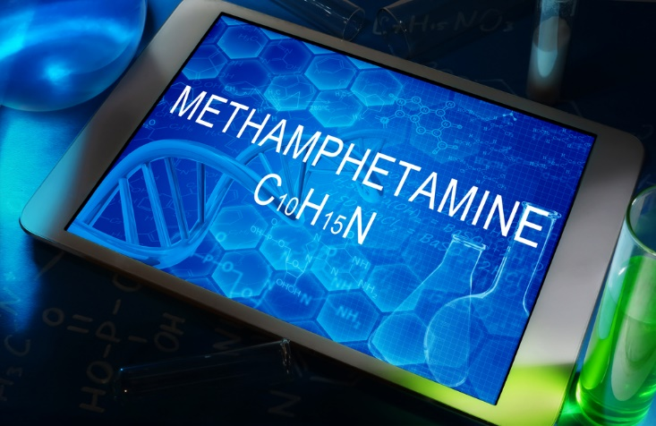
Methamphetamine Abuse
Notes:
According to the National Institute on Drug Abuse, methamphetamine—meth for short—is a white, bitter powder. Sometimes it's made into a white pill or a clear or white shiny rock (called a crystal).
Meth at first causes a rush of good feelings, but then users feel edgy, overly excited, angry or afraid. Their thoughts and actions go really fast. They might feel too hot.

Slide 15
Nicotine Abuse
Notes:
Nicotine Abuse
Affects your heart, lungs and blood vessels
In pregnant women, carbon monoxide and nicotine can reduce the flow of blood and oxygen to the unborn baby
Smoking can cause many different types of cancer
Smoking contributes to crib death, low birth weight babies
Withdrawal from nicotine might result in drowsiness and lethargy
Why should young people avoid using tobacco including cigarettes, cigars, pipe tobacco, snuff and chewing tobacco?
What are the dangers of secondhand smoke?

Slide 16
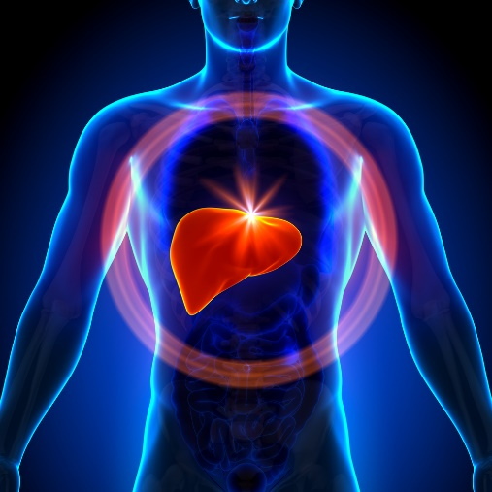
How Smoking Affects Your Health
Larynx
Bronchi and lungs
Heart
Pancreas, kidneys and bladder
Blood vessels
Notes:
The effects of smoking may include:
Blood vessels - Nicotine causes blood vessels to become smaller and as a result raises blood pressure. The heart has to work harder to pump blood through the passages.
Bronchi and lungs - Chronic cough caused by mucus build up in the bronchial tubes. The hair like cilia that cleans the lungs are damaged. Lung cancer and emphysema may develop.
Heart - Nicotine increases blood pressure and causes your heart to beat faster. Carbon monoxide produced by the smoke reduces the supply of oxygen. This increases your chances of heart disease.
Larynx – Smoking can cause cancer of the throat.
Pancreas, kidneys and bladder - If a person smokes tobacco, cancer is more likely to occur in these organs.

Slide 17
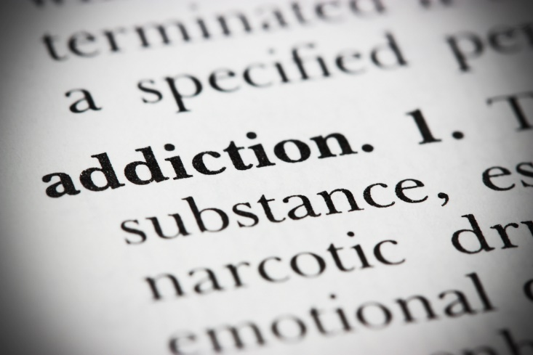
Painkillers Abuse
Notes:
According to the National Institute on Drug Abuse, painkillers relieve pain from surgery or injuries. You need prescription to buy some strong kinds of painkillers. Prescription painkillers are legal and helpful to use when a doctor orders them to treat your medical problem.
But people sometimes take these painkillers without a doctor's prescription to get high or to try to treat themselves or their friends. Drug dealers sell these pills just like they sell heroin or cocaine. Some people borrow or steal these pills from other people.
Why have prescription drugs become the most widely abused category of drugs in the U.S.?

Slide 18

Abuse of Prescription Pain Medications
(click on picture)
Notes:
According to the National Institute on Drug Abuse, this graphic highlights the unexpected association of prescription pain reliever abuse and heroin, to generate more public discussion of prescription drug abuse. The Infographic takes the reader through the possible transition of experimenting with non-medical prescription pain relievers through serious heroin-related health consequences, highlighting the close link between prescription drug abuse and more traditional, and perhaps better understood, drugs of abuse.
Are you surprised to learn about the link between prescription drug abuse and heroin use?
National Institute on Drug Abuse
Abuse of Prescription Pain Medications: Risks Heroin Use
http://www.drugabuse.gov/related-topics/trends-statistics/infographics/abuse-prescription-pain-medications-risks-heroin-use

Slide 19

The Faces of Drug Addiction
(click on picture)
Notes:
The Faces of Drug Addiction
No one is immune to the evils of drug addiction, whether it's a friend, a family member, or a neighbor. In this story we introduce you to two young men who you would never think would be recovering drug addicts, and it all started with the over-the-counter pain killers.
http://youtu.be/QR0rneaFego

Slide 20
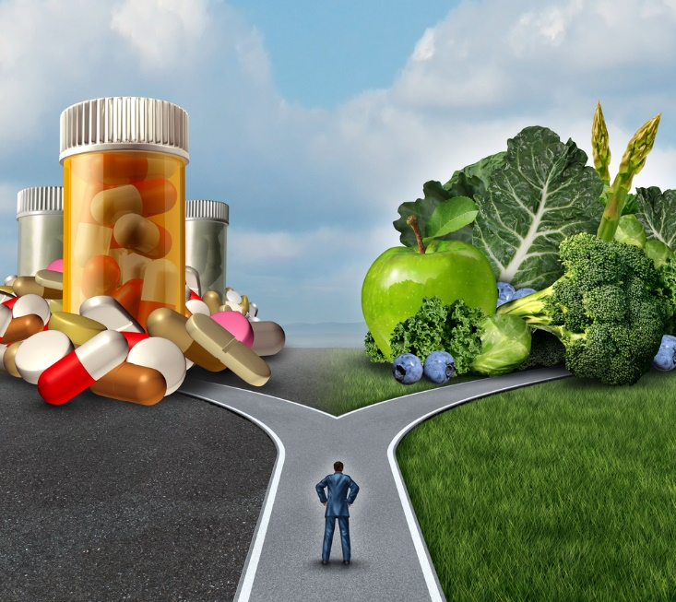
Treatment Options for Drug Dependency
  Treatment options can include:
    Behavioral
    Medications
    Treatment in a criminal justice setting
Notes:
According to the National Institute on Drug Abuse, treatment helps people stop using the drugs they're addicted to. Medication and behavioral therapy, especially when combined, are important elements of an overall therapeutic process that often begins with detoxification, followed by treatment and relapse prevention. It helps them learn to fight the urges to use drugs again, and it helps them regain control in their lives.
Behavioral treatments help patients engage in the treatment process, modify their attitudes and behaviors related to drug abuse, and increase healthy life skills. These treatments can also enhance the effectiveness of medications and help people stay in treatment longer.
Outpatient behavioral treatment encompasses a wide variety of programs for patients who visit a clinic at regular intervals. Most of the programs involve individual or group drug counseling.
Residential treatment programs can also be very effective, especially for those with more severe problems. For example, therapeutic communities (TCs) are highly structured programs in which patients remain at a residence, typically for six to twelve months.
Medications can be used to help with different aspects of the treatment process. Medications offer help in suppressing withdrawal symptoms during detoxification. Medications can also be used to help reestablish normal brain function and to prevent relapse and diminish cravings.
Treatment in a criminal justice setting can succeed in preventing an offender's return to criminal behavior, particularly when treatment continues as the person transitions back into the community.
Drug abuse can mess up every part of a person's life. So treatment needs to work with all areas of your life—your relationships, your work, the way you have fun and how you deal with problems.
Treatment can help people who are just starting to get addicted.
You don't have to be at "rock bottom" for treatment to work.
When someone quits taking drugs and starts learning how to live life without drugs, we say they are "in recovery.“
For additional information, you may opt to visit:
DrugFacts: Treatment Approaches for Drug Addiction
http://www.drugabuse.gov/publications/drugfacts/treatment-approaches-drug-addiction

Slide 21
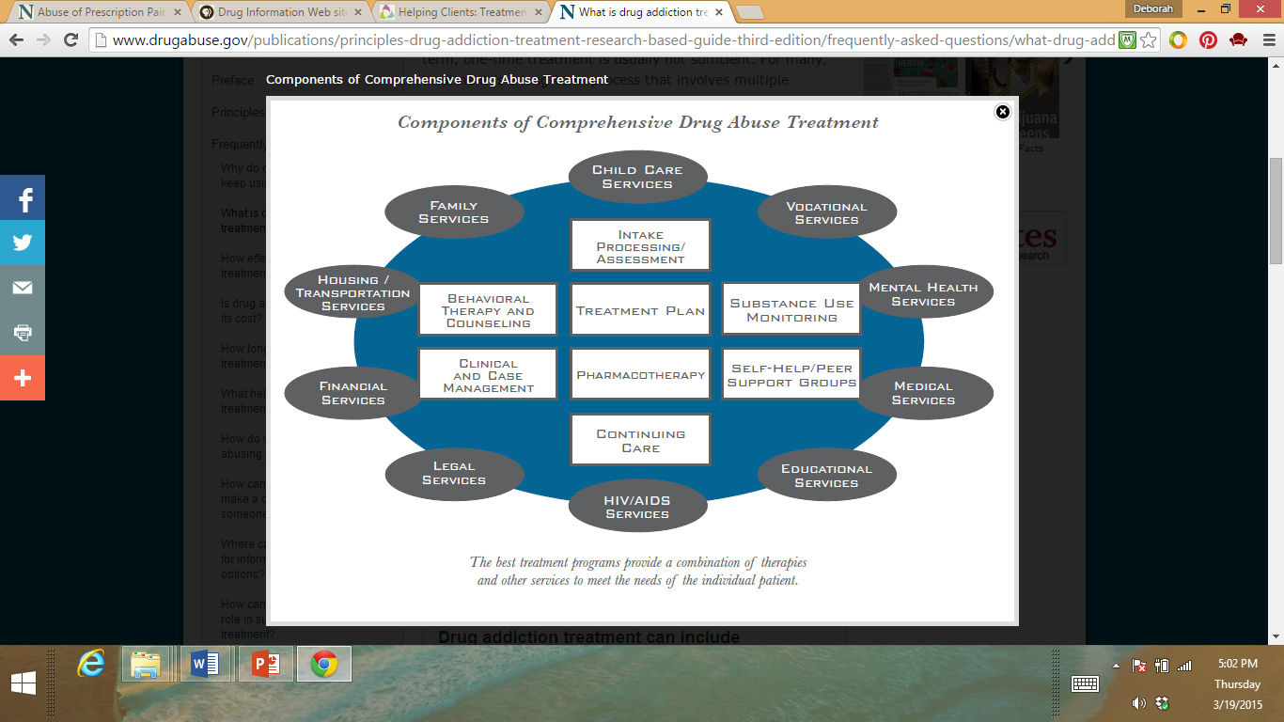
Components of Comprehensive Drug Abuse Treatment
Source: Principles of Drug Addiction Treatment: A Research-Based Guide (Third Edition)
Notes:
A comprehensive drug abuse treatment can include:
Child care services
Educational services
Family services
Financial services
HIV/AIDS services
Housing/transportation services
Legal services
Medical services
Mental health services
Vocational services
As you can see inside the blue circle, drug abuse treatment encompasses many components.
National Institute on Drug Abuse
Components of Comprehensive Drug Abuse Treatment
http://www.drugabuse.gov/publications/principles-drug-addiction-treatment-research-based-guide-third-edition/frequently-asked-questions/what-drug-addiction-treatment

Slide 22
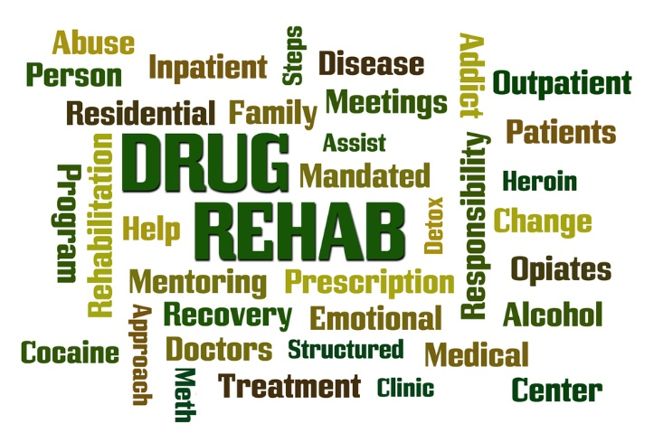
Drug Rehabilitation Center
(click on picture)
Notes:
Best Drug Rehabilitation Center | Find the Best Drug Rehabilitation Center Today
This video includes information about the predominate theory of addiction along with the three phases of addiction. For drug and alcohol addiction treatment, it's important to find a recovery program that fits.
https://youtu.be/1GCex5ReG58

Slide 23

Treatment Centers
(click on picture)
Notes:
To find a treatment in or near your community, enter your zip code.
How many treatment centers are in or near our community?
Substance Abuse and Medical Health Services Administration (SAMHSA)
Behavioral Health Treatment Services Locator
https://findtreatment.samhsa.gov/

Slide 24

What careers in counseling and mental health are related to drug dependency?
Notes:
In our lesson today, what careers in counseling and mental health are related to working with clients with dependency problems? Encourage students to share and discuss what they know about careers in counseling and mental health.
Some careers can include:
addiction counselor
addiction nurses
clinical psychologist
counseling psychologist
criminal psychologist
detoxification specialist
mental health and substance abuse social worker
pediatric nurse
psychiatric nurse
psychiatrist
substance abuse researcher
By a show of hands, how many of you would be interested in pursuing a career related to the field of substance abuse and dependency? Why or why not?
Teacher note: You may opt to have the students research careers in the field of substance abuse and dependency. (See Enrichment activity in the lesson)

Slide 25
Review
  What are three predisposing factors for drug abuse?
  What is substance abuse?
  Compare and contrast alcohol and drug abuse.
  What advice would you give someone with an abuse problem?
  Describe the components of a comprehensive drug abuse treatment program.

Slide 26

Questions?

Slide 27
References and Resources
  Images:
    National Institute on Drug Abuse (Slide 21)
    Photos obtained through a license with Shutterstock.com™. (Slides 1, 3, 4, 5, 6, 7, 8, 9, 10, 11, 12, 13, 14, 15, 16, 17, 18, 19, 20, 22, 23 and 24)
  Textbook:
    Barry, Patricia D., Mental health and mental illness. Seventh Edition, Lippincott, 2002. Print.
  Websites:
    National Institute on Drug Abuse
    NIDA for Teens, The Science Behind Drug Abuse. Facts on how different drugs affect the
    brain and body.
    http://teens.drugabuse.gov/facts/index.php

Slide 28
References and Resources
  Websites:
    Substance Abuse and Mental Health Administration
    Prevention of Substance Abuse and Mental Illness. Creating communities where
    individuals, families, schools, faith based organizations and workplaces take action to
    promote emotional health and reduce the likelihood of mental illness, substance abuse
    including tobacco and suicide.
    www.samhsa.gov
  YouTube™:
    Anyone Can Become Addicted to Drugs
    You might think that only some types of people can get addicted to drugs. The truth is, it can happen to anyone, whether you’re young or old, rich or poor, male or female. This video from NIDA explains addiction in simple terms and offers a hotline to help you or a loved one find treatment.
    http://youtu.be/SY2luGTX7Dk

Slide 29
References and Resources
  YouTube™:
    Best Drug Rehabilitation Center | Find the Best Drug Rehabilitation Center Today
  This video includes information about the predominate theory of addiction along with
  the three phases of addiction. For drug and alcohol addiction treatment, it’s important to
  find a recovery program that fits.
  https://youtu.be/1GCex5ReG58
    The Faces of Drug Addiction
    No one is immune to the evils of drug addiction, whether it’s a friend, a family member, or
    a neighbor. In this story we introduce you to two young men who you would never think
    would be recovering drug addicts, and it all started with the over-the-counter pain killers.
  http://youtu.be/QR0rneaFego

