Slide 1
Health and Wellness Throughout the Lifespan
Counseling and Mental Health

Slide 3







Human Development – Infancy to Geriatrics

Slide 4
Erik Erikson’s Stages of Psychosocial Development
Early infancy
Later
adulthood
Later infancy
Middle adulthood
Early childhood
Early adulthood
Later childhood
Puberty and adolescence

Slide 5

Early Infancy

Slide 6

Later Infancy

Slide 7

Early Childhood

Slide 8

Later Childhood

Slide 9

Puberty and Adolescence

Slide 10

Early Adulthood

Slide 11

Middle Adulthood

Slide 12

Late Adulthood

Slide 13

Geriatrics
Medical conditions the aged may encounter are:
Arthritis
Cancer
Diabetes
Heart disease
Sinusitis
Uncontrolled hypertension

Slide 14

Health and Wellness for Early Infancy through Early Childhood
It is the parents’ responsibility to ensure a healthy environment for a child. The wellness of the child will reflect the growth and development of the child.

Slide 15
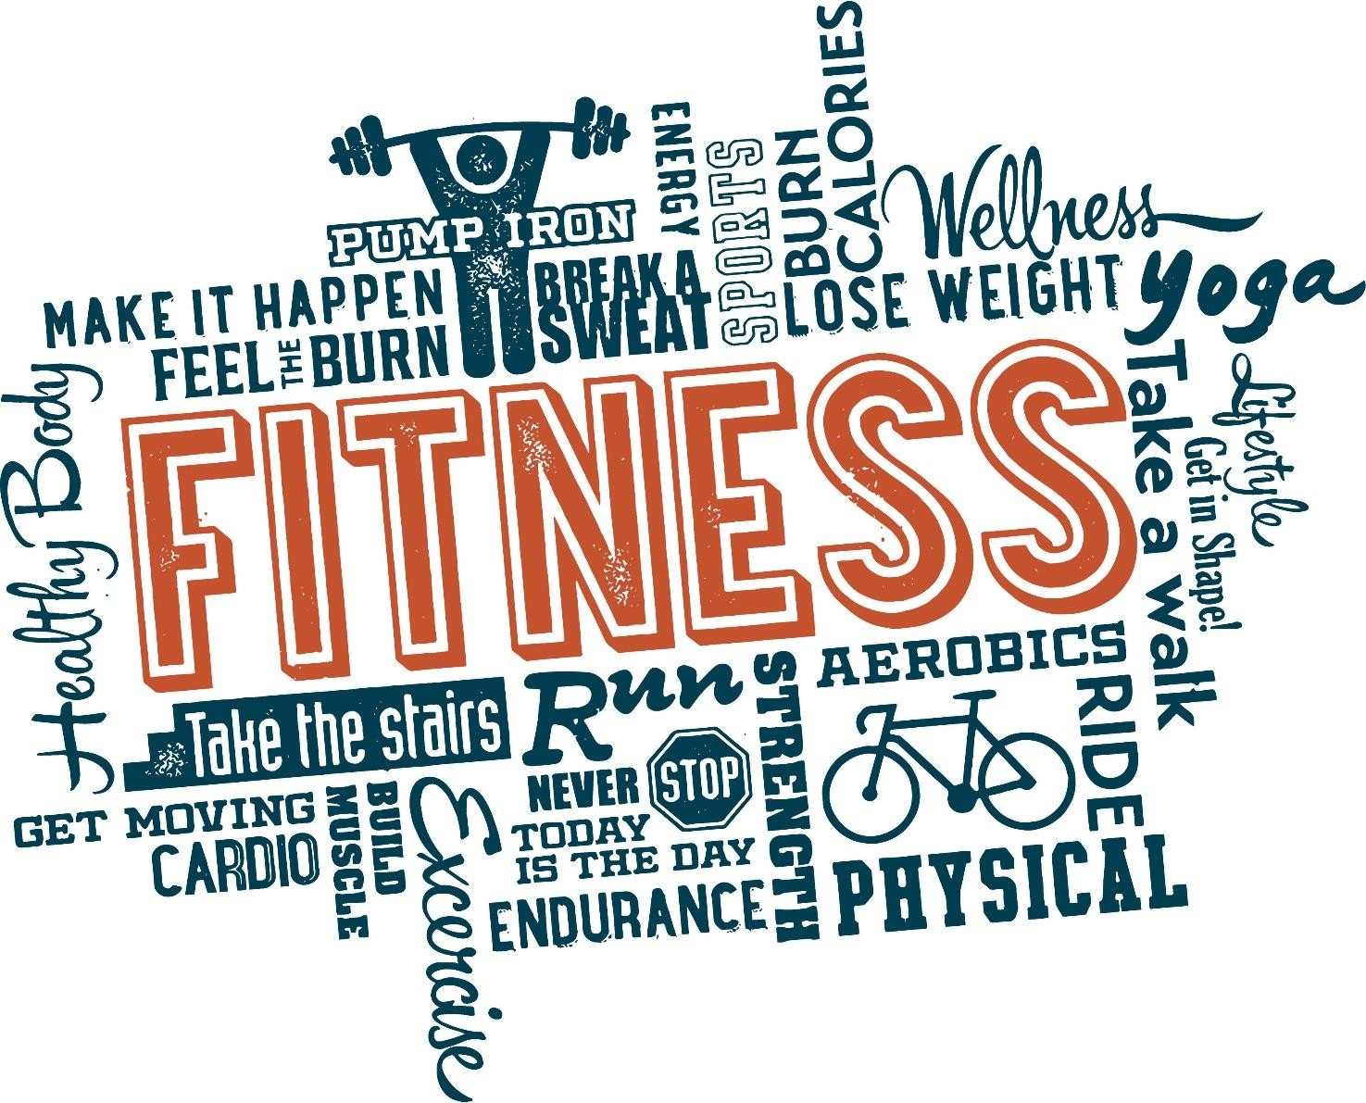
Health and Wellness for Later Childhood
Nutrition and exercise are important for children to continue to grow and develop properly.

Slide 16
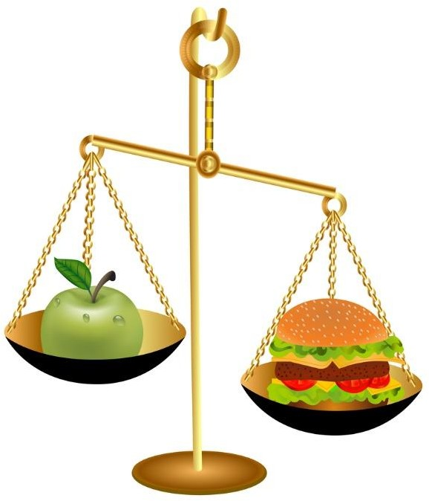
Health and Wellness for Puberty and Adolescence
Refer to ChooseMyPlate.gov for recommendations.
Adolescent individuals should:
Avoid oversized portions
Make half of a plate filled with fruits and vegetables
Drink plenty of water
Exercise

Slide 17

Health and Wellness for Early Adulthood
Avoid drugs and alcohol
Participate in physical activity on a daily basis
Eat balanced meals

Slide 18

Health and Wellness for Middle Adulthood
The USDA Food Patterns suggest that people over 50 years old keep an eye on calories while choosing a variety of healthy foods from the five major food groups and limiting solid fats and added sugars.

Slide 19
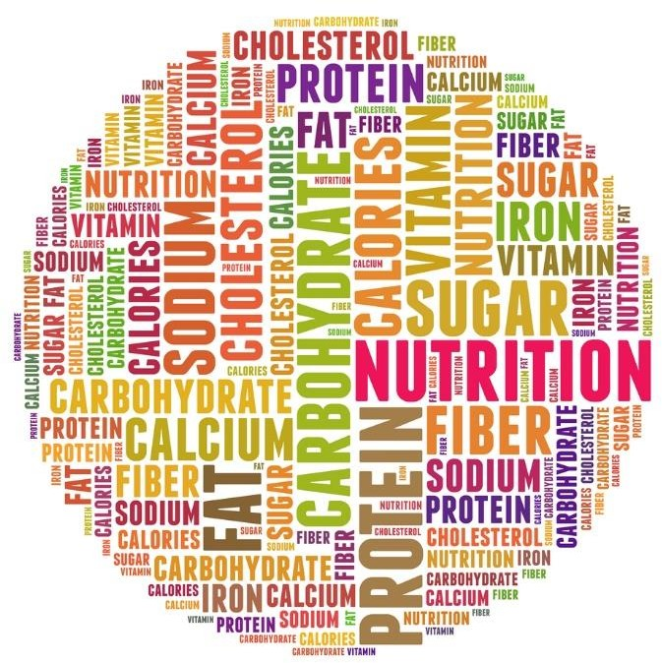
Health and Wellness for Later Adulthood
Most nutritionists recommend a well-balanced, low-fat diet for older adults and at least 30 minutes of physical activity.

Slide 20

Senior Health

Slide 21

Psychological Effects of Aging
The physical and mental health of the aged is a growing concern to the medical community.

Slide 22

What is stress?

Slide 23



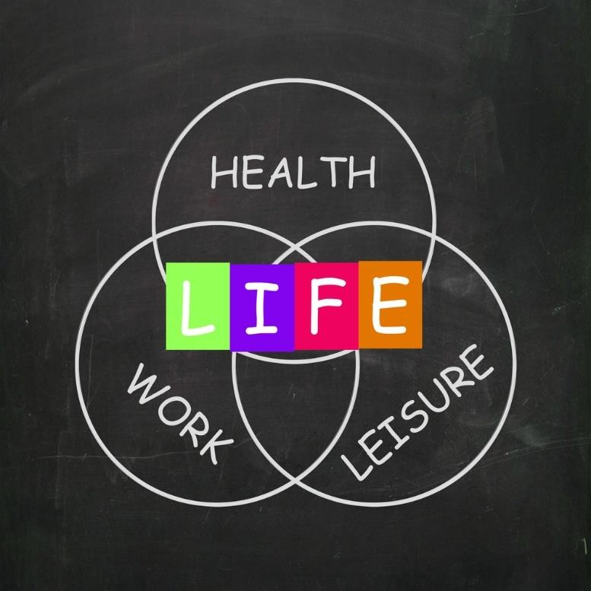
Stress Management Techniques

Slide 24
Review
How would you explain Erik Erikson’s concept of personalities on psychosocial development?
How would you compare and contrast early childhood and later childhood psychosocial development?
How would you compare and contrast early adulthood and later adulthood psychosocial development?
What are five health and wellness tips for individuals over the age of 50?
What approach would you use to reduce the level of stress in older adults?

Slide 25


Slide 26
References and Resources
Images:
Photos obtained through a license with Shutterstock.com™.
Textbook:
Ryder, Verdene, and Marjorie Harter B. Contemporary living. Tinley Park, IL: Goodheart-Willcox, 2010. Print.
Websites:
Adolescent Development
University of Maryland Medical Center. Information on adolescent development. http://www.umm.edu/ency/article/002003.htm
Centers for Disease Control and Prevention
Easy-to-read schedules for all ages to print, tools to download and ways to prepare for your office visit. http://www.cdc.gov/vaccines
ChooseMyPlate.gov
ChooseMyPlate.gov provides practical information to individuals, health professionals, nutrition educators and the food industry to help consumers build healthier diets with resources and tools for dietary assessment, nutrition education, and other user- friendly nutrition information. http://www.choosemyplate.gov/index.html
HealthyPeople.gov
Healthy People provides science-based, 10-year national objectives for improving the health of all Americans. http://www.healthypeople.gov/2020/leading-health-indicators/2020-lhi-topics/Mental-Health/data
Helpguide.org
Stress symptoms, signs and causes. http://www.helpguide.org/articles/stress/stress-symptoms-causes-and-effects.htm

Slide 27
References and Resources
Infants and Toddlers
Source: Centers for Disease Control and Prevention
Parent information regarding milestones and schedules in children. http://www.cdc.gov/parents/infants
National Institute on Aging (NIH)
The nation’s research activities dedicated to understanding the nature of aging, supporting the health and well-being of older adults, and extending healthy, active years of life for more people. http://www.nia.nih.gov
U.S. Department of Commerce Economics and Statistics Administration U.S. Census Bureau http://www.census.gov/prod/2014pubs/p25-1140.pdf
YouTube™:
NIH Senior Health
Seniors can find answers to their medical questions from the comfort of their own homes. http://nihseniorhealth.gov/videolist.html
Nutrition for the Middle Aged Adult Learn how to make healthy food choices. https://youtu.be/FXf-rfIU9Wk

