Slide 1


Get that job! Résumés, Portfolios and Interview skills
HOTEL Management

Slide 2
Copyright
Copyright © Texas Education Agency, 2014. These Materials are copyrighted © and trademarked ™ as the property of the Texas Education Agency (TEA) and may not be reproduced without the express written permission of TEA, except under the following conditions:
1) Texas public school districts, charter schools, and Education Service Centers may reproduce and use copies of the Materials and Related Materials for the districts’ and schools’ educational use without obtaining permission from TEA.
2) Residents of the state of Texas may reproduce and use copies of the Materials and Related Materials for individual personal use only, without obtaining written permission of TEA.
3) Any portion reproduced must be reproduced in its entirety and remain unedited, unaltered and unchanged in any way.
4) No monetary charge can be made for the reproduced materials or any document containing them; however, a reasonable charge to cover only the cost of reproduction and distribution may be charged.
Private entities or persons located in Texas that are not Texas public school districts, Texas Education Service Centers, or Texas charter schools or any entity, whether public or private, educational or non-educational, located outside the state of Texas MUST obtain written approval from TEA and will be required to enter into a license agreement that may involve the payment of a licensing fee or a royalty.
For information contact: Office of Copyrights, Trademarks, License Agreements, and Royalties, Texas Education Agency, 1701 N. Congress Ave., Austin, TX 78701-1494; phone 512-463-7004; email: copyrights@tea.state.tx.us.
Copyright © Texas Education Agency, 2014. All rights reserved.

Slide 3
What is a Job?
It is a paid position of regular employment
Copyright © Texas Education Agency, 2014. All rights reserved.
Notes:
Many teens become more responsible at home and school because of the values that they learn at their jobs. They will likely be more prepared for college, too, where they may have to balance work, school and activities.
Benefits include:
Values
Financial responsibility
Teamwork
Work skills
Can you name any other reasons to work?
Source:
What Are the Benefits of Teenagers Having Jobs?
Even though balancing work and school can be a challenge, working at places such as grocery stores, restaurants and movie theaters can help teens become more mature individuals. Many teens become more responsible at home and school because of the values that they learn at their jobs. They will likely be more prepared for college, too, where they may have to balance work, school and activities.
http://www.ehow.com/about_5103914_benefits-teenagers-having-jobs.html

Slide 4
Jobs in HOTEL Management
Front Office Manager
Food and Beverage Director
Hotel Sales Manager
Kitchen Manager
Housekeeping Manager
Conference Planner
Director of Catering Services
Director of Sales
Lead Cook
General Manager
Corporate Director of Finance
IT Manager
Director of Housekeeping
Copyright © Texas Education Agency, 2014. All rights reserved.
Notes:
There are many jobs available in Restaurant Management. A few jobs are listed.
Which job would interest you?
Sources:
Careers in the Restaurant Industry: Connecting Education and Employment
Whether eating out or buying carry-out, Americans are consuming more and more of their calories from full-service and fast-food restaurants. What type of personality does it take to work in a restaurant? Are you interested in a career in the restaurant industry? This lesson will provide you with an opportunity to learn about the types of skills and training needed to seek employment in this career field. Let’s get started!
http://cte.sfasu.edu/lesson-plans/careers-in-the-restaurant-industry-connecting-education-and-employment/
Occupational Outlook Handbook
The Bureau of Labor Statistics of the U.S. Department of Labor is the principal Federal agency responsible for measuring labor market activity, working conditions, and price changes in the economy. Its mission is to collect, analyze, and disseminate essential economic information to support public and private decision-making. As an independent statistical agency, BLS serves its diverse user communities by providing products and services that are objective, timely, accurate, and relevant.
http://www.bls.gov/ooh/

Slide 5

How does the search begin?
Businesses
Internet
Networking
Want ads
Copyright © Texas Education Agency, 2014. All rights reserved.
Notes:
Once you decide on the type of job you want, you can begin looking for one.
Places to search:
Businesses – have job applications available to walk in and pick up
Internet – many businesses now have their own websites and may include a section for career opportunities
Networking – communicating with family and friends may result in a job prospect
Want ads – located in the classified section of a newspaper

Slide 6
Key requirements
Résumé
Portfolio
Interview skills
Copyright © Texas Education Agency, 2014. All rights reserved.
Notes:
A résumé, portfolio and interview skills are needed to secure a job.
We will be learning how to acquire these skills in this lesson.

Slide 7
Résumé
A brief history of a person’s education, work experience and other qualifications
Copyright © Texas Education Agency, 2014. All rights reserved.
Notes:
A résumé provides a quick way for an employer to learn about your qualifications.
Does anyone in this class already have a résumé?

Slide 8

Résumé components
How to Write an Error-Free Résumé
Name
Objective
Education
Work experience
Activities and interests
Honors
References
Image from video
(click on link)
Copyright © Texas Education Agency, 2014. All rights reserved.
Notes:
Refer to handout Basic Information for Writing a Résumé (see All Lesson Attachments tab) for reference.
Heading - Includes your formal name (not nickname) and personal information such as address, phone number and email address
Objective - A one sentence explanation of the type of job you are seeking. It should be fairly specific. If you are uncertain about specific positions available, note your areas of interest
Education – Schools attended. Be sure to specify dates of attendance. You may also list classes that might contribute to your employability
Experience - Include previous employers, dates of employment and your job title. Be sure to include duties performed and responsibilities
Activities - List any special activities, clubs, organization or service learning you have participated in. Include dates of participation
Honors - Include awards, certifications and achievements
References - Make sure to ask permission before you include anyone as a reference. Two or three references are usually sufficient
Click on hyperlink to view video:
How to Write an Error-Free Résumé
Your résumé is often your first impression on a potential employer. With some careful planning you can make sure it’s a good one.
http://www.howcast.com/videos/307328-How-to-Write-an-ErrorFree-Resume#

Slide 9
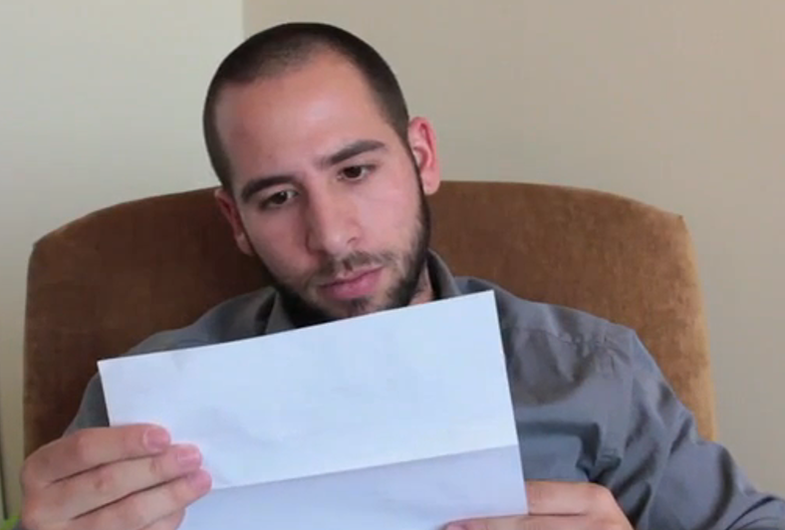
Cover letter
A document sent with your résumé to provide additional information on your skills and experience
How to Avoid Writing an Awful Cover Letter
Image from video
(click on link)
Copyright © Texas Education Agency, 2014. All rights reserved.
Notes:
A cover letter introduces you, highlights your strengths and asks for an interview.
Click on hyperlink to view video:
How to Avoid Writing an Awful Cover Letter
Your cover letter is the first contact that a potential employer has with you. To make a great impression, there are several cover letter mistakes that you should avoid if you'd like to hear the words "you're hired."
http://www.howcast.com/videos/432521-How-to-Avoid-Writing-an-Awful-Cover-Letter#

Slide 10

Portfolio
Portfolio
A collection of work samples that support job qualifications
Copyright © Texas Education Agency, 2014. All rights reserved.
Notes:
In order to secure all of the work samples, the following will be needed:
three ring binder
clear sheet protectors
dividers

Slide 11
Portfolio components
Cover letter
Table of contents
Résumé
Employability skills
Licenses and/or certificates
Awards
Goals and plans for the future
Transcripts
Work samples
Service learning/Volunteer log
Employment evaluations
Letters of recommendations
Copyright © Texas Education Agency, 2014. All rights reserved.
Notes:
Refer to handout Career Portfolio Sections (see All Lesson Attachments tab) for reference.
Most portfolios include some of the following components:
Cover letter - A document sent with your resume to provide additional information on your skills and experience
Table of contents - A list of the sections of a book or document organized in the order in which the sections appear
Résumé - A brief history of a person’s education, work experience and other qualifications
Employability skills - General skills required for success in the labor market at all employment levels and for all sectors
Licenses and/or certificates - A permit from an authority to do a particular thing or carry on a trade
Awards - A prize or other mark of recognition given in honor of an achievement
Goals and plans for the future - The object of a person's ambition or effort; an aim or desired result
Transcripts - An inventory of the courses taken and grades earned of a student throughout a course
Work samples - Examples of your best work specifically related to the job you seek
Service Learning/Volunteer Log – Documentation of community service/volunteer hours
Employment evaluations (if available) - The assessment and review of a worker's job performance
Letters of recommendation (2) - The writer assesses the qualities, characteristics and capabilities of the person being recommended in terms of that individual's ability to perform a particular task or function

Slide 12
Interview Skills
How to talk to people in an interview situation, answering questions correctly and knowing the right questions to ask
Copyright © Texas Education Agency, 2014. All rights reserved.
Notes:
Hopefully, you will be fortunate to secure an interview with a potential employer.
Knowing what to do at the interview, will be key as to whether or not you “Get That Job!”

Slide 13
Interview
A formal meeting between two or more people
An opportunity to:
  Impress the employer
  Learn more about the job
  Decide if the job is right for you
The employer will:
  Become familiar with you
  Evaluate your skills
  Find out if you will work well with other employees
Copyright © Texas Education Agency, 2014. All rights reserved.
Notes:
The interview is probably the most important step in getting a job.
Be prepared with the following tips:
Learn about the employer and the job
Make a list of questions to ask
List the materials to take with you
Decide what to wear
Be prepared for questions
Practice for the interview
Know where to go for the interview

Slide 14
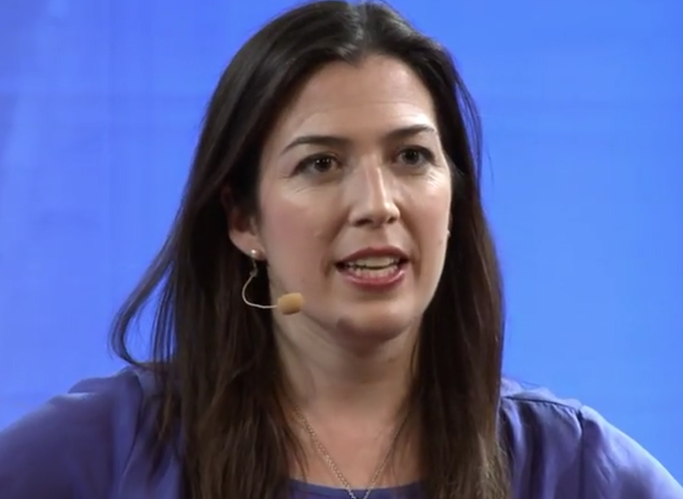
Seven No-brainers for Job Interviews – Anna Post
TED-Ed Talk: Put those smartphones away: Great tips for making your job interview count - Anna Post
1. Be prepared
2. Be early
3. Dress appropriately
4. Speak clearly and make eye contact
5. Address the interviewer by name
6. Shake hands twice
7. Thank them twice
Image from video
(click on link)
Copyright © Texas Education Agency, 2014. All rights reserved.
Notes:
Click on hyperlink to view video:
TED-Ed Talk: Put those smartphones away: Great tips for making your job interview count – Anna Post
The primary event of the job search is the interview. This is your chance to apply your good manners and connect with a potential future employer, presenting yourself as the most qualified person for the job. The more prepared you are to speak eloquently about your life - your experiences, challenges and successes - the more likely you are prove yourself worthy of taking on the tasks within a workplace.
http://youtu.be/NKBlWanXzGE
Seven No-brainers for Job Interviews
A job interview can be intimidating, and you only have a short amount of time to make a good impression on the interviewer. There are definitely some tricks to having a good job interview and giving yourself the best chance to be hired.
http://www.emilypost.com/getting-the-job/the-interview/212-seven-no-brainers-for-job-interviews

Slide 15
Self-responsibility and self-management
Positive Attitude
--
Good Work Habits
--
Business Etiquette
Copyright © Texas Education Agency, 2014. All rights reserved.

Slide 16
Positive Attitudes
Friendliness
Self-motivation
Teamwork
Adaptability
Copyright © Texas Education Agency, 2014. All rights reserved.
Notes:
Attitude is the way you look at the world and the way you respond to things that happen.
Positive attitudes include:
Friendliness – consists of a positive attitude toward yourself and others
Self-motivation – the inner urge to achieve your goals
Teamwork – includes cooperation, the ability to work with others and commitment to a team and its members
Adaptability – the ability to make changes to match new situations

Slide 17
Good Work Habits
Be on time
Be at work every day
Call your supervisor immediately if you become ill and must miss work
Complete all work in a timely fashion
Keep your work area neat and organized
Be accurate
Report mistakes or problems to your supervisor immediately
Do not make personal calls from work
Copyright © Texas Education Agency, 2014. All rights reserved.
Notes:
These habits demonstrate a proactive understanding of self-responsibility and self-management.
Will you have all of these habits?

Slide 18
Business etiquette
Proper behavior for business situations
Can make a difference in making a sale or receiving a promotion
Examples:
  Confident handshakes
  Introducing people correctly
  Wearing appropriate clothes to a business meeting
Copyright © Texas Education Agency, 2014. All rights reserved
Notes:
Etiquette is proper behavior in social situations and is sometimes called manners.
Business etiquette is proper behavior in business situations.
Many people in management take special courses in etiquette.

Slide 19

Questions?
Copyright © Texas Education Agency, 2014. All rights reserved.

Slide 20
References and Resources
Images:
Microsoft Office Clip Art: Used with permission from Microsoft.
Textbooks:
Reynolds, J.S. (2010). Hospitality services: Food & lodging. Tinley Park, IL: Goodheart-Willcox Company.
Littrell, J.J., Lorenz, J.H. & Smith, H.T. (2009). From school to work. Tinley Park, IL: Goodheart-Willcox.
Videos:
How to Avoid Writing an Awful Cover Letter
Your cover letter is the first contact that a potential employer has with you. To make a great impression, there are several cover letter mistakes that you should avoid if you'd like to hear the words "you're hired."
http://www.howcast.com/videos/432521-How-to-Avoid-Writing-an-Awful-Cover-Letter#
How to Write an Error-Free Résumé
Your résumé is often your first impression on a potential employer. With some careful planning you can make sure it’s a good one.
http://www.howcast.com/videos/307328-How-to-Write-an-ErrorFree-Resume#
Copyright © Texas Education Agency, 2014. All rights reserved.

Slide 21
References and Resources
Websites:
Occupational Outlook Handbook
The Bureau of Labor Statistics of the U.S. Department of Labor is the principal Federal agency responsible for measuring labor market activity, working conditions, and price changes in the economy. Its mission is to collect, analyze, and disseminate essential economic information to support public and private decision-making. As an independent statistical agency, BLS serves its diverse user communities by providing products and services that are objective, timely, accurate, and relevant.
http://www.bls.gov/ooh/
Seven No-brainers for Job Interviews
A job interview can be intimidating, and you only have a short amount of time to make a good impression on the interviewer. There are definitely some tricks to having a good job interview and giving yourself the best chance to be hired.
http://www.emilypost.com/getting-the-job/the-interview/212-seven-no-brainers-for-job-interviews
What Are the Benefits of Teenagers Having Jobs?
Even though balancing work and school can be a challenge, working at places such as grocery stores, restaurants and movie theaters can help teens become more mature individuals. Many teens become more responsible at home and school because of the values that they learn at their jobs. They will likely be more prepared for college, too, where they may have to balance work, school and activities.
http://www.ehow.com/about_5103914_benefits-teenagers-having-jobs.html
YouTube™:
TED-Ed Talk: Put those smartphones away: Great tips for making your job interview count – Anna Post
The primary event of the job search is the interview. This is your chance to apply your good manners and connect with a potential future employer, presenting yourself as the most qualified person for the job. The more prepared you are to speak eloquently about your life - your experiences, challenges and successes - the more likely you are prove yourself worthy of taking on the tasks within a workplace.
http://youtu.be/NKBlWanXzGE
Copyright © Texas Education Agency, 2014. All rights reserved.

