Slide 1
Family Crisis Management
Principles of Human Services

Slide 3
What is a Crisis?
Three factors which help determine whether a situation is overwhelming enough to be a crisis:
Hardship
Resources
Mental Attitude
Notes:
A hardship such as a house fire can bring on a crisis. What are other examples of hardships?
If you don’t know how to handle your resources, a problem may become a crisis. What are some examples of not handling your resources well?
It is normal to feel overwhelmed when things are not going well in your life. Some people do not have the resiliency to bounce back from life’s ups and downs. A difficult situation may seem unmanageable and hopeless and in turn become a crisis.

Slide 4
A Crisis Can Be Stressful
A crisis demands a change in the family which can be stressful
Notes:
How does stress affect our personal life? How does stress affect our work? Possible answers—If not managed correctly, a family crisis and stressful situation can lead to drug abuse (alcohol, prescription and illegal drugs), child abuse and domestic violence.
A family crisis is naturally stressful. A crisis demands some sort of change in the family, and this change is stressful for families.
Families which are immobilized by stress often:
are critical and hostile, and blame each other
disagree about family goals and how to reach them
experience stressed-out symptoms — including sleeplessness, lack of appetite, disorientation, memory lapses, depression and anxiety
fight over "who is right”
lack cohesiveness and closeness among members
lack family activities and quality time together
lack open and safe communication. When families do not communicate well, they have more misunderstandings.
lack positive conflict-management skills
lack shared values, rules and roles. In poorly functioning families, members are rigid and will only do what they think they "should" do.
lack time and positive interaction between the parents
How does stress affect children? When a family is experiencing a crisis, all its members are affected -- including the children. Sometimes adults believe that children do not really feel stress, but they do. Some signs that your child may be stressed are:
child is misbehaving more than usual
child is more quiet than usual
child develops some school problems, such as fighting at school or not paying attention
child is having trouble sleeping
child often tells you he is worried and concerned about the family problem

Slide 5
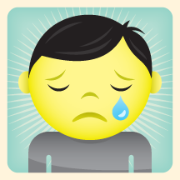
Types of Crises
What kinds of situations or events are likely to cause someone to experience a crisis?
Notes:
Allow students to brainstorm what kinds of situations or events are likely to cause someone to experience a crisis.
Examples may include:
blended family members due to a marriage
death in the family
demotion
deployment of spouse or family member
involvement or addiction of drugs or alcohol, abuse of spouse and children
loss of home due to foreclosure/fire/eviction
loss of job
medical or mental health problems
mental health problems
senior abuse (elderly)
separation or divorce of parents
teen pregnancy
How can these events affect families or individuals? When are these types of crises most likely to occur in the life cycle?

Slide 6
Mental Health Problems
If a family member has a mental illness, it is just that, an illness. It must be treated with professional help.
With appropriate help, counseling and medication, a person can gain control of the illness
Notes:
If a family member has mental health problems, how does this affect the family? If the mental health problem escalates, it could create a crisis in the family.
How do addictions influence your mental health? What are some examples of addictions?

Slide 7
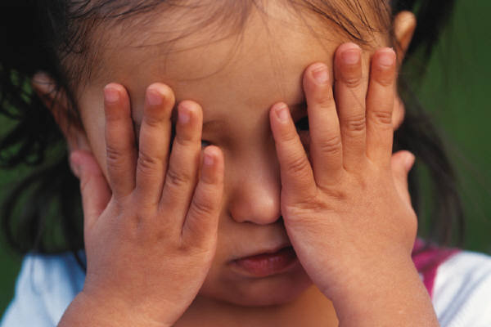
Family Violence
A violent action can be against property, a person and can even kill.
People can become violent for different reasons and under different circumstances.
Violent behavior is often the result of a childhood experience. It is difficult to break the cycle of abuse.
Notes:
There is abuse of a partner and child abuse.
What are the different types of family violence? What are the long-term effects on:
children
families
society
women

Slide 8
What are the Effects of Domestic Violence?
10 Shocking domestic violence statistics for 2011
(click on link)
Notes:
How often does abuse happen between partners?
Can women be abusive towards men?
Why would you stay in an abusive relationship?
Where can an abused person go for help?
10 Shocking domestic violence statistics for 2011
http://youtu.be/3s2hu9Zon4s
Makers of Memories has researched these domestic violence statistics to raise awareness and bring attention to the residual effects domestic violence has on children, kids, and mothers. http://www.makersofmemories.org/support_action_plan
Were you surprised to learn the long-term effects of domestic violence on children and mothers?

Slide 9
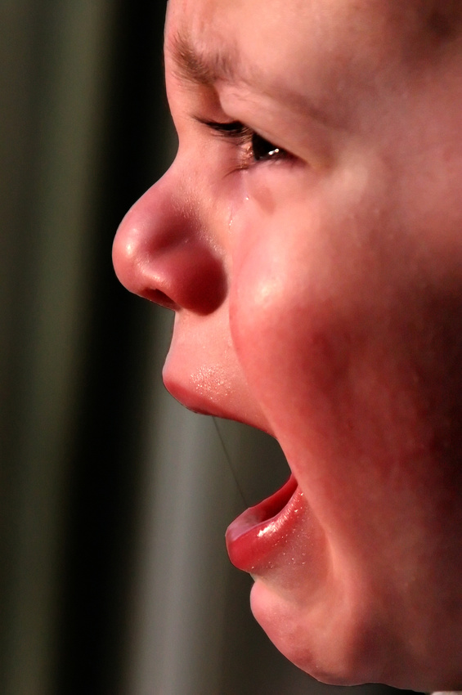
What are the Effects of Domestic Violence?
Children can be harmed by witnessing domestic violence
Notes:
In recent years, increased attention has been focused on children who may be affected by violence in the home, either as victims or as witnesses to domestic violence. Research shows that even when children are not direct targets of violence in the home, they can be harmed by witnessing its occurrence.
The witnessing of domestic violence can be auditory, visual, or inferred, including cases in which the child perceives the aftermath of violence, such as physical injuries to family members or damage to property. Children who witness domestic violence can suffer severe emotional and developmental difficulties that are similar to those of children who are direct victims of abuse. The legal system is beginning to recognize the need to protect and care for these children. Approximately 22 States and Puerto Rico currently address in statute the issue of children who witness domestic violence in their homes.

Slide 10
Types of Child Abuse
Notes:
These percentages sum to more than 100.0 percent because a child may have suffered more than one type of maltreatment.
What are the different forms of child abuse (neglect, emotional abuse, physical abuse and sexual abuse) Why is emotional abuse more damaging than physical abuse? What are the five types of emotional abuse? (rejecting, terrorizing, ignoring, isolating and corrupting) Give an example of each type of emotional abuse.
More general statistics:
A report of child abuse is made every ten seconds
More than five children die every day as a result of child abuse
Approximately 80% of children that die from abuse are under the age of 4
It is estimated that between 50-60% of child fatalities due to maltreatment are not recorded as such on death certificates
More than 90% of juvenile sexual abuse victims know their perpetrator in some way
Child abuse occurs at every socioeconomic level, across ethnic and cultural lines, within all religions and at all levels of education
About 30% of abused and neglected children will later abuse their own children, continuing the horrible cycle of abuse
About 80% of 21 year olds that were abused as children met criteria for at least one psychological disorder
The estimated annual cost of child abuse and neglect in the United States for 2008 is $124 billion
Children whose parents abuse alcohol and other drugs are three times more likely to be abused and more than four times more likely to be neglected than children from non-alcohol/abusing families.
As many as two-thirds of the people in treatment for drug abuse reported being abused or neglected as children.

Slide 11
Prevention and Treatment of Child Abuse
Support and education programs
Parenting education programs for adolescents
Regular child and family screening to detect problems that might lead to abuse
Notes:
Environmental conditions can be stressful on the entire family. When a family or family member changes residence, family structure, or employment status, the entire family is affected. These variations may also lead to financial changes for the family. While changes within the family may have positive effects, they also can product negative effects. Stress, tension, depression and anger can accompany changes in the family. These feelings may lead to abusive situations.
In addition to programs available to aid in preventing abuse, victims of abuse and abusers can turn to various forms of assistance to help them deal with the abuse and their behavior. Many programs are available that not only deal with prevention but also help those who have been involved in abuse.
The National Committee for Prevention of Child Abuse (NCPCA) is an organization with chapters in all fifty states. It was established in 1972 to help prevent child abuse through education, research and support.
For family members to function effectively in a healthy environment, the following programs are helpful:
Support and education programs for parents
Parenting education program for adolescents and others who may become parents
Regular child and family screening to detect problems that might lead to abuse
Child-care programs for families of all financial backgrounds that help relieve stress and teach children basic skills
Training on basic life skills for children and young adults to prepare them for adulthood
Self-help groups to prevent social isolation and promote support from peers
Support services to assist families, especially in times of crisis
The primary purpose of community support programs is to protect the children. All treatment programs must have this as the top priority of the program. Therefore, the main goal is to replace the abusive patterns of a parent with more caring and rewarding methods of raising children. The abusive parent must develop healthy self-esteem, and the stresses and strains that led to abuse must be reduced.
What types of programs and treatment services are available in our community to help family members prevent and stop abuse?
How have laws helped protect children from abuse?

Slide 12
Elder Abuse and Neglect
The Different Types of Elder Abuse
Emotional abuse
Financial exploitation
Healthcare fraud and abuse
Neglect or abandonment by caregivers
Physical abuse
Sexual abuse
Signs and Symptoms of Elder
Abuse
Changes in the elder
Duplicate billings for the same medical service or device
Frequent arguments or tension
Significant withdrawals from the elder’s accounts
Unexplained signs of injury
Unusual weight loss, malnutrition, dehydration
Notes:
Many elderly adults are abused in their own homes, in relatives’ homes, and even in facilities responsible for their care.
Signs and symptoms of elder abuse:
frequent arguments or tension between the caregiver and the elderly person
changes in personality or behavior in the elder
unexplained signs of injury such as bruises, welts, or scars, especially if they appear symmetrically on two side of the body

Slide 13
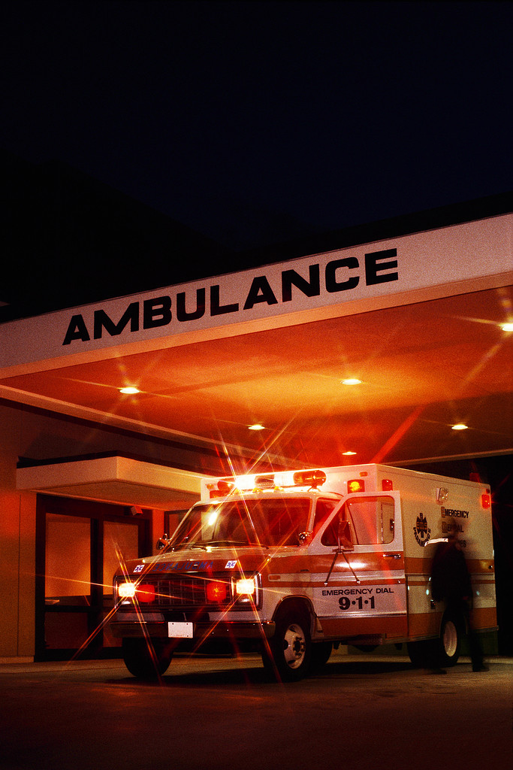
Implications of Substance Abuse
Substance abuse can be a contributing factor for a family crisis
Notes:
The effects of the abuse of substances on couple and family relationships are both direct and indirect—and substantial.
Substance abuse, including underage drinking and the non-medical use of prescription and over-the-counter medications, significantly affects the health and well-being of our nation’s youth and people of all ages:
An estimated 10 million people aged 12 to 20 report drinking alcohol during the past month. To put that in perspective, there are more Americans who have engaged in underage drinking than the number of people who live in the state of Michigan.
Approximately 23 million Americans—roughly the population of Australia—are current illicit drug users. Marijuana use and non-medical use of prescription medications are the most common types of drug use in America.
Almost 18 million Americans are classified with alcohol dependence or abuse.
Heavy alcohol use can cause serious damage to the body and affects the liver, nervous system, muscles, lungs, and heart.
Alcohol is a factor in approximately 41 percent of deaths from motor vehicle crashes.
Stopping substance abuse before it begins can increase a person’s chances of living a longer, healthier, and more productive life.
Read more: Substance Abuse - Effects Of Substance Abuse On Families - Family, History, Development, Alcohol, and Family - JRank Articles http://family.jrank.org/pages/1647/Substance-Abuse-Effects-Substance-Abuse-on-Families.html#ixzz289aa7s3q

Slide 14
Reaction to a Crisis
People react to crisis typically through a process that includes four cycles.
Adapted from: Sasse Connie. (2004). Families Today.
Crisis
Stage 1 Impact
Stage 2 Withdrawal and Confusion
Stage 3 Focus
Stage 4 Adaptation
Notes:
Stage 1: Impact
What do you think your initial thoughts and reactions would be to a crisis such as a house fire? Most people will experience shock and numbness. They cannot believe this is happening to them. Some will experience fear and hopelessness. This impact stage may last from a few hours to a few days. A person may feel it is too overwhelming to function normally. This is also the first reaction a person has when diagnosed with a serious illness.
Stage 2: Withdrawal and confusion
In this stage, people will physically and mentally withdraw from the crisis. Some people will act unresponsive and cold and others will act as though the crisis does not exist. Others will try to maintain busy, but will have a hard time focusing because they are confused.
Scenario: An 18-year-old named Sam was killed as the result of a drunk driver the day before his high school graduation. His mother is “confused” at learning that her son was killed. She keeps insisting that everyone is wrong and continues making last minute plans for his graduation party.
Stage 3: Focus
In this stage, people are ready to focus on the problem and understand action must be taken to deal with the situation. They admit a crisis has occurred and they are ready to take control of it emotionally. They begin to seek out options and make plans to rectify the crisis.
Scenario: The mother from stage 2 accepts the death of her son and is ready to make the funeral arrangements. She seeks support from her family members, church and friends.
Stage 4: Adaptation
In this stage, the plans made in Stage 3, are put into action. Those involved realize that changes must be practical and appropriate. After managing a problem, people realize that life goes on, even though their life and circumstances may be different.
Scenario: Sam’s mom decides to join a support group such as Mothers against Drunk Drivers (M.A.D.D.) and starts a scholarship fund in honor of Sam.
How do you cope with a problem in your life? How can nature help you cope with crises in your life? Example: take a walk, go running, observe birds, enjoy a sunset and etcetera.

Slide 15
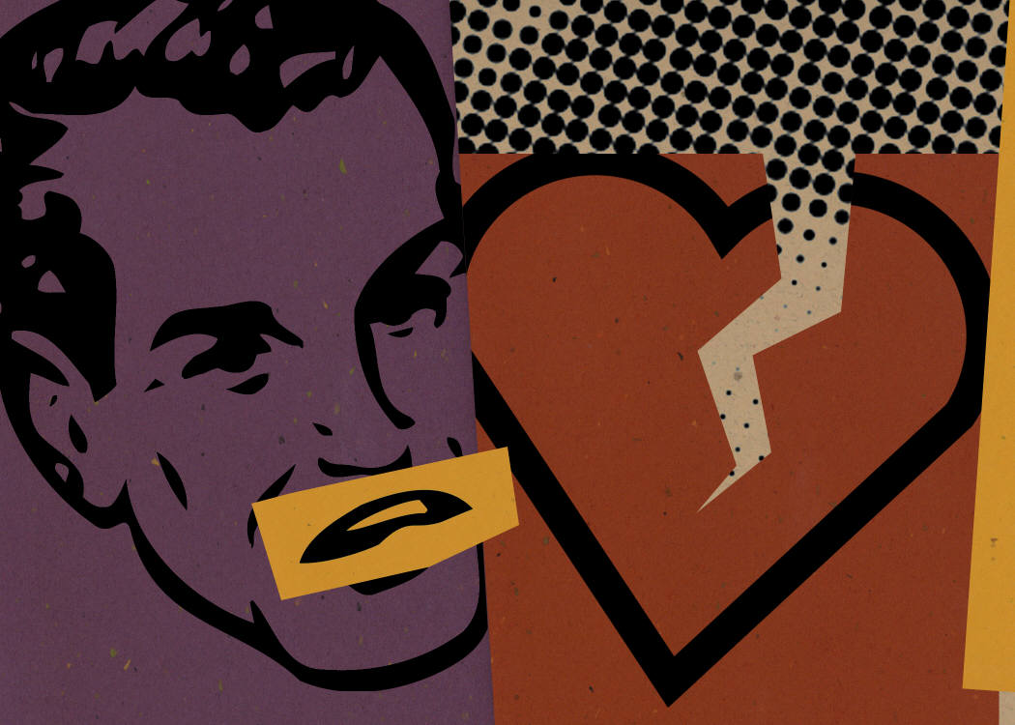
Impact on Families
Effects on family life
Financial effects
Emotional effects
Notes:
We would like to have life running smoothly at all times, but that is not always the case.
How does an illness affect the family?
What about a life threatening illness?
How can a family deal with this type of crisis?
What happens when the family’s income is threatened or reduced?
Unmanageable bills, living conditions, needs and wants can greatly impact the family. How?
An illness can affect a family emotionally. Everyone reacts to this situation differently. Some people are angry, confused, resentful and worried.
What can you do to deal with an illness of a family member?
How can a crisis affect your:
family life
family finances
emotional feelings

Slide 16
Get Facts on Abuse
Get the Facts on Child Abuse
Share child abuse facts with the students
http://visual.ly/get-facts-child-abuse
Salma Hayek Pinault in a PSA for the National Domestic Violence Hotline
http://youtu.be/HT-_BrshWsQ
Notes:
Discuss how a family crisis can have a correlation with child abuse. Share child abuse facts with the students. Allow for discussion and questions.
Academy Award Nominee Salma Hayek has proven herself as a prolific actress, producer, and director, in both film and television. Noted for her acting career, Hayek has also dedicated much of her time to social activism and the prevention of domestic violence. Salma is the Honorary Chair of The Hotline's 15th Anniversary Committee and on the NDVH Celebrity Board.
What resources are available to help an abused person?

Slide 17
Management Strategies
Why is intervention needed?
A person may think a crisis may be unmanageable to handle or control
Notes:
Intervention means taking direct action to cause change when someone else is in crisis. Who is more likely to intervene? When are interventions necessary? Why is an intervention necessary? What happens if a person refuses to participate in the intervention?
Key Steps in the Intervention Process
Regardless of which intervention approaches and models are implemented, certain steps are necessary to make them appropriate for the needs of the child and family, including:
Building a relationship with the family;
Developing case and safety plans;
Establishing clear, concrete goals;
Targeting outcomes;
Tracking family progress;
Analyzing and evaluating family progress.
http://www.childwelfare.gov/pubs/usermanuals/neglect/chaptersix.cfm

Slide 18
Resources for a Crisis
Agencies and Organizations
Health Care Professionals
Hotlines
Religious Organizations
Support Groups
Shelters
Teachers and Counselors
Notes:
Every family will experience a crisis at one time or another. Knowing there are people to provide support, gives you a sense of control. Don’t be afraid to ask for help. The first source of help during a crisis is usually a family member. Friends are another possibility. Most communities have professionals with skills to offer. There are also clinics and health care centers to treat physical, mental or emotional problems. There are also hotlines which are available 24/7. They are usually staffed with trained volunteers. A shelter can provide a safe haven to someone that has been a victim of abuse. Shelters will provide protection from the abuser. How can you locate a shelter in our community? What is a support group?

Slide 19
Careers in Counseling and Mental Health
Family psychologist
Home health aide
Mental health counselor
Occupational therapy assistants and aides
Probation officer
Psychologist
Registered nurse
Rehabilitation counselor
School counselor
Social worker
Social and Human Services assistants
Substance abuse counselor
Notes:
What are some careers related to families in crises? We will research careers in Counseling and Mental Health in another lesson.
Certified crisis intervention counselor- These highly trained individuals introduce strategies and help execute the intervention.
Family psychologist-Psychologists study mental processes and human behavior by observing, interpreting, and recording how people relate to one another and the environment. Family support worker, family counselor and family therapist can be included in this category.
Home health aide-Home health and personal care aides help people who are disabled, chronically ill, or cognitively impaired. They also help older adults who may need assistance. They help with activities such as bathing and dressing, and they provide services such as light housekeeping. In some states, home health aides may be able to give a client medication or check the client’s vital signs under the direction of a nurse or other healthcare practitioner.
Mental health counselor-Mental health counselors and marriage and family therapists help people manage or overcome mental and emotional disorders and problems with their family and relationships. They listen to clients and ask questions to help the clients understand their problems and develop strategies to improve their lives.
Occupational therapy assistants and aides- They work under the direction of occupational therapists in treating patients with injuries, illnesses, or disabilities through the therapeutic use of everyday activities. They help these patients develop, recover, and improve the skills needed for daily living and working.
Probation officer-Probation officers and correctional treatment specialists work with, and monitor, offenders to prevent them from committing new crimes.
Psychologist-Psychologists study mental processes and human behavior by observing, interpreting, and recording how people and relate to one another and the environment. A child psychologist is included in this category.
Registered nurse-Registered nurses (RNs) provide and coordinate patient care, educate patients and the public about various health conditions, and provide advice and emotional support to patients and their family members.
Rehabilitation counselor-Rehabilitation counselors help people with emotional and physical disabilities to live independently. They help their clients overcome the personal, social and professional effects of disabilities as they relate to employment or independent living.
School counselor-School counselors help students develop social skills and succeed in school. Career counselors assist people with the process of making career decisions with choosing a career or educational program.
Social and Human Services assistants-Social and Human Service assistants help people get through difficult times or get additional support. They help other workers, such as social workers, and they help clients find benefits or community services. Clinical Mental Health counselor and clinical social workers are in this category.
Social worker-There are two main types of social workers: direct-service social workers who help people; solve and cope with problems in their everyday lives; and clinical social workers, who diagnose and treat mental, behavioral, and emotional issues. Child social worker falls under this category.
Substance abuse counselor-Substance abuse and behavioral disorder counselors advise people who have alcoholism or other types of addiction, eating disorders, or other behavioral problems. They provide treatment and support to help the client recover from addiction or modify problem behaviors. Addiction counselor is included in this category.

Slide 20
References and Resources
Pictures:
Microsoft Office Online Images
Textbooks:
Parnell Frances Baynor. (2001). Skills for Personal and Family Living. (pp. 195-206). Tinley Park: The Goodheart-Willcox Publishing Company.
Sasse Connie. (2004). Families Today. (4th ed., pp. 285-304). New York: McGraw Hill Glencoe.
Websites:
ChildHelp
Prevention and treatment of child abuse
http://www.childhelp.org/
Get the Facts on Child Abuse
Share child abuse facts with the students
http://visual.ly/get-facts-child-abuse

Slide 21
References and Resources
Websites:
Helping Children and Youth Who Have Experienced Traumatic Events Childhood exposure to traumatic events is a major public health problem in the United States. Traumatic events can include witnessing or experiencing physical or sexual abuse, violence in families and communities, loss of a loved one, refugee and war experiences, living with a family member whose caregiving ability is impaired, and having a life-threatening injury or illness. http://www.samhsa.gov/children/SAMHSA_Short_Report_2011.pdf
HelpGuide.org
Elder Abuse and Neglect--WARNING SIGNS, RISK FACTORS, PREVENTION, AND HELP
http://www.helpguide.org/mental/elder_abuse_physical_emotional_sexual_neglect.htm
KidsPeace
15 Ways to Help Your Kid through Crisis
http://www.kidspeace.org/uploadedFiles/15_Ways_parenting_008_0010_flier.pdf

Slide 22
References and Resources
Websites:
Preventing Child Abuse and Neglect Resources on child abuse prevention, protecting children from risk of abuse, and strengthening families. Includes information on supporting families, protective factors, public awareness, community activities, positive parenting, prevention programs, and more. http://www.childwelfare.gov/preventing/
Tips for Helping Students Recovering from Traumatic Events U.S. Department of Education. The devastation accompanying the recent hurricanes along the Gulf Coast has underscored the crucial role of recovery planning in schools and communities affected by natural disasters. Although the focus is on natural disasters, these tips may apply to other traumas students may experience. http://www2.ed.gov/parents/academic/help/recovering/recovering.pdf

Slide 23
References and Resources
YouTube:
Makers of Memories
Has researched these domestic violence statistics to raise awareness and bring attention to
the residual effects domestic violence has on children and mothers.
http://youtu.be/3s2hu9Zon4s
Salma Hayek Pinault in a PSA for the National Domestic Violence Hotline
Academy Award Nominee Salma Hayek has proven herself as a prolific actress, producer,
and director, in both film and television. Noted for her acting career, Hayek has also
dedicated much of her time to social activism and the prevention of domestic violence.
Salma is the Honorary Chair of The Hotline's 15th Anniversary Committee and on the NDVH
Celebrity Board.
http://youtu.be/HT-_BrshWsQ

