Slide 1
Fad Diets

Slide 3
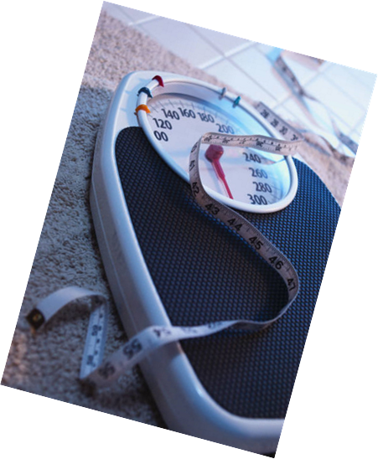
Fad Diets
A popular weight-loss method that is not based on sound nutrition principles
Notes:
Display any popular women’s magazine and more than likely there will be a “fad diet” in it.
It seems that women are always on diets and this helps sell magazines, books, over the counter drugs, meals and drinks.

Slide 4
Weight Loss Diet Plans
Multi-billion dollar industry
New diets plans are constantly being developed
Popular for short time
Often based on misinformation
Notes:
Fad diets do not help people develop healthful eating patterns.

Slide 5
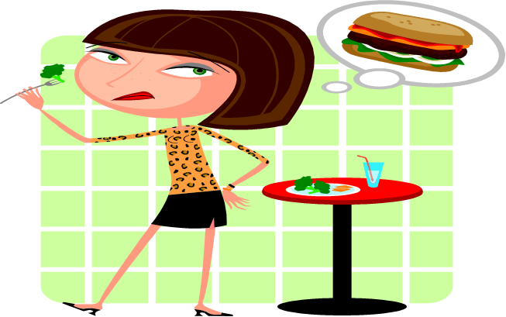
Yo-Yo Dieting
May lead to weight loss for short while
Create unhealthy habits
Weight is regained
Notes:
Yo-yo dieting is called this because of the up and down weight gain.
It can increase frustration and decrease feelings of self-esteem.
May increase risk for high blood pressure, high cholesterol and gallbladder disease.

Slide 6
Claims
Steer clear of any diet plans, pills and products that make the following claims:
Rapid Weight Loss
Quantities and Limitations
Rigid Menus
No Need to Exercise
Specific Food Combinations
Notes:
Rapid Weight Loss
Slow, steady weight loss is more likely to last than dramatic weight changes. Healthy plans aim for a loss of no more than ½ pound to 1 pound per week. If you lose weight quickly, you'll lose muscle, bone and water. You also will be more likely to regain the pounds quickly afterwards.
Quantities and Limitations
Ditch diets that allow unlimited quantities of any food, such as grapefruit and cabbage soup. It's boring to eat the same thing over and over and hard to stick with monotonous plans. Avoid any diet that eliminates or severely restricts entire food groups, such as carbohydrates. Even if you take a multivitamin, you'll still miss some critical nutrients.
Specific Food Combinations
There is no evidence that combining certain foods or eating foods at specific times of day will help with weight loss. Eating the "wrong" combinations of food doesn't cause them to turn to fat immediately or to produce toxins in your intestines, as some plans claim.
Rigid Menus
Life is already complicated enough. Limiting food choices or following rigid meal plans can be an overwhelming, distasteful task. With any new diet, always ask yourself: "Can I eat this way for the rest of my life?" If the answer is no, the plan is not for you.
No Need to Exercise
Regular physical activity is essential for good health and healthy weight management. The key to success is to find physical activities that you enjoy and then to aim for 30 to 60 minutes of activity on most days of the week.
If you want to maintain a healthy weight, build muscle and lose fat, the best path is a lifelong combination of eating smarter and moving more. For a personalized plan, tailored to your lifestyle and food preferences, consult a registered dietitian with expertise in weight management. A registered dietitian can help you find a realistic, flexible eating style that helps you feel and be your best.

Slide 7
Academy of Nutrition and Dietetics
Fad Diet Timeline
Notes:
If a diet or product sounds too good to be true, it probably is.
Click on hyperlink Fad Diet Timeline from the Academy of Nutrition and Dietetics
http://www.eatright.org/nnm/games/timeline/index.html
Review each Fad Diet with your students and discuss the effects some of them may have had.

Slide 8
References and Resources
Images:
Microsoft Office Clip Art: Used with permission from Microsoft.
Textbooks:
Duyff, R. L. (2010). Food, nutrition & wellness. Columbus, OH: Glencoe/McGraw-Hill.
Kowtaluk, H. (2010) Food for today. Columbus, OH: Glencoe/McGraw-Hill.
Weixel, S., & Wempen, F. (2010). Food & nutrition and you. Upper Saddle River, NJ: Pearson/Prentice Hall.
Website:
Academy of Nutrition an Dietetics
The worlds largest organization of food and nutrition professionals www.eatright.org

