Slide 1
Core Characteristics and Abilities of an Effective Teacher

Slide 3
A good teacher can inspire hope, ignite the imagination and instill a love of learning.
-Brad Henry
Notes:
What do you think about this quote? Do you agree or disagree? Why?
What does it take to be an effective teacher?
What does an effective teacher look like?
How does one act?
Allow for student discussion of the questions: What does it take to be an effective teacher? What does an effective teacher look like? How does one act?
Ask students to describe their favorite teacher – does he or she share the same characteristics as their idea of an effective teacher? If so, how are they the same?

Slide 4

Lessons Learned from a Treasured Teacher
(click on picture)
Notes:
What teachers inspired you and how?
Lessons Learned From a Treasured Teacher
A Teaching Channel memory of a teacher Hero by Arne Duncan, the U.S. Secretary of Education. He describes the lasting impact teachers have on students.
https://www.teachingchannel.org/videos/teachers-inspiring-future-leaders

Slide 5

Effective Teachers Need Knowledge of:
educational theories and research
self and students
subject matter
Notes:
Why are these needs so important to an educator?

Slide 6

Knowledge of Educational Theories and Research
Teaching methods and strategies are constantly changing
Use of technology in the classroom has proven to be beneficial
Accomplished teachers work collaboratively with others
Notes:
Teaching methods and strategies are constantly changing. New research and new interpretations of research create different ways to teach students who are also changing. Every generation has varied learning styles and issues that affect their classroom performance.
In the area of technology alone, teaching methods and the wealth of information that is available changes almost every month. Teachers must continue to be learners to be most effective.
They use observation with many other tools to assess progress and performance. These teachers utilize theories of learning and development and continually look for strategies to help each student succeed. Teachers should think systematically about their practice and learn from experience.
Accomplished teachers work collaboratively with other teachers, administrators and support staff in education to create policies, allocate resources and improve education locally, in the state, and nation. They work with parents and families and involve them in the education of their children.

Slide 7

Knowledge of Self and Students
Are you a good student and love learning?
Did you have a teacher that greatly impacted you more than others?
Are you passionate about the subject matter and want to share that with students?
Notes:
There are many reasons why individuals become teachers. It is helpful for future teachers (you) to understand themselves and why they would like to become teachers.
Does the future teacher (you) love learning and facilitating learning for others?
Was the future teacher greatly impacted by a specific teacher more than others?
Are you passionate about the subject matter and would you like to share it with students?
Teachers are responsible for managing and monitoring student learning.
Successful teachers develop, plan and alter classroom settings to keep the students’ focus and make effective use of time. They maintain a disciplined learning environment and keep students motivated. Teachers should be the model of an educated person and should exhibit curiosity, honesty, fairness, respect and appreciation for cultural differences. They need to be able to use their knowledge of the subject matter, human development, educational strategies and experience to teach all students.
Successful teachers believe that all students can learn and treat all students equally. They know that various students have individual differences and they adjust their teaching practices accordingly. They consider interests, abilities and skills as well as personal circumstances. They also foster students’ self-esteem, character and respect for others regardless of cultural or other differences.

Slide 8

Use of Knowledge
Effective teachers use their knowledge to:
Customize and personalize learning activities
Develop skills for living
Promote student learning
Solve problems
Notes:
Accomplished teachers have a thorough understanding of the subject they teach, appreciate how it is linked to other subjects and recognize its connection to the real world. They use their knowledge and skills to help students develop skills for living, learn to think and solve problems.
Knowledgeable teachers also have the ability to help students who may not be skilled or particularly interested in the subject. They can present facts and information from a different angle or explain it in a way that reaches all students.

Slide 9
What does an effective teacher look like?
Notes:
Ask the question and allow for a discussion.

Slide 10

Characteristics and Abilities of Effective Teachers
Communication effectively
Diversify learning experiences
Encourage students to be part of the learning team
Flexible
Strive to connect with students
Notes:
There is no specific list of characteristics that describes the perfect teacher. There are core traits that many successful teachers have in common, such as caring, responsible, trustworthy, confident, creative, honest and friendly.
Some characteristics that are consistently found in teachers whose students excel include:
Diverse – use a variety of methods to help students learn, such as active learning, art, poetry, technology, videos and other media.
Effective Communicator – communicate effectively orally and in writing, are role models for being concise or elaborate as needed.
Encourage students to be part of the learning team– avoid being the center of the classroom, motivate students to explore and research and not always the one with all of the answers.
Flexible – use the community as a classroom, use current resources such as events in the news, technology and newspapers to enrich learning.
Nonconforming – step outside the box, do things differently, keep students interested and engaged, be ready for the unexpected.
Sense of humor – have a good sense of humor, make and accept jokes, bring joy to tough situations and aren’t afraid to laugh.
Promote self-discipline – help students develop self-discipline by not accepting work that is not a best effort, push students to evaluate themselves and their efforts.
These traits were summarized from an article archived on the following website:
Reach Every Child
A collection of archived articles for many areas of education.
http://www.reacheverychild.com/feature

Slide 11

An Effective Teacher is…
Caring
Consistent
Fair
Honest
Notes:
Additional characteristics can include:
Teachers who show they care capture the hearts of their students. Students are more open and able to be engaged in the lesson when they know the teacher is truly invested in their success.
Consistency is an important task to carry out through all areas of the classroom from discipline to grading. Students notice patterns of inconsistency and will be quick to point it out.
Throughout every classroom situation, teachers must show fairness.
Teachers need to be honest with students, parents and faculty. An honest teacher will win the respect of her students and they will in turn be more engaged learners. Parents respect and trust an honest teacher with their children each day. Co-workers want to collaborate with an honest teacher.

Slide 12

An Effective Teacher is…
Knowledgeable
Prepared
Respectful
Responsible
Notes:
Teachers must be knowledgeable in their content area. Students can tell when a teacher is uncomfortable with the material they are trying to teach. It also makes it very difficult for a teacher to provide real-world, student-centered learning opportunities when the teacher does not know the content they are teaching. Lesson – know your material!
An ill-prepared teacher is easily spotted by administration, and even students. Students know immediately when a teacher does not have a plan and they often take advantage of it. A well prepared teacher is able to be flexible and make accommodations in any situation. For example, a great teacher will plan lessons ahead of time well in advance in case of an emergency, or if a lesson ends early.
Teachers who demand respect in their classroom, must first display respect themselves. Students are always watching the teacher for direction and will more likely give respect if they are given it as well.
Teachers must display a great deal of responsibility in a variety of ways from classroom management, time management, grading and more.

Slide 13

What are the Qualities of a Good Teacher?
(click on picture)
Notes:
What Are the Qualities of a Good Teacher?
This is a short video that illustrates why teachers are one of the most important factors in learning.
http://www.youtube.com/watch?v=ZlpBZPLJ0lA

Slide 14
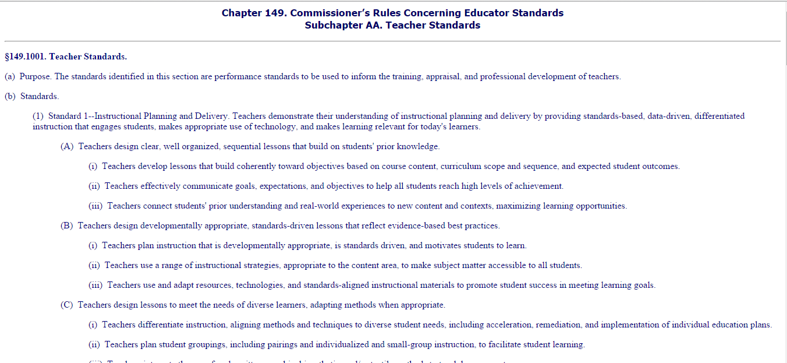
Teacher Standards
(Click on box)
Notes:
The standards identified in this section are performance standards to be used to inform the training, appraisal and professional development of teachers. Let’s read it together. As we are reading it, list the characteristics, attributes and qualities a teacher must possess. For example:
demonstrates their understanding of instructional planning and delivery
provides standards-based, data-driven ad differentiated instruction that engages students
Teacher note: You may opt to provide copies of the teacher standards to the students. Allow them to work in groups to determine the characteristics, attributes and qualities a teacher must possess.
Texas Education Agency
Chapter 149. Commissioner’s Rules Concerning Educator Standards Subchapter AA. Teacher Standards
http://ritter.tea.state.tx.us/rules/tac/chapter149/ch149aa.html

Slide 15

Texas Educators’ Code of Ethics
The Texas educator shall comply with standard practices and ethical conduct toward students, professional colleagues, school officials, parents and members of the community and shall safeguard academic freedom.
Source: Texas Education Agency
(click on picture)
Notes:
Texas Educators’ Code of Ethics
Purpose and Scope
The Texas educator shall comply with standard practices and ethical conduct toward students, professional colleagues, school officials, parents and members of the community and shall safeguard academic freedom. The Texas educator, in maintaining the dignity of the profession, shall respect and obey the law, demonstrate personal integrity and exemplify honesty and good moral character. The Texas educator, in exemplifying ethical relations with colleagues, shall extend just and equitable treatment to all members of the profession. The Texas educator, in accepting a position of public trust, shall measure success by the progress of each student toward realization of his or her potential as an effective citizen. The Texas educator, in fulfilling 39 responsibilities in the community, shall cooperate with parents and others to improve the public schools of the community. (19 TAC 247.1(b))
Ethical teachers follow beliefs and values that are dedicated to what is best for students. Some of the characteristics that help teachers make ethical decisions are knowledge, empathy, reasoning, courage and interpersonal skills. The Texas Education Agency provides a professional code of ethics for educators.
Click on the link and read the professional code of ethics for educators.
What happens when the code of ethics is not upheld? Who is affected by this?
Texas Education Agency
Code of Ethics and Standard Practices for Texas Educators.
http://tea.texas.gov/index2.aspx?id=2147501244&menu_id=771&menu_id2=794

Slide 16

Compliance
Individuals who are compliant within the framework of the law and lawful instructions from their school district are considered ethical educators
Educators must always be conscientious of all duties and responsibilities
Notes:
What does compliant mean to an educator?
Educators have a responsibility to ensure that students gain the knowledge and skills they require to become effective learners and ultimately effective and responsible citizens who understand and appreciate the values and beliefs supported by society.
They also have a responsibility to meet the high standards of professional and ethical behavior required by their district, the public, parents and the profession itself.
Teachers who undertake this responsibility and who are compliant within the framework of the law and lawful instructions from their school district are considered ethical educators.
What happens if an educator is non-compliant?

Slide 17

Non-Compliance
Non-compliance issues may range from habitual tardiness to more serious issues such as sexual harassment or fraudulent use of the district’s monies
All districts handle non-compliance situations differently
Notes:
Educators are expected to do their best work possible and to comply with all policies. Educators who are out of compliance will be notified either verbally or in writing as to the improvements necessary to be in compliance. The School Board Policy Manual is a great resource to refer to. This manual can usually be found at central office, the front office or the district’s website.
All districts handle non-compliance situations differently. Alleged violations of a policy may be discussed in a conference between the employee and the building principal. If the principal finds the violation(s) to be factual, the principal shall issue a written reprimand to the employee(s) involved. This reprimand shall become a part of the employee’s personnel file. Repeated violations may result in non-renewal of an employee’s contract or dismissal.

Slide 18

Teacher Ethics and Responsibility
(click on picture)
Notes:
Teacher Ethics and Responsibility
Video explains educator’s ethics and responsibility.
http://youtu.be/BloG7XjeSxg

Slide 19

How to Be a Good Teacher
(click on picture)
Notes:
How to Be a Good Teacher-Jeremy Harmer-Chapter 1
A student’s suggestions for being a good teacher.
http://www.youtube.com/watch?v=_jh9qkTK52w

Slide 20


Slide 21
References and Resources
Images:
Photos obtained through a license with Shutterstock.com™.
Textbooks:
Diaz, C., Pelletier, C. & Provenzo, Jr., E. (2006). Touch the future: teaching! Boston, MA: Pearson Education, Inc.
Kauchak, D. & Eggen, P. (2014). Introduction to teaching: becoming a professional. (Fifth ed.). Saddle River, NJ: Pearson Education, Inc.
Morrison, G. (2012). Early childhood education today. (Twelfth ed.). Upper Saddle River, NJ: Pearson Education, Inc.
Websites:
About Education
Top ten characteristics of a quality school.
http://712educators.about.com/od/teacherresources/tp/quality-school.htm
Characteristics of Effective Teachers
This collection of characteristics of teachers was collected from various research studies. This site has other useful resources and links.
http://ctl.stanford.edu/handbook/characteristics-of-effective-teachers.html

Slide 22
References and Resources
Code of Ethics
This website sponsored by the National Educators Association provides an overview of ethics for educators.
http://www.nea.org/home/30442.htm
Code of Ethics for Educators
This website sponsored by the American Association of Educators provides an overview of ethics for teachers.
http://www.aaeteachers.org/index.php/about-us/aae-code-of-ethics
Reach Every Child
Now more than ever, new teachers need all the support they can get. So we’ve assembled a great variety of resources on everything from classroom management and skills to job opportunities and new teacher activities. And to help familiarize you with the scope of your new profession, we’ve also included past and present day teaching and teacher appreciation and motivation.
http://reacheverychild.com/classroom-support/new-teachers
Texas Education Agency—-Code of Ethics
This site has the Code of Ethics and the Texas Administrative Code for Texas teachers.
http://ritter.tea.state.tx.us/rules/tac/index.html
Texas Education Agency
Educator Certification
http://www.tea.state.tx.us/index2.aspx?id=5830&menu_id=865&menu_id2=794

Slide 23
References and Resources
Videos:
How to Be a Good Teacher-Jeremy Harmer-Chapter 1
A student’s suggestions for being a good teacher.
http://www.youtube.com/watch?v=_jh9qkTK52w
Lessons Learned From a Treasured Teacher
A Teaching Channel memory of a teacher Hero by Arne Duncan, the U.S. Secretary of Education. He describes the lasting impact teachers have on students.
https://www.teachingchannel.org/videos/teachers-inspiring-future-leaders
Teacher Ethics and Responsibility
Video explains educator’s ethics and responsibility.
http://youtu.be/BloG7XjeSxg
What Are the Qualities of a Good Teacher?
This is a short video that illustrates why teachers are one of the most important factors in learning.
http://www.youtube.com/watch?v=ZlpBZPLJ0lA

