Slide 1
Child Abuse Prevention
Principles of Human Services

Slide 3

What is Child Abuse?
Notes:
Child abuse is any physical or mental threat or injury to a child under the age of 18.
Child abuse is often referred to as maltreatment. Maltreatment is to treat someone in a rough or cruel way; abusive.
Ask the students to list ten reasons they think are causes for increases in violent behaviors in families.
How do you think child abuse might affect the child’s growth and development?

Slide 4
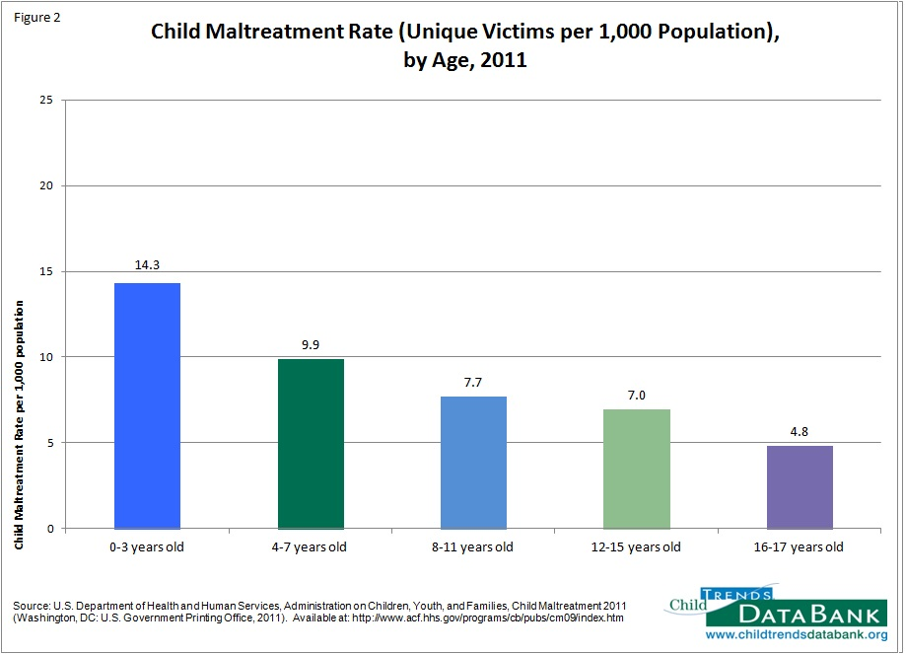
Child Maltreatment Rate
Notes:
Young children are more likely than older children to be victims of child maltreatment. In 2011, children three and younger had a child maltreatment rate of 14.3 per thousand, compared with 9.9 per thousand for children ages four to seven, 7.7 per thousand for children ages eight to 11, 7.0 per thousand for children ages 12 to 15, and 4.8 per thousand for children ages 16 to 17. - See more at: http://www.childtrends.org/?indicators=child-maltreatment#sthash.yGbxNt0t.dpuf
Child Trends DataBank
Child Maltreatment
http://www.childtrends.org/?indicators=child-maltreatment

Slide 5

Child Abuse and Neglect
  Last year:
  231 Texas children died because of abuse or neglect at the hands of their parents or guardians
  65,948 children were confirmed victims of abuse or neglect
  17,108 children were removed from their homes because of abuse or neglect
Notes:
It's hard to talk or even think about child abuse – but child abuse and neglect are simply too destructive to be ignored.
Last year:
231 Texas children died because of abuse or neglect at the hands of their parents or guardians.
65,948 children were confirmed victims of abuse or neglect.
17,108 children were removed from their homes because of abuse or neglect.
Help for Parents. Hope for Kids
It's not easy being a parent. But recognizing that you have room for improvement is the first step toward becoming a better parent. Here you will learn where to find the help you need to begin your journey toward becoming a healthier, happier family.

Slide 6
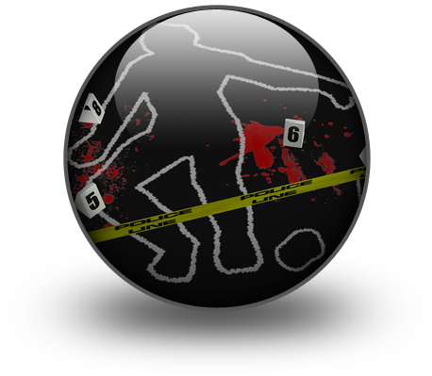
Factors Affecting Child Abuse
  The child’s age and developmental status when the abuse or neglect occurred
  The type of abuse (neglect, physical, sexual, or abandonment)
  The frequency, duration, and severity of abuse
  The relationship between the victim and his or her abuser
Notes:
Child abuse and neglect are serious problems in our country, and there are presently no signs of the problem getting any better. Over 3 million reports of child abuse are made every year in the United States, involving an estimated 6 million children. While physical injuries may or may not be immediately visible, abuse and neglect can have consequences for children, families, and society that last lifetimes, if not generations.
Not all abused and neglected children will experience long-term consequences. The outcomes of individual cases vary widely and are affected by a combination of factors, including the following:
The child’s age and developmental status when the abuse or neglect occurred
The type of abuse (neglect, physical, sexual, or abandonment)
The frequency, duration, and severity of abuse
The relationship between the victim and his or her abuser (English et al., 2005; Chalk, Gibbons, & Scarupa, 2002)

Slide 7
Physical Abuse
  Non-accidental physical injury
  Inflicted by a parent, caregiver or other person
  Physical discipline is not considered abuse as long as it is reasonable
Notes:
Physical abuse is non-accidental physical injury (ranging from minor bruises to severe fractures or death) as a result of punching, beating, kicking, biting, shaking, throwing, stabbing, choking, hitting (with a hand, stick, strap, or other object), burning, or otherwise harming a child, that is inﬂicted by a parent, caregiver, or other person who has responsibility for the child. Such injury is considered abuse regardless of whether the caregiver intended to hurt the child.
Physical discipline, such as spanking or paddling, is not considered abuse as long as it is reasonable and causes no bodily injury to the child.

Slide 8

Neglect
  Neglect may be:
    Physical
    Medical
    Educational
    Emotional
Notes:
Neglect is the failure of a parent, guardian, or other caregiver to provide for a child’s basic needs. Neglect may be:
• Physical (e.g., failure to provide necessary food or shelter, or lack of appropriate supervision)
• Medical (e.g., failure to provide necessary medical or mental health treatment)
• Educational (e.g., failure to educate a child or attend to special education needs)
• Emotional (e.g., inattention to a child’s emotional needs, failure to provide psychological care, or permitting the child to use alcohol or other drugs)

Slide 9

Sexual Abuse
  Five Steps to Protect Our Children
    Step 1 – Learn the Facts
    Step 2 – Minimize Opportunity
    Step 3 – Talk About It
    Step 4 – Recognize the Signs
    Step 5 – React Responsibly
Notes:
Sexual abuse includes activities by a parent or caregiver such as fondling a child’s genitals, penetration, incest, rape, sodomy, indecent exposure, and exploitation through prostitution or the production of pornographic materials.
Darkness to Light: End Child Sexual Abuse
Five Steps to Protect Our Children
http://www.d2l.org/site/c.4dICIJOkGcISE/b.6143703/k.2746/The_5_Steps_to_Protecting_Our_Children.htm
Click on the link and review the five steps with the students. Allow for questions and discussion. Check for understanding.

Slide 10
Child Sexual Abuse
  Abusers - Often Known and Trusted
Notes:
Abusers – Often Known and Trusted
Darkness to Light: End Child Sexual Abuse
http://youtu.be/cAX_n35cjo0

Slide 11
Emotional Abuse
  May include:
    Constant criticism
    Threats
    Rejection
    Withholding love, support or guidance
Notes:
Emotional abuse (or psychological abuse) is a pattern of behavior that impairs a child’s emotional development or sense of self-worth. This may include constant criticism, threats, or rejection, as well as withholding love, support, or guidance. Emotional abuse is often difﬁcult to prove and, therefore, child protective services may not be able to intervene without evidence of harm or mental injury to the child.

Slide 12

Abandonment
  A child is considered to be abandoned when:
    The parent’s identity or whereabouts are unknown
    The child has been left alone in circumstances where the child suffers serious harm
    The parent has failed to maintain contact with the child or provide reasonable support for a specified period of time
Notes:
Abandonment is now deﬁned in many states as a form of neglect. In general, a child is considered to be abandoned when the parent’s identity or whereabouts are unknown, the child has been left alone in circumstances where the child suffers serious harm, or the parent has failed to maintain contact with the child or provide reasonable support for a speciﬁed period of time.
What are the effects of abandonment on children?
Parental abandonment, and its effects, often leave children with lingering questions about their own self-worth.
Some children may over-identify with the absent parent and develop a set of fantasies about him or her which - although they may provide temporary comfort - are not be based in reality.

Slide 13
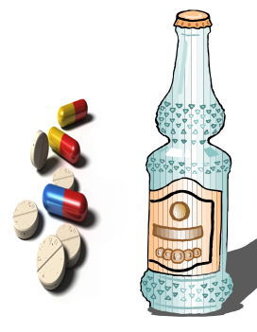
Substance Abuse
  Substance abuse can begin during the prenatal period.
  Children can be exposed to drugs in the home
  Selling, distributing, or giving illegal drugs or alcohol to a child
Notes:
Substance abuse is an element of the deﬁnition of child abuse or neglect in many states. Circumstances that are considered abuse or neglect in some states include:
• Prenatal exposure of a child to harm due to the mother’s use of an illegal drug or other substance
• Manufacture of methamphetamine in the presence of a child
• Selling, distributing, or giving illegal drugs or alcohol to a child
• Use of a controlled substance by a caregiver that impairs the caregiver’s ability to adequately care for the child
What is Fetal Alcohol Spectrum Disorders?
Fetal alcohol spectrum disorders (FASDs) are a group of conditions that can occur in a person whose mother drank alcohol during pregnancy.
Can these disorders be prevented?
Should parents responsible with exposing fetus’ to alcohol be charged with child abuse? Why or why?
What are the signs and symptoms of FASD?
Accidental poisonings for all kids and teens rose by 80 percent, to 824 in 2009, according to the new report. About half of the most recent poisoning deaths were adolescents ages 15 to 19 who overdosed on prescription drugs. Where do adolescents obtain the prescription drugs? Most often from parents' medicine cabinets.

Slide 14

Consequences of Child Abuse
  Child may experience:
    Severe or fatal head trauma such as Shaken Baby Syndrome
    Increased risk for adverse health effects
    Psychiatric disorders
    Post-traumatic stress disorder
    Learning difficulties
    Memory difficulties
    DEATH!!!
Notes:
Children may experience severe or fatal head trauma as a result of abuse. Nonfatal consequences of abusive head trauma include varying degrees of visual impairment (e.g.,
blindness), motor impairment (e.g., cerebral palsy) and cognitive impairments (National Center on Shaken Baby Syndrome 2009).
Children who experience maltreatment are also at increased risk for adverse health effects and certain chronic diseases as adults, including heart disease, cancer, chronic lung disease, liver disease, obesity, high blood pressure, high cholesterol, and high levels of C-reactive protein (Felitti et al. 1998; Danese et al. 2009).
In one long-term study, as many as 80 percent of young adults who had been abused met the diagnostic criteria for at least one psychiatric disorder at age 21. These young adults exhibited many problems, including depression, anxiety, eating disorders, and suicide attempts (Silverman et al. 1996).
In addition to physical and developmental problems, the stress of chronic abuse may result in anxiety and may make victims more vulnerable to problems such as post-traumatic stress disorder, conduct disorder, and learning, attention, and memory difficulties (Dallam 2001; Perry 2001).
Last year, 231 Texas children died because of abuse or neglect at the hands of their parents or guardians.

Slide 15

Consequences of Child Abuse
  Children who experience maltreatment are at an increase for:
    Smoking
    Alcoholism
    Drug abuse
    Engage in high-risk sexual behaviors
    Delinquency
    Teen Pregnancy
    Low academic achievement
    Less likely to graduate from school
    Criminal record and behavior
Notes:
Children who experience maltreatment are at an increased risk for smoking, alcoholism, and drug abuse as adults, as well as engaging in high-risk sexual behaviors (Felsite et al. 1998; Runyan et al. 2002).
Those with a history of child abuse and neglect are 1.5 times more likely to use illicit drugs, especially marijuana, in middle adulthood (Widom et al. 2006).
Studies have found abused and neglected children to be at least 25 percent more likely to experience problems such as delinquency, teen pregnancy, and low academic achievement (Kelley et al. 1997). Similarly, a longitudinal study found that physically abused children were at greater risk of being arrested as juveniles. This same study also found that abused youth were less likely to have graduated from high school and more likely to have been a teen parent (Langsford et al. 2007).
A National Institute of Justice study indicated that being abused or neglected as a child increased the likelihood of arrest as a juvenile by 59 percent. Abuse and neglect also increased the likelihood of adult criminal behavior by 28 percent and violent crime by 30 percent (Widom & Maxfield 2001).
Early child maltreatment can have a negative effect on the ability of both men and women to establish and maintain healthy intimate relationships in adulthood (Colman et al. 2004).

Slide 16
What are the Circumstances that may Lead to Child Abuse?
  Unemployment
  Family illness
  Misappropriation of family funds
  Lack of intelligence and education
  Drug and/or alcohol use
  Lack of coping or parenting skills
  Unwanted pregnancy
  Single-or teen parenting
  Parent having been abused as a child
  Lack of self-esteem
  Marriage problems
  Illness or stressful event
Notes:
Neglect may occur when parents cannot meet their child’s needs. This may be the result of unemployment, family illness, misappropriation of family funds, or lack of intelligence and education on how to properly care for children. According to Decker (2004), drug and alcohol abuse is present in 40 percent of reported neglect and abuse cases. Poverty and financial stress can also lead to child abuse. A parent that does not have coping skills or parenting skills can create parental stress that leads to child abuse. Other circumstances that may lead to child abuse are unwanted pregnancy, single- or teen-parenting, the parent having been abused as a child, lack of self-esteem, marriage problems, illness or a recent stressful event (death in the family, separation, or divorce).
How can parenting classes or support groups provide an approach to preventing child abuse?

Slide 17
Events that May Lead to Child Abuse
  Special problems can strongly impact children such as
    Divorce
    Family violence
    Illness
    Death
Notes:
Special problems such as divorce, family violence, or illness or death in the family can strongly impact children. During very difficult family changes, children may have developmental regressions. Such behavior is not a selfish way to get attention. It may be a sign that the child is under great stress and needs helps from caregivers in order to cope with the stress. Understanding how various factors may influence children helps the caregiver know how best to relate to them. In a divorce, be aware of the legal terms of the divorce that impact child custody. As a childcare worker, it is important to find out who is to pick a child up from the child care center. Do not hand children over to a person not authorized to take them.

Slide 18
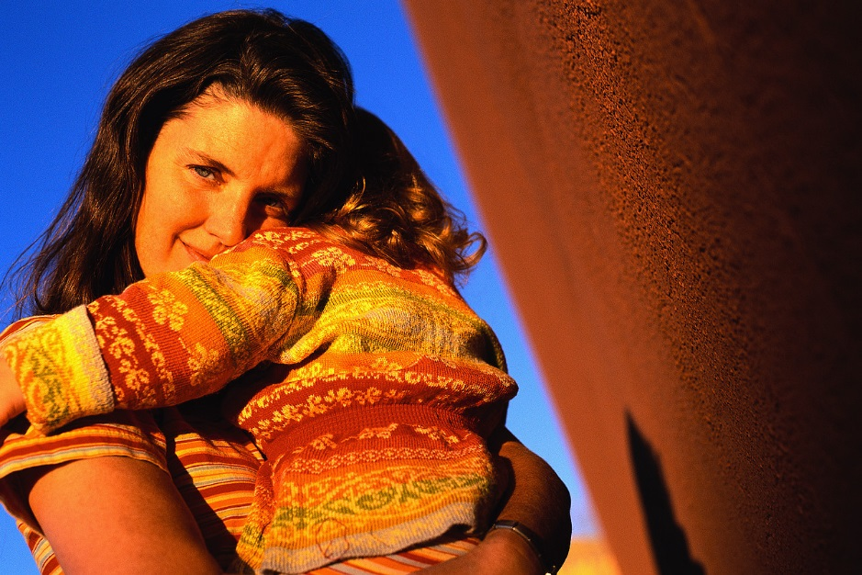
Prevent Child Abuse
  Five important factors that can help protect children from the risk of child abuse and neglect:
    Nurturing and attachment
    Knowledge of parenting and of child and youth development
    Parental resilience
    Social connections
    Concrete support for parents
Notes:
The Promoting Healthy Families in Your Community (2008 Resource) is produced by the United States Department of Health and Human Services’ (USDHHS) Children’s Bureau, Office on Child Abuse and Neglect. The USDHHS has created the premier resource for educators and other interested parties. This resource is provided to support a wide range of service providers to assist in effectively promoting healthy families.
Research has demonstrated that five important factors can help protect children from the risk of child abuse and neglect:
Nurturing and attachment
Knowledge of parenting and of child and youth development
Parental resilience
Social connections
Concrete support for parents
U.S. Department of Health & Human Services
Promoting Healthy Families in Your Community (2008 Resource)

Slide 19
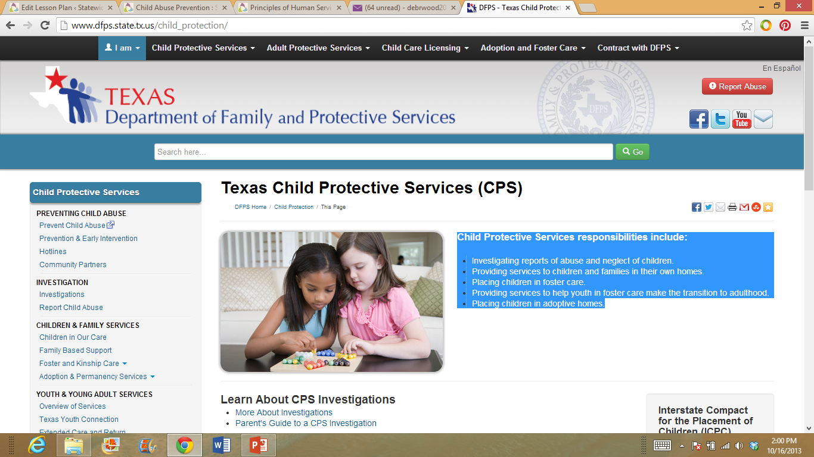
Child Protective Services Division of Texas
  Child Protective Services responsibilities include:
    Investigating reports of abuse and neglect of children
    Providing services to children and families in their own homes
    Placing children in foster care.
    Providing services to help youth in foster care make the transition to adulthood
    Placing children in adoptive homes
Notes:
Child Protective Services Division of Texas is another organization available to assist families in crisis. The Child Protective Services Division investigates reports of abuse and neglect of children. It also:
Places children in adoptive homes
Places children in foster care
Provides services to children and families in their own homes
Provides services to help youth in foster care make the transition to adulthood
For additional information and legal definitions of abuse and neglect, visit http://www.dfps.state.tx.us/

Slide 20
Skills and Resources Available to Address Child Abuse
  Child Protective Services responsibilities include:
    Investigating reports of abuse and neglect of children
    Providing services to children and families in their own homes
    Placing children in foster care.
    Providing services to help youth in foster care make the transition to adulthood
    Placing children in adoptive homes
Notes:
The first step to preventing child abuse is to know the makeup of healthy family relationships. Once the criterion is established for a healthy relationship, it is then easier to determine what makes that relationship unhealthy. Family violence is often a result of a need for power and control in a relationship. This need may be a result from a history of family violence or inappropriate gender-role messages. Conflict resolution skills are needed and ground rules for handling conflict need to be established in all families. Conflict will occur in all relationships. The answer to family success is to find a way to manage anger and resolves issues as they arise without violence.
Society has a responsibility in protecting children and families against abuse and violence. According to a publication by U.S. Department of Health and Human Services, the educator has a vital role in identifying, reporting, and preventing child abuse and neglect. Over the last few decades, various organizations have developed programs directed at informing educators that they are a valuable resource. Child care providers and educators must become involved in preventing and responding to child abuse and neglect. These reasons are related to:
Community efforts
Educational opportunities
Legal concerns
Professional responsibilities
Personal commitments
Why is it important that any suspicion of abuse and neglect must be reported within 48 hours?
Texas Education Agency
Child Abuse and Neglect Reporting and Responsibilities
http://www.tea.state.tx.us/index4.aspx?id=25769803997

Slide 21

How Can I Report Abuse, Neglect, or Exploitation?
  Texas law says anyone who thinks a child, a person 65 years or older, or an adult with disabilities is being abused, neglected, or exploited must report it to DFPS.
  If you suspect child abuse, you can report it by calling 1-800-252-5400 24 hours a day, seven days a week, nationwide.
Notes:
Texas law says anyone who thinks a child, a person 65 years or older, or an adult with disabilities is being abused, neglected, or exploited must report it to Texas Department of Family and Protective Services (DFPS). A person who reports abuse in good faith is immune from civil or criminal liability. DFPS keeps the name of the person making the report confidential. Anyone who does not report suspected abuse can be held liable for a misdemeanor or felony. Time frames for investigating reports are based on severity of allegations. Reporting suspected child abuse makes it possible for a family to get help.
If you suspect child abuse, you can report it by calling 1-800-252-5400 24 hours a day, seven days a week, nationwide. Or visit www.txabusehotline.org and place a report through their secure website, and you will receive a response within 24 hours. The website does not accept e-mail reports of suspected abuse or neglect. Learn more about reporting abuse and neglect at www.dfps.state.tx.us.

Slide 22
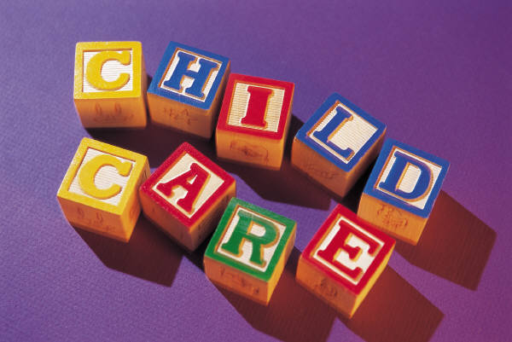
Future Trends in Early Childhood Development and Services
  Professionals in these careers nurture and teach preschool-age children.
Notes:
The future trends in early childhood development services are continuously changing. Current trends, future technology and product development will dictate the directions of this portion of the course. Professionals in these careers nurture and teach preschool-age children. Childcare workers should be informed about abuse laws and reporting laws and how these laws affect centers and caregivers who work there.
According to the Bureau of Labor Statistics, employment of childcare workers is expected to grow by 20 percent from 2010 to 2020, faster than the average for all occupations. Parents will continue to need assistance during working hours to care for their children. Growth is expected because of increases in the number of children who require childcare and continued demand for preschool programs. Because the number of children requiring childcare is expected to grow, demand for childcare workers is expected to grow as well. Have students research and share the potential future trends in early childhood development and services.
According to Achieve Texas career cluster information, the job outlook for Childcare Directors is excellent. Nationally, job growth for child care workers is expected to
grow at an average rate through the year 2016. The number of children enrolled in day care and preschool services will continue to increase as more parents enter the workforce. Also, increases in state implemented and expanded public programs will result in the need for more early childhood center and preschool directors. Nationally, salaries for Preschool and Childcare Directors range from $25,910 to $77,150 (Occupational Outlook Handbook, 2008-2009). In Texas, the starting salary is $25,206 (Texas Workforce Commission, 2009).
Bureau of Labor Statistics
Occupational Outlook Handbook: Childcare Workers
http://www.bls.gov/ooh/personal-care-and-service/childcare-workers.htm

Slide 23
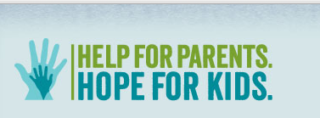
Becoming a Healthier, Happier Family
Notes:
There are several testimonies from different parents. Click on all the pictures to view each testimony.
Help for Parents. Hope for Kids
It’s not easy being a parent. But recognizing that you have room for improvement is the first step toward becoming a better parent. Here you will learn where to find the help you need to begin your journey toward becoming a healthier, happier family.

Slide 24
Questions?

Slide 25
References/Resources
  Images:
    Microsoft Clip Art: Used with permission from Microsoft.
  Textbooks:
    Brisbane, H. (2010). The developing child. Columbus, OH: Glencoe/McGraw-Hill.
    Johnson, L. (n.d.). Strengthening family & self. 6th ed.
  YouTube™:
    Help for Parents. Hope for Kids
    It’s not easy being a parent. But recognizing that you have room for improvement is the first step toward becoming a better parent. Here you will learn where to find the help you need to begin your journey toward becoming a healthier, happier family.
    http://www.helpandhope.org/videos.html
  Websites:
    Child Abuse Awareness
    Founded in 1959 by Sara O’Meara and Yvonne Fedderson, Childhelp® is a leading national non-profit organization dedicated to helping victims of child abuse and neglect. Childhelp’s approach focuses on prevention, intervention and treatment.
    http://www.childhelp.org

Slide 26
References/Resources
  Websites:
    Child Abuse: Emotional, Sexual, and Physical
    There are several types of child abuse, but the core element that ties them together is the emotional effect on the child. Children need predictability, structure, clear boundaries, and the knowledge that their parents are looking out for their safety.
    http://helpguide.org/mental/child_abuse_physical_emotional_sexual_neglect.htm#types
    ChildHelp
    National Child Abuse Statistics
    http://www.childhelp-usa.com/pages/statistics
    Child Trends DataBank
    Child Maltreatment
    http://www.childtrends.org/?indicators=child-maltreatment
    Prevent Child Abuse America
    Since 1972, Prevent Child Abuse America (PCA America) has led the way in building awareness, providing education and inspiring hope to everyone involved in the effort to prevent the abuse and neglect of our nation’s children.
    http://www.preventchildabuse.org/index.shtml

Slide 27
References/Resources
  Websites:
    Prevent Child Abuse America
    What You Can Do: Report Suspected Abuse or Neglect
    http://www.preventchildabuse.org/help/report_abuse.shtml
    Snapguide
    How to Make a Four-Door Diorama
    http://snapguide.com/guides/make-a-four-door-diorama/
    U.S. Department of Health and Human Services
    What is Child Abuse and Neglect? Recognizing the Signs and Symptoms.
    https://www.childwelfare.gov/pubs/factsheets/whatiscan.cfm
    U.S. Department of Health and Human Services
    Child Maltreatment 2011
    http://www.acf.hhs.gov/programs/cb/resource/child-maltreatment-2011
    U.S. Department of Health and Human Services resources – National Child Abuse Prevention Month (April) information.
    Child Welfare Information Gateway connects child welfare and related professionals to comprehensive information and resources to help protect children and strengthen families.
    http://www.childwelfare.gov/

