Slide 1
Career and Technical Education (CTE)
Introduction to Career Clusters

Slide 3
Agriculture, Food, and Natural Resources
This Career Cluster focuses on the essential elements of life - food, water, land, and air.
Courses in the AFNR Career Cluster® are designed to prepare learners for careers in the planning, production, processing, marketing, distribution, financing, and development of agricultural commodities, services, and natural resources, including food, fiber, wood products, water, minerals, and petroleum.

Slide 4
Architecture and Construction
This Career Cluster focuses on designing, planning, managing, building, and maintaining the built environment.
Principles of Architecture provides an overview to the various fields of architecture, interior design, and construction management.

Slide 5
Arts, Audio/Video Technology, and Communications
This Career Cluster focuses on careers in designing, producing, exhibiting, performing, writing, and publishing multimedia content including visual and performing arts and design, journalism, and entertainment services.
Careers in the AAVTC Career Cluster® require a creative aptitude, a strong background in computer and technology applications, a strong academic foundation, and a proficiency in oral and written communication.

Slide 6
Business Management and Administration
This Career Cluster focuses on careers in planning, organizing, directing, and evaluating business functions essential to efficient and productive business operations.

Slide 7
Education and Training
This Career Cluster focuses on planning, managing, and providing education and training services and related learning support services.
All parts of courses are designed to introduce learners to the various careers available within the Education and Training Career Cluster®.

Slide 8
Finance
This Career Cluster encompasses careers that focus on planning, services for financial and investment planning, banking, insurance, and business financial management.
Careers in this field require problem-solving, organization, and communication skills.

Slide 9
Government and Public Administration
The Career Cluster focuses on planning and performing governmental functions at the local, state, and federal levels, including governance, national security, foreign service, planning, revenue and taxation, and regulations. This is largest sectors in the U.S. in terms of number of workers employed.
Careers in this field range from politics to planning and developing affordable housing, public transportation, and recreational areas, as well as the managing the preservation of historic buildings and neighborhoods, and dealing with public health, social, and safety issues.

Slide 10
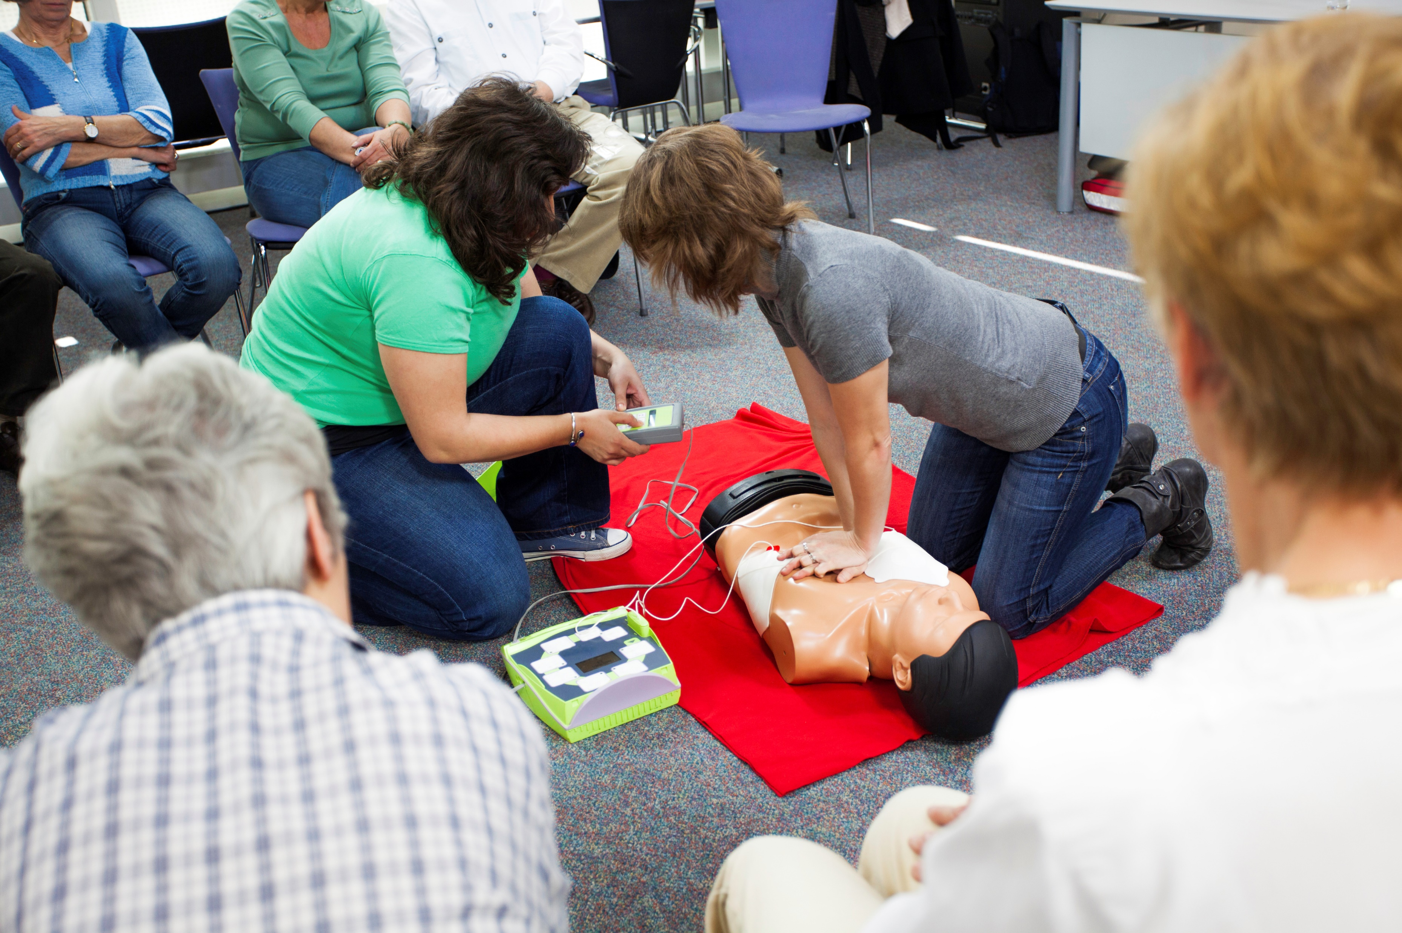
Health Science
This Career Cluster focuses on planning, managing, and providing therapeutic services, diagnostics services, health informatics, support services, and biotechnology research and development.
To pursue a career in the health science industry, students should learn to reason, think critically, make decisions, solve problems, and communicate effectively. Students should recognize that quality health care depends on the ability to work well with others.

Slide 11
Hospitality and Tourism
This Career Cluster focuses on the management, marketing, and operations of restaurants and other food/beverage services, lodging, attractions, recreation events, and travel-related services.
Includes knowledge and skills focusing on communication, time management, and customer service that meet industry standards.

Slide 12
Human Services
This Career Cluster focuses on preparing individuals for employment in career pathways that relate to families and human needs such as counseling and mental health services, family and community services, personal care services, and consumer services.

Slide 13
Information Technology
This Career Cluster focuses on building linkages in IT occupations for entry level, technical, and professional careers related to the design, development, support, and management of hardware, software, multimedia, and systems integration services.

Slide 14
Law, Public Safety, Corrections, and Security
This Career Cluster focuses on planning, managing, and providing legal services, public safety, protective services, and homeland security, including professional and technical support services.
Students will examine the roles and responsibilities of police, courts, corrections, private security, and protective agencies of fire and emergency services.

Slide 15
Manufacturing
This Career Cluster focuses on planning, managing, and performing the processing of materials into intermediate or final products and related professional and technical support activities such as production planning and control, maintenance, and manufacturing/process engineering.

Slide 16
Marketing
This Career Cluster focuses on planning, managing, and performing marketing activities to reach organizational objectives.

Slide 17
Science, Technology, Engineering, and Mathematics
This Career Cluster focuses on planning, managing, and providing scientific research and professional and technical services, including laboratory and testing services, and research and development services.

Slide 18
Transportation, Distribution, and Logistics
This Career Cluster focuses on careers in planning, management, and movement of people, materials, and goods by road, pipeline, air, rail and water and related professional support services such as transportation infrastructure planning and management, logistics services, mobile equipment and facility maintenance.

Slide 19
Alphabetical List of the 16 Career Clusters
Agriculture, Food, and Natural Resources
Architecture and Construction
Arts, Audio/Video Technology, and Communications
Business Management and Administration
Education and Training
Finance
Government and Public Administration
Health Science

Slide 20
Alphabetical List of the 16 Career Clusters
Hospitality and Tourism
Human Services
Information Technology
Law, Public Safety, Corrections, and Security
Manufacturing
Marketing
Science, Technology, Engineering, and Mathematics
Transportation, Distribution, and Logistics

Slide 21
Resources and References
Photo source
Shutterstock
iStock
Websites:
Texas CTE Resource Centre (TCRC) https://www.txcte.org/

