Slide 1
CPR and First Aid Guidelines
  Child Devlopment

Slide 3
When Emergencies Arise
Emergencies happen all too often and early intervention can save a life
CPR and first aid skills are important for caregivers and parents to know
Notes:
All individuals should have a basic understanding of first aid and cardiopulmonary resuscitation (CPR) skills. CPR is a technique involving heart and lungs that is used when breathing stops. Administering CPR can restore breathing and restart the heart if heart failure accompanies the loss of breathing. This valuable technique should be learned by all caregivers and parents in case an emergency arises where professional help is not immediately available. Emergencies happen all too often, and early intervention can save a life. This lesson will cover how to secure the scene of an accident to protect the victim and the first responders.
Would you know what to do in an emergency?

Slide 4
Cardiopulmonary Resuscitation Skills
(CPR)
Notes:
Cardiopulmonary Resuscitation (CPR) is an emergency procedure for manually preserving brain function until further measures are taken to restore spontaneous blood circulation and breathing in a person who is in cardiac arrest.
Have you ever performed CPR on an individual?

Slide 5
What is CPR?
CPR combines rescue breathing and chest compressions
Rescue breathing provides oxygen to the person's lungs
Chest compressions keep oxygen-rich blood flowing until the heartbeat and breathing can be restored
Notes:
CPR combines rescue breathing and chest compressions. Rescue breathing provides oxygen to the person's lungs. Chest compressions keep oxygen-rich blood flowing until the heartbeat and breathing can be restored.

Slide 6
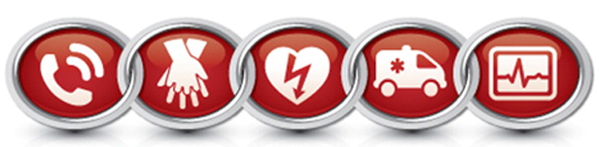
Five Links in the Adult Chain of Survival
Effective advanced life support
Rapid defibrillation
Early CPR with an emphasis on chest compressions
Immediate recognition of cardiac arrest and activation of the emergency response system
Integrated post-cardiac arrest care
Notes:
Each year, more than 250,000 Americans die from sudden cardiac arrest. According to medical experts, the key to survival is timely initiation of a "chain of survival,” including CPR.
The five links in the adult chain of survival are:
Immediate recognition of cardiac arrest and activation of the emergency response system
Early cardiopulmonary resuscitation (CPR) with an emphasis on chest compressions
Rapid defibrillation
Effective advanced life support
Integrated post-cardiac arrest care
American Heart Association
The term Chain of Survival provides a useful metaphor for the elements of the ECC systems concept.
http://www.heart.org/HEARTORG/CPRAndECC/WhatisCPR/AboutUs/Chain-of-Survival_UCM_307516_Article.jsp

Slide 7
CPR Instructional Video
Hands-Only Instructional Video on CPR
(click on link)
Notes:
American Heart Association
Official 2012 Hands-Only CPR Instructional Video. Learn how to perform CPR in this 60-second video showing Hands-Only CPR in action.
http://youtu.be/zSgmledxFe8

Slide 8
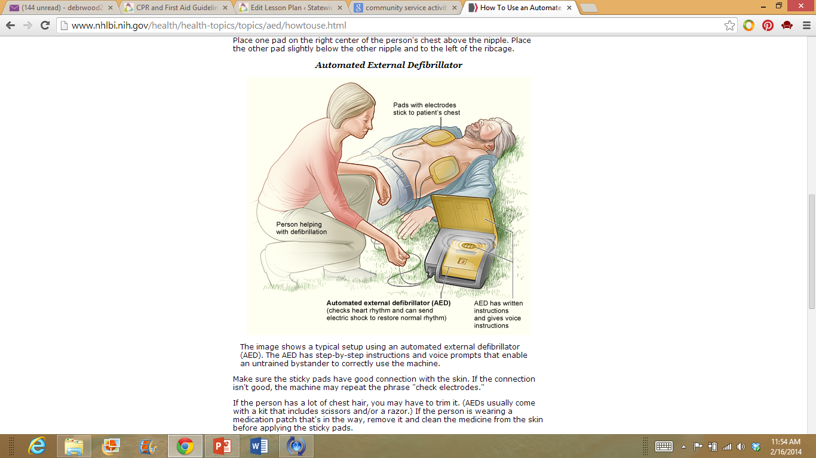
What is an Automated External Defibrillator (AED)?
An automated external defibrillator (AED) is a portable device that checks the heart rhythm
Learning how to use an AED and taking a CPR course are helpful
Notes:
An automated external defibrillator (AED) is a portable device that checks the heart rhythm. If needed, it can send an electric shock to the heart to try to restore a normal rhythm. AEDs are used to treat sudden cardiac arrest (SCA). The American Heart Association notes that at least 20,000 lives could be saved annually by prompt use of AEDs.
SCA usually causes death if it's not treated within minutes. In fact, each minute of SCA leads to a 10 percent reduction in survival. Using an AED on a person who is having SCA may save the person's life. If someone is having sudden cardiac arrest, using an AED and giving CPR can improve the person's chance of survival.
AEDs are lightweight, battery-operated, portable devices that are easy to use. Each unit comes with instructions, and the device will even give you voice prompts to let you know if and when you should send a shock to the heart.
Learning how to use an AED and taking a CPR course are helpful. However, if trained personnel aren't available, untrained people also can use an AED to help save someone's life.
You often find AEDs in places with many people, such as shopping malls, golf courses, businesses, airports, airplanes, casinos, convention centers, hotels, sports venues and schools. You also can purchase a home-use AED.
Some people are afraid to use an AED to help save someone's life. They're worried that something might go wrong and that they might be sued. However, Good Samaritan laws in each state and the Federal Cardiac Arrest Survival Act (CASA) provide some protection for untrained bystanders who respond to emergencies.
Teacher note: You can arrange for the school nurse to come to class to demonstrate the use of an AED.

Slide 9
Texas Guidelines
In Texas, a caregiver trained in CPR must be on duty at all times in a child care facility
Notes:
In Texas, a caregiver trained in CPR must be on duty at all times in a child care facility. First aid to restore breathing includes the following steps:
Begin first aid immediately. Have someone else call for a doctor or ambulance as you give first aid.
Check for blockage of the air passage. Use first aid methods appropriate for the age of the child to unblock air passages. These methods may include back blows and abdominal thrusts.
Apply artificial respiration using a method appropriate for the age of child (mouth to mouth or mouth to mouth/nose respiration).
Continue artificial respiration, including during transportation to the emergency room, until breathing begins or the task is taken over by medical personnel.
Treat the victim for shock.
Get medical care, even if breathing has been restored.

Slide 10
CPR – Child 1 to 8 years old

Slide 11
Check for Responsiveness
Check for responsiveness
If there is no response, shout for help
Carefully place the child on his or her back
Notes:
1. Check for responsiveness. Shake or tap the child gently. See if the child moves or makes a noise. Shout, "Are you okay?“
2. If there is no response, shout for help. Send someone to call 911 and retrieve an automated external defibrillator (AED) if one is available. Do not leave the child alone to call 911 and retrieve an AED until you have performed CPR for about 2 minutes.
3. Carefully place the child on his or her back. If there is a chance the child has a spinal injury, two people should move the child to prevent the head and neck from twisting.
Medline Plus
CPR - Child 1 to 8 years old
http://www.nlm.nih.gov/medlineplus/ency/presentations/100215_1.htm

Slide 12
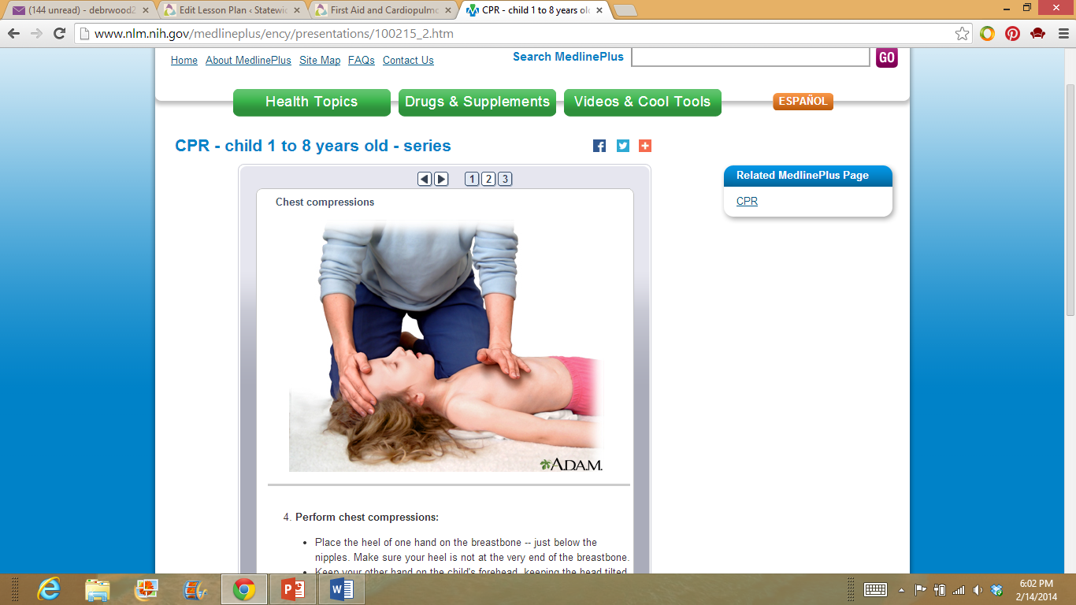
Chest Compression
Perform chest compressions
Notes:
4. Perform chest compressions:
Place the heel of one hand on the breastbone -- just below the nipples. Make sure your heel is not at the very end of the breastbone.
Keep your other hand on the child's forehead, keeping the head tilted back.
Press down on the child's chest so that it compresses about 1/3 to 1/2 the depth of the chest.
Give 30 chest compressions. Each time, let the chest rise completely. These compressions should be FAST and hard with no pausing. Count the 30 compressions quickly: "1,2,3,4,5,6,7,8,9,10,11,12,13,14,15,16,17,18,19,20,21,22,23,24,25,26,27,28,29,30, off.“
Medline Plus
CPR - Child 1 to 8 years old
http://www.nlm.nih.gov/medlineplus/ency/presentations/100215_1.htm

Slide 13
Child Note Breathing
Open the airway
Look, listen and feel for breathing
Continue CPR
Notes:
5. Open the airway. Lift up the chin with one hand. At the same time, push down on the forehead with the other hand.
6. Look, listen and feel for breathing. Place your ear close to the child's mouth and nose. Watch for chest movement. Feel for breath on your cheek.
7. If the child is not breathing:
Cover the child's mouth tightly with your mouth.
Pinch the nose closed.
Keep the chin lifted and head tilted.
Give two breaths. Each breath should take about a second and make the chest rise.
8. Continue CPR (30 chest compressions followed by 2 breaths, then repeat) for about 2 minutes.
9. After about 2 minutes of CPR, if the child still does not have normal breathing, coughing, or any movement, leave the child if you are alone and call 911. If an AED for children is available, use it now.
10. Repeat rescue breathing and chest compressions until the child recovers or help arrives.
If the child starts breathing again, place him or her in the recovery position. Periodically re-check for breathing until help arrives.
Medline Plus
CPR - Child 1 to 8 years old
http://www.nlm.nih.gov/medlineplus/ency/presentations/100215_1.htm

Slide 14
First Aid

Slide 15
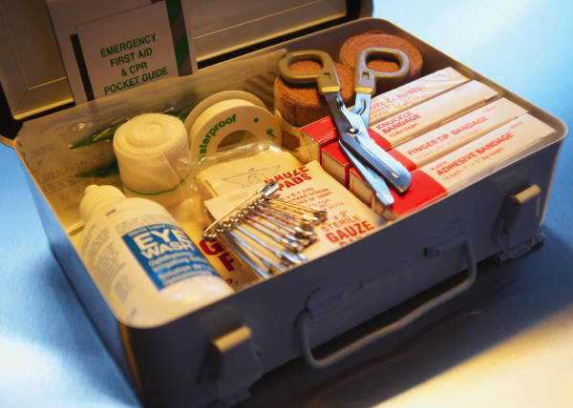
First Aid Kit
A good first aid kit should always be checked and periodically restocked
Notes:
A first aid kit is a collection of supplies and equipment for use in giving first aid and can be put together for the purpose by an individual or organization or purchased complete.
The American Red Cross recommends that a good first aid kit should be checked, restocked periodically and always contain the following items:
2 absorbent compress dressings (5 x 9 inches)
25 adhesive bandages (assorted sizes)
1 adhesive cloth tape (10 yards x 1 inch)
5 antibiotic ointment packets (approximately 1 gram)
5 antiseptic wipe packets
1 blanket (space blanket)
1 breathing barrier (with one-way valve)
First aid instruction booklet
2 hydrocortisone ointment packets (approximately 1 gram each)
1 instant cold compress
oral thermometer (non-mercury/non-glass)
2 packets of aspirin (81 mg each)
2 pair of non-latex gloves (size: large)
scissors
1 roller bandage (3 inches wide)
1 roller bandage (4 inches wide)
5 sterile gauze pads (3 x 3 inches)
5 sterile gauze pads (4 x 4 inches)
2 triangular bandages
tweezers
Do you have a first aid kit in your home? In your car?
American Red Cross
Anatomy of a First Aid Kit.
http://www.redcross.org/prepare/location/home-family/get-kit/anatomy

Slide 16
Using First Aid
Caregivers should complete basic first aid training before beginning child care employment
Notes:
Caregivers should complete basic first aid training before beginning child care employment. Only first aid used for life threatening injuries common to children is discussed in this lesson. In order to save lives and prevent further injury, a person using first aid must prevent severe blood loss, maintain breathing and prevent shock.
After initial first aid is given and it is found that the sick or injured child can be safely moved, the child may be taken to an emergency room in the child care center. This room should contain the following items:
A comfortable place for the child to lie down
First aid supplies
A blanket to cover the child
Posted charts regarding first aid treatment, such as how to handle suspected poisonings, unconsciousness and disease symptoms
Emergency numbers for ambulance, police, fire department and poison control center
An emergency file for each child containing names and telephone numbers of the child’s doctor, hospital, parent(s) and other people the center staff is authorized to call in an emergency

Slide 17
Handling Medical Emergencies
Caregivers must be trained in first aid to handle medical emergencies such as:
Preventing severe blood loss
Helping the child to maintain breathing
Diluting or removing poisons from the child’s body
Preventing shock
Treating burns properly
Immobilizing head and back injuries
Notes:
Caregivers must be trained in first aid to handle medical emergencies. First aid is used to save lives and prevent further injury. Examples of first aid procedures include the following:
Preventing severe blood loss
Helping the child to maintain breathing
Diluting or removing poisons from the child’s body
Preventing shock
Treating burns properly
Immobilizing head and back injuries

Slide 18
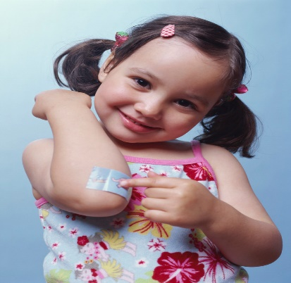
First Aid Techniques
Preventing Severe Blood Loss
First aid for severe bleeding is to apply direct pressure firmly to the wound with a clean dressing held in place by the hand of an adult
Helping the Child to Maintain Breathing
Time is very important when dealing with an unconscious child who is not breathing
Permanent brain damage or even death can occur!
Notes:
Severe bleeding must be stopped immediately. A doctor or emergency medical team should be called. Shock and loss of consciousness may occur quickly in a child. First aid for severe bleeding is to apply direct pressure firmly to the wound with a clean dressing held in place by the hand of an adult. This method prevents blood loss without interference with normal blood circulation.
If possible, raise the injured area above the level of the victim’s heart to slow the blood flow to the wound. If bleeding continues, apply direct pressure to the wound while applying pressure against pressure points. A first aid course will demonstrate exactly the correct procedures to be used.
If a child stops breathing, immediate action should be taken by the closest caregiver. Permanent brain damage (followed by death) can result if breathing does not begin between four to six minutes after the heartbeat has stopped. Time is very important when dealing with an unconscious child who is not breathing. Permanent brain damage begins after only 4 minutes without oxygen, and death can occur as soon as 4 - 6 minutes later. Breathing can stop for any of the reasons listed below:
Obstruction in the air passage
Swelling due to damage of the air passage following the swallowing of a corrosive substance (such as lye)
Acute asthma attack
Lack of oxygen in the air (as in gas poisoning or being locked in an enclosed space such as an abandoned refrigerator)
Suffocation due to a plastic bag or other materials blocking the mouth and nostrils
Electrical shock
Poisoning
Drowning
A child who has stopped breathing may be unconscious with no breathing movements of the chest or stomach. The child’s lips will likely be blue and the pupils will be dilated.

Slide 19
First Aid Techniques
Poisons
It is important to dilute the poison or remove the poison from the body before the body absorbs it
Preventing Shock
Keep the child laying flat on the back
Use a blanket
If the child is thirst, moisten the lips
Get medical help as soon as possible
Notes:
As with other emergencies, quick and correct action is necessary when a child has swallowed a poison. It is important to dilute the poison or remove the poison from the body before the body absorbs it. The steps to take are as follows:
If possible, identify the poison.
Give first aid appropriate for that poison. Sources of information include the following:
The label on the original container
The poison control center hotline
The poison first aid chart posted in the child care center
A hospital emergency room
Treat the child for shock
Rush the child to the hospital or call for emergency medical services. Take the original poison container, if available, and a sample of any vomited material with you if the child has vomited. Why? These can help the doctor with diagnosis and treatment.
Shock is a serious condition that follows injury or sudden illness; it can be fatal. Shock results from a depression of vital body functions. It is a sign that the body is overstressed. In all cases of shock, the blood flow to vital organs is reduced. The child will probably not be able to breathe well. Every victim of injury or illness should be treated for shock, even if symptoms of shock do not appear. The symptoms are as follows:
Pale or bluish skin
Cold, moist skin
Weak, rapid pulse
Shallow or deep breathing
Weakness, dizziness, anxiousness or restlessness of the victim
First aid for the treatment and prevention of shock includes the following steps:
Keep the child lying flat on his or her back. In case of nausea or unconsciousness, turn the head to one side. Raise the feet eight to twelve inches unless doing so might further harm an injury.
Place a blanket appropriate for the climate under and over the child to prevent chilling.
If the child is thirsty, moisten the lips. Do not give fluids if the child is unconscious, is nauseated, has head or abdominal injuries, may require surgery or if medical help will arrive in less than one hour.
Get medical help as soon as possible.
Reassure and encourage the child.

Slide 20
First Aid Techniques
Treating Burns Properly
Do not chill the burn or submerge the child in cold water
Cover the burned areas with a loose, dry, sterile dressing
Do not use ointments or antiseptics
Head and Back Injuries
Do not move the child other than life-threatening circumstances
Treat for shock
Call for emergency medical assistance
Notes:
Severe burns may result from fire, electrical shock, scalding liquids or touching a hot object. Burns are very dangerous to a child. Because a child’s body surface is much smaller than that of an adult, a small burn may cause serious harm to a child. If ten percent or more of a child’s body is burned or if the child has a third degree burn, medical treatment is essential. In a third degree burn, blisters form on the burned area and the skin may be charred.
If a burn is severe, do not chill the burn or submerge the child in cold water. These are appropriate techniques for minor burns. To do so for severe burns may cause shock. Appropriate first aid is to cover the burned areas with a loose, dry sterile dressing to help prevent infection. Do not touch the burned area. Use no ointments or antiseptics. Treat the child for shock and arrange to take the child to a hospital emergency room immediately.
Children take most tumbles, falls and bumps without injury. However, caregivers should be alert for serious head, neck and back injuries. These are likely to occur if the child falls from a high place or falls on a hard surface, such as asphalt or concrete.
Head injuries may show no immediate symptoms except a bump or bruises. However, head injuries may cause bleeding inside the skull. This could cause brain damage and even death. Symptoms which may occur later include headache, dizziness, drowsiness, blurred vision, vomiting and unconsciousness.
If a neck or back injury is suspected, do not move the child unless there is danger of explosion, fire or other life-threatening circumstances. If the child must be moved for these reasons, move the child with caution and follow the procedure you will learn in first aid training. Treat for shock and other injuries. Call for an emergency medical team to move the victim to the hospital. In the case of head, neck or back injuries, the child should always be immobilized. To immobilize means to hold or fix so that a part of the body cannot move.

Slide 21
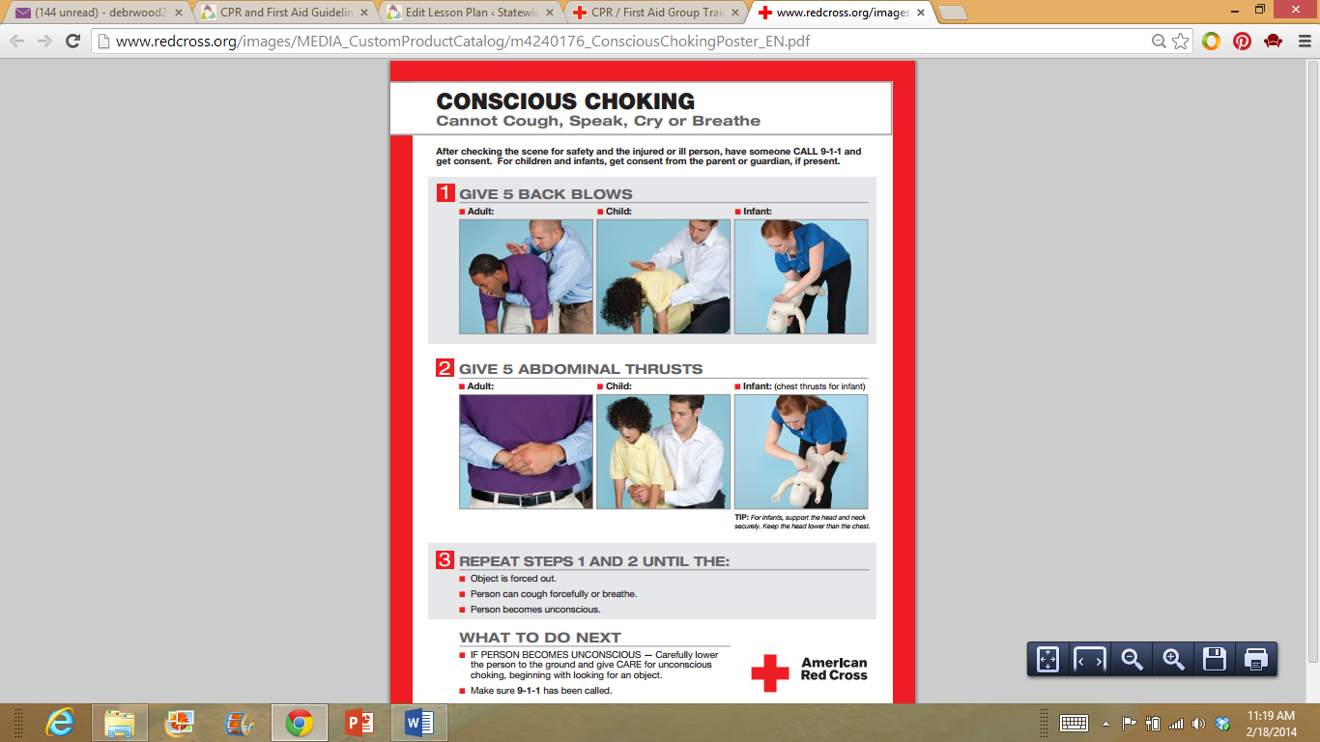
What to do about conscious choking
(click on poster)
Notes:
Choking occurs when a food or a foreign object becomes lodged in the throat or windpipe. The Red Cross recommends a "5-and-5" method of first aid for choke victims (refer to poster).
What should you do if you see someone choking?
What should you do if you see a baby choking?
What are some common choking hazards for children?
Remember the cardboard toilet-paper tube test? If an object can fit in a cardboard toilet-paper tube, it’s a choking hazard. Check your home and make sure all small objects are out of both sight and reach of young ones. Tie up cords from blinds and drapery, and keep ropes, ribbons, string and plastic grocery bags away from small children.
In a choking scenario, when do you call 911?
American Red Cross
Conscious choking poster.
http://www.redcross.org/images/MEDIA_CustomProductCatalog/m4240176_ConsciousChokingPoster_EN.pdf

Slide 22
What is the universal distress signal for choking?

Slide 23
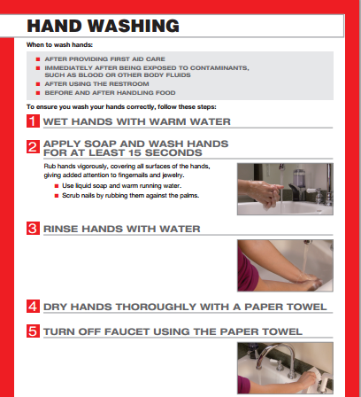
Hand Washing
After providing first aid care
Immediately after being exposed to contaminants, such as blood or other body fluids
After using the restroom
Before and after handling food
Notes:
American Red Cross
Hand washing poster.
http://www.redcross.org/images/MEDIA_CustomProductCatalog/m4240174_HandWashingPoster_EN.pdf

Slide 24
Reporting Accidents and Injuries
Reporting incidents should be done according to established center policies
Notes:
Accurate reporting of accidents, injuries or illness is essential to the child’s health record. This should be done according to established center policies and procedures in order to protect the child care center and the caregiver from possible legal liability.

Slide 25
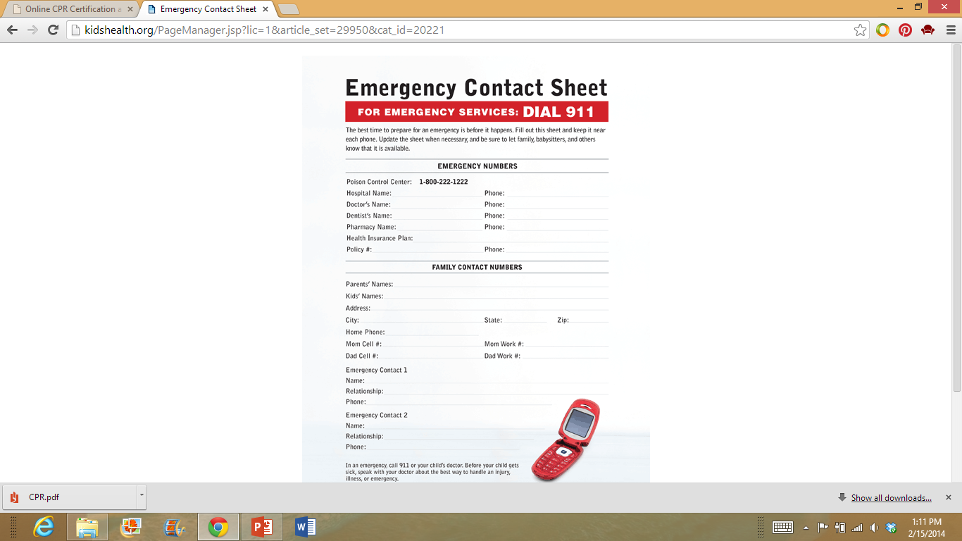
Emergency Contact Sheet
(click on poster)
Notes:
Why is it important to have an emergency contact sheet?
Who should have this information? Where should this contact sheet be placed?
KidsHealth.org
Printable safety guides.
http://kidshealth.org/parent/firstaid_safe/#cat20221

Slide 26

Babysitting Basics
Babysitting Basics Online Course: Overview
(click on link)
Notes:
Have you ever babysat? Completing this Babysitting Training Online Course will provide you with a certificate. You can share this with potential babysitting clients and perhaps earn more per hour. You can also add this certificate to your portfolio and résumé.
The American Red Cross offers a Babysitting Training Online Course. It will take you four hours to complete. You must pass a final exam with an 80 or better to receive a printable diploma. The cost is $25.00.
American Red Cross
Babysitting Basics Online Course: Overview
http://youtu.be/-sIMpZJaPZ4

Slide 27
Questions?

Slide 28
References and Resources
Images:
American Accreditation Health Care Commission
http://www.urac.org
American Red Cross
Conscious choking poster.
http://www.redcross.org/images/MEDIA_CustomProductCatalog/m4240176_ConsciousChokingPoster_EN.pdf
American Red Cross
Hand washing poster.
http://www.redcross.org/images/MEDIA_CustomProductCatalog/m4240174_HandWashingPoster_EN.pdf
Microsoft Clip Art: Used with permission from Microsoft.
National Institutes of Health
http://www.nih.gov/
Textbook:
Decker, Celia. Child development; early stages through age 12. 7th. Tinley Park, IL: Goodheart-Willcox, 2011.
Websites:
American Heart Association
What is CPR?
http://www.heart.org/HEARTORG/CPRAndECC/WhatisCPR/What-is-CPR_UCM_001120_SubHomePage.jsp

Slide 29
References and Resources
Kidshealth
Every parent should know how and when to administer CPR. When performed correctly, CPR can save a child’s life by restoring breathing and circulation until advanced life support can be given by health care providers.
http://kidshealth.org/parent/firstaid_safe/emergencies/cpr.html
Medline Plus
CPR – Child 1 to 8 years old
http://www.nlm.nih.gov/medlineplus/ency/presentations/100215_1.htm
YouTube™:
American Heart Association
Official 2012 Hands-Only CPR Instructional Video
http://youtu.be/zSgmledxFe8
American Red Cross
Babysitting Basics Online Course: Overview
http://youtu.be/-sIMpZJaPZ4

