Slide 1
Back to the Future
An Introduction to Sustainability in Food Service

Slide 3
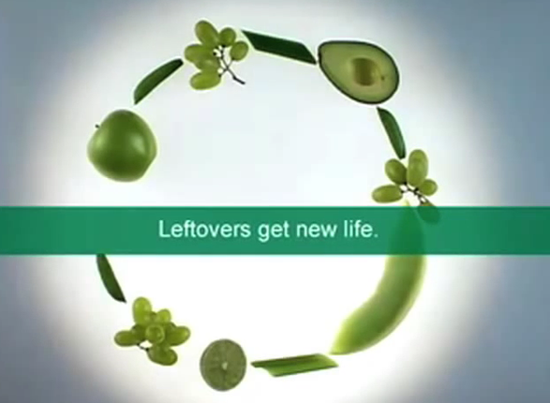
What is Sustainability?
  The practice that meets current resource needs without compromising the ability to meet future needs
  Food Scraps to Green Energy
  (click on link)
Notes:
Ask students what they think sustainability is.
Click on hyperlink to view video:
Food Scraps to Green Energy
Food waste is the second largest portion of garbage going into landfills in the United States, accounting for over 30 million tons each year.
http://youtu.be/vhyekv1V32s
Accessible version: http://www.epa.gov/region09/waste/features/foodtoenergy/

Slide 4

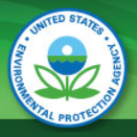
Environmental Protection Agency (EPA)
  Federal agency
  Mission
    To protect human health and the environment
  Focus
    Finding ways to preserve natural resources such as:
      Water
      Energy
Notes:
In recent years, many people/businesses have voiced an interest in going green.
What actions are you aware of that protect and preserve the environment?
Protecting the environment means protecting our resources through engaging in conservation and sustainable practices.
Sustainable agriculture was addressed by Congress in the 1990 Farm Bill - Food, Agriculture, Conservation, and Trade Act of 1990.
Under that law, “the term sustainable agriculture means an integrated system of plant and animal production practices having a site-specific application that will, over the long term:
satisfy human food and fiber needs
enhance environmental quality and the natural resource base upon which the agricultural economy depends
make the most efficient use of nonrenewable resources and on-farm resources and integrate, where appropriate, natural biological cycles and controls
sustain the economic viability of farm operations
enhance the quality of life for farmers and society as a whole.”

Slide 5
Water
  Quick fact
    On average, North Americans use 92 gallons of water per person per day
  Effect of disappearing water supply
    No water for crops and animals
    Businesses and farms may close
    Unemployment rises
    Increase in brush fires and dust storms
    Dying cities and towns or overpopulation
Notes:
As industries, population and recreation activities increase, so do the demands on the water supply.
Weather patterns also impact water supply. Lack of water has far reaching effects.

Slide 6
Conserving Water
  The Food Service Industry can conserve water by:
    Thawing food in cooler/refrigerator
    Soaking and scraping dirty dishes before washing
    Loading dishwashers correctly
    Repairing leaks quickly
    Not automatically serving water to customers
Notes:
Many times, as we are working in the restaurant, we do not think about how we are working.
Conservation suggestions for food service may have been introduced first in the home – a smaller setting.
The food service industry soon realized these money saving practices would provide an environmentally sound policy for business.
Which water conservation practices could be applied to our culinary classroom?

Slide 7
Energy
  Renewable Energy
    Can be refurnished quickly
    Water – Hydropower
    Wind
    Solar
    Geothermal – heat inside earth
    Biomass – stored energy from sun
  Non-Renewable Energy
  Limited Supply
  Fossil Fuels
    coal
    natural gas
    petroleum (crude oil)
    propane
  Effects:
    air pollution (greenhouse gas)
    earth’s average temperature affecting climate
Notes:
Energy is divided into two categories: Renewable and non-renewable.
For years, even decades and centuries, we have relied on non-renewable energy. We have become comfortable using coal for electricity and petroleum for our cars.
Society is trying to move toward more renewable and sustainable energy.
If you drive along some interstate highways (in your hybrid or electric car), you may see wind farms. The Air Force Academy in Colorado Springs has installed 81,888 solar panels over 41 acres which will provide 11% of the academy’s electricity needs.
Our population is becoming cognizant (aware) of the need to conserve our resources. It is time for the business community to join that effort.

Slide 8

Energy Conservation
  Highest percentage of energy used by:
    Cooking equipment
    Heating and cooling
  Conserve by:
    Turning off lights when not in use
    Powering down idle equipment – use timers
    Purchasing energy-efficient equipment
    Using compact fluorescent or LED light bulbs
    Sealing off unused areas
Notes:
Once again, conservation practices in the home have transitioned to business/food service establishments.
Conserving energy not only affects the carbon footprint of businesses, but increases the bottom line by saving money through these efforts.

Slide 9



Conservation Construction
  Brownfield site – repurposed industrial site
  Green building – a sustainable building
  Renovate existing buildings – green improvements
Notes:
When deciding to start a business, there are three building considerations.
Building on a cleaned and repurposed industrial site (may have been contaminated with hazardous waste), this would be considered a brownfield site.
Building on a cleared “pad” site, design the structure to conserve energy – thus creating a green building.
Renovate an existing building and incorporate the use of green building materials.
Be sure to research energy savings that may offer incentives and tax breaks.

Slide 10
The 3 R’s of Conservation
  Recycle
    Audit trash
    Create a recycle environment
  Reduce
    Smart planning – limit overproduction
    Bulk purchasing
  Reuse
    Repurpose food
    Recycle products
Notes:
Identifying the 3 R’s of conservation will assist moving to sustainable practices.
For example:
Simple practices to institute, but take thought and planning.
Recycle:
create a recycling environment by providing recycle bins and include recycling practices in your everyday operations
use recycled furniture or products
use trayless dining by using plates and glasses
Reduce:
food waste can be eliminated by smart planning and better forecasting of food needed
if food is made ahead of time and not used (such as loaves of bread and desserts) it can be sold or donated as long as it was cooked and stored properly
Reuse:
repurpose food into another format – unused cooked chicken to make chicken salad
donate food, if allowed, to local programs
help local farmers by composting food scraps
Who would think to audit their trash? By auditing you trash you can better estimate your recycling focus.
Be mindful of each business practice/policy.

Slide 11
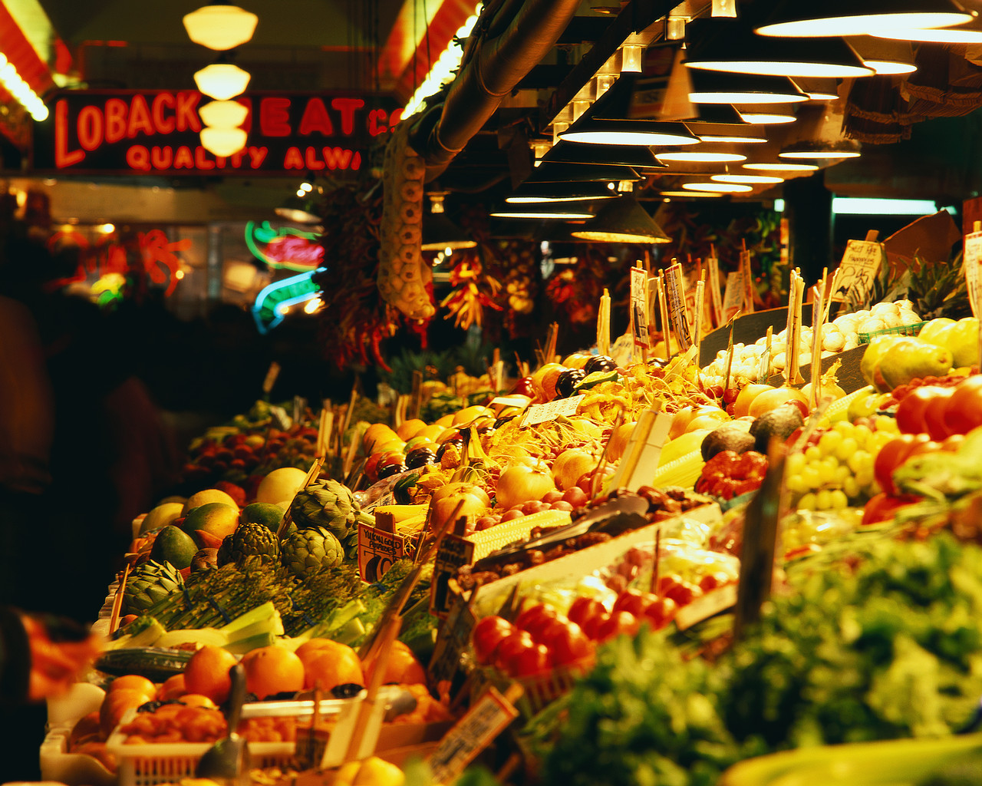
Composting
  Turn food throwaways into organic fertilizer
  Natural form of recycling
  Do not compost:
    dairy products
    fats, grease and oil
    meat, fish bones and related scraps
Notes:
Do you or does your family compost?
What can be done with compost?
Why do you think we cannot compost dairy products, fats, grease, oil, meat, fish bones and related scraps?

Slide 12
Sustainable Food Practices
  Food Miles
    How far food products travel
  Local Sourced Food
    Food produced in surrounding area
  Overfishing
    Aquaculture
Notes:
Eating and preparing “fresh” food has several benefits:
buying from local producers positively affects the local economy
better flavor and nutrition from less processed food - it stands to reason that food freshness is affected by the number of miles and processing it experiences
farm to table is a growing food service trend that allows restaurants to receive the freshest food possible for their menu. In addition, the farm to table trend influences chefs and restaurateurs to plan seasonal menus optimizing seasonally fresh food.
Sustainable seafood is included in sustainable food practices.
Some fish species experience overfishing – catching fish at a faster rate than they can reproduce.
The demand for fresh seafood has given rise to aquaculture – production of seafood under controlled conditions.

Slide 13

Other Sustainable Food Improvements
  Industrialized Farming
    Effects on environment
  Organic Food – Alice Waters
    Pesticides or synthetic fertilizers stopped being used
  Shade Coffee
    Grows under taller rainforest trees
  Smaller Family Farms and Ranches
    Produce smaller quantities
  Sun Coffee
    Large forests cleared for sun coffee
Notes:
Farming has existed for centuries. At one time, family farms, ranches and dairies were the backbone of this country.
It still is, but the size and production has changed as population has changed. This has increased the demand for available food.
Industrialized commercial farms process food and animals on a large scale.
In what way, do you feel, this industrialized farming has affected the farming industry as a whole?
In the early 1970’s, Chef Alice Waters (Berkley, California), embraced and promoted the now trendy local food use and has been a proponent of the organic food movement for 40 years.
She has been called the mother of American food. Her initial plant farming has gone full circle.
Although there are still industrial food production facilities, more people are opting to buy food from local food producers. Not only is their food fresher, but they economically contribute to the local community.
The traditional coffee growing practice is shade coffee. This practice allows for coffee to grow under taller rainforest trees. In what way is the environment and habitats affected by this practice?
The increasing popularity in coffee affects the demand to grow more coffee.
Modern coffee growing practices use sun coffee – larger forests are cleared or thinned to make room for more crops.
What effect might this have on the forests and habitats?
What will you do?

Slide 14

Questions?

Slide 15
References and Resources
  Images:
    Microsoft Office Clip Art: Used with permission from Microsoft.
  Textbook:
    Foundations of restaurant management and culinary arts, Level two. (2011). Boston: Prentice Hall.
  Website:
    EPA – United States Environmental Protection Agency
    Our mission is to protect human health and the environment
    http://www2.epa.gov/aboutepa
  YouTube™:
    Food Scraps to Green Energy
    Food waste is the second largest portion of garbage going into landfills in the United States, accounting for over 30 million tons each year.
    http://youtu.be/vhyekv1V32s
    Accessible version: http://www.epa.gov/region09/waste/features/foodtoenergy/

