Slide 1
Welding Sheet Metal
Flexible Manufacturing

Slide 3
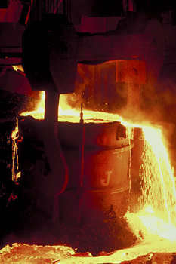
Sheet Metal
There are many types of sheet metals manufactured for various applications.
The sheet metal may be developed to bend, stretch, or to resist corrosion.
The application will determine what alloys are added to the steel when making it.

Slide 4
History of Sheet Metal
Sheet metal is formed when a hot steel ingot is squeezed between a series of rollers.
The rollers apply pressure and compress the metal into a long, thin sheet.

Slide 5
Rolling Mill Animation

Slide 6
Hot Rolled vs. Cold Rolled
Hot Rolled
Formed while hot
Not uniform in thickness
Surface can be scaly
Less expensive
Cold Rolled
Formed when cold
Uniform in thickness
Surface is smooth
Costs more than hot rolled
Surface can be grained or textured

Slide 7
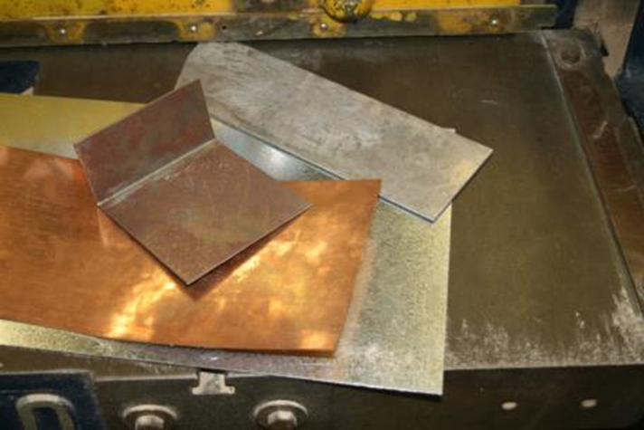
Sheet Stock in Flexible Manufacturing
Sheet stock used in a lab will be different gauges of steel, and it could include materials such as copper, aluminum, and brass.

Slide 8
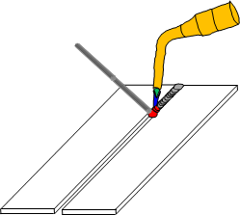
Welding Sheet Metal
Oxy-fuel Process
Welding sheet metal is achieved by heating the edges of the metal and adding a filler rod into the weld pool.

Slide 9
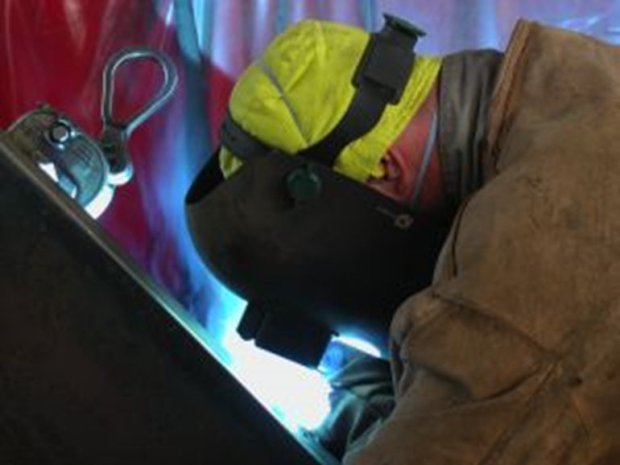
Welding Sheet Metal
The torch tip selected should provide the right amount of heat to melt the metal and rod.
If the tip has a large opening, the metal will heat too fast, causing the puddle to be too hard to control, which causes a poor weld.

Slide 10
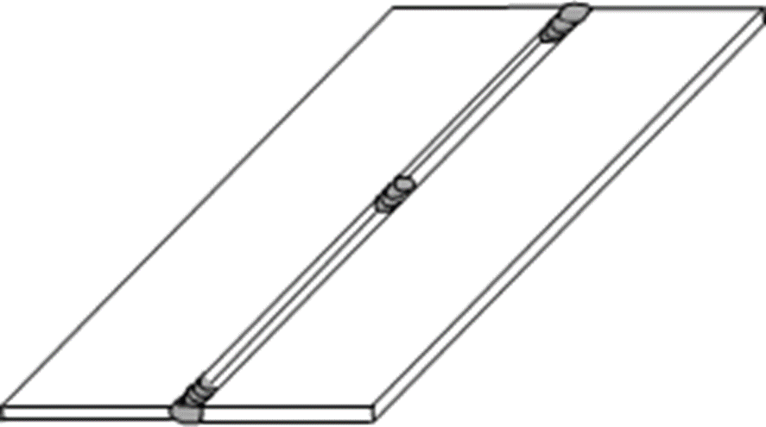
Welding Sheet Metal
The weld joint should be tacked in a few places before welding, to keep the joint from warping and twisting.

Slide 11
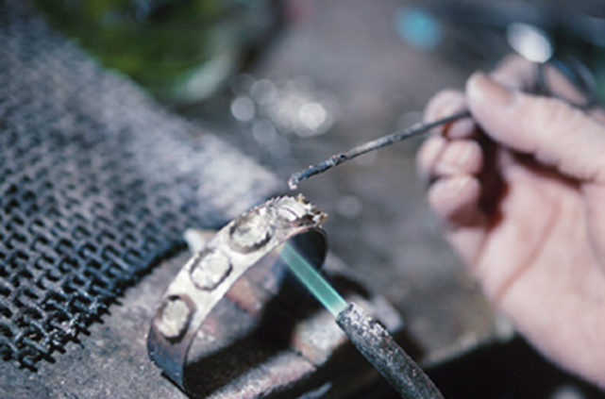
Welding Coated Metal
Zinc and other coated metals should be welded with great caution.
Weld only in a well-ventilated area.

Slide 12
Shielded Metal Arc Welding on Sheet Metal
Welding on thin sheet metals requires a smaller diameter electrode and less amperage.
When welding 1/16” thick sheets together, the electrode used will be a 1/16” diameter rod with the amperage set at 20-40 amps.
The amperage used should not melt the metal too fast; this will cause burn through.
Overheating of the weld makes it hard to control the weld pool and causes a poor weld.

Slide 13
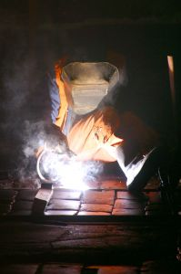
Shielded Metal Arc Welding on Sheet Metal
The welder will need to tack-weld the joint in different places to keep the welded metal even.
Overheating the metal causes it to wrap, twist, or spread apart.

Slide 14
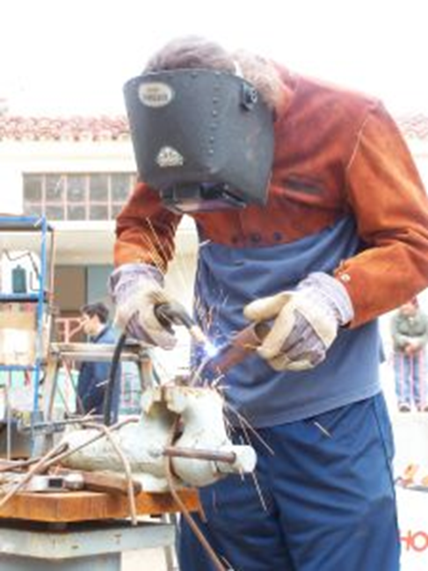
Gas Metal Arc Welding on Sheet Metal
Gas metal arc-welding uses a thin wire for the electrode.
The electrode is fed through the machine and out of a gun.
The gun also has argon gas piped to it.
The gas envelopes the arc and shields the molten puddle from the atmosphere.

Slide 15
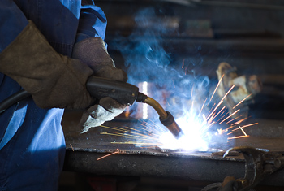
Gas Metal Arc Welding on Sheet Metal
The small diameter of the wire electrode makes it easier to weld sheet metal.
The amperage can be set lower to keep from burning through the metal edges.
The operator can set the feed rate for the wire electrode, controlling the arc more easily.

Slide 16
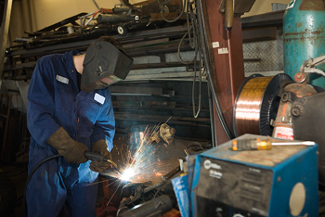
Gas Metal Arc Welding on Sheet Metal
Used on production lines
Used in welding and auto body repair shops

Slide 17
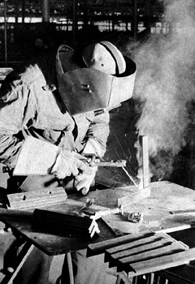
Welding Electrodes
Common Types of Electrodes
Different types of welding have different styles of electrodes.
The electrode provides the path for the current to flow to the metal to be welded.

Slide 18
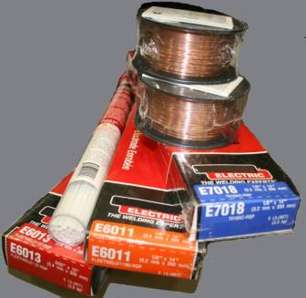
Welding Electrodes
Common Types of Electrodes
Shielded metal-arc welding (SMAW) or “stick welding” uses a metal rod coated with a flux.
They have a number system that describes the rods, tensile strength, coating, welding current, and direction.
E6013

Slide 19
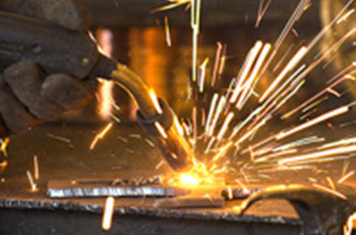
Welding Electrodes
Common Types of Electrodes
Gas metal arc-welding (GMAW) or “MIG welding” uses a thin wire loaded into the machine’s feeder.
The wire is sized by diameter.

Slide 20
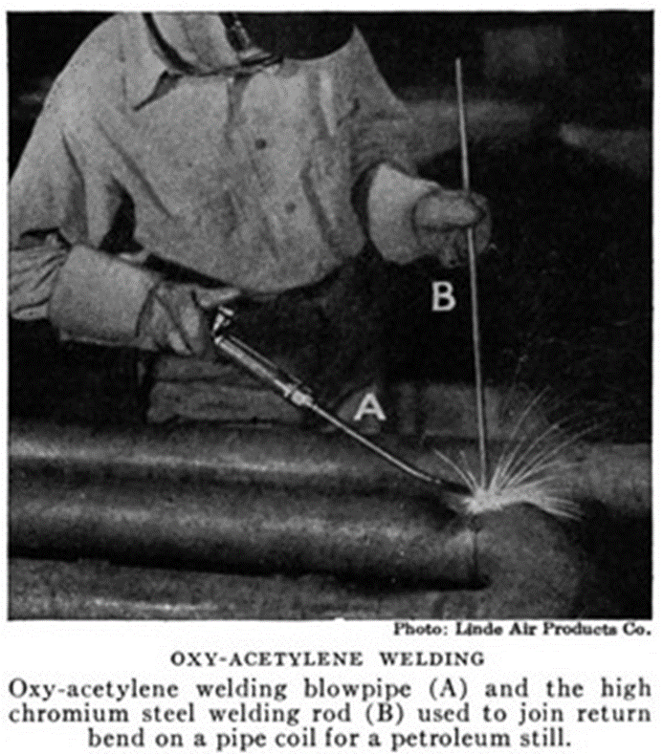
Welding Electrodes
Common Types of Electrodes
Gas Tungsten Arc Welding(GTAW) or “TIG welding” uses a tungsten rod as the electrode.
Oxygen Acetylene (OAW) uses a metal filler rod in the welding process.

Slide 21
Welding Electrodes
Common Types of Electrodes
Different types of welding have different styles of electrodes.
The electrode provides the path for the current to flow to the metal to be welded.

Slide 22
Resources
Althouse, Turnquist, Bowditch, Bowditch, Bowditch. (2013). Modern welding. Tinley Park, Illinois: Goodheart-Willcox.

