Slide 1
The Making of Laws
Principles of Law, Public Safety, Corrections & Security

Slide 3
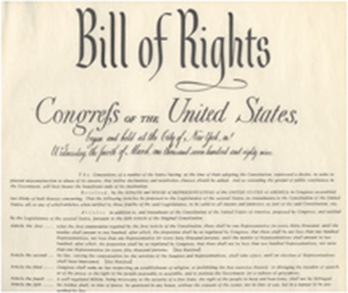
Sources of Laws
Federal
U.S. Constitution
U.S. Criminal Codes
Judicial decisions interpreting codes
Executive orders

Slide 4
Sources of Laws
State
State constitution
State criminal codes
Common law
Local
City and county charters
Municipal and county ordinances or violations
Common law
Judicial decisions interpreting the codes or laws

Slide 5
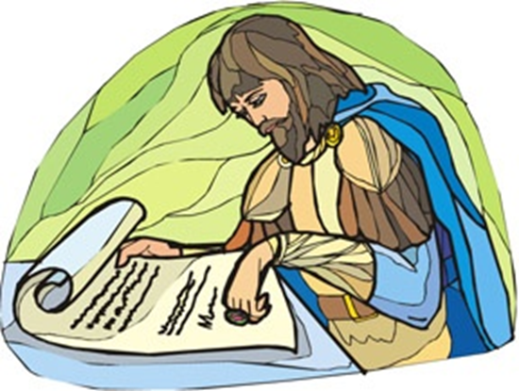
Historical Origins
Code of Hammurabi
Magna Carta
English common law
English Bill of Rights

Slide 6
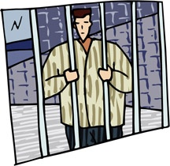
Classifications of Crimes
Class C Misdemeanor
Fine up to $500 (ticket)
Cannot be arrested
Speeding or Open Container
Class B Misdemeanor
Up to 180 days in jail
$2,000 fine
Class A Misdemeanor
Up to 2 years in jail
$4,000 fine

Slide 7
Classifications of Crimes
State Jail Felony (SJF):
180 days to 2 years
$10,000 fine
3rd Degree:
2-10 years
$10,000 fine
2nd Degree:
2-20 years
$10,000 fine
1st Degree:
5-99 years
$10,000 fine
Capital:
Death
Life without Parole

Slide 8
Amendments
First Amendment
Religion
Speech
Press
Peaceful assembly
Petition for redress of grievances
Second Amendment
Right to bear arms

Slide 9
Second Amendment
Places Weapons Prohibited Penal Code 46.03, F3
A person intentionally, knowing, or recklessly possesses, or carries a weapon onto the physical premises of:
School grounds, events, or transportation
A polling place during voting
Government courts or offices
A racetrack
An airport
1,000 ft from executions
Third degree felony

Slide 10
Second Amendment
Unlawfully Carrying a Weapon Penal Code 46.02, class A
A person intentionally, knowingly, or recklessly carries, on or about his person, a handgun (without license)
Felony if the person carries a gun on premises licensed or issued a permit by the state for the sale or service of alcoholic beverages

Slide 11
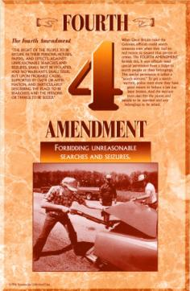
Amendments
Fourth Amendment
“The right of the people to be secure in their persons, houses, papers, and effects, against unreasonable searches and seizures, shall not be violated, and no Warrants shall issue, but upon probable cause, supported by Oath or affirmation, and particularly describing the place to be searched, and the persons or things to be seized.”

Slide 12
Fourth Amendment
Arrest, Search, and Seizure
CCP 15.22
A person is arrested when he has been actually placed under restraint or taken into custody by an officer or person executing a warrant of arrest, or by a person who has the authority to arrest

Slide 13
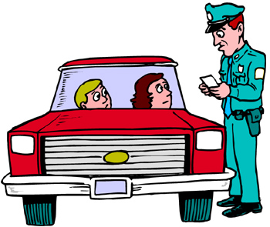
Fourth Amendment
Elements of Arrest
Intent
Authority
Custody (seizure or detention)
Understanding of the subject

Slide 14
Fourth Amendment
Absolute Certainty
Beyond a Reasonable Doubt
Levels of Proof
Criminal Jury Verdict
Non-Suggestiveness of Identification
Clear and Convincing
Civil Trial Decision
Preponderance
Take Case to a Jury
Prima Facie
Arrest, Search, Indictment, Information
Probable Cause
Stop, Frisk, Question
Reasonable Suspicion
Mere Hunch
No Basis for Knowledge

Slide 15
Fourth Amendment
Guidelines of Arrest
An arrest may be made anytime of the day or night (CCP 15.23).
When making an arrest, all reasonable means are permitted to affect it. No greater force, however, shall be resorted to than is necessary to secure the arrest and detention of the suspect (CCP 15.24)

Slide 16
Fourth Amendment
Temporary Detention
Reasonable suspicion
Activity occurring/just occurred
Person connected to activity
Limited time
Florida v. Royer
Investigative detention
No longer than necessary
Scope of detention matches justification
Stops
Justified if:
Not fitting time or place
Fits description of a wanted person
Emotional, frightened, or intoxicated
Running/furtive movements
Loitering, hanging out, or on “look out”
Crime scene area

Slide 17
Fourth Amendment
Elements of Arrest
Intent
Authority
Custody (seizure or detention)
Understanding of the subject

Slide 18
Fourth Amendment
Elements of Arrest
Intent
Authority
Custody (seizure or detention)
Understanding of the subject

Slide 19
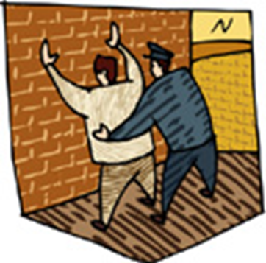
Fourth Amendment
“Terry Frisk”
Terry v. Ohio
Unusual Conduct
May be armed and dangerous
Protection of self and others
Suspicion of crime and weapon to be used
Careful pat of outer clothing
Alone and no backup
Emotions or behavior of suspects

Slide 20
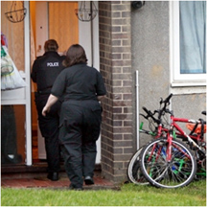
Fourth Amendment
Search Defined
Prying into hidden places to look for material which is concealed; it is not a search to observe that which is open to view.

Slide 21
Fourth Amendment
Search Warrant
Definition – CCP 18.01
Neutral and detached magistrate
Probable cause or staleness
Sworn affidavit
Must include:
The specific offense committed
The specific property to be seized
The property is at place to be searched
Search Beyond a Warrant
Protective sweep
Prevent the destruction of evidence
Discover more, or possible, evidence in plain view elsewhere on the property
Hunt for evidence or contraband that, as a result of the initial search, is believed to exist in another location on the property

Slide 22
Fourth Amendment
Exceptions to Search Warrant
Vehicles
Open fields
Anything with consent
Abandoned property
Inventory
Plain view
Searches Allowed at School
Backpack searches
Locker searches
Vehicles searches
Strip searches
The use of metal detectors
The use of drug dogs
Consent to search

Slide 23
Fourth Amendment
Search Incident to Lawful Arrest
The arrest must be lawful
Search the area within immediate control
Contemporaneous with arrest
Do not destroy evidence

Slide 24
Fourth Amendment
Plain-View Doctrine Coolidge v. New Hampshire
The initial intrusion must be lawful or in proper position to view the property.
The discovery must be inadvertent.
It must be immediately apparent that items are evidence of a crime, contraband, or subject to seizure

Slide 25
Fourth Amendment
Exclusionary Rule
CCP 38.23
No evidence shall be admitted into a criminal trial that was obtained in violation of constitutional rights
Mapp v. Ohio
Illegally seized evidence could be excluded from both state and federal cases

Slide 26
Amendment
Fifth Amendment
Grand jury
Double jeopardy
Self-incrimination
Due process
Just compensation for government takings

Slide 27
Amendment
Double Jeopardy
Exceptions to Double Jeopardy
Convicted and asks for a new trial
Convicted and the case is overturned
The case results in a hung jury
Can be tried at both the state and federal levels for the same crime

Slide 28
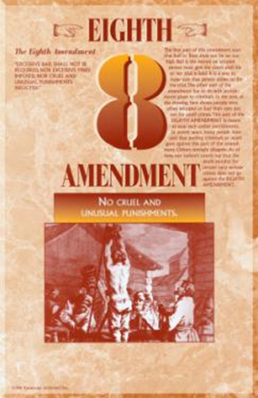
Amendment
Eighth Amendment
No excessive bail
No excessive fines
No cruel and unusual punishment

Slide 29
Elements of a Crime Definitions
Actus Reus
The actions of the person committing the crime as defined by law
Mens Rea
The state of mind and intent of the person committing the actus reus

Slide 30
Actus Reus
Physical or verbal acts that are voluntary
Can be failure to act or lack of action
Possession of an illegal or prohibited item
Constructive possession – does not have physical or actual possession of an illegal item but exercised care, custody, or control over the contraband, knowing it was illegal
Knowing possession – a person has actual possession and knows that the item is illegal
Mere possession – a person has actual possession of an illegal item, but does not know it is illegal

Slide 31
Mens Rea
The state of mind and intent of a person committing the act of a crime
General intent – the logical outcomes associated with a criminal act
Transferred intent – a person injures another but did not intend to harm the party
Constructive intent – the actor did not intend to harm anyone but should have known that his or her behavior created a high risk of injury
Strict liability

Slide 32
Inchoate Offenses
Solicitation
The incomplete crime of urging, requesting, or commanding another person to commit a crime
Conspiracy
A criminal act requiring no action other than communication
Attempt
A criminal act amounting to more than mere preparation

Slide 33
Classification of Crimes
Crimes against
The state
Persons
Habitations
Property
Public order
Public morals

Slide 34
Crimes Against Persons
Murder
Rape
Sexual assault
Kidnapping
Robbery
Assault

Slide 35
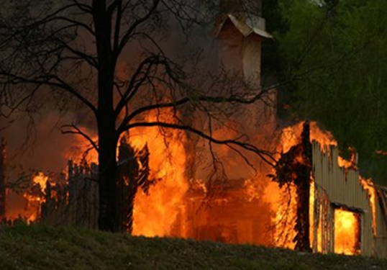
Crimes Against Habitations
Arson
Burglary
Criminal trespass

Slide 36
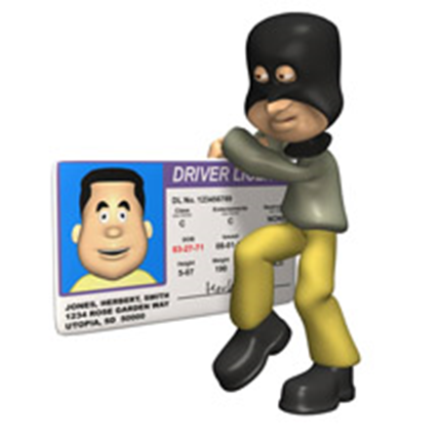
Crimes Against Property
Theft
Forgery
Fraud
Criminal mischief
Reckless damage
Graffiti
Unauthorized use of a motor vehicle

Slide 37
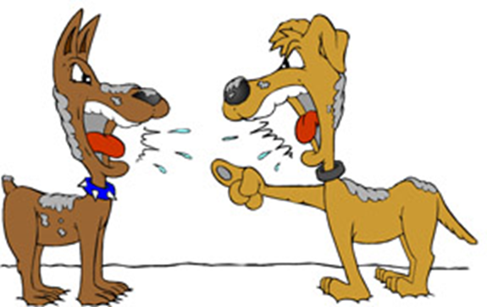
Crimes Against Public Order
Public intoxication
Disorderly conduct
Riot
Harassment or stalking
Cruelty to animals
Dog fighting

Slide 38
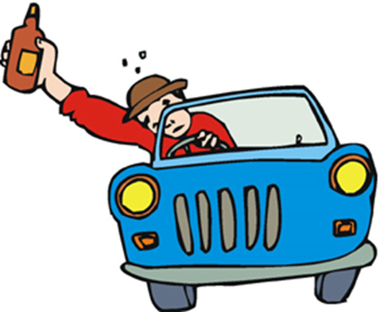
Crimes Against Public Morals
Prostitution
Possession of child pornography
Gambling
Driving while intoxicated
Engaging in organized crime

Slide 39
Problems with Enforcement
Rules of evidence
The Exclusionary rule
Fruit of the Poisonous Tree Doctrine

Slide 40
Procedures for Enacting Law
The idea is formatted in the written form of a Bill.
The bill is sent to a congressional committee.
The bill goes to House for a vote; if it does not pass, it dies.
If the bill passes the House vote, it proceeds to Senate.
The Senate passes the Bill.
The bill is sent to the President for a signature.
If the President fails to sign, the Bill goes back to a committee.
If the President signs the bill, it becomes law.

Slide 41
Resources
Texas Penal Code http://www.statutes.legis.state.tx.us/
Bill of Rights http://www.archives.gov/exhibits/charters/charters.html

