Slide 1
Streaking an Agar Plate For
Isolation
of Bacterial Colonies

Slide 3
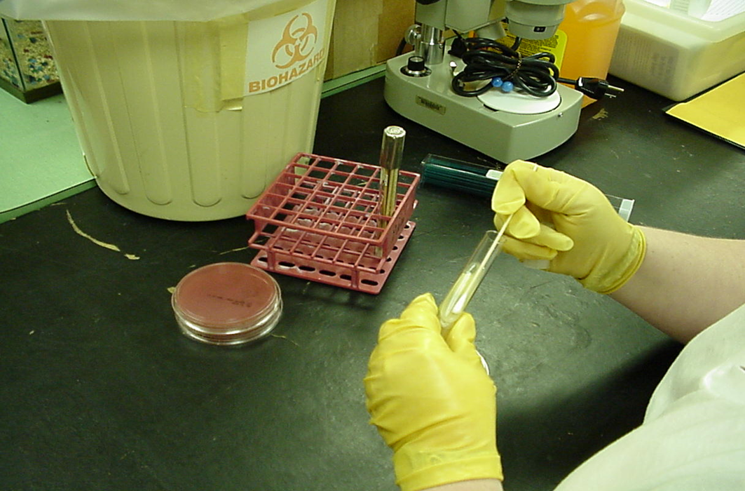
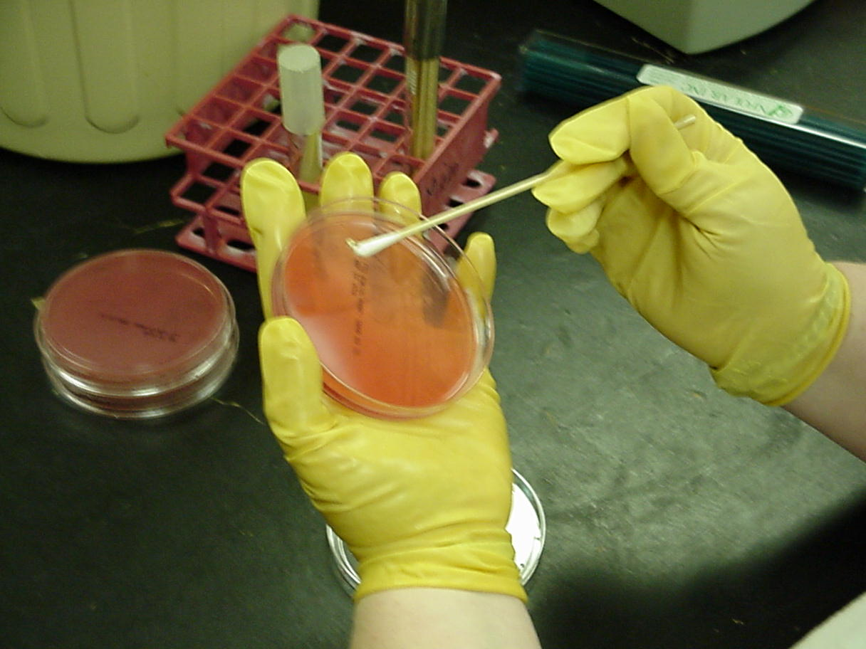
Streaking for Isolation
Step 1: Using a sterile cotton swab, insert it into your bacteria culture.
Step 2: Place a small amount of specimen in quadrant one of your agar plate.

Slide 4
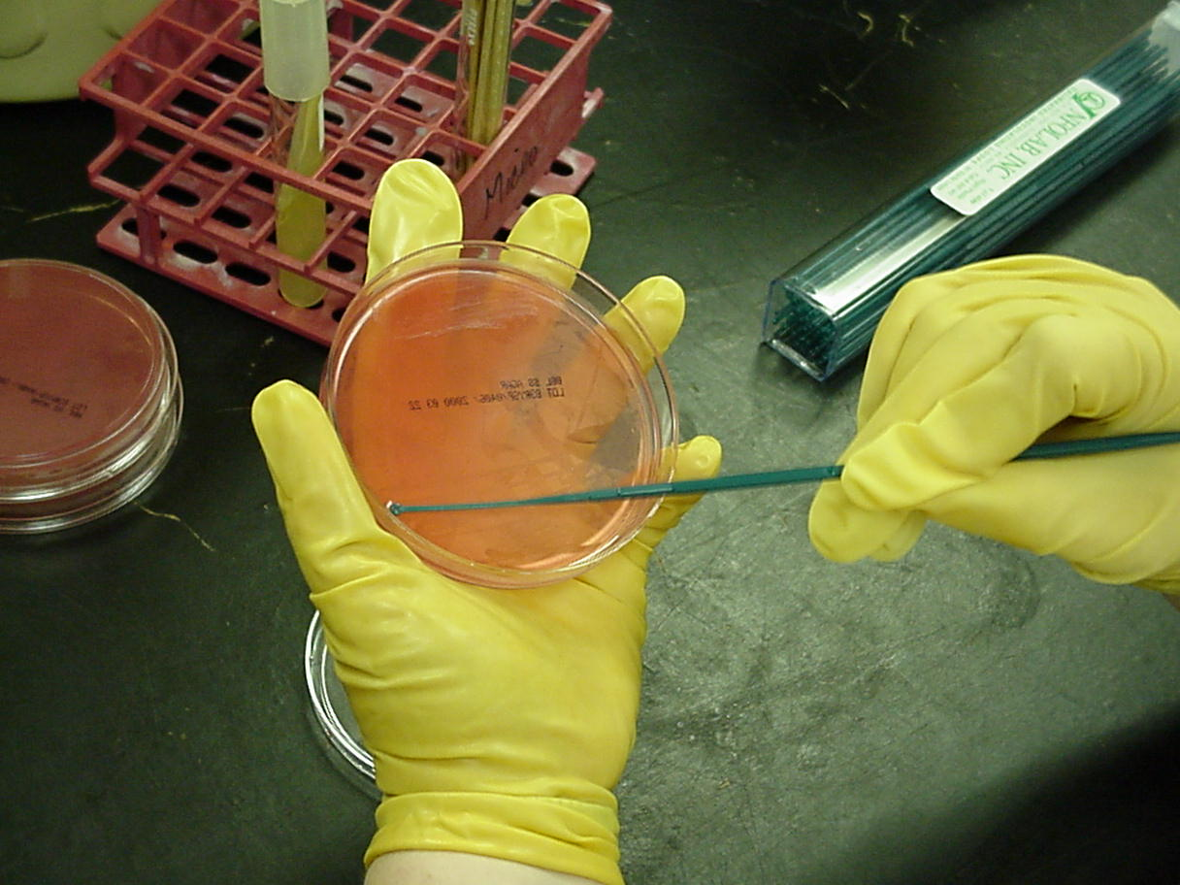
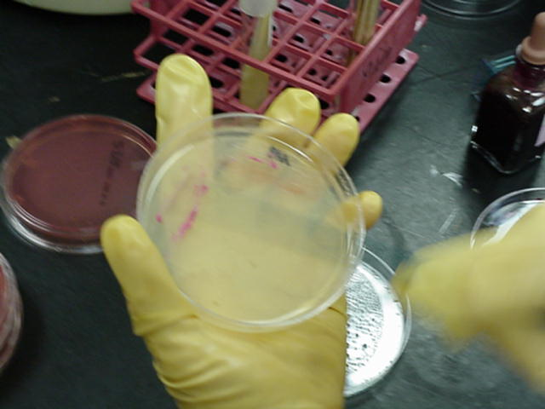
Streaking for Isolation
Step 3: Hold the inoculating loop handle in one hand and the agar plate in the opposite hand.
Step 4: Streak quadrant one with numerous streak lines as indicated on your handout. Streak lines close together. Do not streak over previous lines.

Slide 5
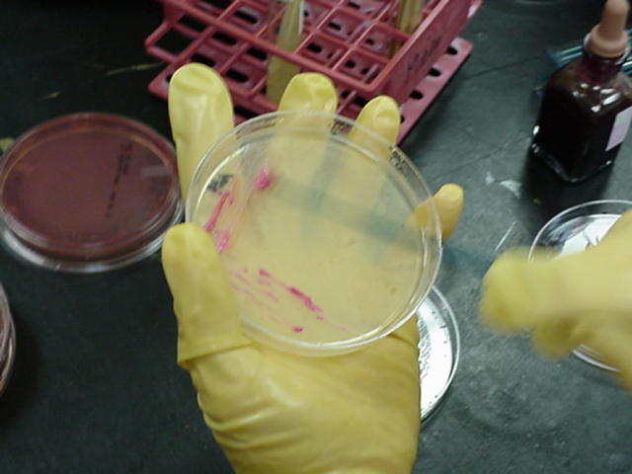
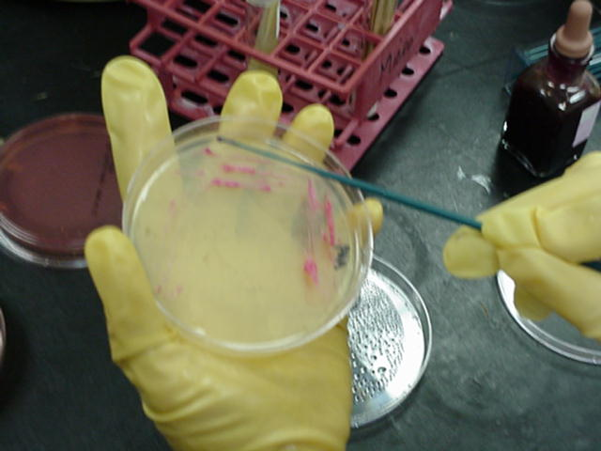
Streaking for Isolation
Step 5: Turn the plate to quadrant two. Pass through quadrant one with the inoculating loop ONCE to obtain some of the inoculum. Streak quadrant two as quadrant one was streaked.
Step 6: Streak quadrant three as quadrant two was streaked, taking one pass through quadrant two.

Slide 6
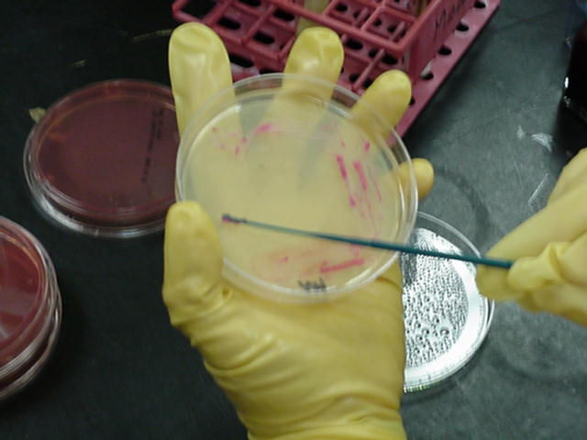
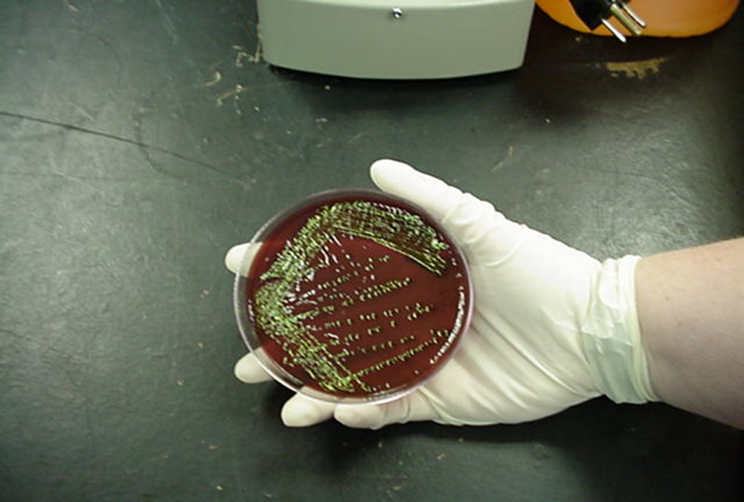
Streaking for Isolation
Step 7: Turn the agar plate to quadrant four. Obtain a small amount of quadrant three and place a streak line ONCE through quadrant four. This quadrant should run into the middle of the plate.
Step 8: Incubate the agar plate at 37C for 24 to 48 hours. Successful isolation of colonies will be obtained!

