Slide 2
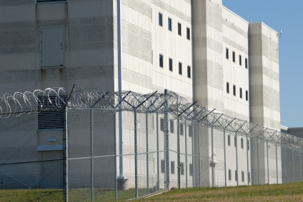
External Controls
A correctional facility’s physical features that make up its perimeter and support structures
Examples:
Anywhere inmates have access
Tower gates
Fences
Walls
Detection systems
Catwalks/run-arounds

Slide 3
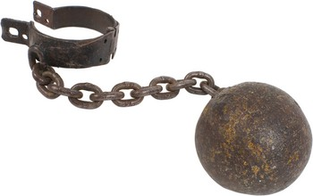
Inspections
Inspections help prevent
Hazards
Assaults
Contraband concealment
Disturbances
Escapes
Security breaches
Facility Alterations

Slide 4
Pedestrian and Vehicular Traffic
May only enter and leave at designated points
Should be located close to each other
Gates separate public access portions of the administration
All visitors and employees must
Pass through a security entrance
Have proper identification
Be processed into the facility

Slide 5
Hostage Policy
No hostage has any authority
No inmate will be released while holding someone hostage (visitor, employee, or another inmate)
Be a casual observer
Tunnels penetrating the perimeter are concerns
Secure them with grills
Use closed-circuit TV
Use motion detectors
Drain pipes must have a small diameter

Slide 6
Lighting
Light the perimeter
Place interior lights to eliminate blind spots in the shadow of buildings
Use high intensity, high mast lighting
Provides lighting level and coverage
Safer for staff
Reduces inmates’ ability to move at night

Slide 7
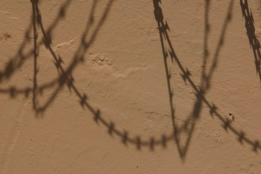
Outside-assisted Escape Attempts
They take a predictable form
A visitor brings in a weapon, disguise and/or other contraband
Be aware of situations outside the perimeter
Helicopter
Firing at towers

Slide 8
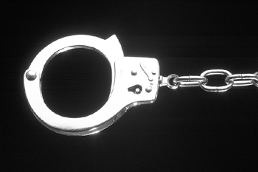
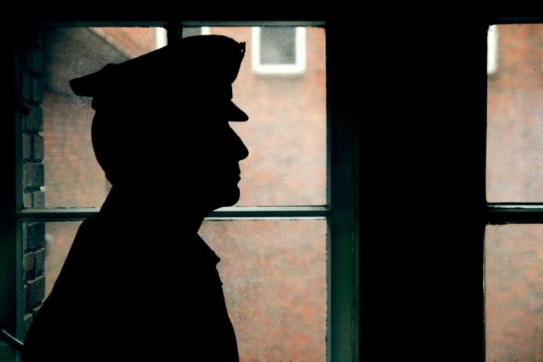
Internal Controls
Staff must account for the inmates
Follow procedures in the written security manual
Perform security inspections and inmate counts
Control weapons, chemical agents, keys, and tools
Attend yearly training
A visible supervisor helps a facility stay well-managed.

Slide 9
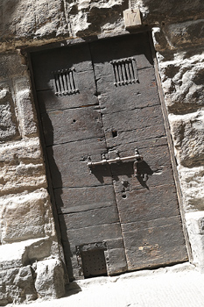
Design Issues
Central Control
Outside of the secure perimeter
Away from direct inmate activity
Most secure location (completely invulnerable to inmate attack)
Center of all communication
Is staffed 24 hours a day
Takes inmate counts
Issues and inventories keys
Coordinates internal and perimeter security networks

Slide 10
Design Issues
Central Control
Monitors
Key traffic points
Fire alarms
Smoke and thermal detection
Radios and computers
And more

Slide 11
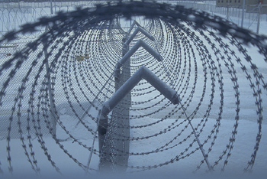
Internal Movement
Control can be facilitated by
Cutoff fences
Checkpoints
Closed-circuit cameras

Slide 12
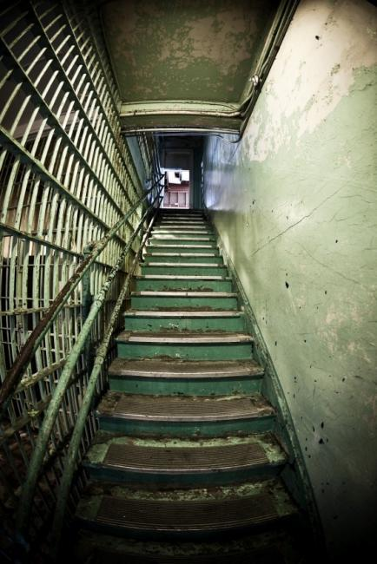
Entrances
Used to monitor and control inmate traffic
Mirrors
Closed-circuit television
Location is key
External physical features greatly affect the internal ones
Examples
Windows
Doors
Stairwells
Elevators

Slide 13
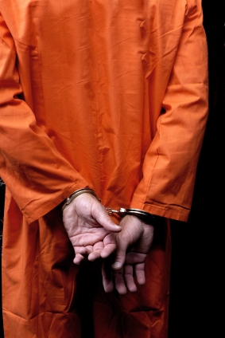
Inmate Accountability
Involves
Movement control
Pass systems
Census checks
Record systems
Requires a count each shift
Before and after typical working hours
After any mass movement
At bedtime
During the night (two or more)
Each inmate must actually be seen

Slide 14
Outcounts
Inmates
Assemble in a general area
Must be out when a count is done
Staff
Must submit inmates names and numbers
Call control center with numbers
Report to the count officer, who is accountable

Slide 15
Inmate Movement
Staff
Verify the inmates description
Check the count onboard each time the vehicle stops or starts
Use restraints (varies with inmate classification)
Use a combination of pass systems

Slide 16
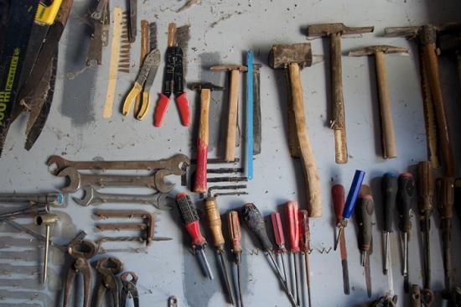
Tools
Control
Tools must be accounted for at all times
Every item is contraband
Need a tool control officer
Inventory is checked daily
Classifications
Class A (extremely dangerous)
Class B (Hazardous)
Class C (Non-Hazardous)
Storage
Shadow boards
Identifying marks
Receipt for each tool in use
Class A tools must be locked in a secure room

Slide 17
Food Service Items
Keep Class A items locked on a shadow board in the room of use
Do not use any food with alcoholic base
Keep yeast, nutmeg, and sugar in a locked area, or do not use

Slide 18
Hospital Items
Consider and store surgical tools as Class A
Keep bulk items in a vault (Emergencies only)

Slide 19
Searches and Contraband
Searches are frequent and unannounced
Inmates, property, and quarters
Other areas of the facility
Searches
Help detect contraband
Help prevent disturbances
Contraband
Can be sold or traded
Aids escape attempts
Destroys property
Endangers human life
Violate the institution’s rules
Need a written search policy and well-trained staff

Slide 20
Inmate Searches
Officers during pat downs
Require inmates to
Remove hats
Unbutton jackets
Empty pockets
Avoid using unnecessary force
Work from behind
Examine all the subject’s articles

Slide 21
Inmate Searches
Officers during pat downs
Follow these steps:
Run hands under the inmate’s shirt collar
Down the upper part of each arm to the wrists
Along the undersides of arms to the armpits
Down from the shirt front to the belt
Run thumbs around the inside of the belt (front to back)
Run hands down the front of legs to shoe tops
Then up the backside of legs
Down the back from the shirt collar to the waist

Slide 22
Body Searches
Officer’s duties
Perform only in a private area
Stand behind the inmate
Tell the inmate to remove all clothing, dentures, and prostheses and move away from them
Search the clothing
Inspect the inmates entire body visually for contraband
Mouth, armpits, feet, toes, and between buttocks
Only inspect body cavities with reasonable belief the inmate is carrying contraband

Slide 23
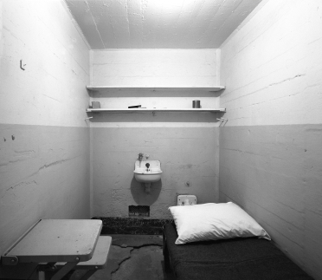
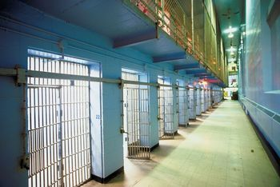
Housing Unit Searches
Do without warning
Conduct with two officers
Search before being occupied by new inmates
Be careful of needles
A few obvious hiding places
Holes and cracks in wall, floor, and ceiling
Lighting and wall fixtures
Washbowl, toilet, plumbing stacks
Shelves, drawers, and medicine cabinets and their contents

Slide 24
Vehicle Searches
Search all vehicles and machinery when entering or leaving
Inspect all the passenger compartments
Use mirrors to inspect the undercarriage
Search the contents of commercial vehicles

Slide 25
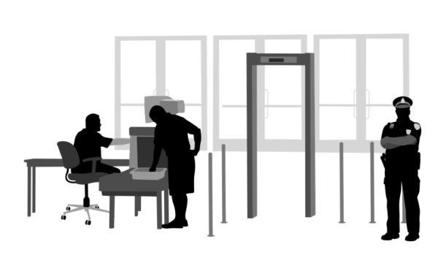
Visitation Searches
Search visitors before entering
Use metal detectors
Search all packages

Slide 26
Keys
Emergency Keys
Allows staff rapid access to every part of the facility to respond to a crisis
Should look the same as other keys
Restricted Keys
Laundry and clothing issue areas
Business office
Personnel office
The Commissary
Warehouses
Administration offices
Armory
Control center

Slide 27
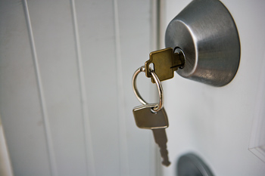
Key Handling
Do not leave keys in the lock
Never take entrance keys inside the facility
Never allow inmates contact with armory keys
Never allow grand master key in open circulation inside the institution

Slide 28
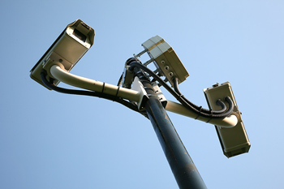
Security Inspections
Search all physical security features
Check for compromised security features
Follow maintenance procedures
Confirm security equipment is fully operational
Document all of this

Slide 29
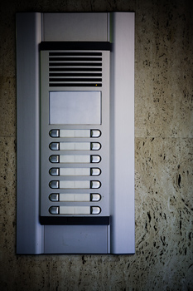
Communications
Effective communication is key for officers to function
Equipment used
Radios
Tower intercoms
Personal body alarms
Closed-circuit television

Slide 30
Handling High Security Inmates
High Security Inmates
Held in special housing units
Require extra supervision
Tower officers must know who they are

Slide 31
Special Supervision Units
These areas confine inmates who
Are extremely dangerous
Cannot be held safely in the general population of any regular institution.
Examples
Protective custody
Witness security
Death Row

Slide 32
Summary
Every correctional unit has protocols and policies in place to maintain the security of the facility and handle emergency situations.
It is important for a correctional officer to know these things for their safety and the safety of the other officers and inmates.

Slide 33
Resource
Correctional Officer Resource Guide (3rd edition), American Correctional Association

