Slide 1
The Global Economy
“It’s All Relative”

Slide 3
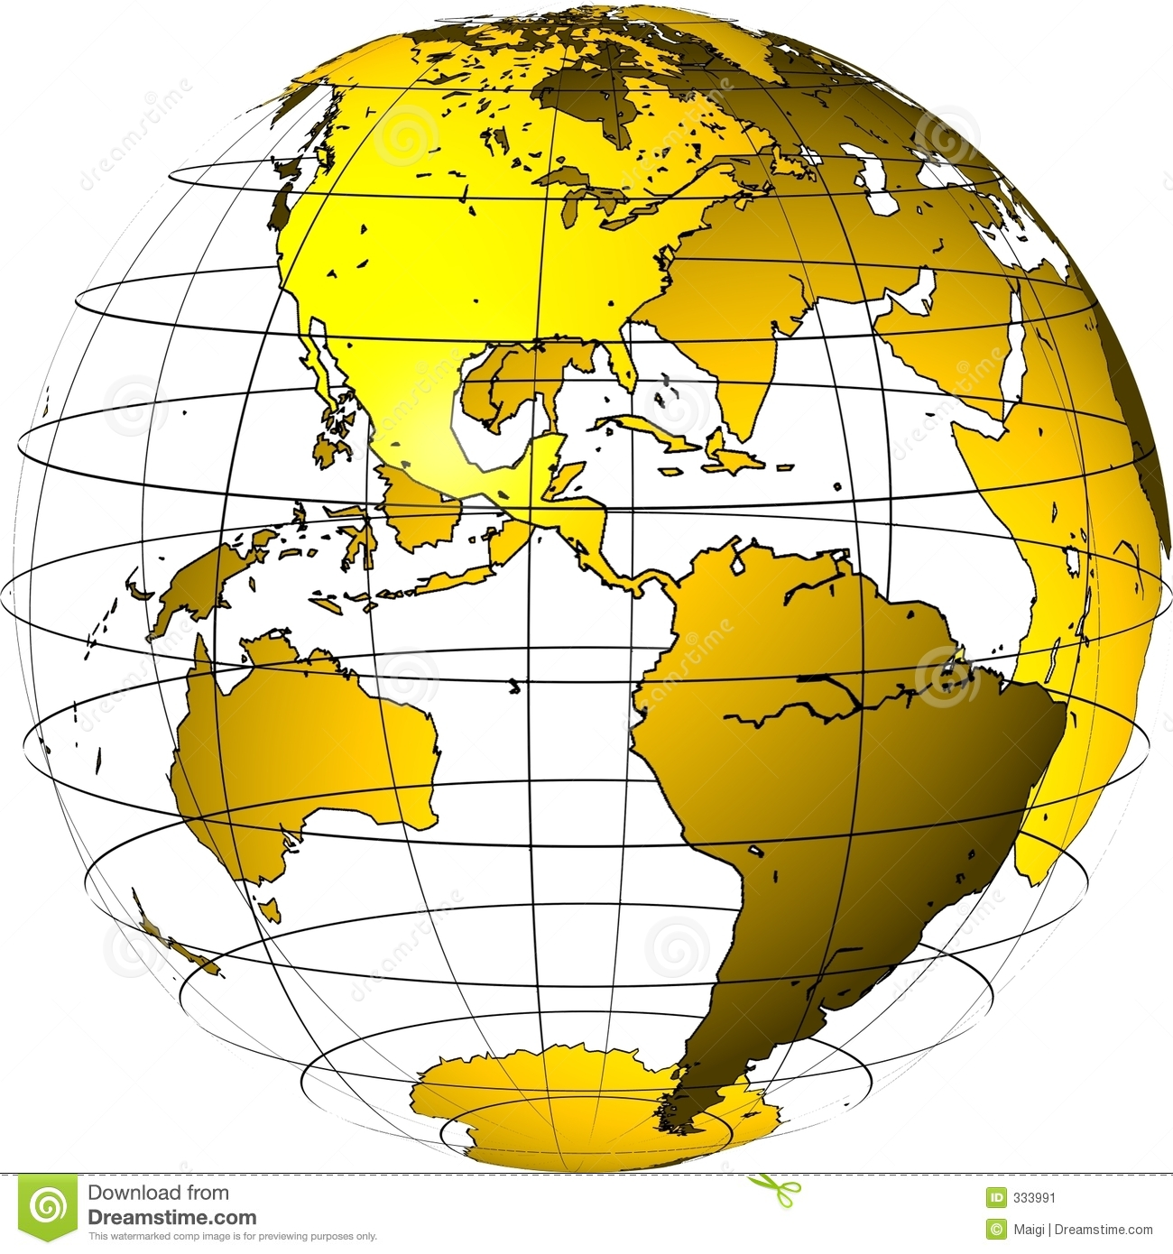
Bell Work Activity
Answer the following questions on a sheet of paper.
Make a list of at least three large, successful global corporations that you are familiar with today.
Now, create a list of at least two products or services produced by these corporations.

Slide 4
Warm-Up Activity: Terms
There are several important terms and definitions students need to know.
Complete Global Economy Student Notes handout.
Students may work in groups.

Slide 5
U.S. and International Trade
World Interdependence
Approximately 1/3 of worldwide production is sold outside of the “home” country.
The bulk of products Americans use daily are imported.
U.S. exports are music, movies, cars, airplanes, and food items.
Changing Nature of International Trade
Raw materials once were an abundant commodity; today it makes up less than 1/3 of world’s exports.
Manufactured goods/services are most popular.

Slide 6
U.S. and International Trade
Services (communications, travel, education, and financial) are most popular exchanges between countries.
Data is transferred via phone, fiber optics, or satellite on a daily basis.

Slide 7
Businesses are Going Global
Changing Markets
Foreign markets are enticing to domestic businesses that experience dropping sales and profit.
Another way to expand competition.
Increasing worldwide demand for products.
Benefits of international marketing
Government support is available.

Slide 8
Importance of International Trade
U.S. economy: over 250,000 businesses export products
Accounts for over 11% of GNP
95% of U.S. exporting businesses are small to medium-sized
Manufacturers export over $500 billion of products
Wholesalers export over $100 billion
U.S. is second largest exporter

Slide 9
Importance of International Trade
Germany is #1 exporter.
U.S. is #1 importer of products.
Germany is #2 importer of products.
U.S. had 1st trade deficit of 20th Century in 1971 (imports exceeded exports by over $1 billion that year).

Slide 10
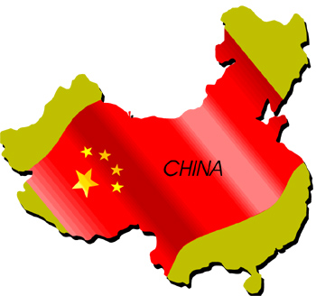
Forbes Magazine Global 2000: Top 25
ICBC (China; banking).
China Construction Bank (banking).
JP Morgan Chase (banking).
General Electric ( U.S. conglomerate).
Exxon Mobile (oil and gas).
HSBC Holdings (UK banking).
Royal Dutch Shell Oil (Netherlands, oil and gas).
Agricultural Bank of China (China, banking.

Slide 11
Forbes Magazine Global 2000: Top 25
PetroChina (China, oil).
Berkshire Hathaway (U.S. diversified financial).
Bank of China (banking).
Wells Fargo (U.S. banking).
Chevron (U.S. oil and gas).

Slide 12
Forbes Magazine Global 2000: Top 25
Volkswagen Group (Germany world’s largest auto maker) 14
Apple (U.S. tech hardware and equipment) 15
Wal Mart (U.S. retailing) 16
Gazprom (Russia oil and gas—largest producer in the world) 17
BP (U.K. oil and gas) 18
Citigroup (U.S. banking) 19
Petrobras (Brazil oil and gas) 20

Slide 13
Company Statistics
Global 2000 company data
Include 63 countries.
$38 trillion in revenues.
$159 trillion in assets.
Employ 87 million worldwide.
Country Ranking
U.S. (543 members).
Japan (251 members).
China (136 members).

