Slide 1
Methods of Handling Horses Safely
Equine Science

Slide 3
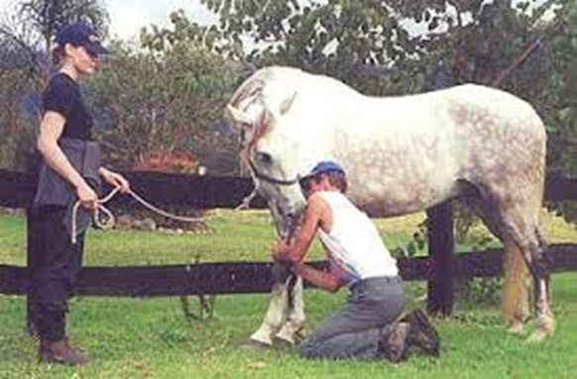
Your friend calls you in a panic—The vet is on the way!
Are you prepared to help with your friends horse in an emergency situation?

Slide 4
Safely handling horses
Horses are very unique. They are not like cattle who can be restrained on a trim chute. We must be aware of the basic rules of thumb as well as emergency restraint methods.

Slide 5
Objectives
Today we will:
Describe best practices in handling horses safely
Identify restrain methods used in emergency situations
Analyze scenarios for safe horse handling

Slide 6
Best Practices in Horse Handling
We have already discussed that horses are naturally flight animals. This means that when horses get frightened, they flee.
This is an important concept with handling horses safely.
Do not stand directly in front of the horse
Do not stand directly behind the horse
When holding the lead while a vet or farrier are working on the horse, stand on the same side as the vet/farrier
Let the horse know where you are by gently touching the horse as you walk around or approach

Slide 7
Can you guess Why?
Do not stand directly in front of the horse
Do not stand directly behind the horse
If the horse tries to flee, you don’t want to be in the way
When holding the lead while a vet or farrier are working on the horse, stand on the same side as the vet/farrier
If the horse tries to move, you will move the horse away from the vet/farrier
Let the horse know where you are by gently touching the horse as you walk around or approach
You don’t want to startle the horse when you approach

Slide 8
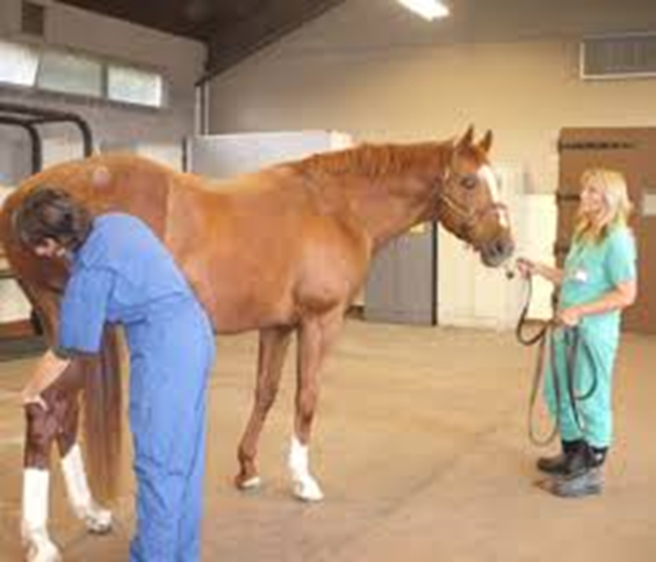
Horse Safety
Watch the Horse Safety Video to learn more about how a horse senses their surroundings and how to be safe when handling

Slide 9
Do you know how to handle a Horse related Emergency?
Horses are prone to injury because of their flight instinct.
You should always contact a veterinarian if there is an emergency.
Being aware of the restraint methods veterinarians are likely to use will help you be more prepared in the event of an emergency.
Twitch
Neck Pinch
Chain over the nose or under the chin
Sedation

Slide 10
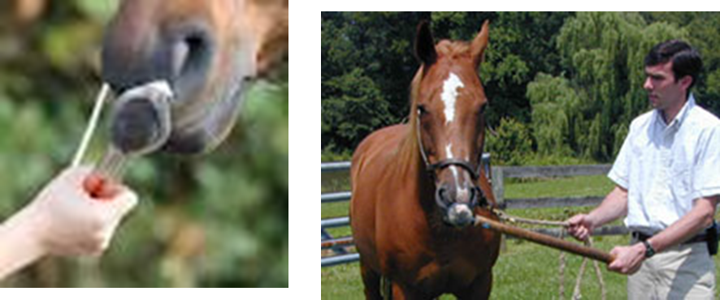
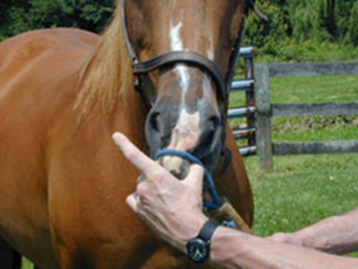
Twitch
A twitch typically has a small piece of rope attached to a long stick.
The rope is put around the top lip and twisted to restrain the horse.
A “one man twitch” works off the same principle but typically has a clip so that one person can use it
Care should be taken using any twitch. Horses may try to escape and cause injury to the horse or the handler

Slide 11
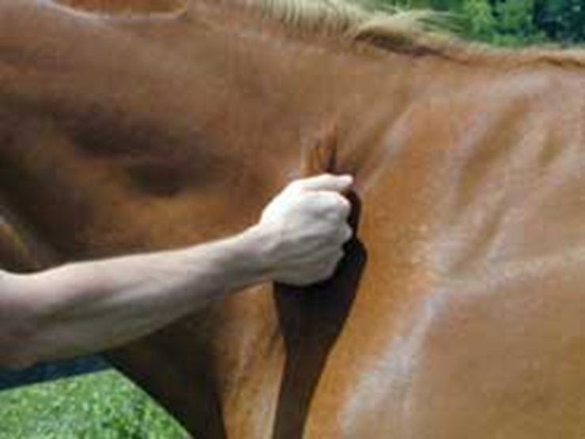
Neck Pinch
A neck pinch may be used to give the horse something else to think about while a vet is working on the horse

Slide 12
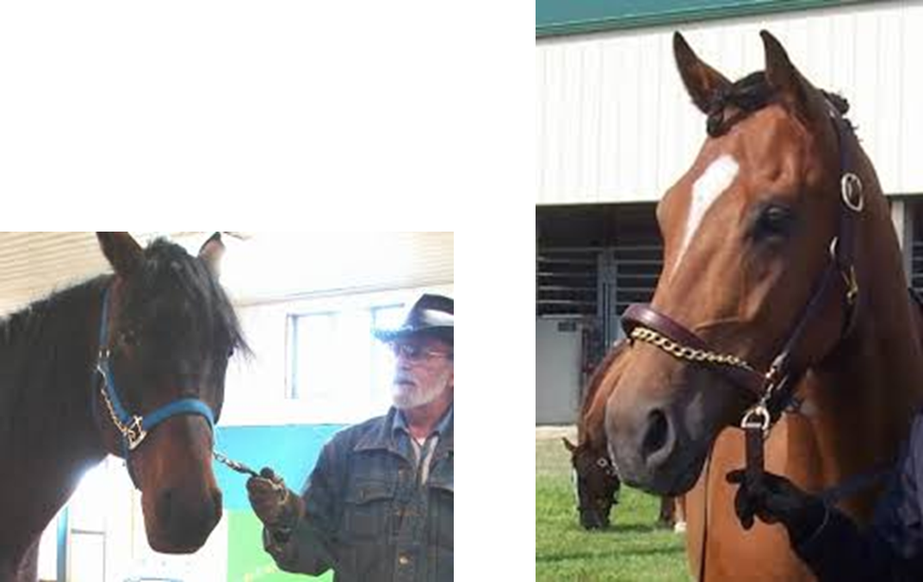
Chain over nose or Chin
A lead rope with a chain may be used over the nose or under the chin
Never tie the horse with the chain; if the horse sets back, injury can occur.

Slide 13
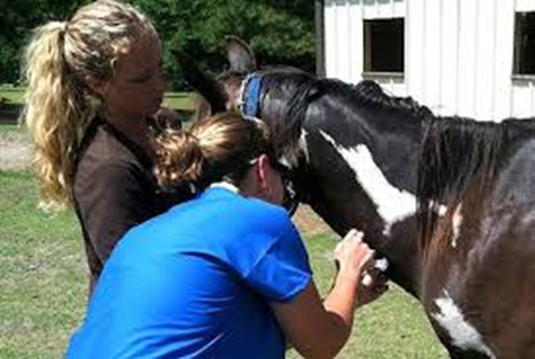
Sedation
If the injury is severe or the horse is not cooperating with other methods, sometimes the vet will give an injected sedative.
This should only be done with the advise and care of the veterinarian.
Just like any drug, there can be unwanted side effects.

Slide 14
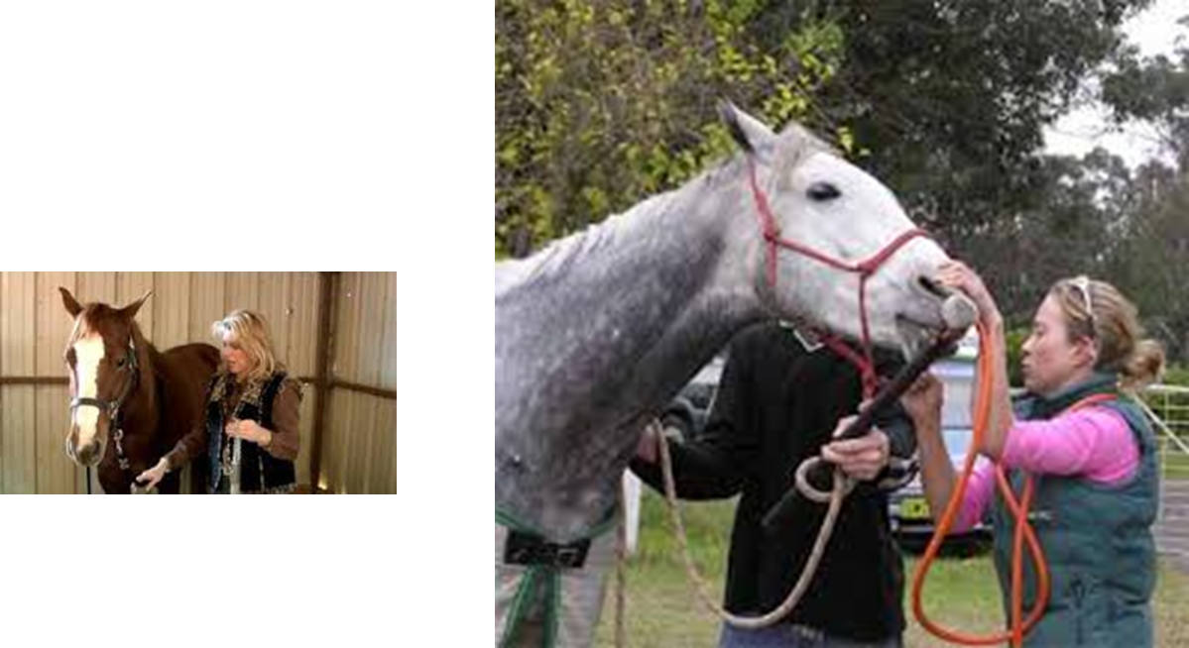
Methods of Restraining a horse
Watch the video on Restraining a Horse
What were the different methods of restraint covered in this video?

Slide 15
Analyze Situations for Horse Handling Safety
For each picture, identify potential safety concerns

Slide 16
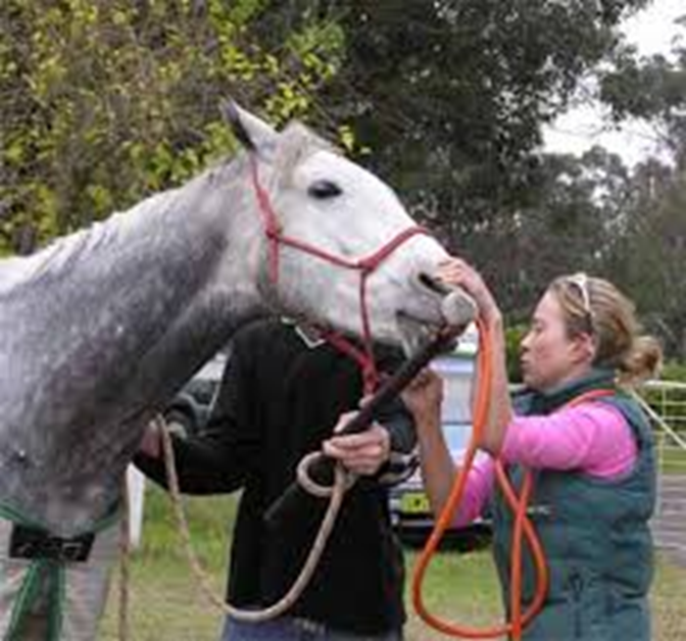
Safety Concerns?
The handler and vet are on the same side—GOOD
Be careful not to stand directly in front of the horse—BAD
There is a possibility of the horse swinging its head and hitting the vet—BAD

Slide 17
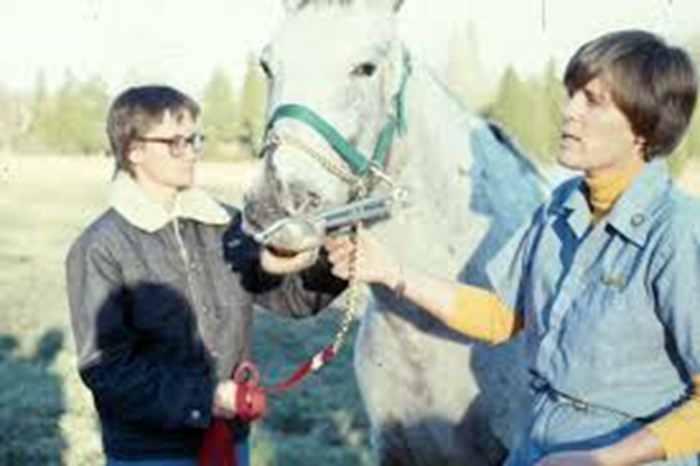
Safety Concerns?
The handler and vet should be on the same side—BAD
This is an example of a one man twitch—GOOD
The handler has the rope wrapped around the hand—BAD

Slide 18
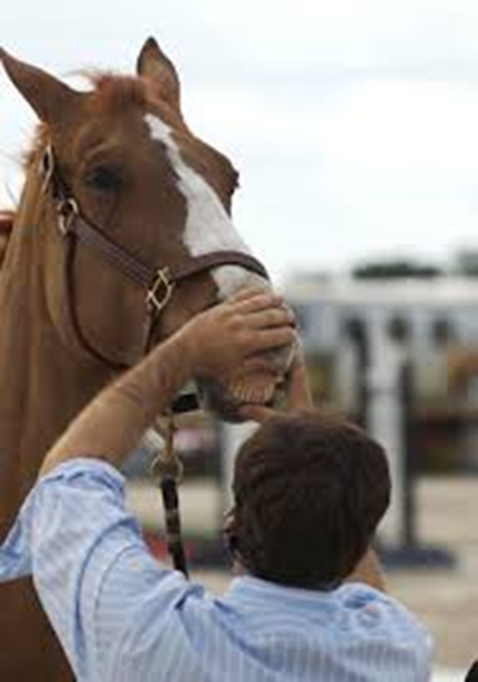
Safety Concerns?
The handler is standing directly in front of the horse—BAD

Slide 19
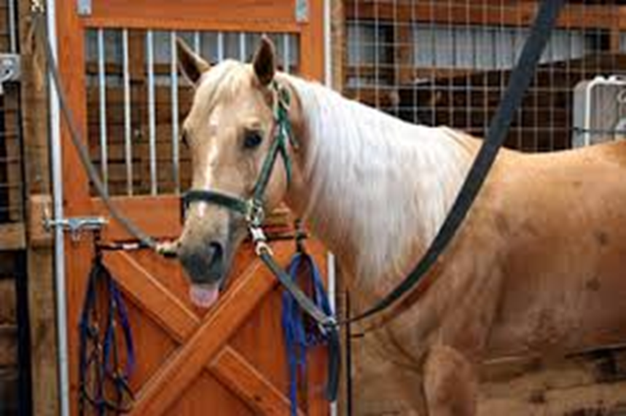
Safety Concerns?
Cross Ties are great for grooming and saddling but are dangerous to use in an emergency situation—BAD

Slide 20
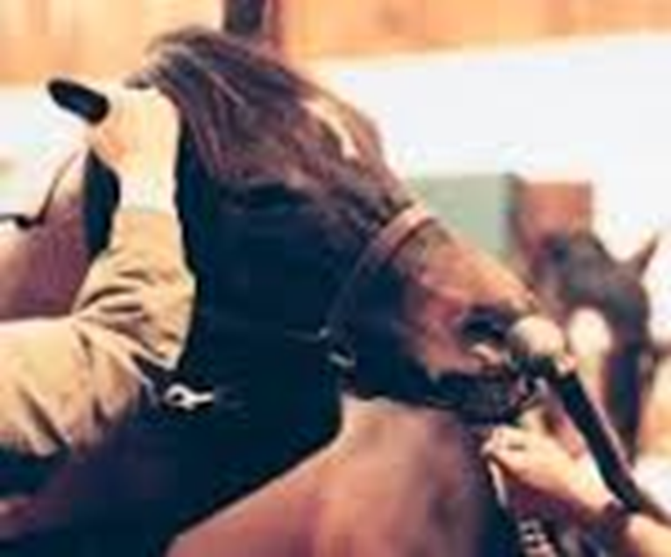
Your Turn
Find or draw a picture of an emergency situation with a horse. Identify at least three safety concerns and how to correct them.

Slide 21
Questions for Review
Why is safety such a concern when handling horses?
What are three rules of thumb when handling horses?
Name three restrain methods used in an emergency situation.

Slide 22
Questions for Review
Why is safety such a concern when handling horses? Horses are flight animals; you could be injured if they become frightened
What are three rules of thumb when handling horses? Don’t stand directly in front or behind the horse; stay on the same side as the vet; touch the horse to let it know where you are
Name three restrain methods used in an emergency situation. Twitch, neck pinch, chain, or sedation

Slide 23
Summary
Safe horse handling is an important component of equine science.
Being aware of the general safety rules of thumb as well as emergency measures can help you be prepared for any situation

Slide 24
References
Handling Horses Safely: http://extension.missouri.edu/p/G2878
4-H Horse Safety Video: https://www.youtube.com/watch?v=XJif22DLGlI
Equine Restraint: http://cal.vet.upenn.edu/projects/fieldservice/Equine/eqrestr/eqrestr.htm
Restraining a Horse: https://www.youtube.com/watch?v=_kUIJu46LvA

Slide 25
Texas College and Career Readiness Standards
English Language Arts: II. Reading, B, 1-3.
Science: VI. Biology, C, 1-2; VIII. Physics, C, 3.

