Slide 1
Identify Animal Welfare Policies in Equine
Equine Science

Slide 3
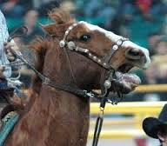
Read “The Horse Industry’s Responsibility to Equine Welfare”
What is your reaction to this article?

Slide 4
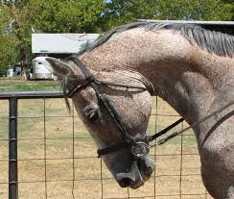
Animal welfare is in the spotlight. As agriculturalists, we must do our best to protect the animals we utilize while educating others.

Slide 5
Objectives
Today we will:
Describe the difference between animal rights and animal welfare
Discuss the major issues related to animal welfare in the equine industry
Share opinions related to equine animal welfare
Research an equine animal welfare topic

Slide 6
Animal Rights VS Animal Welfare
There is a BIG difference between these viewpoints

Slide 7
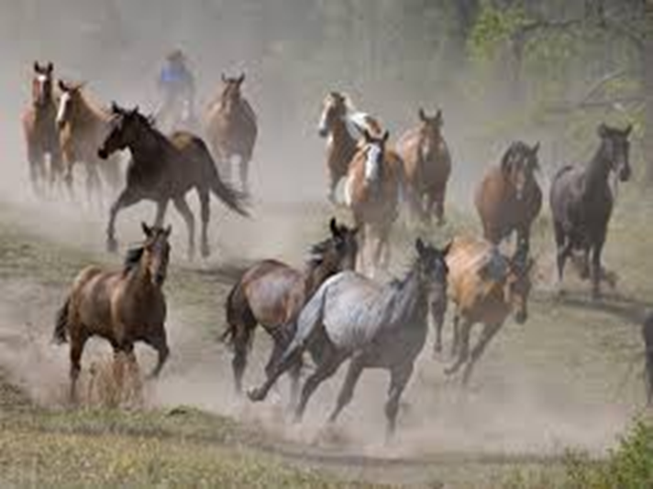
Animal Rights
The animal rights activist is committed to changing how the world uses animals; they believe animals should be free and NOT used for any human purpose

Slide 8
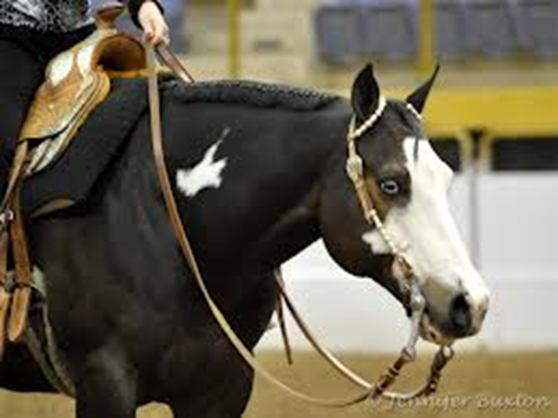
Animal Welfare
The animal welfare advocate is committed to humane use of animals; they believe that animals should be cared for and properly treated, but may be used for food, entertainment, and companionship

Slide 9
Animal Welfare Issues in the Equine Industry
A quick search for equine animal welfare issues will produce the following results:
Inhumane practices related to training for a variety of events including western pleasure, saddlebreds, cutting, and racing
Breeding mares for the purpose of using them as nurse mares or progesterone
Inhumane horse slaughter and transport practices domestic and international

Slide 10
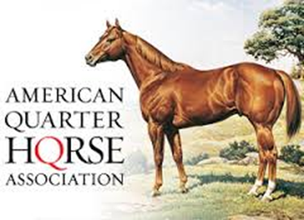
Review Position Statements
Review the position statements on the following websites
What do they have in common?

Slide 11
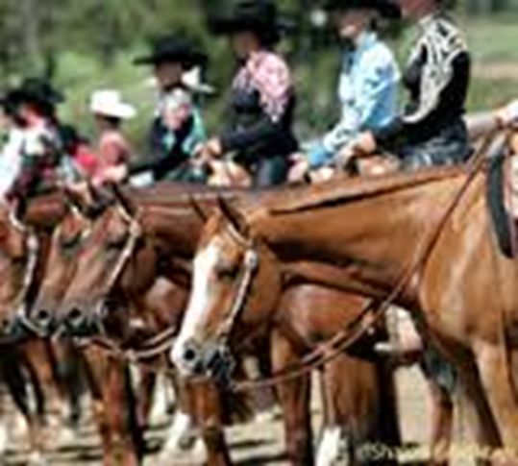
Think—Pair—Share
Think about the following questions
Pair with a classmate to discuss together
Share your responses with the class
What is position when it comes to equine welfare policies?
Do you believe that these organizations are doing enough to ensure equine welfare?
Why do you believe it is important for equine professionals to be clear about their message concerning animal welfare?

Slide 12
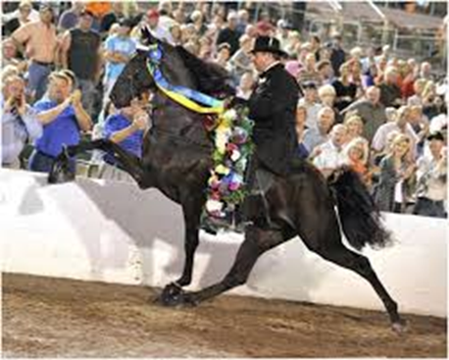
Research Equine Welfare Issues
Pick one of the equine welfare issues discussed or another with approval of your instructor
Research the topic you have chosen, be sure to use reputable sources (government and educational are best)
Show both sides of the issue if possible
Develop an oral report of your findings to share with the class

Slide 13
Questions for Review
What is the difference between animal rights and animal welfare?
Name three animal welfare issues impacting the equine industry.
If you were stuck on an elevator for one minute with someone who was against horse ownership, what would you say?

Slide 14
Questions for Review
What is the difference between animal rights and animal welfare?
Animal rights activists believe that animals have a right to live free;
Animal welfare advocates believe we should humanely care for and use animals

Slide 15
Questions for Review
Name three animal welfare issues impacting the equine industry.
Inhumane practices related to training for a variety of events including western pleasure, saddlebreds, cutting, and racing
Breeding mares for the purpose of using them as nurse mares or progesterone
Inhumane horse slaughter and transport practices domestic and international

Slide 16
Questions for Review
If you were stuck on an elevator for one minute with someone who was against horse ownership, what would you say?
Share your one minute speech with your classmates

Slide 17
Summary
As agriculturalists, animal welfare is a timely and important issue.
With the media always watching for a story, the equine industry is no exception to dealing with animal welfare issues.
We should be prepared to tell our story and defend our position with compassion and honesty.

Slide 18
References
USDA National Agricultural Library, Equine Handling: http://awic.nal.usda.gov/farm-animals/livestock-species/horses
Equine Welfare Resources: http://www.aaep.org/info/equine-welfare-51
American Quarter Horse Association Animal Welfare: http://www.aqha.com/animalwelfare
American Veterinary Medical Association Animal Welfare Policy Statements: https://www.avma.org/KB/Resources/Reference/AnimalWelfare/Pages/Animal-Welfare-Policy-statements.aspx

Slide 19
Texas College and Career Readiness Standards
English Language Arts: II. Reading, A; III. Speaking, A, 1-2; B 1-3; V. Research, B, 1, a-b
Science: I. Nature of Science, A. 1. IV. Science, Technology, and Society, A. 1, B. 1-2
Social Studies: IV: Analysis, Synthesis, and Evaluation of Information, A 1, 3, 5, 6; V. Effective Communication, A. 1-2

