Slide 1
History of Printing & Imaging
The capturing and reproduction of imaginations

Slide 3
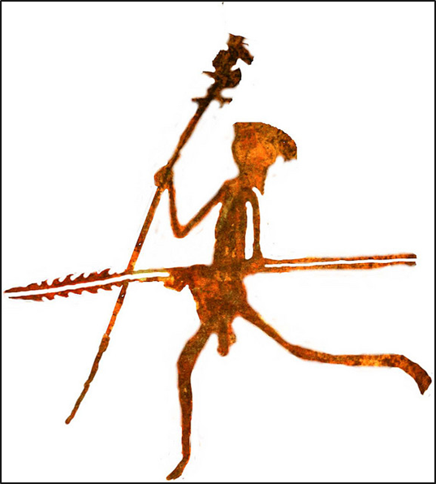
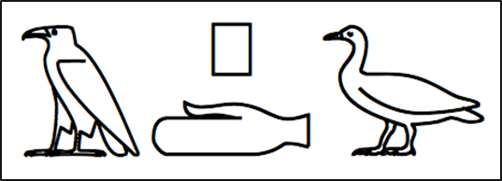
Introduction
The origin of imaging
Cave paintings / drawings: people capturing moments and reproducing them to remember or for others to see
Letters started out as images (hieroglyphics)
The origin of printing
Scribes were the first to print by writing manuscripts then copying (reproducing) them by hand
Making copies is what printing really is
But to print images or text, you need paper, right?
Printing on fabrics (like silk) came first

Slide 4
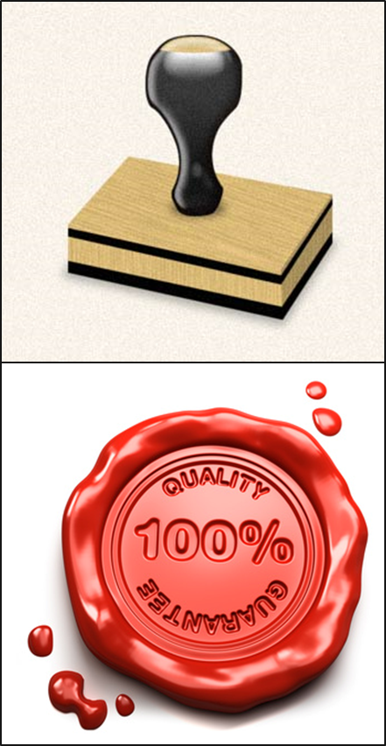
Printing and Imaging Methods
Woodblock Printing
First method of printing images, text and patterns on fabrics and other textiles used wooden blocks carved in relief, and then the exposed surface was dipped in paint or ink and firmly applied or stamped onto the cloth
Seals and Stamping
One early example is the use of seals, blocks carved with images or text, then pressed into clay tablets
Rubbings
Instead of pressing the carved block onto something, the cloth is placed on the block and the top is rubbed with a hard substance to create the pressing

Slide 5
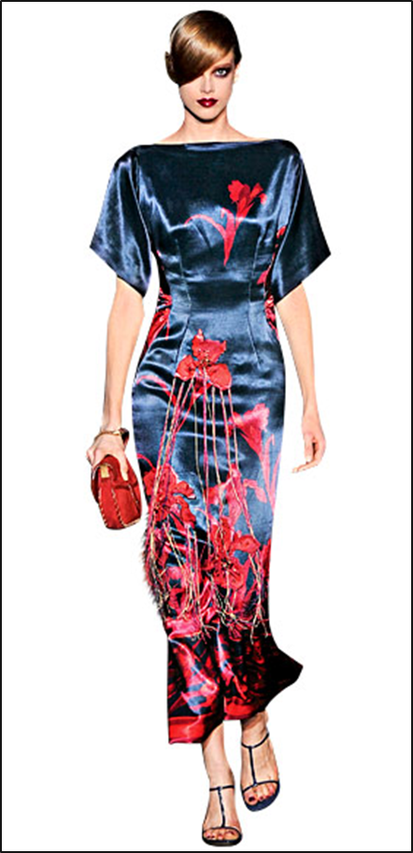
Printing and Imaging Methods
Woodblock Printing (cont.)
The earliest surviving fragments of are from China (silk printed with flowers in three colors around AD 200)
Woodblock Printing developed in Asia several centuries before Europe

Slide 6
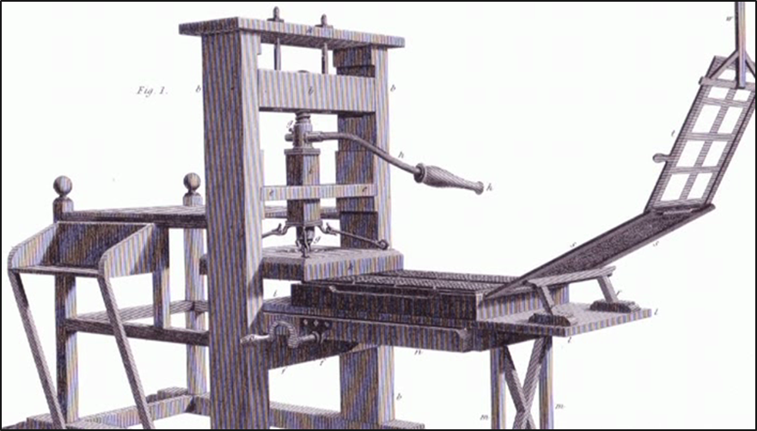
Printing and Imaging Methods
Movable Type
A system of printing using movable pieces of metal type carved in relief like woodblocks
Page-setting was quicker and more durable than woodblock printing
The metal type pieces also helped lettering become more uniform, which increased the quality of printing and lead to the development of typography

Slide 7
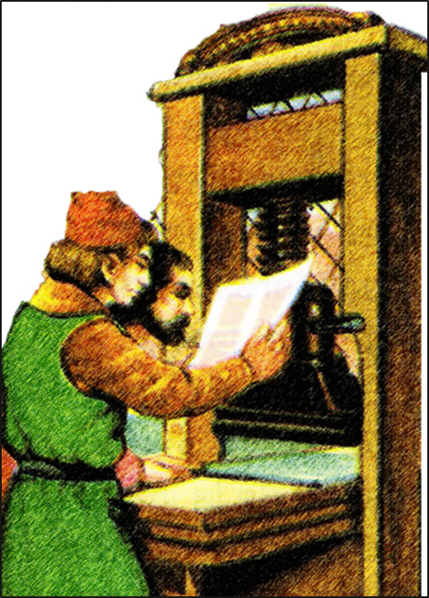
Printing and Imaging Methods
Movable Type (cont.)
Johannes Gutenberg developed the movable type printing press in Mainz, Germany around AD 1439
Acknowledged as the most important invention of the second millennium
Although others in Asia developed movable type systems using porcelain, wood, clay and even metal, it was Gutenberg’s press that sparked the Printing Revolution
The oldest known book to be printed with movable metal type was actually printed in Korea around AD 1377

Slide 8
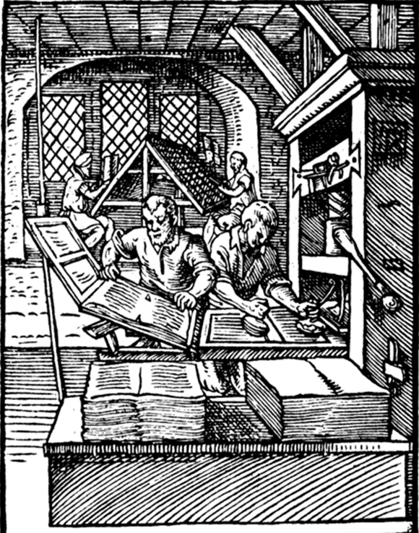
Printing and Imaging Methods
Printing Press
Process:
The movable type pieces were put in a tray (coffin) in the bottom of the press and ink was applied
The paper was clipped to an extension then folded into place above the type
The paper and type were then rolled into place and a screw press evenly applied pressure on the paper pushing it onto the inked type
The process was reversed and repeated
Men operating the press, a very labor intensive job, were called ‘Pressmen’
A European printing press in the 16th century could produce about 3600 impressions per workday

Slide 9
Printing and Imaging Methods
Printing Houses
Master Printers
Owned the shops
Selected the manuscripts
Determined the size of print runs
Sold the printed works
Organized distribution
The printing was actually completed by employees of the print house
Employees:
Compositors first set the movable type for printing in a tray
Pressmen then inked the type and pressed the paper with the printing press
Apprentices and Journeymen had to work for years to become Compositors or Pressmen

Slide 10
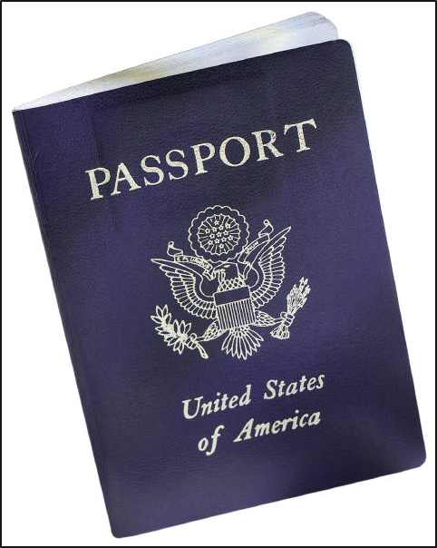
Printing and Imaging Methods
Intaglio Printing
A family of printing techniques in which the image is cut into a surface, and the sunken area holds the ink
Normally copper or zinc plates are used as the surface or matrix
Etching and Engraving are types of Intaglio
Today Intaglio engraving is used for printing currency and passports

Slide 11
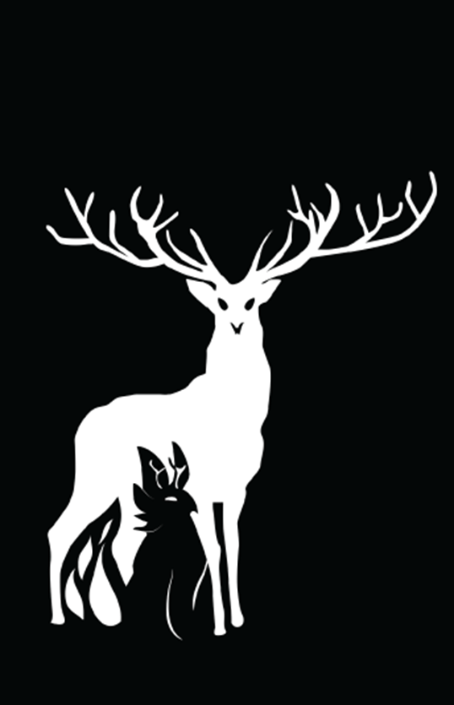
Printing and Imaging Methods
Lithography
Printing from a smooth flat stone or metal surface (also called a plate) using a chemical process to create an image
Invented in 1796 by German author and actor Alois Senefelder
Process:
Because oil and water don’t mix, an oil based image is first created on a smooth stone or metal surface
The surface is then treated with an acid and gum arabic mixture, etching areas not protected by the grease-based image
The etched area retains water and repels the oil based ink, which sticks to the image
The image can then be transferred and reproduced many times on paper

Slide 12
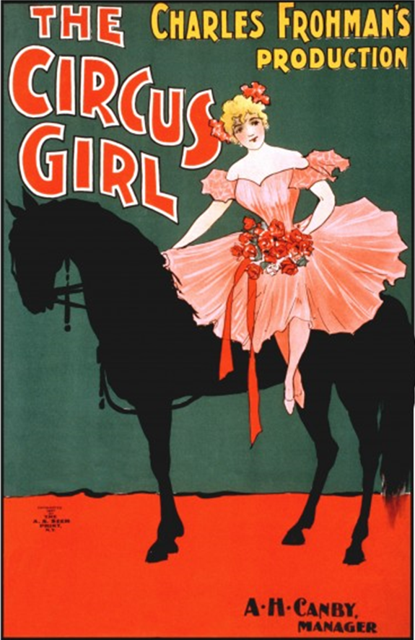
Printing and Imaging Methods
Color Printing
Using different color inks on separate plates (chromolithography) helped achieve color prints, but the process was costly and very time consuming, taking months to set the colors in the stone and months to do the multiple pass printing
Master Printers had to correctly line up the color plates (this is called registering)
High quality color prints were called ‘chromos’ and used many color plates
Lower quality and lower cost prints could be made by using large blocks of color requiring fewer color plates; so many posters were created this way, it became a style of image coloring

Slide 13
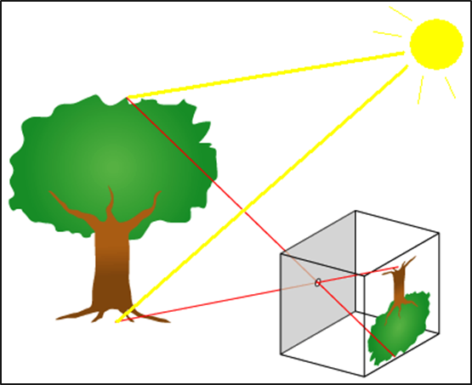
Printing and Imaging Methods
Photography
Is the combination of the pinhole camera obscura concept with the observations that certain substances are visibly altered by exposure to light
Pinhole Camera Obscura
Light coming through a pinhole projects an image (reversed & upside down) in a dark box
Different light sensitive materials, chemicals and plates were tested over many years; each building quicker more stable cameras
Faint ‘latent’ images were enhanced with various vapors decreasing exposure times
Color photographs originally came from overlaying 3 color sensitive images

Slide 14
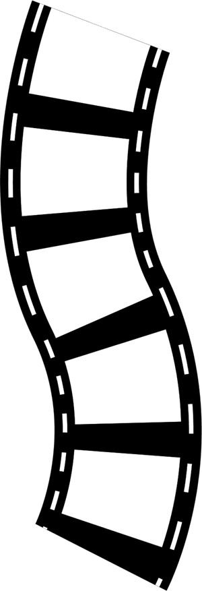
Printing and Imaging Methods
Photography (cont.)
Lenses replaced the pinhole bringing more clarity and focus to the photos
Metal plates used to capture exposures were eventually replaced by photo sensitive paper and film
How a camera works:
Light comes through the lens (a typical camera has several lens to manipulate that light)
Aperture controls the amount of light let into the lenses affecting the brightness
Shutter is the last stop controlling exposure and letting the light into the camera
Light quickly passes through the shutter and projects on the photo sensitive material or sensor to create the image

Slide 15
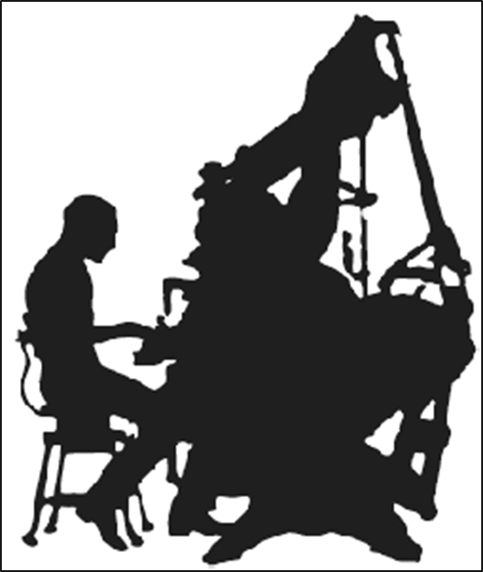
Printing and Imaging Methods
Typesetting
Hot Metal (late 19th century)
Linotype machines mechanized letterpress printing (similar to Gutenberg printing press) by using molten type metal (lead) molded temporarily for press ink printing
Slugs, or entire lines of type, were created
After printing, the slugs are reheated and recycled for use on another print project
Photo (mid 20th century)
A form of offset printing in which machines project characters onto film first
This ‘cold type’ typesetting could now be done in an office instead of a warehouse
With the development of CRT screens composition and markup became even easier
These advances in typesetting technology would eventually lead to consumers being capable of desk top publishing

Slide 16
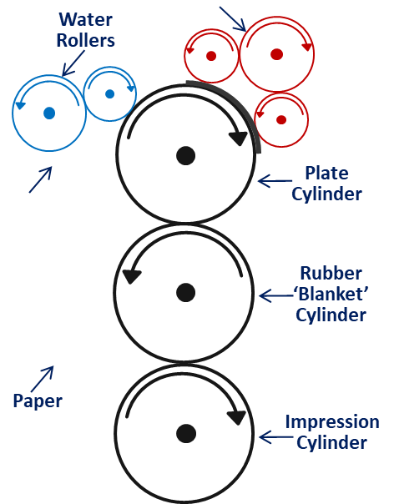
Printing and Imaging Methods
Offset Printing (Modern Lithography)
Today, most high volume printing of posters, books, newspapers, etc. use “offset lithography”
Process:
Photographic negative or a CTP (computer-to-plate) laser image is applied to a flexible plate covered with a photosensitive emulsion
Plate is attached to a cylinder on a printing press where dampening rollers apply water
Water is repelled by the emulsion of the image area, then hydrophobic ink is applied to the plate which is repelled by the water, but it sticks to the emulsion of the image area
Rubber ‘blanket’ cylinder squeezes away the excess water
Uniform pressure and an impression cylinder finally transfers the image to the paper

Slide 17
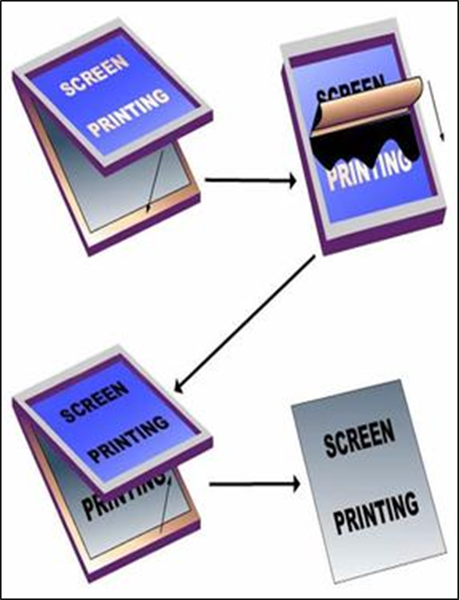
Printing and Imaging Methods
Screen Printing (early 20th century)
Also called silk-screen or serigraphy
Uses a woven mesh to support an ink-blocking stencil to receive a desired image
The open areas of mesh allow ink to be pressed through to the substrate (surface to be printed)
Modern uses for screen printing include posters, stickers, vinyl, wood, and tee shirts
Screen printing on garments currently accounts for over half of the screen printing activity in the United States

Slide 18
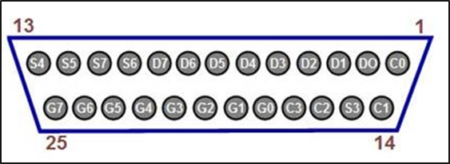
Printing and Imaging Methods
Dot Matrix Printing
Uses a print head that prints back and forth on a page and impacts an inked ribbon like a typewriter creating letters out of dots
Normally used for high volume data specific printing on tractor-fed paper
Because it uses impact printing, carbon copies could be printed as well
As technology grew:
Print heads increased from 9 pins to 25 pins improving the quality and dots per inch of printouts
Near Letter Quality (NLQ) was created by printing a second or third pass, but it was slower

Slide 19
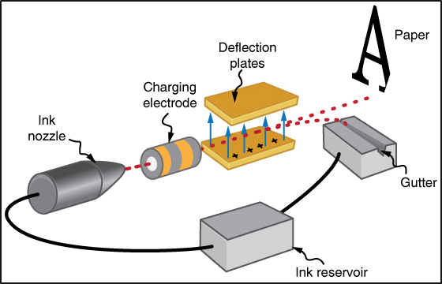
Printing and Imaging Methods
Inkjet Printing
Printing a digital image by projecting droplets of ink onto the print medium; paper, plastic, metal, etc
Continuous Inkjet (CIJ)
Ink is pumped at high speed through a microscopic nozzle and separated into drops by a vibrating piezoelectric crystal
Drop-on-Demand (DOD)
Thermal
An electronic signal heats the ink just enough to create a drop for printing placement
Piezoelectric
Uses a piezoelectric print head creating a pulse to force drops out for printing placement

Slide 20
Printing and Imaging Methods
Dye-sublimation Printing
Uses heat to transfer dye to materials like paper, plastic or fabric
Excellent for printing photographs
Many consumer photo printers are dye-sublimation printers
Slower than inkjet printing
Uses transfer paper to get graphics to fabrics
Better than screen printing because the image bonds with the material not just placed on top

Slide 21
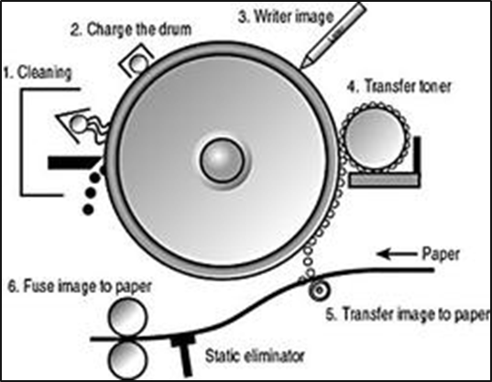
Printing and Imaging Methods
Xerography (Photocopying)
Also called electrophotography
Dry photocopying technique using an image projected onto an electrically charged drum to create high quality reproductions of the original
Process:
After the drum head is cleaned it is charged and readied to receive the image
The image is scanned and exposed onto the rotating drum creating a latent image
Electrically charged powdered ink (toner) is attracted to the latent image
Image is transferred to the paper
Paper heated and pressed through rollers to fuse the toner in place

Slide 22
Printing and Imaging Methods
Laser Printing
Is actually an electrostatic digital printing process that uses an image that is laser projected on a negatively charged drum to create high quality text and graphics with toner
Process:
After the drum head is cleaned it is negatively charged and readied to receive the image
The image, which is stored in the printer’s memory, is written to the drum with a laser, creating a latent image
Electrically charged powdered ink (toner) is attracted to differentially charge image
Image is transferred to the paper
Paper heated and pressed through rollers to fuse the toner in place

Slide 23
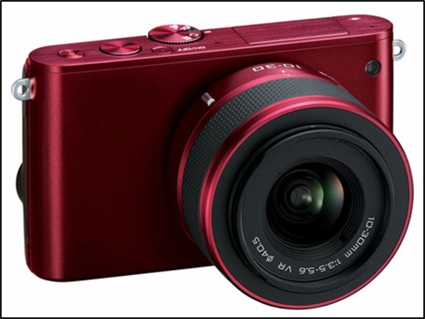
Printing and Imaging Methods
Digital Photography
Uses a camera to capture images by projecting light through lenses to electronic photodetectors (image sensors) instead of film
Image sensors are Charge-Coupled Devices (CCDs) which store information in the form of pixels
Images are stored digitally eliminating the need to purchase film for the camera
Digital cameras can
capture images quicker
perform better in low light
have a greater depth of field
have a higher resolution than film cameras
But regular film cameras do not have digital artifacts or unusual pattern displays on large blocks of color in images

Slide 24
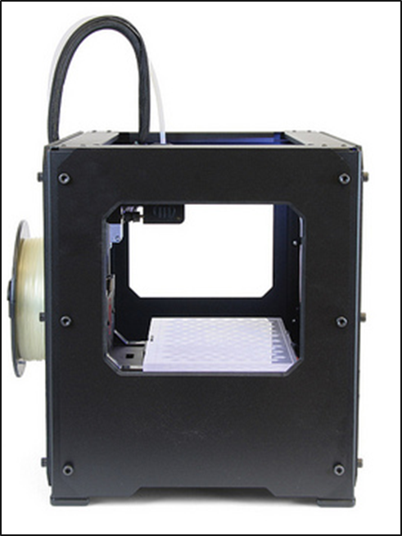
Printing and Imaging Methods
3D Printing
Also called Additive Manufacturing
Uses a virtual 3D model to create a physical ‘print’ by building layers of material to form the finished object
Process:
Models the image using computer aided design (CAD) software or a 3D scanner
‘Fix up’ stage ensures no manifold errors (e.g. lines not connecting properly) in the model
Successive layers of material are then printed from cross sections of the model and fused to create the final shape
Completed printing may require smoothing of edges and/or painting, which some 3D printers can do
There are many different types of 3D printers using many different materials

