Slide 1
Courtroom Roles and Responsibilities

Slide 3

Introduction
  The courtroom is made up of various roles that perform specific functions.
  The roles are vital in having a criminal justice system that is fair and just.
  We will be looking at what these roles are and what function they serve in the courtroom.

Slide 4
Courtroom Roles
  Police Officer
  Prosecutor
  Defense attorney
  Judge
  Defendant
  Victim
  Bailiff
  Court reporter
  Jury

Slide 5
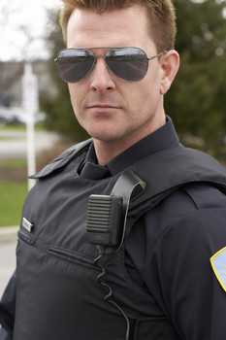
Police Officer’s Responsibilities
  Tell the facts of the case
  Has worked directly on the case
  Positive results seen if:
    Precaution was taken at the crime scene
    Case management was high quality
  Review the report before the trial
  A good report will jog the memory
  Discuss the report with the prosecutor before the trial (should NOT be told what to say)

Slide 6
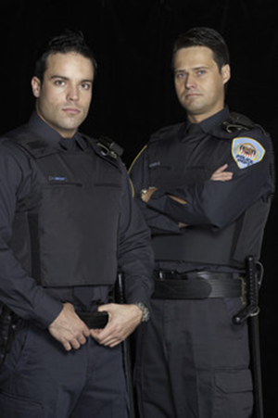
Police Officer’s Responsibilities
  Appearance enhances or diminishes the reputation of the officer and the police department
  Wear the uniform or formal wear

Slide 7
Prosecutor’s Responsibilities
  Representative of the state
  Usually, at least two prosecutors are assigned to the courtroom for each trial.
  Opens the trial with an opening statement
      Intended to “whet the appetite” of the jury regarding the topic of the trial and
      Why the defendant is guilty
  Present the evidence to the jury

Slide 8

Prosecutor’s Responsibilities
  Presents their case to the jury first
  Gives a closing statement to the jury at the end of the trial
      Summarizes why the defendant is guilty
      Given after the defense attorney’s closing statement

Slide 9
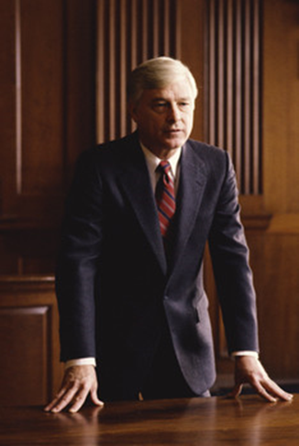
Defense Attorney’s Responsibilities
  Representative of the defendant
  May be employed by the defendant or
  May be appointed by the state to represent the defendant

Slide 10
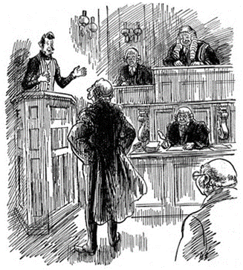
Defense Attorney’s Responsibilities
  Gives an opening statement after the prosecutor
      Intended to inform the jury that their client is innocent
      As they will be convinced of when the trial is over
  Presents his or her case to the jury after the prosecution has presented its case
  Gives a closing statement when done with the case
      Should summarize the case for the jury and
      Emphasize why the defendant is innocent

Slide 11
Prosecutor’s and Defense Attorney’s Responsibilities
  Direct Examination –
  the first series of questions asked of the witness by the prosecutor or defense attorneys when they are presenting their case
  Cross-Examination –
  the first series of questions asked of the witness by the prosecutor or defense attorneys when the other side is presenting their case

Slide 12
Prosecutor’s and Defense Attorney’s Responsibilities
  Redirect Examination–
  when the prosecutor or defense attorneys are allowed to ask questions after their witness has been cross-examined by the other side
  Recross-Examination–
  when the prosecutor or defense attorney can ask questions of the other side’s witness after that witness has been redirected

Slide 13

Prosecutor’s and Defense Attorney’s Responsibilities
  The prosecutor and the defense attorney have the duty to object to the judge when the other side is violating proper courtroom procedure.
  An objection prevents illegal questioning

Slide 14
Judge’s Responsibilities
  The judge:
  Is referee in the courtroom
  Has the final say on everything that happens in the courtroom (except the jury’s verdict)
  If the defendant has waived his or her right to a jury trial, then the judge also decides the guilt or innocence of the defendant

Slide 15
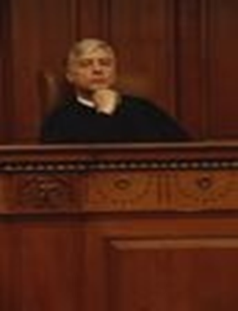
Judge’s Responsibilities
  The judge makes two types of rulings on objections:
  Sustained– the witness is NOT allowed to answer the question that has been asked of them
  Overruled– the witness IS allowed to answer the question that has been asked of them

Slide 16
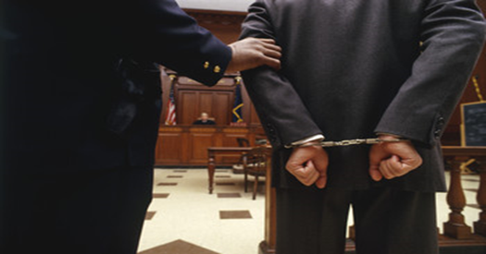
Defendant’s Responsibilities
  The defendant is:
  The person accused of committing the crimes and
  Is protected by the 5th amendment from testifying against his or her self in court
  If the defendant chooses to testify, they will be questioned by the prosecution as well as the defense

Slide 17
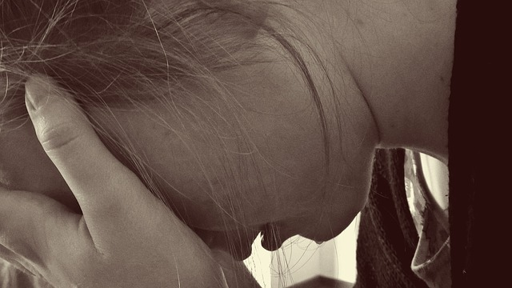
Victim’s Responsibilities
  The victim is:
    The person who the crime was committed against
    Usually called to testify during the course of the trial

Slide 18
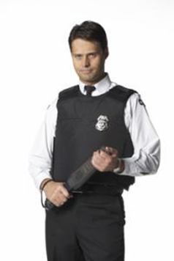
Bailiff’s Responsibilities
  The bailiff:
  Is a certified peace officer that maintains order in the court
  Administers the oath to anyone who takes the stand
  Takes things to and from the judge
  Does anything else that the judge needs him or her to do

Slide 19

Court Reporter’s Responsibilities
  The court reporter:
  Is an employee of the court who records everything that is said in the trial
  Goes to a school where they learn how to take notes using a style called shorthand
    These notes are official documents that may be used as reference in future court proceedings.

Slide 20
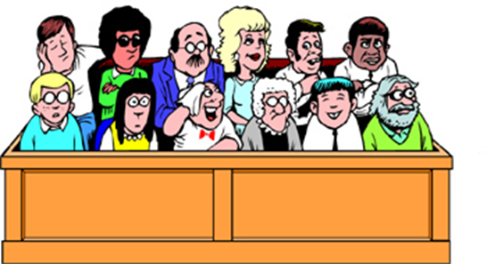
Jury’s Responsibilities
  The jury:
  Consists of 6 to 12 U.S. citizens
  Selected before the trial by the prosecutor and defense attorney
    The judge has the final say on who can serve on the jury
  Observes the trial
  Decides on the guilt or innocence of the defendant

Slide 21
Jury’s Responsibilities
  The jury:
    Must be unanimous in their decision
      If not unanimous, it is a hung jury and a new trial has to take place with a different jury
    May also be asked to decide what the punishment of the defendant should be if they are found guilty

Slide 22
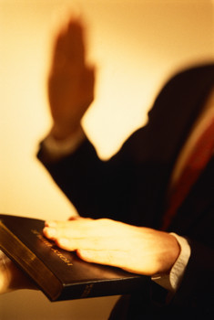
Proper Courtroom Testimony
  A witness is anyone who is called to testify at a trial
  The following information will assist a witness in performing at an effective and professional level.

Slide 23
Proper Courtroom Testimony
  Witnesses should:
  Be confident
  Not look at the jury, judge, or the accused when walking into the courtroom
  When taking the oath, look at the person administering it
  Sit up straight and keep their hands in their lap, not near the mouth
  Answer questions loudly and clearly
  Make eye contact with the jurors when answering the questions

Slide 24
Proper Courtroom Testimony
  Witnesses should:
  Address the judge as “Your Honor” if it is necessary to ask the judge a question
  Make sure they understand the question before answering it
  Stop talking if an objection is made, until the judge has made a ruling
  Always tell the truth
  Admit when they make mistakes
  Know the facts but not memorize the testimony

Slide 25
Resources
  The Courts and Criminal Procedure, Instructional Materials Service, Trade and Industry Education
  Criminal Courts: Structure, Process, & Issues (2nd Edition), Dean John Champion, Richard D. Hartley, & Gary A. Rabe
  Our Rights (1st Edition), David Bodenhamer
  http://www.sunnylandsclassroom.org/Asset.aspx?Id=1329
  The Annenberg Classroom http://www.annenbergclassroom.org
  Justice Learning http://www.justicelearning.org
  Do an Internet search for FindLaw

