Slide 1
The Bill of Rights
Amendments I-X
  Court Systems and Practices

Slide 3
Certain Unalienable Rights
  “We hold these truths to be self-evident, that all men are created equal, that they are endowed by their Creator with certain unalienable rights, that among these are life, liberty and the pursuit of happiness. That to secure these rights, governments are instituted among men, deriving their just powers from the consent of the governed. That whenever any form of government becomes destructive to these ends, it is the right of the people to alter or to abolish it, and to institute new government, laying its foundation on such principles and organizing its powers in such form, as to them shall seem most likely to effect their safety and happiness.”
  -Declaration of Independence

Slide 4
Certain Unalienable Rights
  Each is basically addressed in the Preamble of our constitution: “We the People of the United States, in Order to form a more perfect Union, establish Justice, insure domestic Tranquility, provide for the common defence, promote the general Welfare, and secure the Blessings of Liberty to ourselves and our Posterity, do ordain and establish this Constitution for the United States of America.”

Slide 5
Unalienable Vs Inalienable
  “Inalienable”
    Temporary rights
    Subject to interpretation
    Can be given, sold, or taken away by re-interpreting the law
  “Unalienable” – natural rights not open to interpretation, sale, giveaway, or negation
    Natural rights
    NOT open to interpretation
    Cannot be sold, given away or negated
Notes:
The battle we face lies in the fact that some of our politicians, attorneys and courts prefer to refer to our rights as “Inalienable” meaning that our rights can be given, sold, or taken way simply by re-interpreting the law as it was written.
Our forefathers specifically chose the word “Unalienable” as the word to enhance and modify the word “Rights” because they wanted the world to know that they meant “Rights” with which no one could alter, change, stop or interpret. Unalienable rights are rights that are natural rights not open to interpretation, sale, giveaway, or negation.
Inalienable rights are rights that are indeed considered temporary; subject to interpretation and may be sold, given or taken away.
Americans need to grasp hold of the words of our forefathers, “endowed by their Creator with certain unalienable rights”.

Slide 6

Amendment I
  “Congress shall make no law respecting an establishment of religion, or prohibiting of religion, or prohibiting the free exercise thereof; or abridging the freedom of speech, or of the press; or the right of the people peaceably to assemble, and to petition the Government for a redress of grievances.”

Slide 7
Freedom of Religion
  What is freedom of religion?
  The right to hold whatever religious beliefs one wishes and to practice without unfair or unreasonable interference from government
Notes:
The first challenge facing our government, even more so today, is the definition of “Religion.”
What determines a person’s religion?
Does it matter what or who we worship?
Should anyone be able to tell us what, when, and where we can worship?
At what point should the government step in and say “Whoa…this is not religion”?

Slide 8
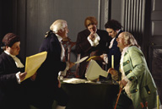
What Did Our Forefathers Say?
  “Congress shall make no law respecting an establishment of religion, or prohibiting the free exercise thereof.”
  No Established Religion
Notes:
Based on this single excerpt we have no right to interfere with anyone’s right to worship…period!
Ok…so if people worship by torturing and sacrificing animals we have no right to interfere with that form or worship…right?
Do we not have laws controlling when, where, and what we worship?

Slide 9
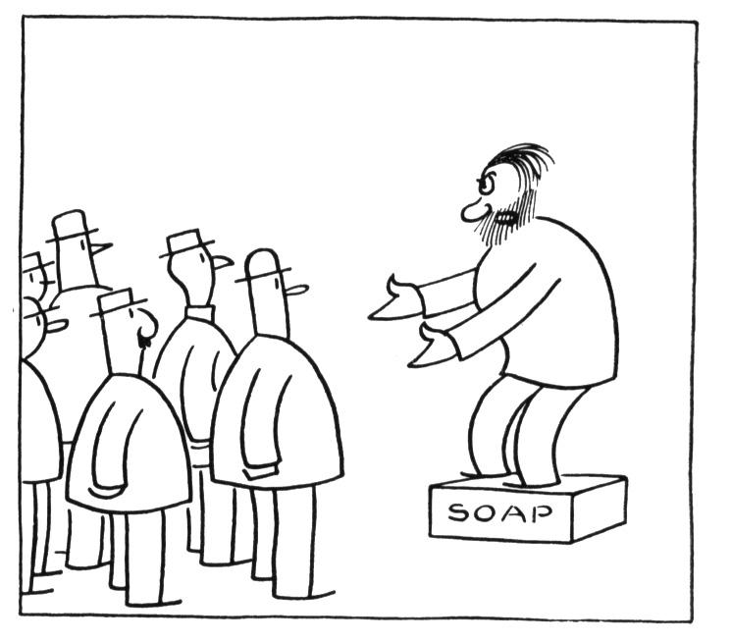
Freedom of Speech
  Right to communicate information and ideas
  Includes speeches, books, art, newspapers, television, radio, and other media
  Protects the person making and the person receiving
Notes:
Freedom of Speech…meaning we can say anything we want about anything or anyone, anywhere, and anytime?
Therefore if you want to scream and cuss at anyone that you have the right to do so…right?
No one should be able to stop you from using profanity if you so choose?
Do we not have laws that prohibit just such actions in public?

Slide 10

Freedom of Press
Protects from government censorship
  Newspapers
  Magazines
  Books
  Radio
  Television
  Film
Notes:
Ok, this means that we can print, publish or produce, anything we wish, any time we wish, and show it to anyone we wish without regard or concern to the impact it will have on other American people…right?
Fine…except I think we have specific laws preventing exactly just that…do we not?

Slide 11
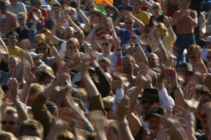
Right of the People Peaceably To Assemble
  Right to assemble in a public forum
    Street
    Parks
    Sidewalks
  Right to associate
  Government responsible for peace and safety
Notes:
I am ok with that. I mean we have churches, clubs, and organizations galore and no one interferes with their right to peaceably assemble.
Wait a minute, what about the night a group of students were gathered at the public park or on the public square. Didn’t the police run the students off? The students were not hurting anything or anyone. They were not drinking or hitting drugs. So why the push off? What happened to the right of peaceable assembly?
How about other times we have attempted to peaceably assemble either to protest a law or rule?

Slide 12

Redress Of Grievances
  Right to Petition:
  The legal claim that allows citizens to urge their government to correct wrongs and injustices or to take some other action
Notes:
I am ok with that. I mean we have churches, clubs, and organizations galore and no one interferes with their right to peaceably assemble.
Wait a minute, what about the night a group of students were gathered at the public park or on the public square. Didn’t the police run the students off? The students were not hurting anything or anyone. They were not drinking or hitting drugs. So why the push off? What happened to the right of peaceable assembly?
How about other times we have attempted to peaceably assemble either to protest a law or rule?

Slide 13

Amendment II
  “A well regulated Militia, being necessary to the security of a free State, the right of the people to keep and bear arms, shall not be infringed.”
Notes:
Do we have State Militia? We have had National Military Reserve units and National Guard units in our State…but Militia?
Until after the creation of “Homeland Security” subsequent to “9/11” our State had a State Police unit known as the Texas Department of Public Safety or commonly known as “DPS.”
Presently we have a State Militia which is technically referred to as the Texas State Guard.
An interesting fact about the Texas State Guard is that part of their oath is a question of whether or not they, as individuals, can bring themselves to disarm a fellow American citizen.

Slide 14

The Right of the People to Keep and Bear Arms
  State Militias vs Individuals?
  Overall lower crime
  Extreme violent crimes on the rise
  Family violence on the rise
  Female crime on the rise
  Juvenile/young children extreme violence on the rise
Notes:
Many activist groups (guaranteed the right of peaceable assembly) are presently pursuing, fervently, the destruction of this “unalienable” right.
Such groups are attempting to convince fellow Americans that we are so protected by our troops and federal, state, and local law enforcement that we have no use for “Arms” anymore.
Such groups want us to believe that our forefather’s could not have had enough foresight to have seen that we live in such a protected society.
Maybe these groups should check the national statistics in reference to the status of crime.

Slide 15

Amendment III
  “No Soldier shall, in time of peace be quartered in any house, without the consent of the Owner, nor in time of war, but in a manner to be prescribed by law.”
Notes:
This amendment is rarely mentioned simply because we have never had cause to be aware of the need of it.
Our country, until 9/11 has not suffered an invasion of any sort, much less a need to house soldiers.
If indeed the need did arise I feel that this Amendment would not even be an issue. I know of no one who would not eagerly invite a soldier or soldiers into their home and even provide food, care, and whatever assistance the soldiers may need.
To think otherwise seems un-American.
Even in wars such as the Viet Nam war, I experienced families who had nothing who took us in and fed us their meager meals, probably secretly doing without, because they knew we were there to protect them and they had no such Amendment.

Slide 16
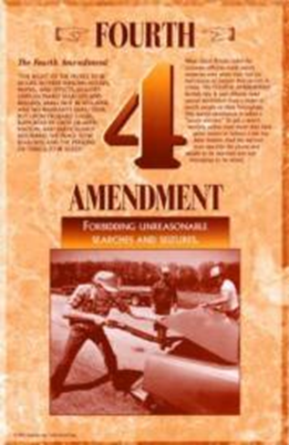
Amendment IV
  “The right of the people to be secure in their persons, houses, papers, and effects, against unreasonable searches and seizures, shall not be violated, and no Warrants shall issue, but upon probable cause, supported by Oath or Affirmation, and particularly describing the place to be searched, and the persons or things to be seized.”

Slide 17
Against Unreasonable Searches and Seizures
  Key = “probable cause”
  Probable Cause – an amount of reliable information indicating that it is more likely than not that evidence will be found in a specific location or that a specific person is guilty of a crime
  Reasonable Suspicion – certain events and/or circumstances make it appear to a normal, prudent person for them to believe that a crime has been or is about to be committed
  Mere Suspicion – a feeling that someone has or is about to commit a crime
Notes:
We could spend an entire lesson reviewing searches and seizures just of persons alone.
Can a law enforcement officer, federal, state or local, stop you without reasonable suspicion, much less probable cause?
The key to this amendment is “probable cause.”
What is “probable cause”?... When a law enforcement officer has reason to believe that based on certain facts and evidence that would lead an ordinary prudent person to believe that a crime has been or is about to be committed.
What then is “reasonable suspicion”? …When a person believes that certain events and/or circumstances make it a appear to a normal prudent person to believe that a crime has been or is about to be committed.
What then is “mere suspicion”?...When a person has a feeling that someone has or is about to commit a crime.

Slide 18
What Does that Mean to Me?
  Probable cause before police can initiate a search of your person, your vehicle, or apply for a search warrant
  A frisk is a “pat-down” search of the outer clothing for any “telltale” bulges that would lead a normal, prudent person to believe that the suspect was either unlawfully carrying a weapon or possibly drugs
  Search Incident to Arrest – after arrest, an officer may conduct a thorough search of the suspect without probable cause to search
Notes:
Thanks to Amendment IV, law enforcement officer must have probable cause before they can initiate a stop of your person or your vehicle, or apply for a search warrant.
Does that mean that if a law enforcement officer has probable cause to stop me when I am walking down the street that he has the right to force me to empty my pockets or submit to a strip search?
Not only no…but…NO!
If an officer has probable cause to stop you when you are walking down the street, he assumes the right, given by State and Federal law, to perform a “Frisk” and to question you about the “probable cause.”
Ok…but what is a frisk?
A frisk is a “pat-down” search of the outer clothing for any “telltale” bulges that would lead a normal, prudent person to believe that the suspect was either unlawfully carrying a weapon or possibly drugs.
If such items are discovered during the pat-down, then the officer can place the suspect under arrest based on the probable cause that weapons or drugs exist because such was discovered during the pat-down.
Subsequent to the arrest the officer may then complete a thorough search of the suspect’s clothing for further contraband or weapons.

Slide 19
What About My Car?
  Searches evolve from the requirement of “Probable Cause”…right?
  While driving, a law enforcement officer SHOULD NOT stop you without having reasonable suspicion or probable cause.
    Violate traffic law
    Officer observes criminal conduct
    Another informs of criminal conduct
    Articulable suspicion
Notes:
The U.S. Constitution and the State of Texas have very specific laws guaranteeing your freedom from an unlawful search of your vehicle.
All searches evolve from the requirement of “Probable Cause”…right?
What this means to you is that a law enforcement officer SHOULD NOT stop you, while you are driving, without having reasonable suspicion or probable cause. In other words if you have not violated a law or if no one has assured a law enforcement officer that you have violated a law or if no suspicion exists then there is no legal premise to initiate a stop against you.
“IF” an officer does stop you without reasonable suspicion or probable cause and you have a weapon lying in “plain view” right beside you, the officer cannot “legally arrest” you for unlawfully carrying a weapon.
That does not mean to imply that an officer “CANNOT” make an arrest. It only means that the arrest will not be considered a legal arrest because no probable cause existed for the stop in the first place. This is referred to as the “Tainted Fruit” clause of the law. If you violate someone’s rights through illegal seizure or by an illegal stop then any evidence seized during or after that point is considered tainted fruit and cannot be used against you in a court of law.
This, however, does not stop you from having to go to jail.

Slide 20
What About My Car?
  Search of vehicle:
    Reasonable suspicion/probable cause of illegal activity
    Plain view (ex: sees marijuana in the front seat)
    Observes with senses (ex: smells alcohol or marijuana)
    Consent
    Warrant
    Exigent Circumstances
  Exclusionary Rule: If rights are violated through illegal seizure, or by an illegal stop, then any evidence seized during or after that point is considered tainted fruit and can be suppressed in a court of law. (Fruit of the Poisoned Tree Doctrine)

Slide 21
HYPOTHETICAL

Slide 22

If the Officer Continues His Search of Your Vehicle
  If the officer finds contraband or an illegal weapon – probable cause to search the rest of the vehicle, including the trunk for additional weapons or contraband
  The officer’s best interest is to advise and place under arrest
  Search Incident to Lawful Arrest – Inventory of the vehicle
Notes:
If during the initial “Lunge Area” search the officer finds contraband or an illegal weapon, he then has probable cause to search the rest of the vehicle, including the trunk, for additional weapons or contraband.
However, it is in the interest of the Officer’s case against you to advise you that he has found a weapon or contraband and that you are under arrest for possessing such.
The officer may then search your car subsequent to arrest in order to inventory the car before it is towed to storage.
If, during the search, the officer finds anything that is locked and requires a key from you or another person, the officer must stop the search and gain permission to search the locked area or items, or transport you to jail for book-in and then request a legal search warrant for the locked items or areas based on the probable cause that they may contain evidence of further contraband or weapons.

Slide 23
Searches of My Home
  In hot pursuit the officer may follow into your home
  May seize any evidence or contraband in plain view
    Ex: the officer hases you into your home and sees a six foot marijuana plant growing in the corner of the living room. The officer can seize the plant and charge you with possession
Notes:
An officer in fresh pursuit may follow you into your home in order to complete the arrest of you based on his original probable cause and any other probable cause created during the pursuit.
In addition, the officer may seize any evidence or contraband he sees in plain view when he enters your home, based on where he finds you.
In other words, as the officer chases you into your home he sees a six foot marijuana plant growing in the corner of your living room. He can seize the plant and charge you with possession of marijuana.
The contraband, however, must be in plain view. The officer has no right to search any drawers or cabinets or any area that cannot hide a human body. Additionally, the officer is not allowed to search the rest of the house once you (the suspect) have been located and placed under arrest. The only exception would be if the officer truly felt that his or her life was in danger from other suspects the officer believed were hiding in the house as well. The officer must be able to convince the courts that such fear of danger did truly exist and that the search of the rest of the house was not simply to gain more evidence against the suspect.

Slide 24
Searches of My Home
  Plain View is the key!
    Cannot search any drawers or cabinets
    Cannot search any area that cannot hide a human body
    Cannot search the rest of the house once the suspect is located and placed under arrest
      Exception: if the officer truly felt that his or her life was in danger from other suspects believed to be hiding in the house, the officer must be able to convince the courts that such fear of danger did truly exist and that the search of the rest of the house was not simply to gain more evidence against the suspect.

Slide 25

Search of My Home When Not In Pursuit
A law enforcement officer may not search your home without a warrant or without your permission (unless there are exigent circumstances)

Slide 26
How Easy Is It For a Warrant To Be Issued?
  “Affidavit” filed with the courts
    States probable cause for a warrant
    Complete description of the person or evidence to be seized
    Complete address of the place to be searched
    Name of the owner of the place to be searched
    Any and all outbuildings on the same property that will be searched
  Must include a complete description of the person they’re searching for
  Must describe the place by ownership, physical address, and a photo of the property if possible
Notes:
In order for a peace officer to be issued a warrant he or she must file an affidavit with the courts stating the probable cause for the warrant, the complete description of the person or evidence to seized, the complete address of the place to be searched and the name of the owner of the place to be searched, and any and all outbuildings on the same property that will be searched.
The warrant affidavit must include a complete description of the person for whom the officer is searching…in other words, first, middle and last name, alias names, complete physical description including scars, marks and tattoos, date of birth, driver’s license number, social security number, and any other identifier available at the time of the issuance of a warrant.
The warrant affidavit must describe the place by ownership, physical address, and a photo of the property if possible.

Slide 27
Other Types of Affidavits
  What if all information or identification of the suspect is not available?
  A judge may choose to issue a “John Doe” or “Jane Doe” warrant
    If so, it must include specific details of the physical description of the person for whom the police are searching
Notes:
Sometimes all the information or identification of the suspect is not available at the time of the affidavit.
A judge may then choose to issue a warrant known as a “John Doe” or “Jane Doe” warrant.
In order to do so the affidavit must include specific details of the physical description of the person for whom the police are searching.

Slide 28
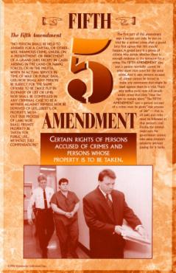
Amendment V
No person shall be held to answer for a capital, or otherwise infamous crime, unless on a presentment or indictment of a Grand Jury, except in cases arising in the land or naval forces, or in Militia, when in actual service in time of War or public danger; nor shall any person be subject for the same offense to be twice put in jeopardy of life or limb; nor shall be compelled in any criminal case to be a witness against himself, nor be deprived of life, liberty, or property, without due process of law; nor shall private property be taken for public use, without just compensation (Eminent Domain).

Slide 29

So You Are Arrested on a Felony Charge
HYPOTHETICAL:
  Arrested for a felony
  The case is presented to the Grand Jury
  The Grand Jury determines whether or not probable cause does exist, and that none of your rights have been violated
  If everything is in order, the Grand Jury will “True Bill” your case (if not, they will “no bill” your case)
  Issue indictment – a legal document telling you that you are being charged with the crime, and that the case will be tried in a court of law
Notes:
Your arrest does not guarantee that you will be held for trial or required to return to trial subsequent to your release on bail.
Before a trial can be established the law requires that your case must be presented by the District Attorney to the Grand Jury.
The Grand Jury has the ultimate responsibility to determine whether or not probable cause does exist and that none of your rights have been violated.
If the Grand Jury determines everything is in order, they will find in favor of the State and “True Bill” your case (issue an indictment).
You will then receive an indictment notice which is a legal document telling you that you are being charged with the crime and that the case will be tried in a court of law.

Slide 30
More On The 5th Amendment
  The Grand Jury indictment rule does not apply in a time of war.
  You cannot be tried twice for the same offense.
  You cannot be forced to be a witness against yourself.
  You cannot be arrested, convicted, or executed without due process of law.
  The government can seize your land but they have to pay you just compensation. This law is referred to as “Eminent Domain.”

Slide 31
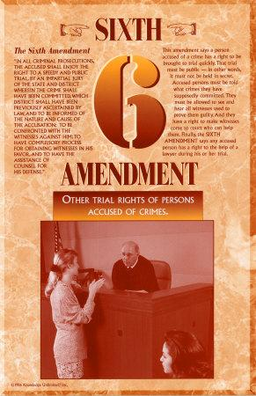
Amendment VI
In all criminal prosecutions, the accused shall enjoy the right to a speedy and public trial, by an impartial jury of the State and district wherein the crime shall have been committed, which district shall have been previously ascertained by law, and to be informed of the nature and cause of the accusation; to be confronted with the witnesses against him; to have compulsory process for obtaining witnesses in his favor, and to have the Assistance of Counsel for his defense.

Slide 32
A Look At VI
  The right to a speedy trial:
    The prosecution generally has 60 to 120 days to bring a prisoner or defendant to trial
    The defendant can waive the right to a speedy trial
    A defendant out of custody has no set time limit
  The calculation of the speedy trial time does not include
    Delays caused by motions
    Adjournments with the consent of the defendant
    Time when the defendant is unavailable
    Time when the defendant is without counsel
    Other exceptional circumstances

Slide 33
Further Look At VI
  The trial must be made available to the public.
  The trial must be before an impartial jury; in other words, no one who has a personal grudge against the defendant.
  The defendant has the right to confront the witnesses against him (by counsel) in a court of law.
  The defendant has the right to obtain his own witnesses.
  The defendant has the right to counsel even if the taxpayer has to pay for one.

Slide 34
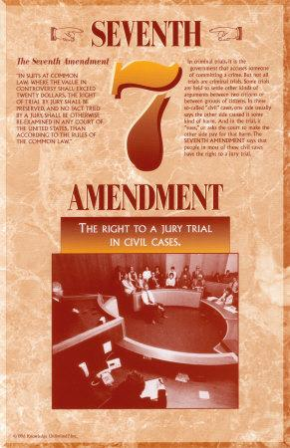
Amendment VII
In Suits at Common Law, where the value in controversy shall exceed twenty dollars, the right of trial by jury shall be preserved, and no fact tried by the jury, shall be otherwise re-examined in any Court of the United States, than according to the rules of the common law.
  This applies strictly to civil law. If your lawsuit value exceeds $20, you have the right to trial by jury.

Slide 35
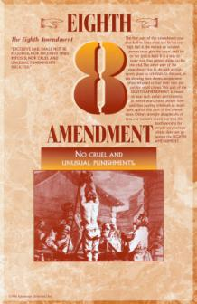
Amendment VIII
Excessive bail shall not be required, nor excessive fines imposed, nor cruel and unusual punishments inflicted.
  This means that a judge cannot issue bail that is excessive according to the standards of his or her predecessors. Such action will result in a Bail Reduction hearing request by the defendant’s attorney.
  The same rule and response applies to fines and punishments imposed.

Slide 36
Amendments IX & X
The enumeration in the Constitution, of certain rights, shall not be construed to deny or disparage others retained by the people.
  Basically covers an attempt to not infringe on the rights of anyone
The powers delegated to the United States by the Constitution, nor prohibited by it to the States, are preserved to the States respectively, or to the people.
  In other words, unless a law or rule is specifically stated in the Constitution as being the right and privilege of the Federal Government, such rights and privileges are automatically delegated to the States or to the people of the States.

Slide 37
Bill of Rights In Review
  The 1st Amendment guarantees Americans freedom of religion.
  The 1st Amendment guarantees Americans that no law may be passed to prohibit the exercise of the religion of our choice.
  The 1st Amendment guarantees Freedom of Speech, Freedom of Press, and the right of peaceable Assembly.
  The 1st Amendment also guarantees Americans the right to petition the Government in redress of grievances.

Slide 38
Bill of Rights In Review
  The 2nd Amendment guarantees the right of the people to keep and bear arms.
  The 2nd Amendment is presently one of the most contested unalienable rights guaranteed by our Bill of Rights.
  The 2nd Amendment also guarantees States the right to create and operate a well regulated Militia, being necessary to the security of the State.
  The 3rd Amendment guarantees that Americans do not have to fear intrusion by American troops into their homes, without due process of law during war or without the owner’s consent during peacetime.

Slide 39
Bill of Rights In Review
  The 4th Amendment guarantees that Americans will be secure in their persons, houses, papers, and effects against unreasonable searches and seizures.
  The 4th Amendment also guarantees Americans that no Warrants shall be issued but upon probable cause supported by Oath or Affirmation, particularly describing the place to be searched and the persons or things to be seized.

Slide 40
Amendments IV – X In Review
  The rule against “Double Jeopardy” is found where?
  Can a person be forced or coerced into being a witness against himself?
  The rule against excessive bail is found in what Amendment?
  Can a law enforcement officer, under any circumstance, enter your home without a warrant?
  A peace officer may pull you over just to make sure you have a driver’s license and then search your vehicle…right?
  A $500 bail for a person who has committed aggravated sexual assault is considered to be a normal bail for that offense…right?
  If you have a civil lawsuit you are guaranteed a trial by jury, if the suit value exceeds $20, by what Amendment?
  The parameters for completing an affidavit for a warrant and the parameters of the warrant itself are found in what Amendment?
  The Federal and State right to seize your land is found in what Amendment?
  The requirement that a search or stop and frisk be based on probable cause is found in what Amendment?
  The right to a speedy, public trial is guaranteed by what Amendment?
  The right to counsel is provided in what Amendment?
  States’ rights and privileges are addressed in what Amendment?

Slide 41
Resources
U.S. Constitution and the Declaration of Independence http://www.archives.gov/national_archives_experience/charters/bill_of_rights.html
www.sunnylandsclassroom.org
http://www.archives.gov/national_archives_experience/charters/bill_of_rights.html
http://www.saf.org/pub/rkba/books/jfp5ch05.txt
Do an Internet search for the following:
  Caselaw findlaw data constitution first amendment religion expression
  Caselaw findlaw scripts Griswold Connecticut
  Cyber essays politics 42
  Supreme findlaw constitution annotation 11 amendment
  US gov info rights and freedoms
  Gem world USA unalienable
  Lectlaw probable cause

